Slide 1
Discussion on CR for CID 5066
Date: 2017-1-16
Authors:
Name | Affiliations | Address | Phone | email
Dengyu Qiao | Huawei Technologies Co., Ltd. |  |  | qiaodengyu@huawei.com
Zhigang Rong
Yunsong Yang

Slide 2
CID 5066
CID | Clause | Page | Line | Comment | Proposed Change
5066 | 9.3.1.23 | 45 | 36 | In TWT SP, if AP want to use random access RU to collect buffer status information from TWT scheduled STAs, AP can send a Trigger frame to indicate an RU with AID12=0. But a STA that has no TWT capability also can use the RU to do OFDMA random access. This is inefficient way. | Define a mechanism to solve this issue.

Slide 3
Abstract
This proposal can improve transmission efficiency of TWT mechanism, especially when network congestion increases
  For random access RU that is allocated during TWT service period, TWT scheduled STA needs to contend with other STAs that support random access
  When many STAs unscheduled by TWT contend for random access RU, TWT scheduled STA will frequently fail to send UL frame by random access RU.
  One AID value is assigned to indicate random access RU dedicated to TWT STA

Slide 4
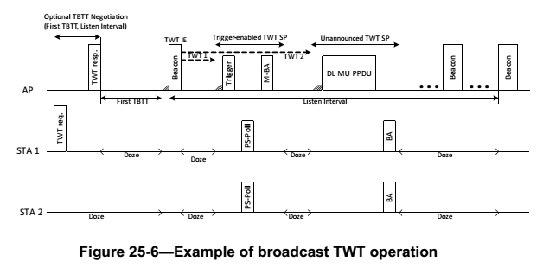
Background: TWT Procedure
As TWT negotiation is optional for broadcast TWT, TWT scheduled STA may not wake up for every TWT SP. AP needs to know which TWT scheduled STA has waked up.
As not every TWT scheduled STA has UL data to transmit, TWT scheduling STA needs to collect buffer report from TWT scheduled STA

Slide 5
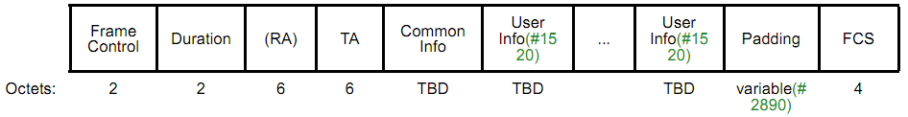
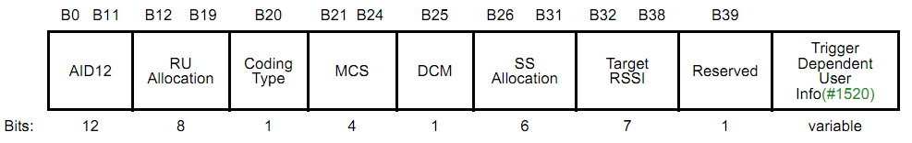
Background: Random Access in TWT Service Period
OFDMA random access is an efficient way to collect buffer report or PS-Poll from TWT STA.
AID=0 in trigger frame identifies an RU for random access. Any STA can send frame in the RU after OFDMA backoff procedure
AID12=0 indicates RU for random access

Slide 6
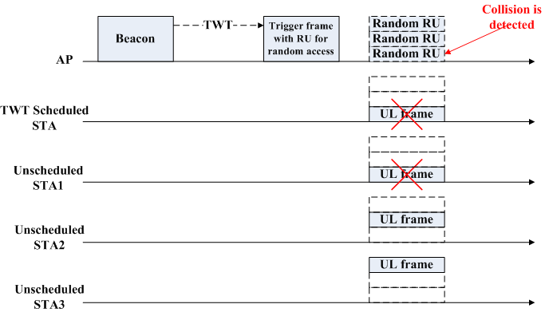
Motivation (1/2)
Any STA can perform OFDMA random access as long as it receives a Trigger frame containing a RU with AID = 0, even during TWT service period.
If AP allocates some Random RUs to collect buffer status from TWT scheduled STAs, TWT scheduled STAs may collide with non-TWT STA at random access RU.

Slide 7
Motivation (2/2)
When network congest increases, TWT scheduled STA will hard to send UL frame by random access RU during TWT SP, and may be also hard to send outside TWT SP, especially for those STAs that have no negotiation with TWT scheduling.
Even though severe collision is detected by AP, AP can do nothing for helping TWT STA to contend for random access RU, during TWT service period.

Slide 8
Proposed scheme (1/2)
An AID value indicates a random access RU dedicated to TWT scheduled STAs
  TWT scheduling STA (AP) can choose one available AID value and indicate it in TWT IE
    Different AID values can be allocated for Broadcast TWT IDs
  A bit in Control field to indicate AID for Random Access field is present or not
Element ID | Length | Control | Request Type | Target Wake Time | TWT Group Assignment | Nominal Minimum TWT Wake Duration | TWT Wake Interval Mantissa | Broadcast TWT ID | TWT Channel | NDP Paging | AID for Random Access
B1 | B2 | B3 | B4 | B5 B8
NDP Paging Indicator | Responder PM Mode | Broadcast | Indicator for AID for Random Access | Reserved

Slide 9
Proposed scheme (2/2)
Setting of AID12 subfield of Trigger frame
  AID12=0 identifies a random access RU for any STA
  AID12 = AID for random access subfield defined in a TWT element, identifies a random access RU for only STAs scheduled by the TWT element

Slide 10
Proposed Procedure
Where to announce the AID for random access
  Option1: TWT Negotiation
  Option2: TWT element included in Beacon frame
  Option3: Both

Slide 11
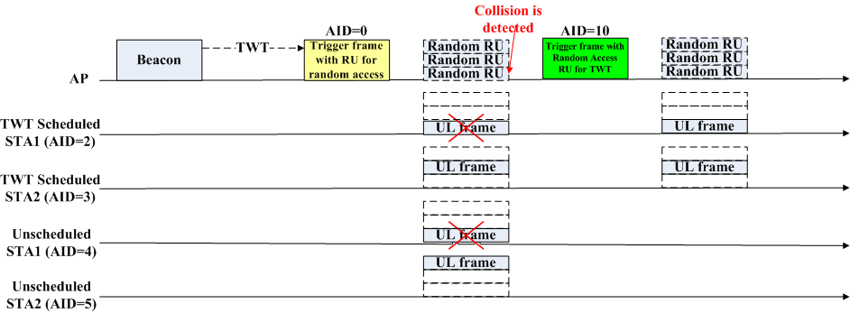
Proposed Procedure
When to use the AID for random access
  Always
  After AP detects collision

Slide 12
Benefit
TWT mechanism can be more efficient
Power consumption of TWT scheduled STA can be reduced.

Slide 13
Straw Poll 1
Do you support that an AID value is allocated to identify an random access RU dedicated to TWT scheduled STA, shown in slide 8 and 9?
Y/N/A

