Slide 1
Discussion of a Wake-Up Receiver Front-End Model
Date: 2017-01-15
Authors:

Slide 2
Abstract
This contribution addresses the need for a front-end model for evaluation of WUR sensitivity performance
We propose a model based for an envelope detector that can be used for e.g. evaluating syncwords, coding schemes, etc.
Various simulations are done to address the impact of some key parameters and thereby the feasibility of a simple model
Based on the envelope detector model, a (required) value for the noise figure to obtain sufficient sensitivity is also briefly discussed

Slide 3
Outline
Motivation
Some theory for ideal OOK with envelope detection
Discussion of a realistic WuRX model
  Some findings based on simulations
  Proposed model
Discussion of Noise Figure
  What has been reported in the literature
  Brief discussion of NF requirement
Conclusions
Straw poll

Slide 4
Motivation
To determine whether the WUR concept meets the requirement in [1] on sensitivity, it seems we should agree on a receiver model
A model is also needed to evaluate different alternatives for syncwords, FEC etc.
A simple model is proposed because
  The sensitivity is expected to largely depend on the noise figure
  When comparing e.g. syncwords and coding schemes it is a relative comparison, in which case a simple model should suffice

Slide 5
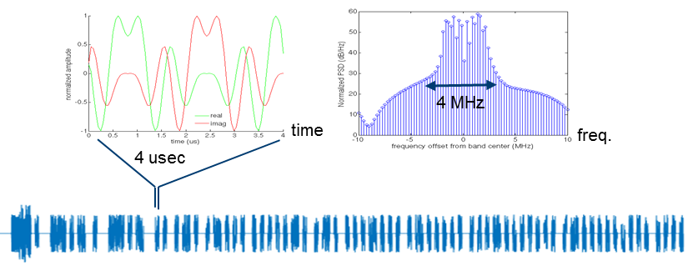
Motivation, cont’d
In [2], it is proposed to generate the OOK signal reusing the OFDM transmitter (64-points FFT and 0.8 us CP), using 13 sub-carriers
Here we also evaluate the impact of the number of carriers, to verify that the proposed model is not limited to a very specific signal design

Slide 6
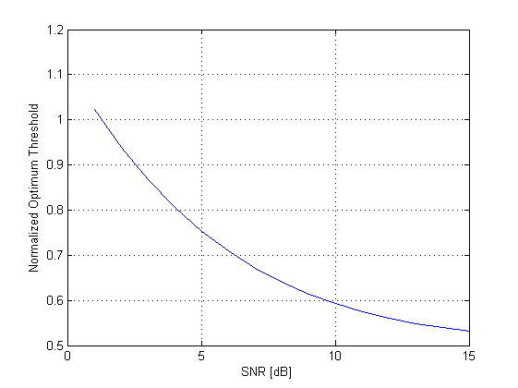


Some Theory
For OOK the threshold will be SNR dependent, which was also pointed out in [3]
With the noise normalized to unity, the optimum threshold can be accurately approximated by [4]:
$$Threshold=\sqrt{2+SNR/2}$$
In [3], a threshold of t = 0.55*Amplitude was proposed at a SNR of roughly 10 dB
This agrees well with the theory
$$Threshold=\sqrt{2+SNR/2}$$

Slide 7
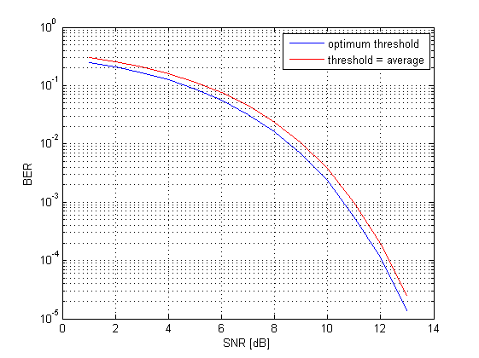
Some Theory
For small SNR, the average threshold value is far from being 0.5*Amplitude
However, selecting the threshold as 0.5*Amplitude, only gives a loss of a few tenths of a dB. Becasue of this, we propose to use this threshold in the model

Slide 8
Some Theory
For the ideal case, about 11dB SNR is required to obtain 0.1% BER, which here is taken as a reasonable operating point
To operate at lower SNR, the data rate is decreased
If the receiver processing would have been linear, one could get a linear improvement in sensitivity, i.e., 3dB better sensitivity if the data rate is reduced by 50%
As an envelope detector is non-linear, a somewhat smaller gain by reducing the rate is expected

Slide 9
Discussion of the Wake-up Receiver Chain
”NF”
”model”
LNA
IF Amp.
BPF
Env. Det.
ADC
LO
|
.
|
LPF
DC blocker
Starting with a rather generic WuRX architecture [5] [6], the idea is to model its performance with
  The performance of a simple model for an envelope detector
  A noise figure (NF)

Slide 10
The Envelope Detector
Envelope detector
|
.
|
LPF
DC blocker
The proposed model consists of an envelope detector followed by a ”DC-blocker”
The choice of LPF in the envelope detector depends e.g. on the symbol rate and will be discussed in detail
The DC-blocker just subtracts the average value, which means that the decision boundary can be set to zero, i.e., independent of the received signal level

Slide 11
The LPF
The purpose of the LPF is to extract the slowly varying wake-up signal
We will here follow [2] and assume 250 kb/s.
To start with, we assume ideal OOK, i.e., no amplitude variations. We later varify that this is OK e.g. for a waveform proposed in [2]
The performance is detemined by estimating the BER at the output of the DC blocker, where the down-sampling phase is set by looking at the eye-diagram

Slide 12
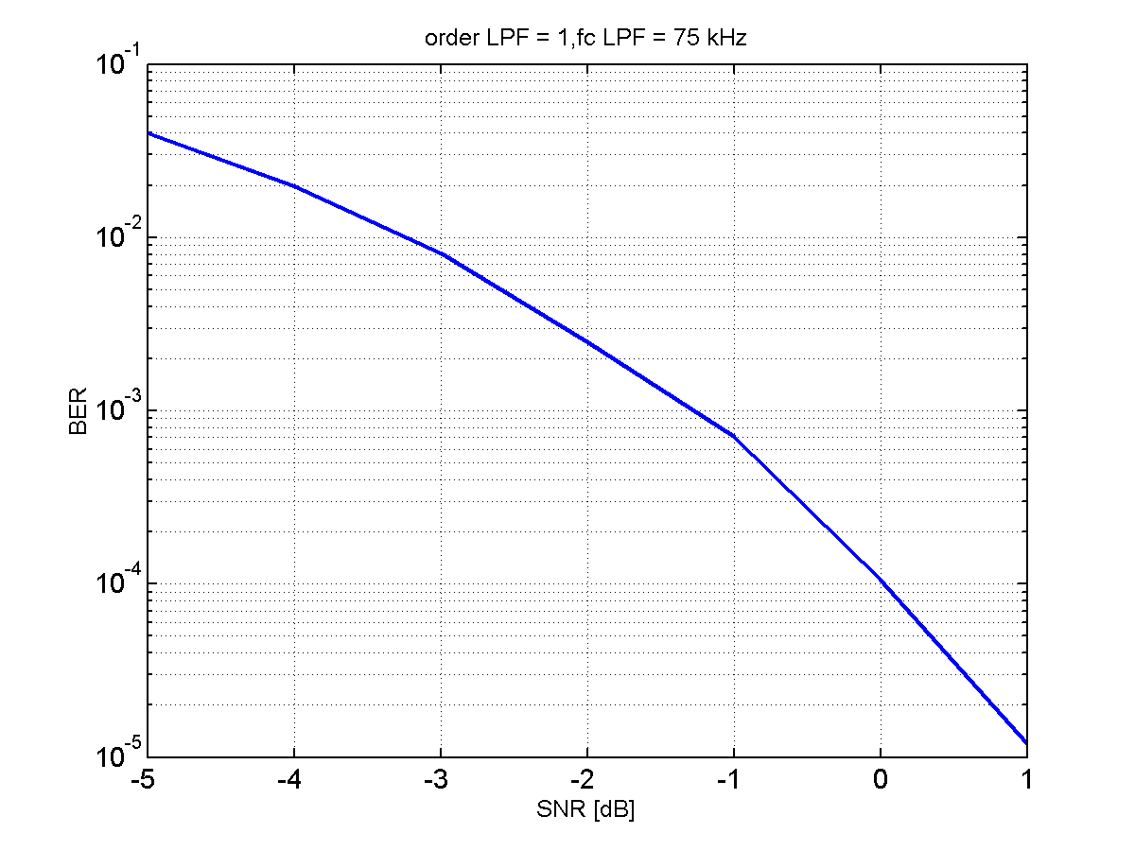
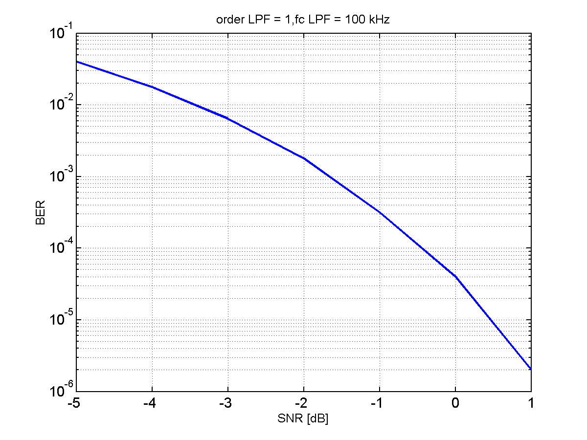
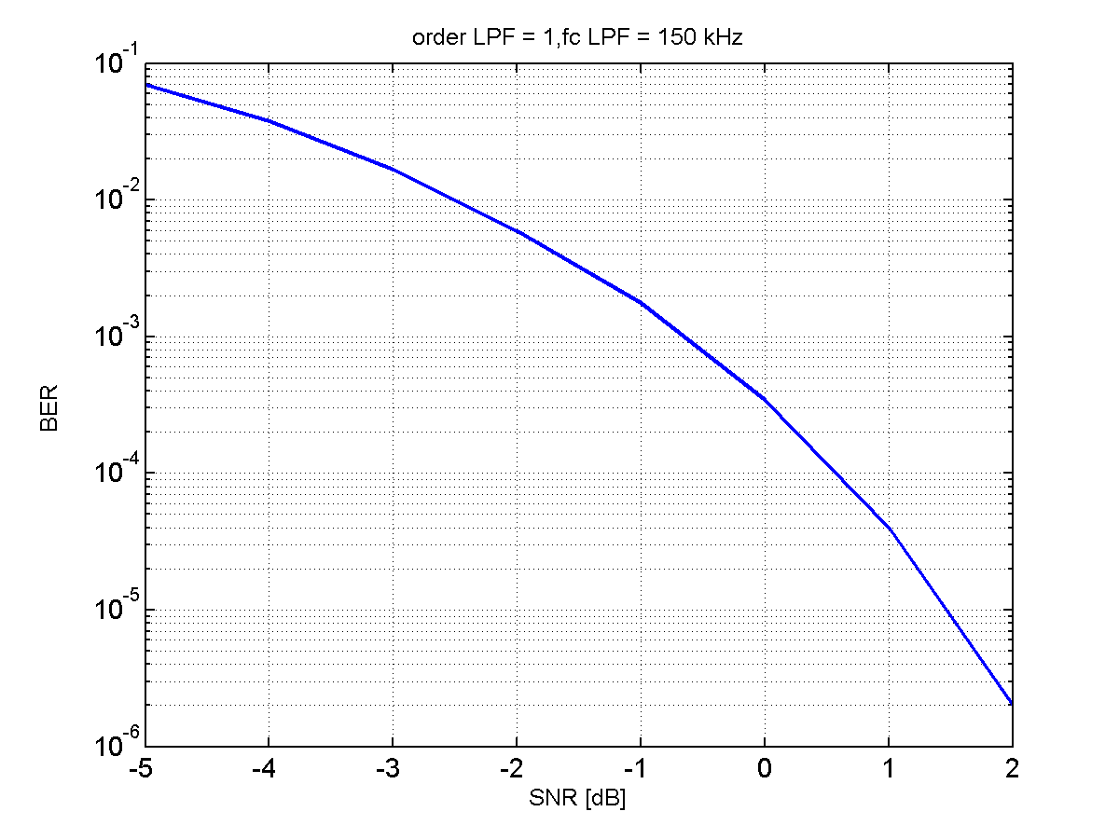
First order filter
The BW of the LPF is a trade-off between suppressing noise and introducing ISI
For a first order filter, around 100 kHz seems to give the best result, although performance is not very sensitive to some variations around this value
A C/N of about -2dB is required to obtain a BER = 0.1%

Slide 13
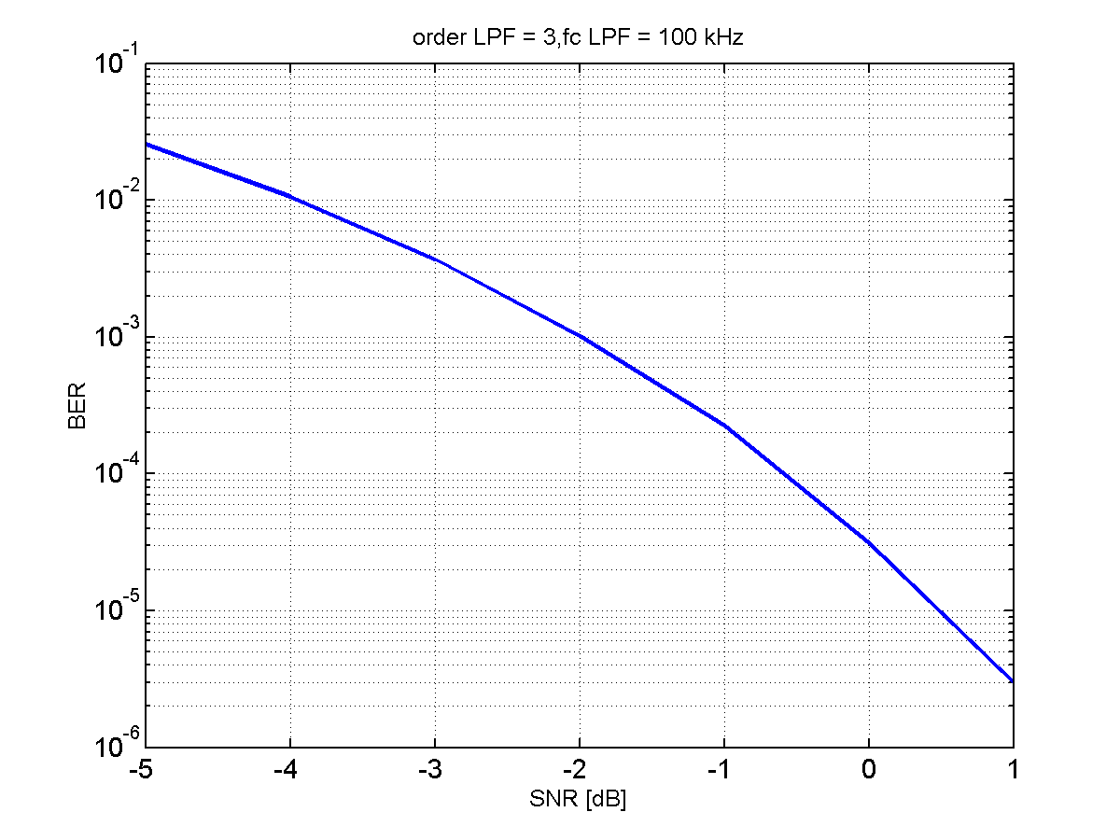
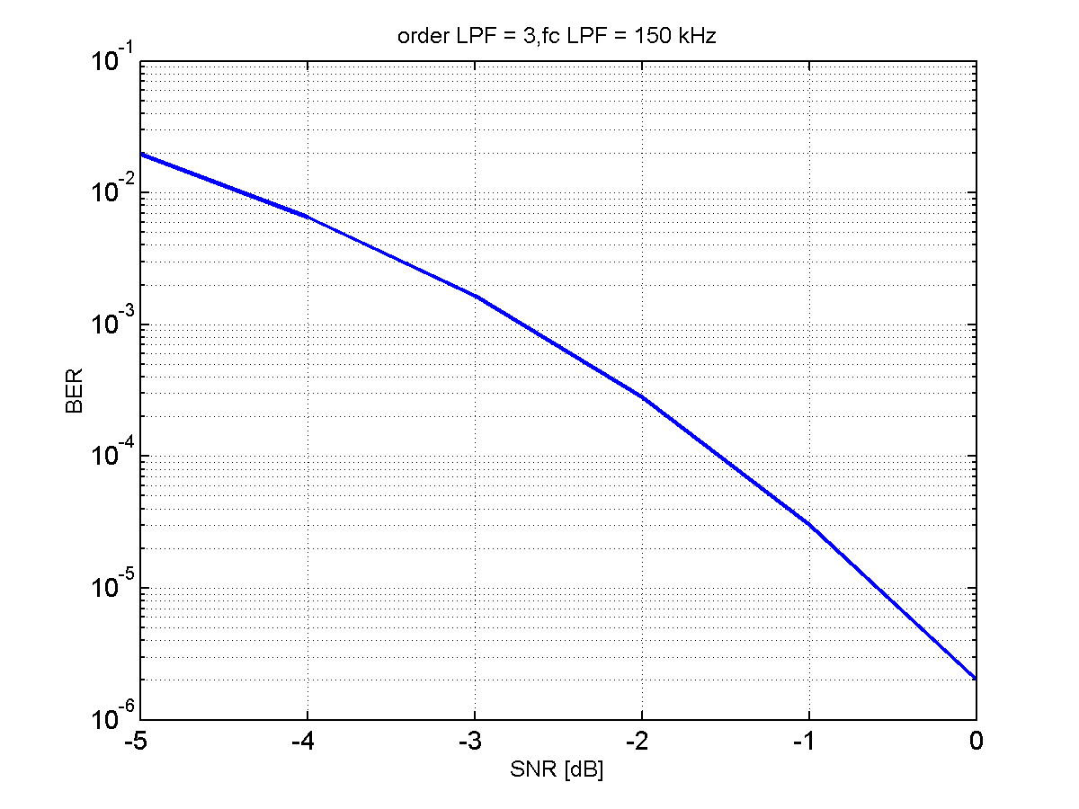
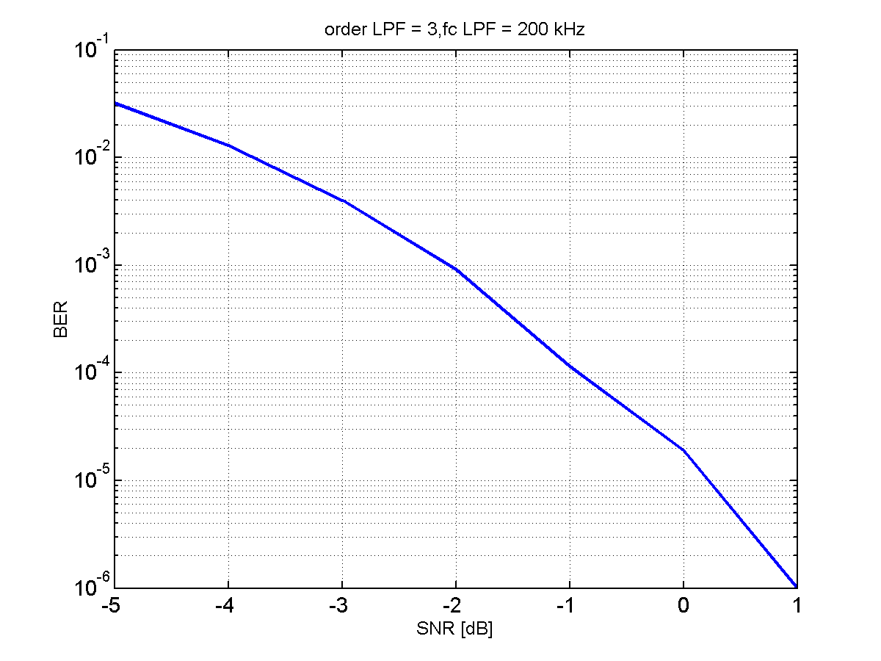
Third order filter
If instead a 3rd order (Butterworh) filter is used, the optimum BW is somewhat increased, to around 150 kHz
The performance is also improved with about 1 dB to a required C/N of about -3dB to obtain a BER = 0.1%

Slide 14
Impact of # of sub-carriers
If the signal is generated by means of an IFFT, the signal envelope will not be perfectly constant, thus worse performance than with the ideal OOK can be expected
Here we compare the performance for different number of used sub-carriers and also compare it with the case of ideal OOK
Random data is sent on the sub-carriers, so possibly this can be improved with proper signal design…

Slide 15
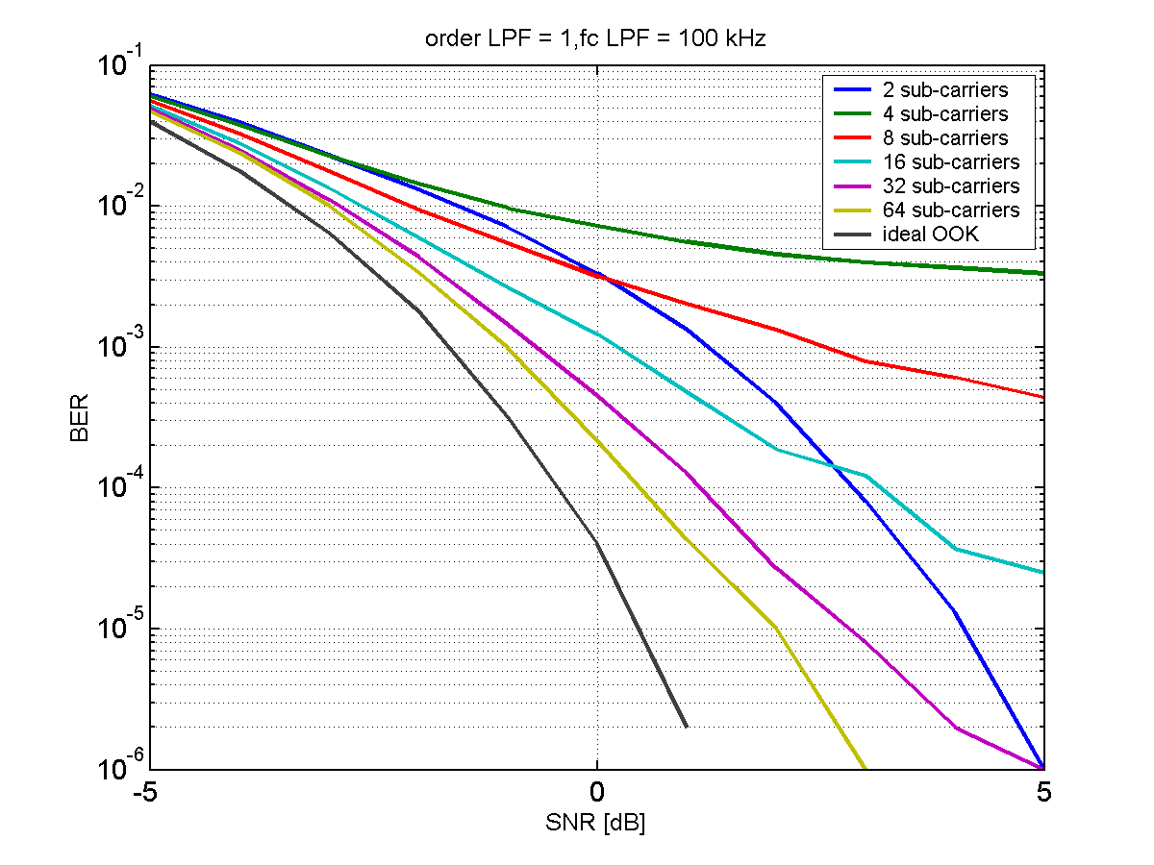
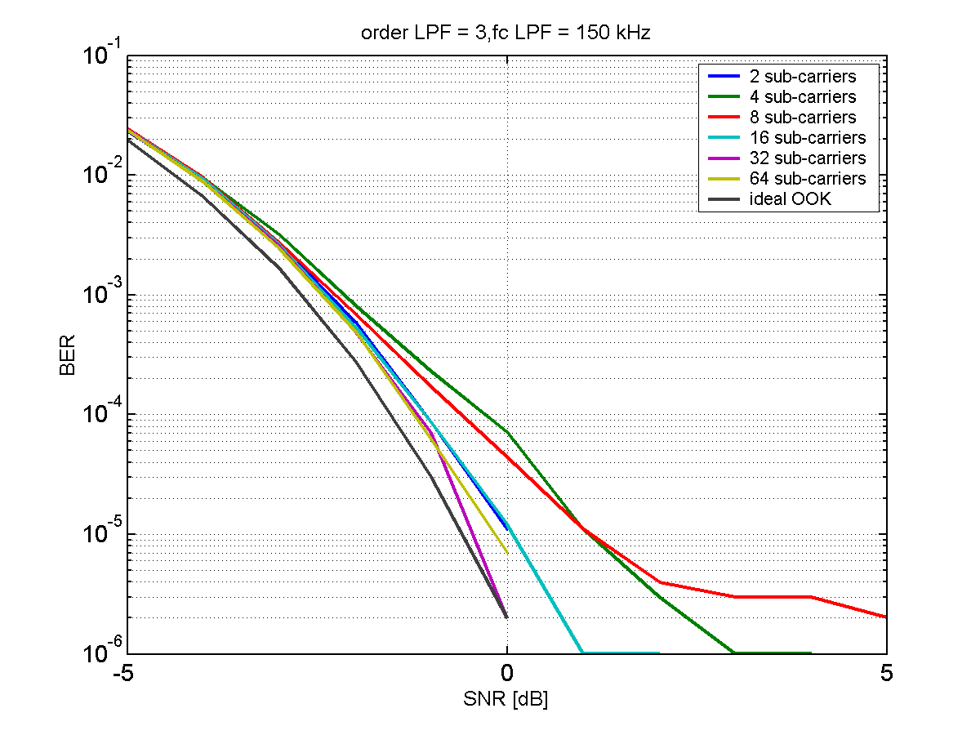
Impact of # of sub-carriers
Here the impact of # of sub-carriers is studied by sending random QPSK data on a specific number of sub-carriers
For a 3rd order filter, there is very little difference, but for the 1st order filter a loss of about 2 dB is seen with only 16 sub-carriers (again, random data)

Slide 16
Impact of bandwidth
Envelope detector
|
.
|
LPF
DC blocker
To see the impact of signal bandwidth at the input of the envelope detector, the detector is simulated at different sampling rates, i.e., 20, 40, 80, and 160 MHz
The OOK is still 250 kb/s, and the LPF is kept the same
For linear processing the sampling rate should not matter, but here one can expect a degradation with increased sampling rate as effectively the summation (filtering) is after the non-linear device

Slide 17
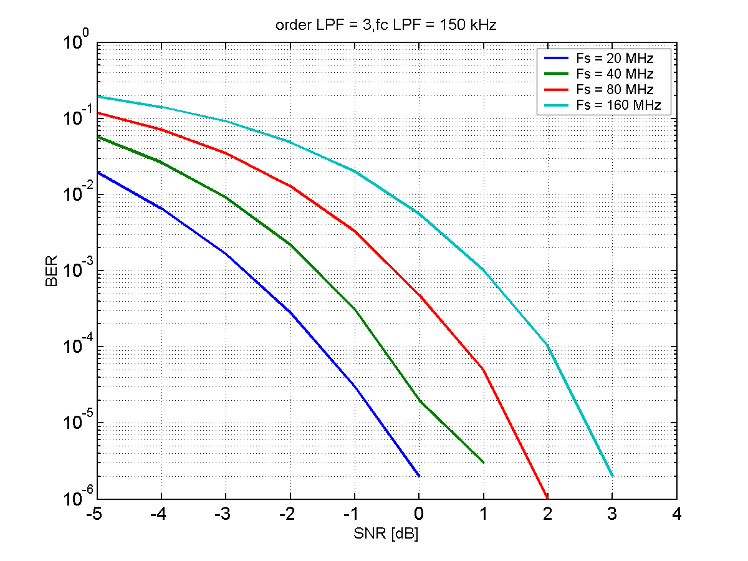
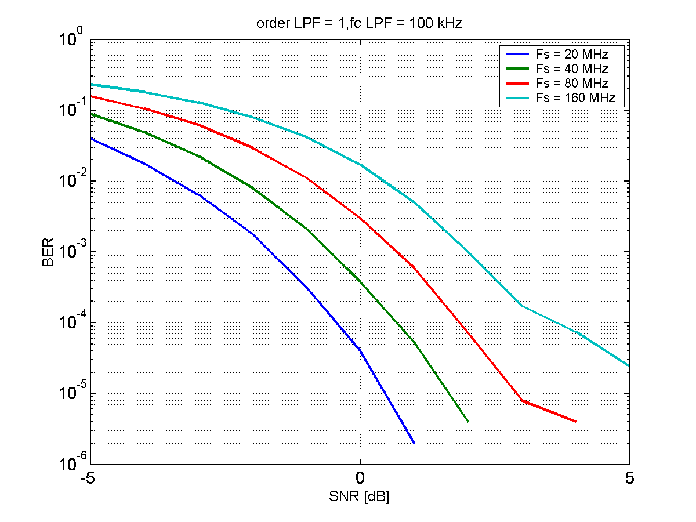
Impact of bandwidth
The increased noise power at the input to the envelope detector will results in degraded
Doubling the bandwidth causes about 1 dB additional degradation
Note: For the idea of protecting the wake-up signal with a legacy preamble to work, the BW should not be more than 20 MHz

Slide 18
Summary: Envelope detector:
A suitable BW of the LPF is 100-150 kHz for a symbol rate of 250 kb/s (BW 40-60% of the data rate), dependent on filter order
A sensitivity of -2 – (-3) dB @ BER= 0.1% is achieved with an ideal OOK signal and a 20 MHz IF bandwidth
”Theory”: 11dB – 19dB(80 samples) = -8dB
  But this assumes summation before non-linear operation
  5-6 dB loss, compared to this seems to be reasonable (?)
With an OOK signal generated by an IFFT, the loss can likely be kept within 1 dB compared to ideal OOK
Increasing signal BW to the envelope detector will also not make more than 1 dB difference in sensitivity for what is believed to be a reasonable BW

Slide 19
NF - What has been reported in the literature
Bryant and Sjöland[7]
  Front-end within an order of magnitude of that of the main receiver
  Noise figure below 15 dB at IF input
  -3 dB BW of 54 MHz
  -88dBm with Manchester coding and data rate of 250 kb/s, -71 dBm at data rate of 650 kb/s

Slide 20
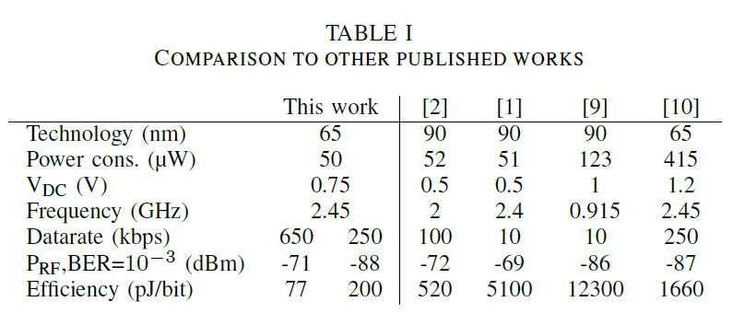
Some published results [7]

Slide 21
Summary: Noise Figure
Some rough estimation
  Say we target a sensitivity of -82 dBm
  Uncoded we need about -2 dB. Say coding gives 3 dB, we are then at -5dB (coding gain after a non-linearity may be harder to get)
  Noise level at envelope detector should be at -77dBm
  Suppose 20 MHz => NF = -77- (-114 + 13) = 24 dB
  Reasonable?
Would be beneficial if different companies could provide numbers for what they see as a reasonable NF

Slide 22
References
S. Azizi et al., “A PAR proposal for wake-up radio,” IEEE 802.11-16/1045r9.
M. Park et al., “LP-WUR (Low-Power Wake-Up Receiver) follow-up”, IEEE 802.11-16/0341r0
S. S. Qu et al., “On error rate performance of OOK in AWGN”, IEEE 802.11-16/1379r2.
M. Schartz et al., “Communication Systems and Techniques”, IEEE Press, 1996.
S. Shellhammer, “Wake-up receiver: Power savings and thoughts on PHY and MAC design,” Globecom 2016.
N. M. Pletcher et al., “A 2 GHz 50 uW wake-up receiver with -72 dBm sensitivity using uncertain IF architecture,” IEEE J. Solid-State Circuits, vol. 44, no.1 pp. 269-280, Jan. 2009.
C. Bryant and H. Sjöland “A 2.45 GHz, 50uW wake-up receiver front-end with -88dBm sensitivity and 250kbps data rate,” Eur. Solid State Circuits Conf., Sept. 2014, pp. 235-238.

Slide 23
Straw Poll
Do you support using the proposed WuRX model for the (envelope detector + DC-blocker) for performance evaluations (parameters TBD)?
Y/N/A: Straw Poll withdrawn

