Slide 1
Resolution to CID 7547
Date: 2017-03-02
Authors:
Name | Affiliations | Address | Email
Xiaogang Chen | Intel |  | Xiaogang.c.chen@intel.com
Ilan Sutskover | Intel
Michael Simon | Rohde-schwarz
Lisa Ward | Rohde-schwarz

Slide 2
Statement of Problem
Draft 1.0 defines that masks of HE PPDUs are measured with RBW=25kHz and VBW=7.5kHz
  A change over former 802.11 that used RBW=100kHz and VBW=30kHz
With RBW of 25kHz, each spectrum point for 160MHz transmission is approximately 10LOG(160/0.025)=38dB below the total power. 6dB lower than 11ac.
  For in-band spurs, there is more chance that 0dBr at peak spectrum will be touching the CW “spur” instead of the data subcarriers.
  For out-band spurs, there is more chance the spur break the mask.
Smaller RBW requires larger number of points at the SA, resulting in significantly more variance in the frequency domain & higher test time
We have identified that some major SA manufacturers (like Keysight) support RF filtering with a limited RBW granularity only, where RBW=25kHz is not one of the available options
2
Intel

Slide 3
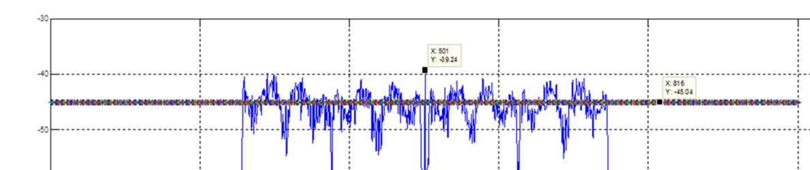
Spur Resilience (in-band)
CW-like signals’ power does not vary with RBW, as their bandwidth is infinitely small. But the mask peak spectrum reduces in power with reduction to RBW.
As a result, resilience to CW-like spurs has degraded by 6dB upon the change from RBW=100kHz to RBW=25kHz
LO @ center frequency
Power
Avg. PSD
Frequency
Intel

Slide 4
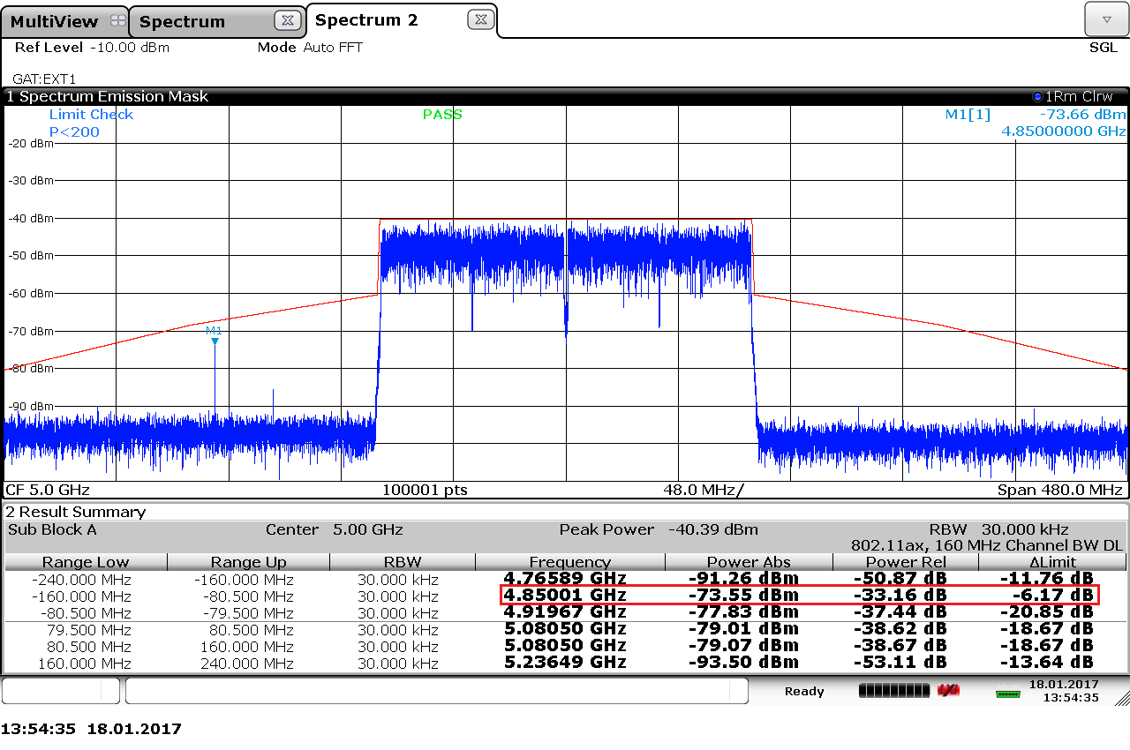
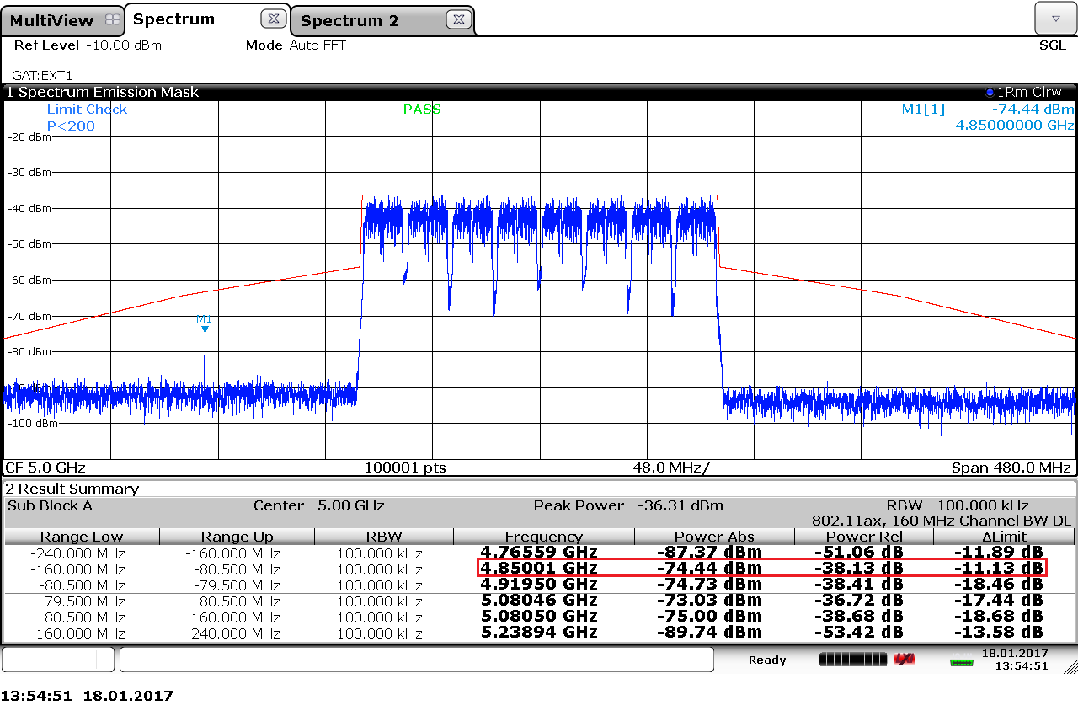
Spur Resilience (out-band)
Mask drop more due to accumulated power drop from 100kHz to 30kHz;
Less margin for 30kHz RBW to the mask if out of band spur presents.

Slide 5
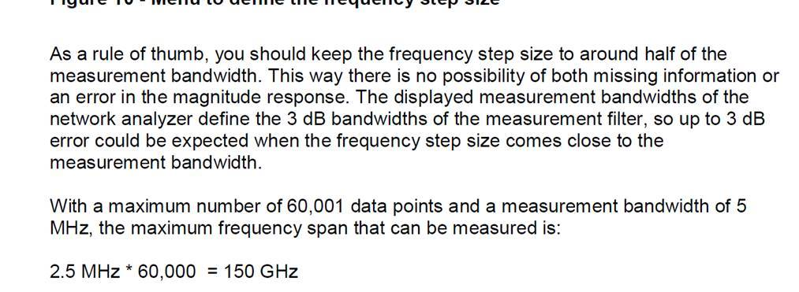
Number of Points in the Spectrum Analyzer
To ensure proper coverage of the tested span, the number of points measured must cover the spectrum properly. With reduction of RBW by 4X (compared to 11ac and earlier WiFi), 4X points are required to ensure same coverage.
For 160MHz PPDU, span greater than 480MHz is required. With RBW=25kHz, according to R&S guideline (see below), one expects at least 2*480000/25=38400 points.
Number of points has a significant impact on both test time and “deviations” in the spectrum (see next slides). The number of points is an implementation issue and is not defined by the standard.
https://cdn.rohde-schwarz.com/pws/dl_downloads/dl_application/application_notes/1ez62/1EZ62_0e.pdf
Intel

Slide 6
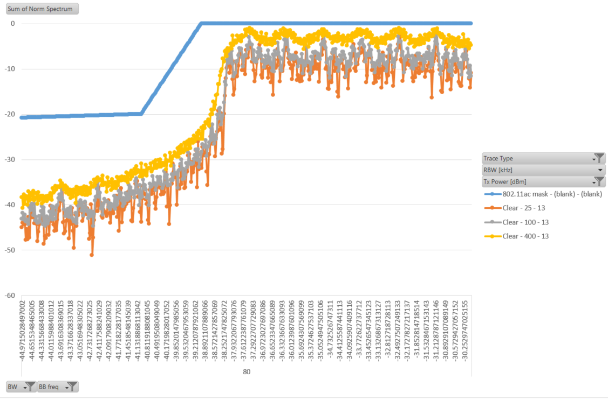
Impacts on the 11ax mask (1/3)
11ac transmissions with RBW=24kHz, 100kHz, 400kHz
Shaping with 4X RBW is only slightly worse (~1 subcarrier spacing) than with 1X RBW.
Intel

Slide 7
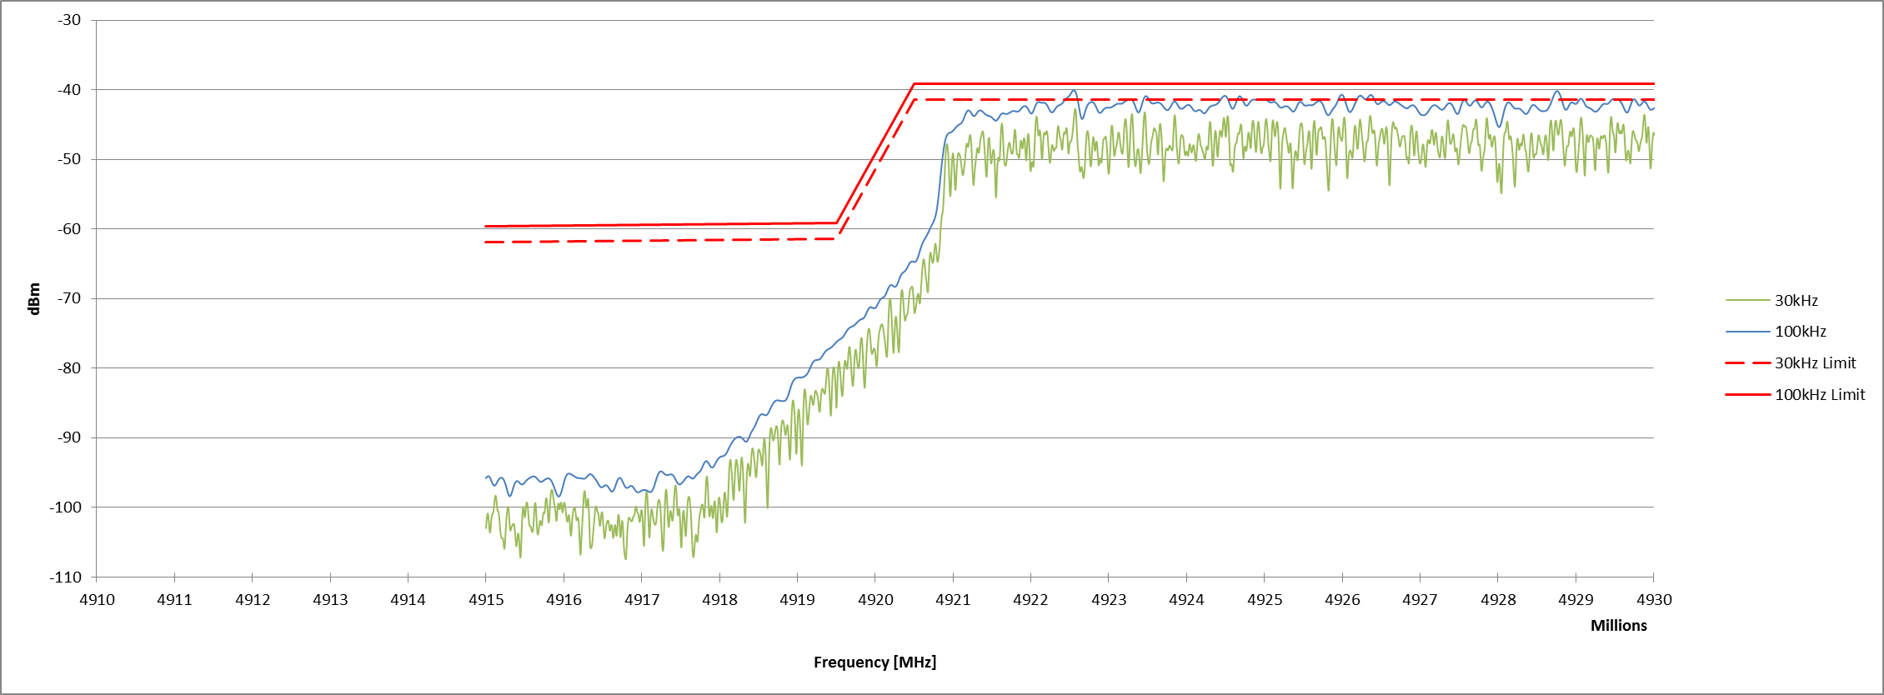
Impacts on the 11ax mask (2/3)
Cross check from Rohde-schwarz

Slide 8
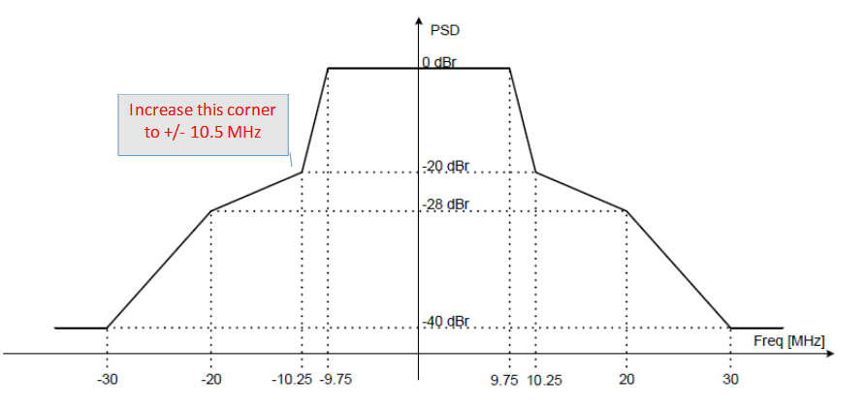
Impacts on the 11ax mask (3/3)
RBW 100kHz extends the shoulder part of the measured signal;
If CFO presents in testing, it might be safer to stretch out 20MHz mask a little as shown bellow (to be updated)

Slide 9
Proposed changes: Revised for CID 7547 per editing instructions in 11-17/0078r1
To the TGax Editor: modify P.L. 353.53 as following
  Measurements shall be made using a 25 100 kHz resolution bandwidth and a 7.5 kHz video bandwidth.
In addition, replace Figure 28-37 with the bellow figure.
Intel

