Slide 1
PAR Verification Multiple BSS Simulation
Date: 2017-01-16
Authors:

Slide 2
Summary
In this presentation, we continue with UL system throughput simulations, comparing 11ac and 11ax OFDMA in multiple BSS scenarios instead of just single BSS [3].
Our results show that modes of operation exists for 11ax OFDMA to achieve > 4x gain compared to 11ac and maintain fair bandwidth utilization
But, several factors strongly affect the 11ac UL performance
  Number of STAs inside a BSS
  RTS ON/OFF
  STAs’ access category distribution
We propose changes to the TGax Simulation scenario and EVM documents based on these results

Slide 3
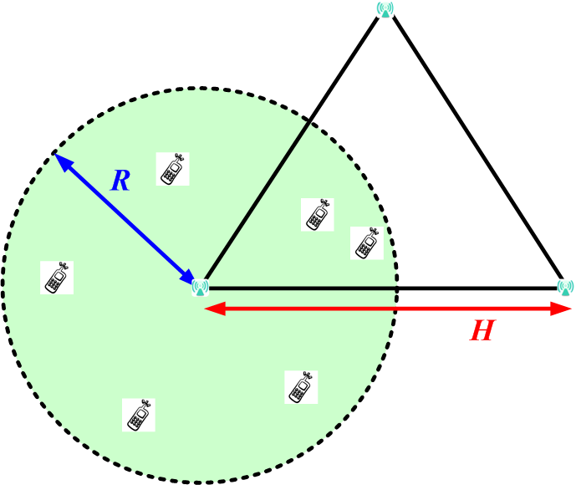
Multiple BSS Simulation Setup (1/3)
3 APs form a regular triangle
  Distance between two APs is 30 meters
Topologies, in each BSS
  13 STAs are within a 15-meter radius circle (39 STAs total)
  26 STAs are within a 15-meter radius circle (78 STAs total)
  52 STAs are within a 15-meter radius circle (156 STAs total)
STAs are randomly dropped within the circle

Slide 4
Multiple BSS Simulation Setup (2/3)
PHY abstraction and SINR calculation
  Follow 11ax evaluation methodology [1]
MAC protocols, such as CCA, back-off, trigger frame, and etc.
  Based on 11ax draft D1.0 [2]
General settings
Parameters | Default Value
Traffic type | Full buffer UDP UL traffic
UDP packet size | 100 Bytes
AP/STA # of TX/TX antenna | 1
Access Protocol parameters | EDCA with default parameters
Bandwidth | 80 MHz
Aggregation | 64 MPDU per AMPDU
RTS/CTS | ON or OFF

Slide 5
Multiple BSS Simulation Setup (3/3)
Access category (AC) setting in each BSS
  Scenario ThreeAC
    1/3 STAs are AC_VO (7, 15)
    1/3 STAs are AC_VI (15, 31)
    1/3 STAs are AC_BE (31, 1023)
  Scenario Best Effort (BE)
    All STAs are AC_BE (31, 1023)
MCS setting
  11ac: MCS5, MCS9
  11ax OFDMA: MCS9, MCS5
OFDMA (80MHz)
  8 106-tone RU users
  5 26-tone RU users
OFDMA scheduling
  For each RU, AP selects a STA randomly

Slide 6
Topology 1: 39 STAs
UL System throughput in Mbps
QoS: ThreeAC
QoS: Best effort
 | 11ac RTS OFF | 11ac RTS ON | 11ax RTS OFF
MCS5 | 59.09 | 83.32 | 127.66
MCS9 | 45.78 | 68.48 | 175.22
 | 11ac RTS OFF | 11ac RTS ON
MCS5 | 91.60 | 87.55
MCS9 | 83.75 | 83.30

Slide 7
Topology 2: 78 STAs
UL System throughput in Mbps
QoS: ThreeAC
QoS: Best effort
 | 11ac RTS OFF | 11ac RTS ON | 11ax RTS OFF
MCS5 | 48.77 | 114.06 (82.84, 17) (#) | 127.31
MCS9 | 28.30 | 79.84 (51.99, 14) (#) | 172.87
(#) T-puts majorly are from some STAs
Closer to AP
High AC
(Sum T-put of STAs of which individual T-put > 2.0 Mbps,
Number of STAs of which individual T-put > 2.0 Mbps)
 | 11ac RTS OFF | 11ac RTS ON
MCS5 | 98.18 | 103.02
MCS9 | 86.68 | 89.47

Slide 8
Topology 3: 156 STAs
UL System throughput in Mbps
QoS: ThreeAC
QoS: Best effort
 | 11ac RTS OFF | 11ac RTS ON | 11ax RTS OFF
MCS5 | 31.35 | 133.21 (93.47, 22) (#) | 129.60
MCS9 | 15.81 | 98.98 (63.41, 14) (#) | 177.57
(#) T-puts majorly are from some STAs
Closer to AP
High AC
(Sum T-put of STAs of which individual T-put > 2.0 Mbps,
Number of STAs of which individual T-put > 2.0 Mbps)
 | 11ac RTS OFF | 11ac RTS ON
MCS5 | 99.75 | 117.09
MCS9 | 86.69 | 95.91

Slide 9
Data Analysis of 156 STA 11ax OFDMA
STAs have similar throughputs
random schedule
5% percentile throughput is scheduling dependent
11ax 156STA M9
Throughput CDF
11ax 156STA M9
Throughput Histogram

Slide 10
Data Analysis of 11ac
MCS5, ThreeAC, 156 STAs Throughput Histogram
RTS OFF
Most STAs have very low throughputs
4 Mbps
8 Mbps
RTS ON
Some STAs have very high throughputs
4 Mbps
8 Mbps

Slide 11
Data Analysis of 11ac
MCS5, BE, 156 STAs Throughput Histogram
RTS OFF
More balanced throughputs
Still many STAs have very low throughputs
4 Mbps
8 Mbps
RTS ON
Similar distribution as RTS OFF
4 Mbps
8 Mbps

Slide 12
Discussion
For 11ax OFDMA
  Similar observation as we have in single BSS simulation
  APs are close enough so that a trigger frame from one AP is heard by the other two APs
    Inter BSS interference is minor
  As the number of STA increases,
    OFDMA can maintain a stable UL system throughput
  AP may determine STA’s UL throughput by scheduling
  5% percentile throughput is determined by AP’s scheduling
For 11ac
  In ThreeAC scenario
    Collision is serious and RTS does help improve overall system throughput
    However, aggressive STAs can dominate the channel, making it difficult for most other STAs from accessing the channel
  In BE scenario
    RTS does not have obvious impact on the system throughput

Slide 13
Next Step
Contribute additional TGax Simulation scenario and EVM documents
  Single BSS simulation scenario draft
  Multiple BSS simulation scenario draft
Addition of DL and DL/UL multiple BSS simulations, as well as mixed (legacy and 11ax) scenarios.

Slide 14
References
11-14-0571-12-00ax-evaluation-methodology.docx
Draft P802.11ax_D1.0.pdf
11-16-1604-00-00ax https://mentor.ieee.org/802.11/dcn/16/11-16-1604-00-00ax-single-bss-simulations-for-par-verification.pptx

