Slide 1
NDP-Based Measurement Protocol
Date: 2016-12-01

Slide 2
Outline
Propose a NDP-based sounding sequence for the MU measurement protocol in 802.11az

Slide 3
Motivation
Reuse 11ax PHY architecture for simplicity
Support MU operation for improving efficiency
Support MIMO and full bandwidth for enhanced accuracy

Slide 4
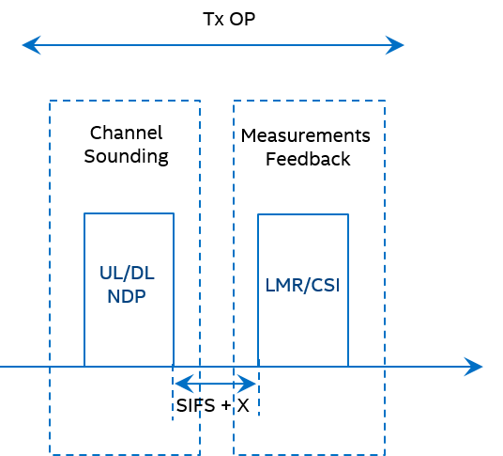
Background
Measurement protocol includes two phases
  Channel sounding phase
  Measurements feedback phase
  These two phases can be within the same or different TxOPs

Slide 5
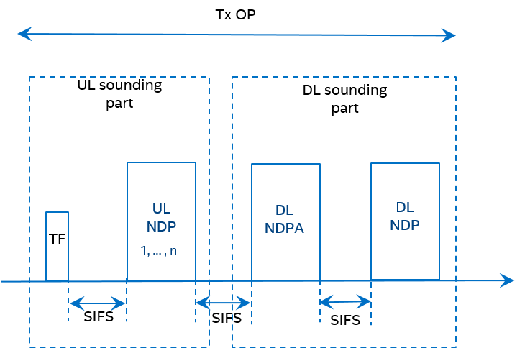
Sounding Sequence
Maximum compatibility with 11ax
  NDP is reused as sounding signal
  Trigger frame precedes UL transmission
  NDP-A precedes NDP sounding

Slide 6
Feedback Content
CSI
  Channel estimates for obtaining ToD/ToA and/or AoA/AoD (MIMO case)
  Receiver calculates ToA for both UL and DL (non-critical path calculation)
LMR
  ToD/ToA and AoA/AoD
  Sender of the feedback pays the computing power
Feedback sender can choose either CSI or LMR

Slide 7
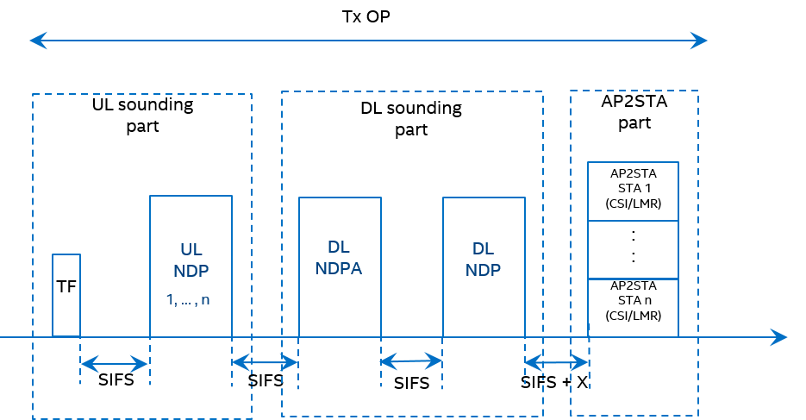
Measurement Protocol — Option 1
STA has t1 and t4
AP feeds back CSI/LMR to STA, where t2 and t3 are carried
Feedback can be in the same or another TXOP
No ACK for the feedback the same as “action no ack” CSI feedback in 11ac/ax

Slide 8
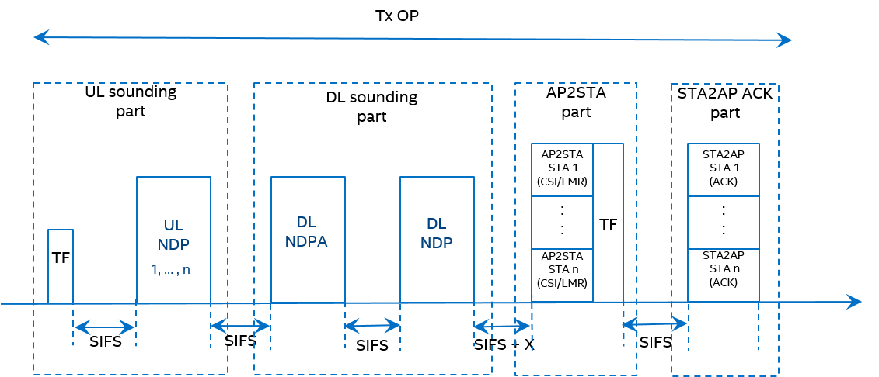
Measurement Protocol — Option 2
Same as Option 1 except the feedback is acknowledged
Trigger frame is aggregated with the feedback frame to schedule the ACK

Slide 9
Conclusion
NDP-based measurement sequence is proposed
Measurement protocol is maximally compatible with 11ax
MIMO and full bandwidth measurement are supported

Slide 10
Motion
  We agree to the following text for 11az SFD under the “Accuracy and Coverage over 2.4 and 5GHz” subsection:
    The measurement phase for the ranging protocol for MU shall be only based on NDP sounding and have the following frame exchange sequence:
    Note : the detailed design of DL Trigger, DL NDPA, UL NDP, DL NDP are TBD.
Moved: Chitto Ghosh
Second: Carlos Cordeiro
Y: 8 N: 1 Abstain: 8
Motion passes
DL Trigger
UL NDP
DL NDPA
DL NDP
1 to n NDPs
SIFS
SIFS
SIFS

Slide 11
Appendix

Slide 12

Option 1 (cont’d)
For high end AP, t2 and t3 are obtained within SIFS
AP aggregates t2 and t3 with NDP-A
Measurement finishes by 4 steps

