Slide 1
NDP Short Feedback Design
Date: 2017-05-02
Authors:

Slide 2
Revision r4
Based on discussions and SP during the March meeting, this revision includes a proposal for one specific design as follows:
  One bit feedback only without high power mode
  One N_{ss} value, N_{ss}=2
This proposal seems to be the sweet spot between overhead,
robustness and the maximum supportable number of users.
We also revised the simulation results in Appendix A and added more simulation for CW interference in Appendix D.

Slide 3
Background (1)
It is well accepted that being able to get a very short simultaneous feedback from a high number of STAs (all STAs) improve the 11ax system and power efficiencies [1], [3]
  Many feedbacks require 1 bit: PS-Poll (power efficiency), Channel Availability (collisions avoidance)
  A short simultaneous resource request feedback capable of supporting a high number of STAs is needed for an efficient UL MU simultaneous scheduling in addition to the existing (or enhanced) piggybacked buffer information
  Less overhead for resource request feedback than polling method
  Low and stable latency for resource request feedback, compared to possibly high and unpredictable latency with CSMA-CA in dense environments

Slide 4
Background (2)
In Nov. 2016, added subclause 25.5.2.7 to the spec:
25.5.2.7 NDP feedback report procedure
The NDP feedback report is a mechanism for an HE AP to collect short feedbacks from a very high number of HE STAs, in an efficient manner. The feedbacks (e.g. resource requests) are sent without data payloads in response to a Trigger frame. The feedbacks are not for channel sounding. This mechanism is optional for non-AP STA.
But details of the NDP feedback mechanism are TBD and are needed to resolve several comments (e.g. 7390)
This contribution propose a signaling technique for the NDP feedback mechanism that can handle a high number of STAs and is power and air time efficient

Slide 5
How to define the NDP feedback mechanism?
UL MU transmission in response to a trigger frame
Use frequency dimension for many small orthogonal allocations
To avoid collisions, assign orthogonal allocations to users
No data payload (NDP), STAs transmit energy on one orthogonal allocation for feedback
  with spreading gain in time domain for PHY robustness
For minimal changes to the current PHY, we propose
  to use UL MU NDP simultaneous transmissions in response to a trigger frame; and
  define orthogonal allocations tone sets to multiplex different STAs’ feedbacks
  AP and STAs have a prior agreement on tone sets and P-matrix spreading to use for a given response (no collisions between STA)

Slide 6
Proposed signaling for Short Feedback (1 of 3)
Define tone sets that spread a 242RU → provides diversity and enables the AP to estimate AGC value based on HE-STF spread over a 242RU
For compatibility with 20 MHz only STAs, to minimize degradation from DC offset and CFO, signaling use tones in each 20 MHz with indices: [-113:-6, 6:113] → simple shifts to support 40/80MHz
Puncture HE-LTF sequence except for tones at indices I_{ULf}
20 MHz tones used for UL feedback (up to 216 tones) - I_{ULf}
40 MHz tones used for UL feedback (up to 432 tones)
  I_{ULf} - 128, I_{ULf} + 128
80 MHz tones used for UL feedback (864 tones)
  I_{ULf} - 384, I_{ULf} - 128, I_{ULf} + 128, I_{ULf} + 384
80+80 MHz, 160 MHz tones used for UL feedback (up to 1728 tones)
  Same as 80 MHz on lower and upper 80 MHz

Slide 7
Proposed signaling for Short Feedback: I_{ULf} (2 of 3)
Tone sets | b = 1 | b = 0
1 | -113,-77,-41,6,42,78 | -112,-76,-40,7,43,79
2 | -111,-75,-39,8,44,80 | -110,-74,-38,9,45,81
3 | -109,-73,-37,10,46,82 | -108,-72,-36,11,47,83
4 | -107,-71,-35,12,48,84 | -106,-70,-34,13,49,85
5 | -105,-69,-33,14,50,86 | -104,-68,-32,15,51,87
6 | -103,-67,-31,16,52,88 | -102,-66,-30,17,53,89
7 | -101,-65,-29,18,54,90 | -100,-64,-28,19,55,91
8 | -99,-63,-27,20,56,92 | -98,-62,-26,21,57,93
9 | -97,-61,-25,22,58,94 | -96,-60,-24,23,59,95
10 | -95,-59,-23,24,60,96 | -94,-58,-22,25,61,97
11 | -93,-57,-21,26,62,98 | -92,-56,-20,27,63,99
12 | -91,-55,-19,28,64,100 | -90,-54,-18,29,65,101
13 | -89,-53,-17,30,66,102 | -88,-52,-16,31,67,103
14 | -87,-51,-15,32,68,104 | -86,-50,-14,33,69,105
15 | -85,-49,-13,34,70,106 | -84,-48,-12,35,71,107
16 | -83,-47,-11,36,72,108 | -82,-46,-10,37,73,109
17 | -81,-45,-9,38,74,110 | -80,-44,-8,39,75,111
18 | -79,-43,-7,40,76,112 | -78,-42,-6,41,77,113
Complementary tone set are adjacent
  Noise like interference will add power in both bins, biasing RX decision toward a “No Response” instead of a “1” or “0”
  Non-coherent CW interference (not aligned to tone grid) will bias RX decision toward a “No Response” instead of a “1” or “0
Detection at RX does not need a Channel Estimate
  RX detect energy in one tone set and compare to energy in complementary tone set

Slide 8
Proposed signaling for Short Feedback (3 of 3)
In order to allow multiplexing of multiple users and/or improved robustness we repeat the punctured HE-LTF twice and multiply by the 2x2 P-matrix row corresponding to a specific spatial stream (SS)
The maximum number of users supported per BW is:
Bandwidth | # Users
20 MHz | 36
40 MHz | 72
80 MHz | 148
160 MHz | 296

Slide 9
Design Properties
Channel estimation is not required for detection
Detection performance is independent of sequence
  AP is not required to have prior knowledge of feedback sequence
Signal is robust to interference and channel response
Trivial detection, no adaptive threshold adjustment
  Compare sum of power between sets of complementary 6 tones
Detection in unaffected by timing offset
  With the +/-400 ns timing accuracy and a 120 m radius, there is up to 1.6 us of timing offset.
A “No response” from STA can be easily detected
  A “No response” from a STA could mean STA did not received the query, is out of range or the AP did not decode properly the feedback response.
  In interference prone environments, responses from STAs could be missed. AP can identify STAs with “No response” and treats them accordingly

Slide 10
Example of Detection Algorithm
Processing for each P-matrix row:
  De-spreading
  Sum power per set of 6 tones
  Compare powers between complementary tone sets for decision
Detection algorithm for b₀ (3 outcomes)
  P1 = sum(power in b₀ = 1 tone locations)
  P0 = sum(power in b₀ = 0 tone locations)
  ( P1 > K∙P0 ) → b = 1
  ( P0 > K∙P1 ) → b = 0
  not( P1 > K∙P0 ) & not( P0 > K∙P1 ) → No response
  False: “1” is received as a “0” or “0” is received as a “1”
  Mis: “1” or “0” is received as a “No Response”
  For K=3, Probability of False is very low (<10⁻⁶) for SNR ≥ -2 dB
  For K=1, we only have two states.
See Appendix A for simulation results

Slide 11
Summary
We define an NDP short feedback report mechanism based on 18 tone sets per 20 MHz
Users are multiplexed in the frequency and time using 2x2 P matrix.
The design has the following attributes:
  Frequency spreading of tone set and complementary tone set are adjacent; makes the RX detection insensitive to the Channel frequency response
  Detection algorithm is independent of RX level, number of RX antennas and Sequence
  Detection is robust to interference
  Feedback response is an affirmative b_{n} = 1 or b_{n} = 0
  For SNR ≥ -2 dB and 4 RX antenna, False detection is very low (< 10⁻⁶)
  6 tones sequence PAPR is between 4.26 to 7.78 dB Median is 4.60 dB

Slide 12
References
[1] IEEE 802.11-16/1367r0: NDP feedback report
[2] IEEE 802.11-15/1334r1: HE-LTF sequence design
[3] IEEE 11-16-0xxx-00-00ax-Proposed spec text for NDP feedback report

Slide 13
Straw poll #1
Do you agree to the NDP short feedback report as described in slides 6-8?

Slide 14
Appendix A – Simulations
Results over various channels, antenna configuration, CFO values and loading

Slide 15
Flat channel, CFO=0, K=3, [1, 2, 4] RX Antennas, N_{ss}=2
0 dB reference is power in 12 tones
Nb. of RX Antennas | “1” or “0” from “No Response”
1 | 2.29e-2
2 | 3.10e-3
4 | 7.27e-5
0 dB refers to noise
power in 12 tones.
SNR = -13.05 dB
relative to 242 RU

Slide 16
Multipath Channel, CFO = 0, K = 3, N_{ss} = 2, 4 and 8 RX Antennas
0 dB reference is power in 12 tones
For ≥ 4 RX antennas and
Ch. D, E and Umi-NLOS
with SNR ≥ -2 dB
Probability of False <= 10⁻⁶

Slide 17
Simulations of 2 STA with CFO and power imbalance
1x1, 1x2 and 1x4 (TX antennas x RX antennas)
N_{ss} = 2
K=3
Channel D: SNR is for the ensemble of channel realizations
Timing offset added
  +400 ns of timing error plus round trip delay for 100 m
CFO and Power imbalance added
RX antennas signals are equally combined
  Flat channel and MIS=10⁻² : gain of 4 RX vs. 1 RX is 2 dB
  D channel and MIS=10⁻² : gain of 4 RX vs. 1 RX is 4.6 dB
Worst case analysis;
  STA #1 reply b₀ = 1 and STA #2 reply b₀ = 0
  Select tone locations that maximize crosstalk
    b₀ = 1 → Energy on tones set: [-113,-77,-41,6,42,78]
    b₀ = 0 → Energy on tones set: [-112,-76,-40,7,43,79]

Slide 18
Cont. - STA #1 Probability Mis & False
0 dB reference is power in 12 tones
AP: 1, 2 and 4 RX antennas
CP: 1.6 us, Time offset: 1.0667 us
#1 send b0 = 1, #2 send b0 = 0
#1 to #2 power: [0, +9] dB
#1 to #2 CFO: [-350, +350] Hz
False for 4 RX antennas is not
measurable for SNR ≥ -2 dB

Slide 19
Simulation of a Loaded System
18 users (all tones are occupied) with 20 dB power imbalance
Flat channel
N_{ss} = 2 (2 symbols transmitted), users use first row of P-Matrix
1 RX antenna and each user has 1 TX antenna
Detection using K = 3
Simulation #1
  b = 1 on tone set [9], P = 0 dB, CFO = 350 Hz
  b = 0 on tone set [1 3 5 7 11 13 15 17], P = 20 dB, CFO = -350 Hz
  b = 0 on tone set [2 4 6 8 10 12 14 16 18], P = 20 dB, CFO = 350 Hz
Simulation #2
  b = 1 on tone set [9], P = 0 dB, CFO = 1 KHz
  b = 0 on tone set [1 3 5 7 11 13 15 17], P = 20 dB, CFO = -1 KHz
  b = 0 on tone set [2 4 6 8 10 12 14 16 18], P = 20 dB, CFO = 1 KHz
Simulation #3
  b = 1 on tone set [9], P = 0 dB, CFO = 4 KHz
  b = 0 on tone set [1 3 5 7 11 13 15 17], P = 20 dB, CFO = -4 KHz
  b = 0 on tone set [2 4 6 8 10 12 14 16 18], P = 20 dB, CFO = 4 KHz

Slide 20
Cont.
Probability for user on tone set 9
0 dB reference is
power in 12 tones

Slide 21
Simulation Summary
Degradation is negligible if CFO ≤ 1 KHz and power imbalance ≤ 20 dB, irrespective of Channel response
  18 users with +20 dB power imbalance and CFO = 350 Hz and 1000 Hz (slide #20) has same probability as 1 user with CFO = 0 Hz (slide #15)
  2 users with +9 dB power imbalance and CFO = 350 Hz Channel D, 4 RX antennas (slide #18) has same probability as 1 user with CFO = 0 Hz, Channel D, 4 RX antennas (slide #16)
At MIS = 10⁻² , Gain for 4 RX combining vs. 1 RX antenna:
  Flat channel : 2.0 dB
  D channel : 4.6 dB
  UMi-NLOS channel : 4.9 dB
No measurable error floor for Flat, D, E and UMi-NLOS channel

Slide 22
Appendix - B

Slide 23
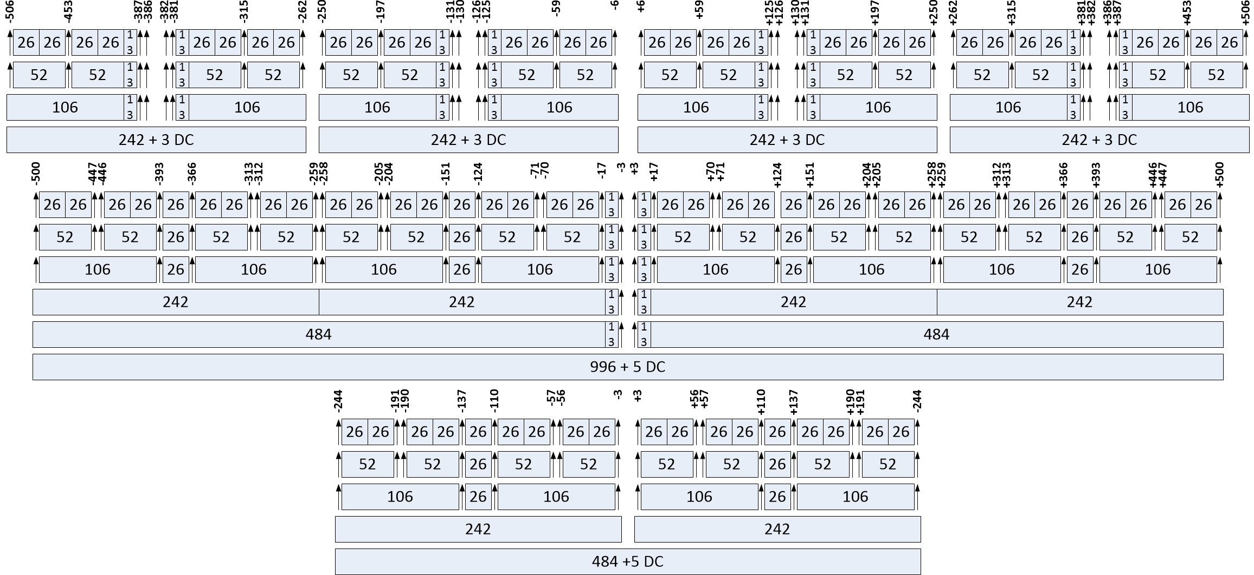
Tones alignment between 20 MHz only STAs and 40/80 MHz STAs
Four 20 MHz only STAs
80 MHz
Tones at [-116:-2, 2:116]
are common to 20 MHz
only, 40 and 80 MHz
tone plan
40 MHz

Slide 24
Appendix - C

Slide 25
Comparison of Proposed Schemes
We compare the proposed scheme which we name in the plots M-OOK (Manchester OOK) with an alternative scheme which we call D-BPSK
In the D-BPSK all 12 tones are populated, for example for tone set 1
    b₀ = 1 → Tones locations: -113,-77,-41,6,42,78 are modulated with +1
    b₀ = 1 → Tones locations: -112,-76,-40,7,43,79 are modulated with +1
    b₀ = 0 → Tones locations: -113,-77,-41,6,42,78 are modulated with +1
    b₀ = 0 → Tones locations: -112,-76,-40,7,43,79 are modulated with -1
    The receiver multiplies adjacent tones by the conjugates to create a decoding metric: sum(Y(k)conj(Y(k+1)))>0
Under ideal conditions both schemes perform the same
In practice D-BPSK suffers from:
  Timing errors
  Interference will bias the decision towards an error
  Not easy to detect a “No Response”
  Error floor at around 10⁻³ in UMi-NLOS Channel

Slide 26
Flat Channel, 1 TX, 1 RX, N_{ss}=2
0 dB reference is power in 12 tones

Slide 27
Channel D, 1 TX, 1 RX, N_{ss}=2
0 dB reference is power in 12 tones

Slide 28
Channel UMi-NLOS, 1 TX, 1 RX, N_{ss}=2
0 dB reference is power in 12 tones

Slide 29

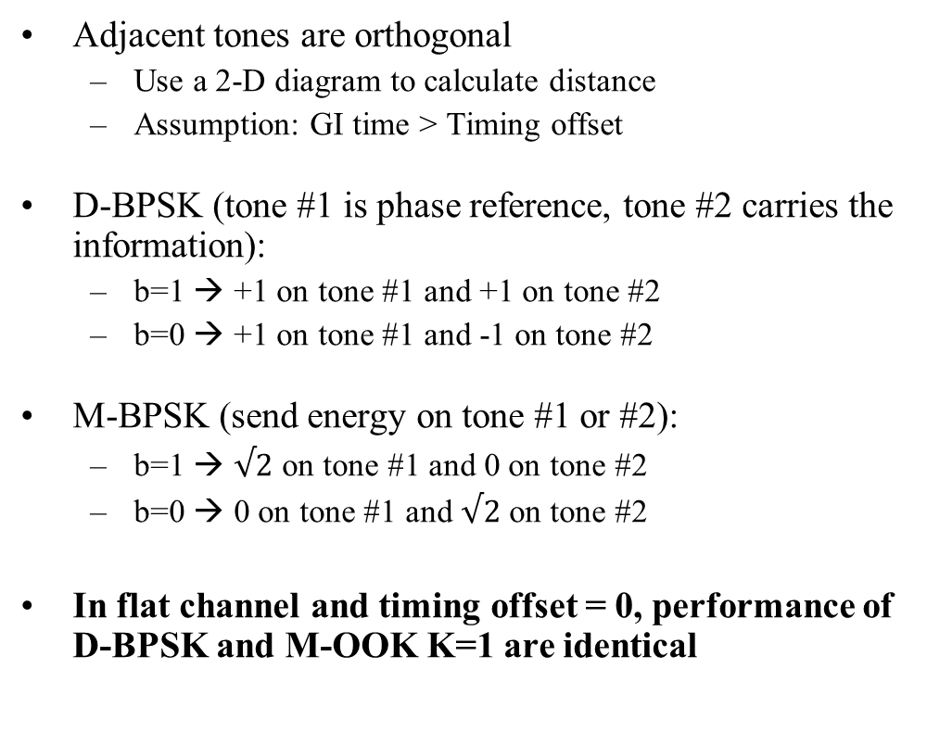

D-BPSK and M-OOK K=1 signals distance
Adjacent tones are orthogonal
  Use a 2-D diagram to calculate distance
  Assumption: GI time > Timing offset
D-BPSK (tone #1 is phase reference, tone #2 carries the information):
  b=1 → +1 on tone #1 and +1 on tone #2
  b=0 → +1 on tone #1 and -1 on tone #2
M-BPSK (send energy on tone #1 or #2):
  b=1 → $√2$ on tone #1 and 0 on tone #2
  b=0 → 0 on tone #1 and $√2$ on tone #2
In flat channel and timing offset = 0, performance of D-BPSK and M-OOK K=1 are identical
Tone #1
D-BPSK
+1
-1
+1
Tone #2
x>0
D=2
D=2
M-OOK
$√$2
K=1
$√$2
0

Slide 30
Appendix – D
CW Interference

Slide 31
CW Interference Simulations
Use tone set #12
  -91,-55,-19,28,64,100
  -90,-54,-18,29,65,101
On tone set #12 P-Matrix row #1, User 1 send b₁
On tone set #12 P-Matrix row #2, User 2 send b₂
Power in 12 tones is 1 for each User
GI = 3.2 us
Detector scaling factor K=3
Find worst case frequency by sweeping CW from tone 61 to 68, increase Interference level to get Mis and False detection
Simple receiver as described on slide 10

Slide 32
Signal/Interference (S/I) for Mis and False with CW at worst Frequency
Signals | False S/I (dB) | Mis S/I (dB) | OK (dB)
b₁ = 1, b₂ = 0 | S/I ≤ -8.60 | -8.60 < S/I < +1.17 | +1.17 ≤ S/I
 | S/I ≤ -7.78 | -7.78 < S/I < +1.77 | +1.77 ≤ S/I
b₁ = 1, b₂ = 1 | S/I ≤ -8.60 | -8.60 < S/I < +1.18 | +1.18 ≤ S/I
 | S/I ≤ -8.72 | -8.72 < S/I < +1.13 | +1.13 ≤ S/I
b₁ = 0, b₂ = 0 | S/I ≤ -9.36 | -9.36 < S/I < +0.24 | +0.24 ≤ S/I
 | S/I ≤ -7.78 | -7.78 < S/I < +1.77 | +1.77 ≤ S/I
b₁ = 1, b₂ = NoResp | S/I ≤ -8.60 | -8.60 < S/I < +1.17 | +1.17 ≤ S/I
 | - | - | -
b₁ : signal on first row of P-Matrix, b₂ : signal on second row of P-Matrix

Slide 33
CW Interference with Erasure
From 6 tones set and complementary 6 tones set, remove the largest magnitude tones from both sets
  This can be done on each antenna separately
Remaining two 5 tones set power are summed for decision
Erasure circuitry can be left ON all the time
  minor impact on overall performance
Improve robustness in presence of narrowband interference

Slide 34
Simulations with CW Interference Erasure Technique
Send b₁=1 or b₁=0 on tone set #12
Energy on tones: [-91,-55,-19,28,64,100] or [-90,-54,-18,29,65,101]
Flat channel, CFO = 0, 1 RX antenna, GI = 3.2 us
Send a time-domain CW interference at +20 dB relative to power in 12 tones → S/I = -20 dB
CW frequencies used to check effectiveness of interference erasure:
  No CW: No CW interference (baseline reference)
  CW1: 5.0370625 MHz @ +20 dB (between tones 64 & 65)
  CW2: 5.0781250 MHz @ +20 dB (on top of tones 65)
  CW3: 5.1171875 MHz @ +20 dB (between tones 65 & 66)
  CW4: 5.0000000 MHz @ +20 dB (on top of tones 64)
  CW5: 4.9609390 MHz @ +20 dB (between tones 63 & 64)
RX does not know the frequency or magnitude of CW interference

Slide 35
Simulations with CW Interference Erasure Technique, S/I = -20 dB, b₁ = 1

Slide 36
Simulations with CW Interference Erasure Technique, S/I = -20 dB, b₁ = 0

Slide 37
Results Summary of CW Interference Erasure Technique, S/I = 20 dB
Degradation estimated by increasing signal level until MIS = 10⁻²
b₁ = 1 | Erasure OFF |  | Erasure ON
Interference | RX Decision | Degradation | RX Decision | Degradation
None | “1” | 0 dB (reference) | “1” | -0.4 dB
CW1 | “NoRes” (Mis) | +20.7 dB | “1” | +0.9 dB
CW2 | “0” (False) | +22.3 dB | “1” | +0.9 dB
CW3 | “0” (False) | +13.0 dB | “1” | +0.7 dB
b₁ = 0 | Erasure OFF |  | Erasure ON
Interference | RX Decision | Degradation | RX Decision | Degradation
None | “0” | 0 dB (reference) | “0” | -0.4 dB
CW1 | “NoRes” (Mis) | +19.0 dB | “0” | +1.2 dB
CW4 | “0” | 0 dB | “0” | -0.4 dB
CW5 | “1” (False) | +21.1 dB | “0” | +0.8 dB

