Slide 1
NDP Short Feedback Design
Date: 2017-03-13
Authors:

Slide 2
Background (1)
It is well accepted that being able to get a very short simultaneous feedback from a high number of STAs (all STAs) improve the 11ax system and power efficiencies [1], [3]
  Many feedbacks require 1 bit: PS-Poll (power efficiency), Channel Availability (collisions avoidance)
  Other feedbacks could be 2 bit. For example: “How many buffered Bytes for transmission: 0, 1 to 1000, 1000 to 5000, > 5000 ?”
  A short simultaneous resource request feedback (1 or several bits) capable of supporting a high number of STAs is needed for an efficient UL MU simultaneous scheduling in addition to the existing (or enhanced) piggybacked buffer information
  Less overhead for resource request feedback than polling method
  Low and stable latency for resource request feedback, compared to possibly high and unpredictable latency with CSMA-CA in dense environments

Slide 3
Background (2)
In Nov. 2016, added subclause 25.5.2.7 to the spec:
25.5.2.7 NDP feedback report procedure
The NDP feedback report is a mechanism for an HE AP to collect short feedbacks from a very high number of HE STAs, in an efficient manner. The feedbacks (e.g. resource requests) are sent without data payloads in response to a Trigger frame. The feedbacks are not for channel sounding. This mechanism is optional for non-AP STA.
But details of the NDP feedback mechanism are TBD and are needed to resolve several comments (e.g. 7390)
This contribution propose a signaling technique for the NDP feedback mechanism that can handle a high number of STAs and is power and air time efficient

Slide 4
How to define the NDP feedback mechanism?
UL MU transmission in response to a trigger frame
Use frequency dimension for many small orthogonal allocations
To avoid collisions, assign orthogonal allocations to users
No data payload (NDP), STAs transmit energy on one orthogonal allocation for feedback
  with spreading gain in time domain for PHY robustness
For minimal changes to the current PHY, we propose
  to use UL MU NDP simultaneous transmissions in response to a trigger frame; and
  define orthogonal allocations tone sets to multiplex different STAs’ feedbacks
  AP and STAs have a prior agreement on tone sets and P-matrix spreading to use for a given response (no collisions between STA)

Slide 5
Overview of proposed signaling for Short Feedback (1 of 3)
Define tone sets that spread a 242RU → provides diversity and enables the AP to estimate AGC value based on HE-STF spread over a 242RU
For compatibility with 20 MHz only STAs, to minimize degradation from DC offset and CFO, signaling use tones in each 20 MHz with indices: [-113:-6, 6:113] → simple shifts to support 40/80MHz
Puncture HE-LTF sequence except for tones at indices I_{ULf}
20 MHz tones used for UL feedback (up to 216 tones) - I_{ULf}
40 MHz tones used for UL feedback (up to 432 tones)
  I_{ULf} - 128, I_{ULf} + 128
80 MHz tones used for UL feedback (864 tones)
  I_{ULf} - 384, I_{ULf} - 128, I_{ULf} + 128, I_{ULf} + 384
80+80 MHz, 160 MHz tones used for UL feedback (up to 1728 tones)
  Same as 80 MHz on lower and upper 80 MHz

Slide 6
Overview of proposed signaling for Short Feedback (2 of 3)
Two sets of 6 tones are used to transmit 1 bit
  b₀ = 1 → Send energy on first 6 tones set
  b₀ = 0 → Send energy on complementary 6 tones set
  in the proposed design this tone set is shifted by one tone relative to b₀ = 1
Four sets of 6 tones are used to transmit 2 bits
High power mode - four sets of tones can also be used to transmit one bit to enable higher transmit power by 3dB in PSD limited regions by duplicating the response on b1 and b0: STAs send b0=b1=1 or b0=b1=0
For same power between HE-STF and tone sets, boost per tone power relative to the target RSSI
  1 bit (6 tones): 10*log10(242/6) = 16.06 dB above target RSSI
  2 bit (12 tones): 10*log10(242/12) = 13.05 dB above target RSSI

Slide 7
Tone set indices for each 20 MHz: I_{ULf}
 | 2 bit or 1 bit high power
 | 1 bit
Tone sets | b0 = 1 | b0 = 0 |  | b1 = 1 | b1 = 0
1 | -113,-77,-41,6,42,78 | -112,-76,-40,7,43,79 |  | -95,-59,-23,24,60,96 | -94,-58,-22,25,61,97
2 | -111,-75,-39,8,44,80 | -110,-74,-38,9,45,81 |  | -93,-57,-21,26,62,98 | -92,-56,-20,27,63,99
3 | -109,-73,-37,10,46,82 | -108,-72,-36,11,47,83 |  | -91,-55,-19,28,64,100 | -90,-54,-18,29,65,101
4 | -107,-71,-35,12,48,84 | -106,-70,-34,13,49,85 |  | -89,-53,-17,30,66,102 | -88,-52,-16,31,67,103
5 | -105,-69,-33,14,50,86 | -104,-68,-32,15,51,87 |  | -87,-51,-15,32,68,104 | -86,-50,-14,33,69,105
6 | -103,-67,-31,16,52,88 | -102,-66,-30,17,53,89 |  | -85,-49,-13,34,70,106 | -84,-48,-12,35,71,107
7 | -101,-65,-29,18,54,90 | -100,-64,-28,19,55,91 |  | -83,-47,-11,36,72,108 | -82,-46,-10,37,73,109
8 | -99,-63,-27,20,56,92 | -98,-62,-26,21,57,93 |  | -81,-45,-9,38,74,110 | -80,-44,-8,39,75,111
9 | -97,-61,-25,22,58,94 | -96,-60,-24,23,59,95 |  | -79,-43,-7,40,76,112 | -78,-42,-6,41,77,113
10 | -95,-59,-23,24,60,96 | -94,-58,-22,25,61,97
11 | -93,-57,-21,26,62,98 | -92,-56,-20,27,63,99
12 | -91,-55,-19,28,64,100 | -90,-54,-18,29,65,101
13 | -89,-53,-17,30,66,102 | -88,-52,-16,31,67,103
14 | -87,-51,-15,32,68,104 | -86,-50,-14,33,69,105
15 | -85,-49,-13,34,70,106 | -84,-48,-12,35,71,107
16 | -83,-47,-11,36,72,108 | -82,-46,-10,37,73,109
17 | -81,-45,-9,38,74,110 | -80,-44,-8,39,75,111
18 | -79,-43,-7,40,76,112 | -78,-42,-6,41,77,113

Slide 8
Overview of proposed signaling for Short Feedback (3 of 3)
Complementary tone set are adjacent
  Noise like interference will add power in both bins, biasing RX decision toward a “No Response” instead of a “1” or “0”
  Non-coherent CW interference (not aligned to tone grid) will bias RX decision toward a “No Response” instead of a “1” or “0
Detection at RX does not need a Channel Estimate
  RX does not care about sequence in tone set
  RX detect energy in one tone set and compare to energy in complementary tone set
In order to allow multiplexing of multiple users or improved robustness repeat punctured HE-LTF twice or four times and multiply by the P-matrix row corresponding to a specific spatial stream (SS)
  Use 2x2 for or 4x4 P-matrix

Slide 9
Max # of STAs that can simultaneously send the UL Short Feedback
BW | Response = 1 bit |  |  | Response = 2 bit
 | N_{ss} = 1 | N_{ss} = 2 | N_{ss} = 4 | N_{ss} = 1 | N_{ss} = 2 | N_{ss} = 4
20 MHz | 18 | 36 | 72 | 9 | 18 | 36
40 MHz | 36 | 72 | 144 | 18 | 36 | 72
80 MHz | 74 | 148 | 296 | 37 | 74 | 148
160 MHz | 148 | 296 | 592 | 74 | 148 | 296

Slide 10
Design Properties
Channel estimation is not required for detection
Detection performance is independent of sequence
  AP is not required to have prior knowledge of feedback sequence
Signal is robust to interference and channel response
Trivial detection, no adaptive threshold adjustment
  Compare sum of power between sets of complementary 6 tones
Detection in unaffected by timing offset
  With the +/-400 ns timing accuracy and a 120 m radius, there is up to 1.6 us of timing offset.
A “No response” from STA can be easily detected
  A “No response” from a STA could mean STA did not received the query, is out of range or the AP did not decode properly the feedback response.
  In interference prone environments, responses from STAs could be missed. AP can identify STAs with “No response” and treats them accordingly

Slide 11
Example of Detection Algorithm
Processing for each P-matrix row:
  De-spreading
  Sum power per set of 6 tones
  Compare powers between complementary tone sets for decision
Detection algorithm for b₀ (3 outcomes)
  P1 = sum(power in b₀ = 1 tone locations)
  P0 = sum(power in b₀ = 0 tone locations)
  ( P1 > K∙P0 ) → b₀ = 1
  ( P0 > K∙P1 ) → b₀ = 0
  not( P1 > K∙P0 ) & not( P0 > K∙P1 ) → No response
  False: “1” is received as a “0” or “0” is received as a “1”
  Mis: “1” or “0” is received as a “No Response”
  Note: For K=3, the Probability of False is very very low (<10^-6) in the SNR range of plots. For K=1 we only have two states.

Slide 12
Theory with Flat channel, 1 TX and 1 RX, N_{ss} = 4
Note: For 1b, boost by +13.05 dB. For 2b, boost by +10.04 dB
0 dB reference is power in 12 tones
P(NoResp → YES/NO) = 2.29e-2
Theory with CFO=0
6 tones with 1 bit
12 tones with 2 bits
SNR = -13.05 dB
in 20 MHz

Slide 13
Simulations
1x4 (TX antennas x RX antennas)
N_{ss} = 4
Channel D: SNR is for the ensemble of channel realizations
Timing offset added
  +400 ns of timing error plus round trip delay for 100 m
CFO and Power imbalance added
4 RX signals are equally combined
  With flat channel and MIS=10⁻², gain of 4 RX vs. 1 RX is around 1.8 dB
  With channel D and MIS=10⁻², gain of 4 RX vs. 1 RX is around 4.5 dB
Worst case analysis;
  STA #1 reply b₀ = 1 and STA #2 to #4 replies b₀ = 0
  Select tone locations that maximize crosstalk
    b₀ = 1 → Tones locations: -113,-77,-41,6,42,78
    b₀ = 0 → Tones locations: -112,-76,-40,7,43,79

Slide 14
STA #1 Probability Mis & False, N_{ss} = 4,
Channel D with CFO & Time Offset
0 dB reference is power in 12 tones
Time offset is 400ns of timing error plus 100m round-trip
Signal power normalized for the realization ensemble
4 STAs with 1 TX antenna
AP with 4 RX antennas
CP: 1.6 us, Time offset: 1.0667 us
#1 send b0 = 1, #2 to #4 send b0 = 0
#1 to #4 power: [0, +9, +9, +9] dB
#1 to #4 CFO: [-350, +350, -350, +350] Hz
SNR = -13.05 dB
in 20 MHz

Slide 15
Summary
Define an NDP short feedback report mechanism based on 12 tone sets per 20 MHz
Users are multiplexed in the frequency and time using P matrix.
The design has the following attributes:
  Frequency spreading of tone set and complementary tone set are adjacent; makes the RX detection insensitive to the Channel frequency response
  Detection algorithm is independent of RX level, P-Matrix size (i.e. number of symbols), number of RX antennas and Sequence
  Detection is robust to interference
  Feedback response is an affirmative b_{n} = 1 or b_{n} = 0
  For SNR ≥ -24 dB, False detection rate is very small (< 10⁻⁶)
  6 tones sequence PAPR is between 4.26 to 7.78 dB. Median is 4.60 dB
  12 tones sequence PAPR is between 4.36 to 10.78 dB. Median is 5.88 dB

Slide 16
References
[1] IEEE 802.11-16/1367r0: NDP feedback report
[2] IEEE 802.11-15/1334r1: HE-LTF sequence design
[3] IEEE 11-16-0xxx-00-00ax-Proposed spec text for NDP feedback report

Slide 17
Straw poll #1
Do you agree that the NDP short feedback report is based on tone sets as defined in slide 7 with the following options
  Option A - design may be limited to 1 or 2 bits, one power mode and one Nss value (4)
  Option B - design will be limited to one mode (as far as bits, power and Nss) (18)
  Option C – ABS (22)
  Option D – No (1)

Slide 18
Appendix

Slide 19
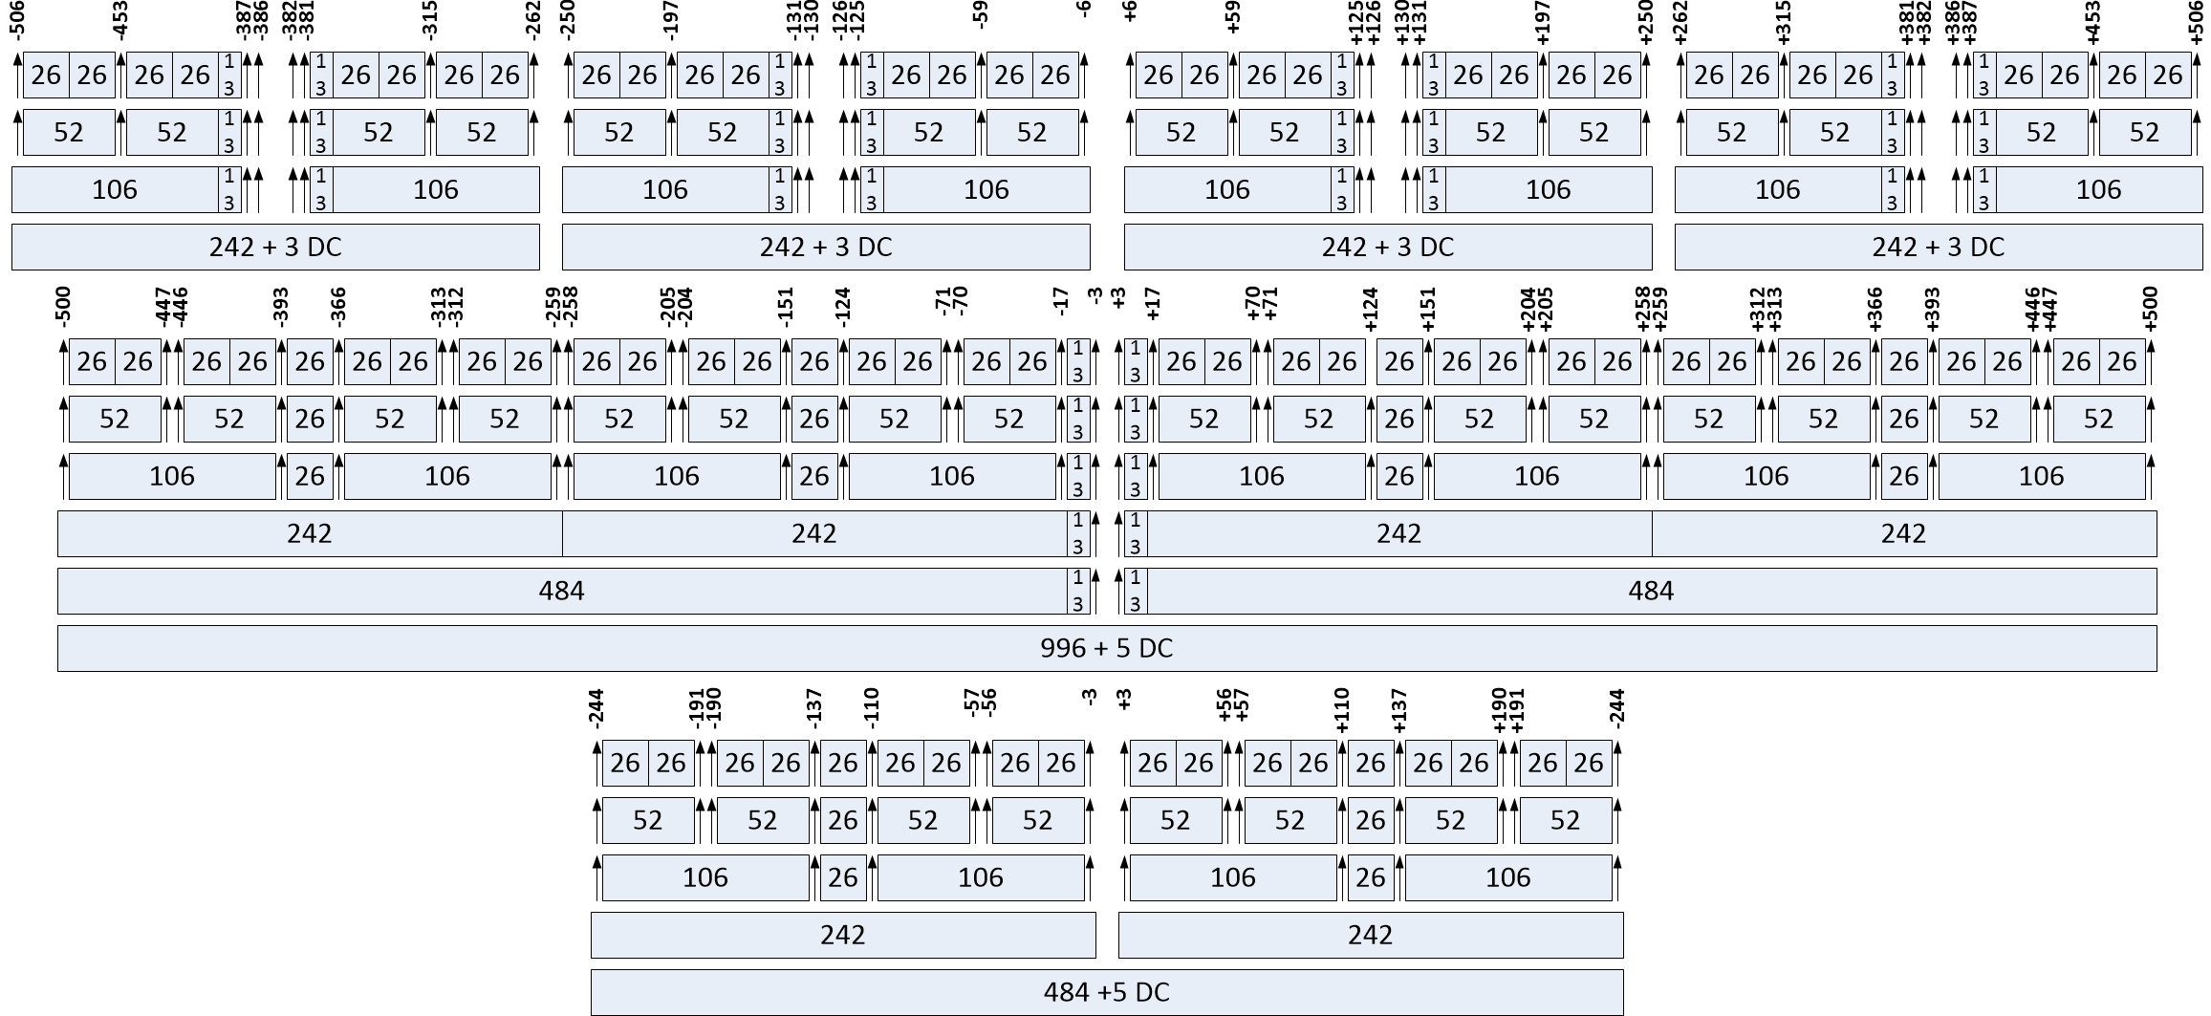
Tones alignment between 20 MHz only STAs and 40/80 MHz STAs
Four 20 MHz only STAs
80 MHz
Tones at [-116:-2, 2:116]
are common to 20 MHz
only, 40 and 80 MHz
tone plan
40 MHz

Slide 20
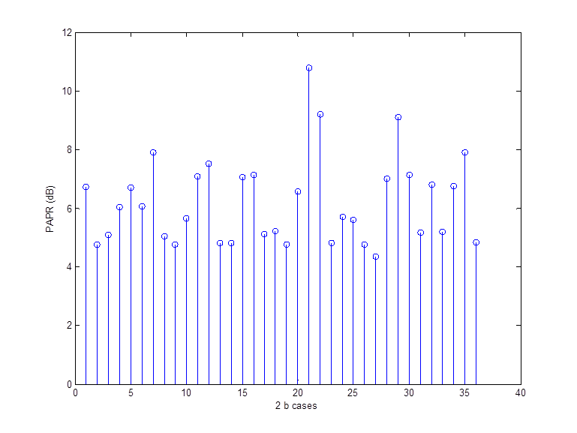
PAPR of 6 and 12 tones puncture HE-LTF
6 tones sequence PAPR is between 4.26 to 7.78 dB. Median is 4.60 dB for 36 cases in 20 MHz.
12 tones sequence PAPR is between 4.36 to 10.78 dB. Median is 5.88 dB for 36 cases in 20 MHz

Slide 21
Comparison of Proposed Scheme
We compare the proposed scheme which we name in the plots M-OOK (Manchester OOK) with an alternative scheme which we call D-BPSK
In the D-BPSK all 12 tones are populated, for example for tone set 1
    b₀ = 1 → Tones locations: -113,-77,-41,6,42,78 are modulated with +1
    b₀ = 1 → Tones locations: -112,-76,-40,7,43,79 are modulated with +1
    b₀ = 0 → Tones locations: -113,-77,-41,6,42,78 are modulated with +1
    b₀ = 0 → Tones locations: -112,-76,-40,7,43,79 are modulated with -1
    The reciever multiplies adjacent tones by the conjugates to create a decoding metric: sum(Y(k)conj(Y(k+1)))>0
Under ideal conditions both schemes perform the same
In practice D-BPSK suffers from:
  Timing errors
  Interference will bias the decision towards an error
  Not easy to detect no response
  Error floor at around 10⁻³ in UMi-NLOS Channel

Slide 22
Flat Channel, 1 TX, 1 RX, N_{ss}=1
0 dB reference is power in 12 tones

Slide 23
Channel D, 1 TX, 1 RX, N_{ss}=1
0 dB reference is power in 12 tones

Slide 24
Channel UMi-NLOS, 1 TX, 1 RX, N_{ss}=1
0 dB reference is power in 12 tones

Slide 25
M-OOK, Flat Channel, 1 TX, 1 RX, N_{ss}= 4, 8 users, 1 bit
0 dB reference is power in 12 tones
MIS and False Probability are for user #1
Degradation from CFO is mostly from
other users on the same tone set.
Due to loss of orthogonality of P-Matrix
#1 send b = 1, Power = 0 dB
#2 to #8 send b = 0, Power = +9 dB
#1, #3, #5, #7 negative CFO
#2, #4, #6, #8 positive CFO

Slide 26
M-OOK, Flat Channel, 1 TX, 1 RX, N_{ss}= 4, 8 users, 1 bit
0 dB reference is power in 12 tones
MIS and False Probability
are for user #1
#1 to #4 on one tone set
#5 to #8 adjacent tone set
#1 to #4 send b = [1 0 0 0], power = 0 dB
#5 to #8 send b = [0 0 0 0], power = +9 dB
#1 CFO is negative CFO
#2 CFO is positive CFO

Slide 27

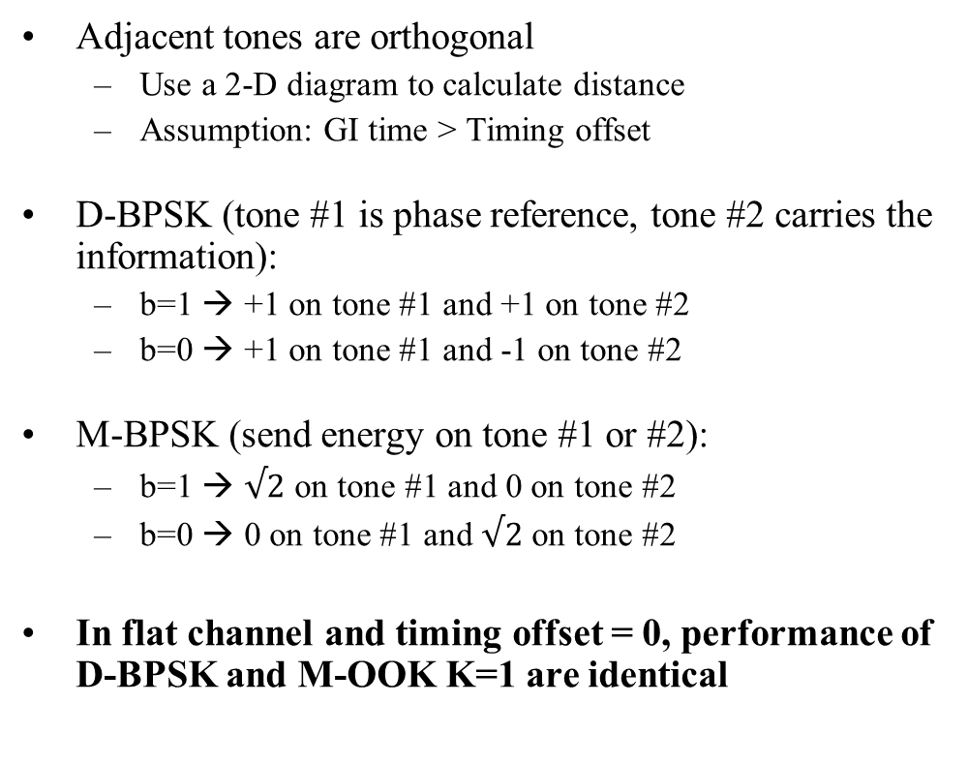

D-BPSK and M-OOK K=1 signals distance
Adjacent tones are orthogonal
  Use a 2-D diagram to calculate distance
  Assumption: GI time > Timing offset
D-BPSK (tone #1 is phase reference, tone #2 carries the information):
  b=1 → +1 on tone #1 and +1 on tone #2
  b=0 → +1 on tone #1 and -1 on tone #2
M-BPSK (send energy on tone #1 or #2):
  b=1 → $√2$ on tone #1 and 0 on tone #2
  b=0 → 0 on tone #1 and $√2$ on tone #2
In flat channel and timing offset = 0, performance of D-BPSK and M-OOK K=1 are identical
Tone #1
D-BPSK
+1
-1
+1
Tone #2
x>0
D=2
D=2
M-OOK
$√$2
K=1
$√$2
0

