Slide 1
Beam Tracking for 802.11ay
Date: 2017-01-16
Authors:

Slide 2
Introduction
A consolidated BF training protocol for use during the DTI period of the beacon interval was proposed for MU MIMO beamforming in [1]. The protocol is comprised of:
  Phase 1: SISO phase (mandatory)
  Phase 2: MIMO phase (mandatory)
For SU-MIMO beamforming the following phases have also been proposed [2]:
  Phase 1: Sector Level Sweep (SLS)
  Phase 2: Tx-Rx Sector/antenna Mapping
  Others: TBD
In this contribution, we propose an analog and a digital baseband channel tracking as possible tracking phases to allow for tracking and channel update purposes.
  We use a common framework for both SU-MIMO and MU-MIMO tracking.

Slide 3
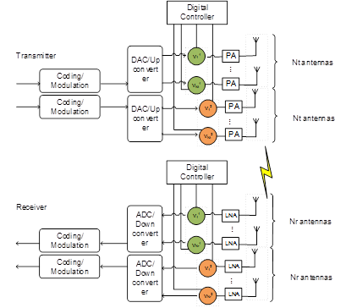
Hybrid Beamforming in 802.11ay
802.11ad transmits a single stream with analog beamforming.
802.11ay may transmit multiple streams with
  Analog Beamforming.
  Hybrid Precoding: a combination of analog beamforming and digital baseband beamforming.
Analog Beamforming
Hybrid Beamforming

Slide 4
Beam Tracking in 802.11ad
In 802.11ad, the beam identification phases are:
  SLS
  BRP
  Beam Tracking
Beam tracking is primarily for identifying the best beam for transmission and is comprised of setup, training and feedback sub-phases:
  Setup: Initiator requesting Tx beam tracking sets parameters in transmitted packet:
    BEAM_TRACKING_REQUEST: Beam tracking requested
    Packet Type: TRN-T-PACKET
    TRN-LEN: number of TRN-T fields
  Training: Initiator appends an AGC field and TRN-T subfields to the packet
  Feedback: Responder feeds back channel to the initiator.
    The feedback type is the same as the feedback type in the last BRP frame that was transmitted from the initiator to the responder with TX-TRN-REQ equal to 1.
    If the responder has never received a BRP frame from the initiator with TX-TRN-REQ equal to 1, the responder shall respond with the best sector.

Slide 5
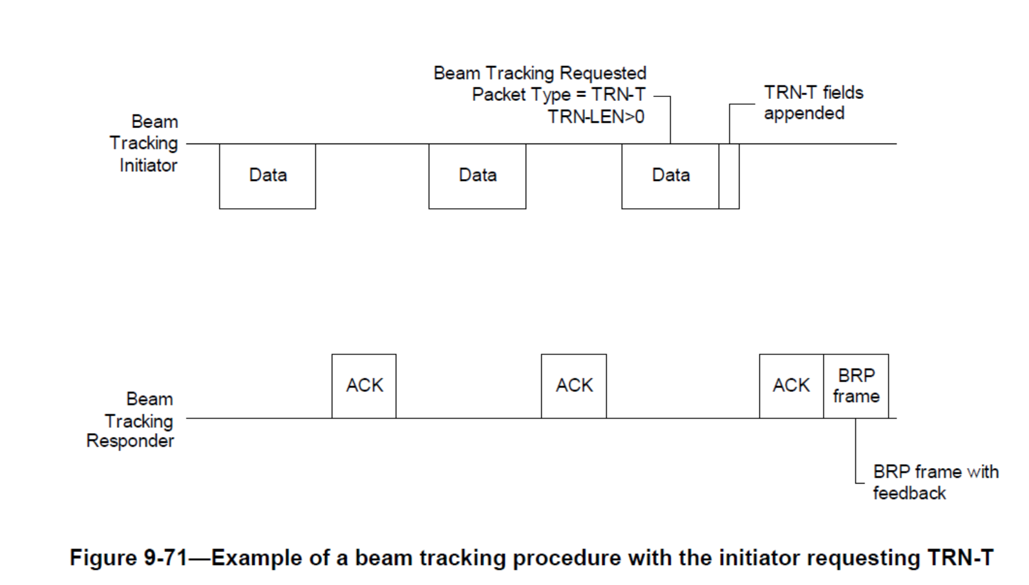
Beam Tracking with Initiator Requesting TRN-T [3]

Slide 6
Beam Tracking for 802.11ay
For 802.11ay, two types of beam tracking can be defined:
  Analog Beam Tracking (AB): used to track the change in analog beams e.g. due to STA rotation or movement.
    Similar to 802.11ad tracking but updated for SU/MU-MIMO
  Digital Baseband Channel Tracking (DBC): used to track the change in the baseband channel for a fixed set of analog beams e.g. due to beam blockage when using hybrid beamforming.
    Simplifies tracking by (a) simplifying setup (b) enabling use of CEF and a feedback request.
For 802.11ay beam tracking procedure can also be split into three sub-phases; setup, training and feedback:
  Setup: Needs to signal the tracking type, antenna configuration needs to be set up.
  Training: based on the BRP (using TRN-T/R fields) or null data packet (using the CEF).
  Feedback: channel feedback is needed for DBC tracking while any one on the best beam, SNR, or channel feedback is suitable for AB tracking.

Slide 7
Beam Tracking for 802.11ay

Slide 8
Steps for Beam Tracking in 802.11ay
Setup or Announcement
  Indicate if analog beam (AB) or digital baseband channel (DBC) tracking request : (AB or DBC)
    Indicate if SU or MU (AB or DBC)
  SU-MIMO/MU-MIMO BF setup :
    Indicate information similar to MU-MIMO BF setup sub-phase : (AB or DBC)
    Indicate SU/MU transmission configuration or use parameter to indicate keep current configuration : (DBC)
  Training Type
    Indicate use of TRN-T/R and TRN_length and set baseband precoder to Identity matrix : (AB or DBC)
    Indicate the use of CEF based training and set baseband precoder to Identity matrix: (DBC only)
  Indicate Feedback type required
    Best Beam(s), SNR(s): (AB only)
    Channel feedback : (AB or DBC)
Training
  TRN-T/R based training: (AB or DBC)
  CEF based training : (DBC only)
Feedback
  Based on simple polling (AB or DBC)
  Other methods are TBD

Slide 9
Conclusion
A framework for beam tracking in 802.11ay is introduced.
The beam tracking may be :
  Analog Beam tracking
  Digital Baseband Channel tracking

Slide 10
References
[1] IEEE 802.11-16/1365r0, MU MIMO beamforming protocol proposal, Intel et. al.
[2] IEEE 802.11-15/1358r9, Specification Framework Document, Intel
[3] IEEE 802.11ad

Slide 11
Straw Poll 1
Do you agree to add the following text to the 802.11ay SFD?
  “An EDMG STA may support hybrid precoding (defined as a combination of analog beamforming and digital baseband precoding) for SU-MIMO”
  “An EDMG STA may support hybrid precoding (defined as a combination of analog beamforming and digital baseband precoding) for MU-MIMO”

Slide 12
Straw Poll 2
Do you agree to add the following text to the SFD ?
  “An EDMG STA may support Digital Baseband Channel Tracking in addition to Analog Beam Tracking for SU-MIMO and MU-MIMO”

