Slide 1
Comparison between Simulated and Measured Results for a Residential Setting
Date: 2017-01
Authors:
Name | Affiliations | Address | Phone | email
Zabed Iqbal | Georgia Southern University | 1100 I.T. Drive, BLDG 255, Room 1313 Statesboro, GA 30458 | 701-404-3818 | zi00060@georgiasouthern.edu
James Moseley | Georgia Southern University | 1100 I.T. Drive, BLDG 255, Room 1313 Statesboro, GA 30458 | 478-455-2786 | jm12068@georgiasouthern.edu
Sungkyun Lim | Georgia Southern University | 1100 I.T. Drive, BLDG 255, Room 1313 Statesboro, GA 30458 | 912-478-2266 | sklim@georgiasouthern.edu
Carol Ansley | ARRIS Enterprises LLC | 3871 Lakefield Dr. Suwanee GA USA | 678-473-8630 | carol.ansley@arris.com

Slide 2
Abstract
This document presents the results of a comparison of simulated and measured RSSI (Received Signal Strength Indicator) tests in a residential setting. Simulation based on ray tracing method has been carried out and compared with measurement data. Both the simulated and measured results show good agreement over different transmitter positions.

Slide 3
Outline
Motivation & Objectives
Approach
Initial Setup
Comparison of Measurement and Simulation for Position 1
Comparison of Measurement and Simulation for Position 2
Comparison of Measurement and Simulation for Position 3
Comparison of Measurement and Simulation for Position 4
Summary

Slide 4
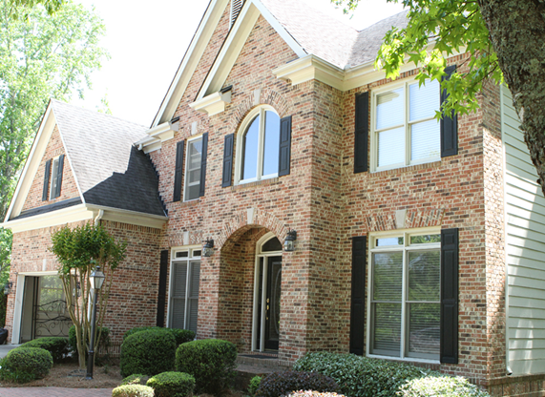
1. Motivation & Objectives
Motivation
Characterize propagation channel for 60 GHz correctly in Wi-Fi test house
Avoid multiple time-consuming measurements.
Objectives
Measure the RSSI data in Wi-Fi test house. Create the Wi-Fi test house for simulation and numerically calculate RSSI.
Verify simulation results by comparing with the measured data.
Wi-Fi test house

Slide 5
2. Approach
Take RSSI measurement using 60GHz Access Point in residential Wi-Fi test house.
Create residential Wi-Fi test house in simulation software based on the floor plan to simulate 60 GHz wireless propagation.
Compare the simulation results with measured data.
Determine accuracy of simulation software.
Try different transmitter positions to validate simulated results.

Slide 6
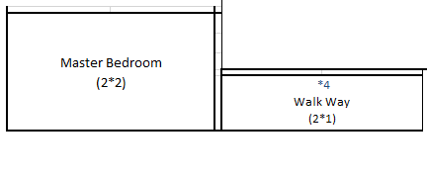
3. Initial Setup
1st Floor
2nd Floor
Combined Floor

Slide 7
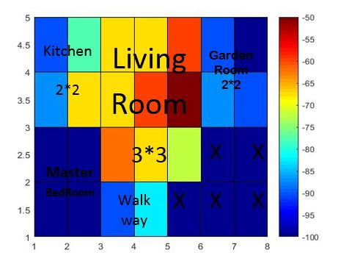
Floor Layout
RSSI (dBm) Mapping Matlab-Color Map
Customized floor layout and color map
Shows all the position/rooms to color map in contrast to the floor layout
“O” indicates the position of metal

Slide 8
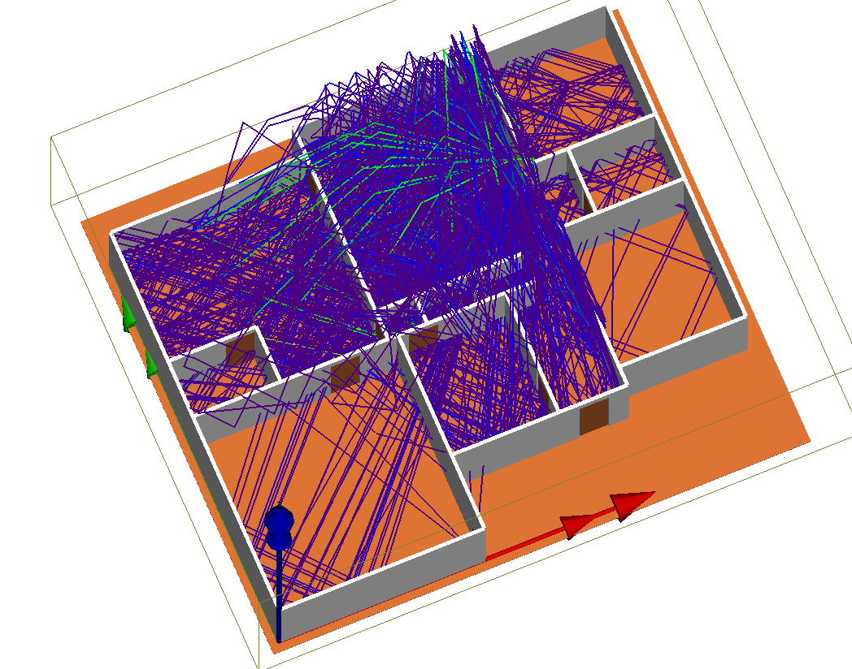
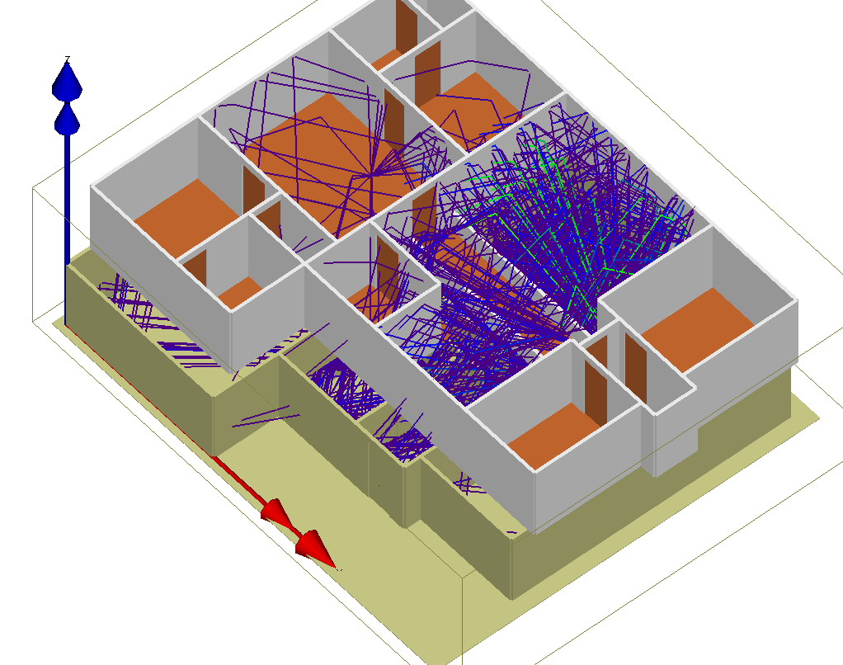
Ray Tracing
*2nd floor has been kept invisible to observed the ray propagation in the 1st floor.
*Ray propagation of both floor is shown.

Slide 9
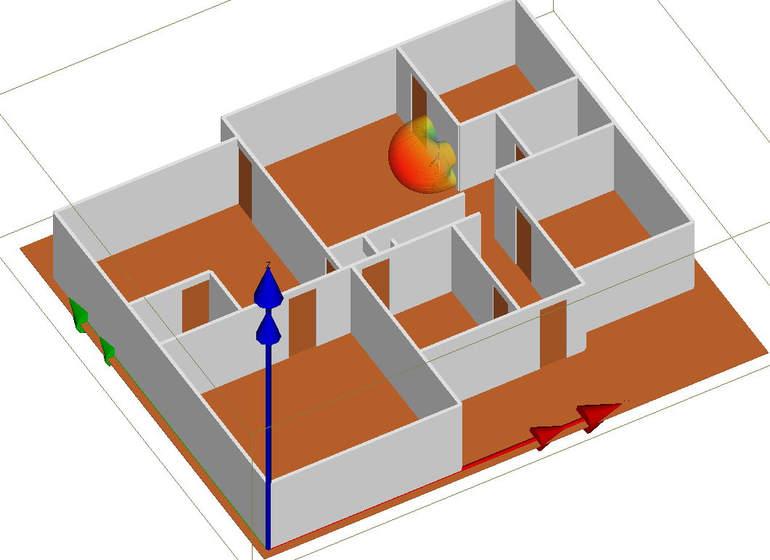
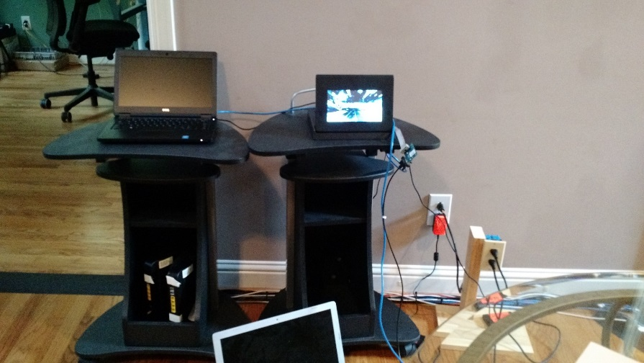
4. Comparison of Measurement and Simulation (with refrigerator and TV) for Position 1
Linux Machine
Access Point
* Antenna position with radiation pattern shown in the simulation.

Slide 10
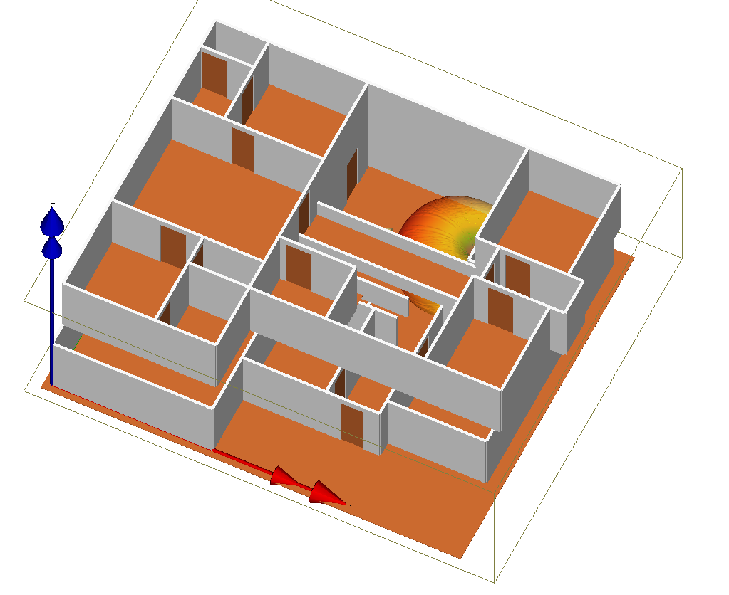
Floor Layout
3D Layout
*3D model has been created exactly same as the Arris Test House floor plan.
*Roof (both top floor and 1st floor) has been made invisible to show the 3D layout clearly.

Slide 11
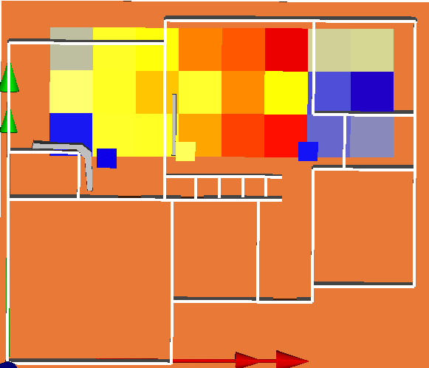
3D Layout
3D Layout with simulation results
TV
Metal Appliances
*Position 1: Half Sphere is the radiation pattern of the 60 GHz transmitter

Slide 12
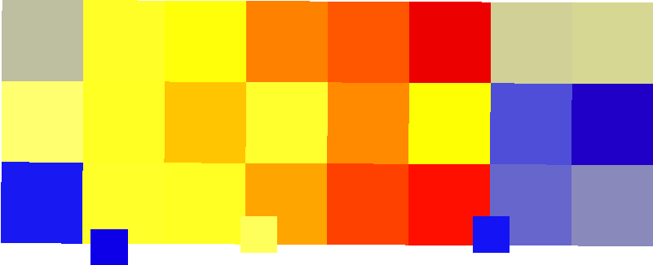
3D Layout with Simulation Results
Simulation Results(Color-Map)
*To show the Simulation Color-map More clearly, 2nd floor has been made invisible.

Slide 13
Direct Comparison Between RSSI of Measurement and Simulation Results Using Matlab Colormap
RSSI(dBm) Measurement
RSSI(dBm) Simulation
*Measurement and Simulation results are almost similar. In the master bedroom and garden room there is almost no signal both in measurement and simulation. For kitchen, there is a metal refrigerator (marked ‘O’) and other metal kitchen appliances (marked ‘O’), for which there is week signal in measurement as well as in the simulation.

Slide 14
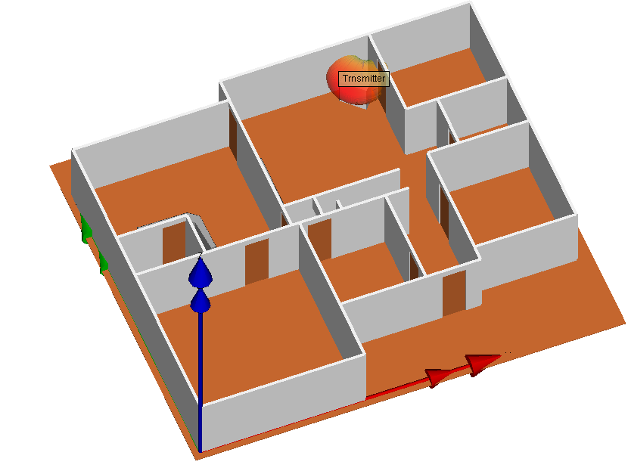
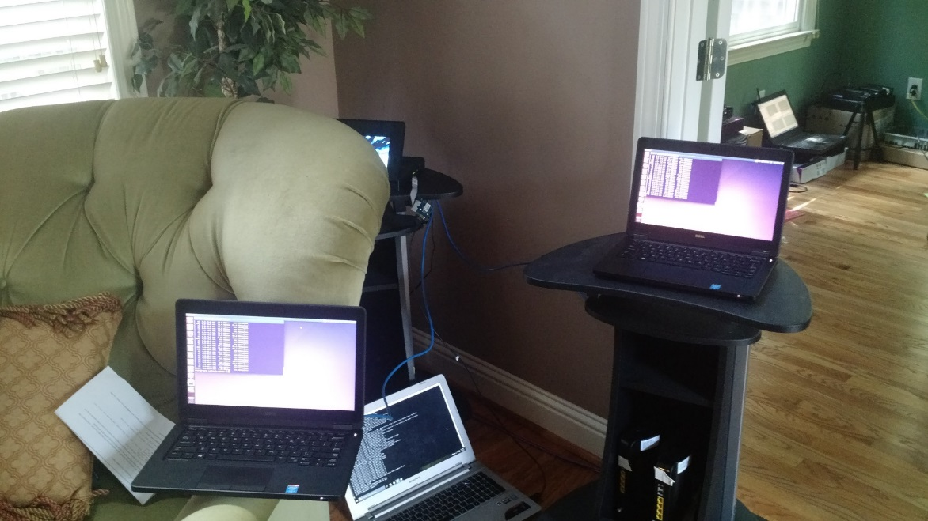
5. Comparison of Measurement and Simulation (with Fridge and TV) for Position 2
*Setup Position- Living room Corner with Chair in front of the transmitter

Slide 15
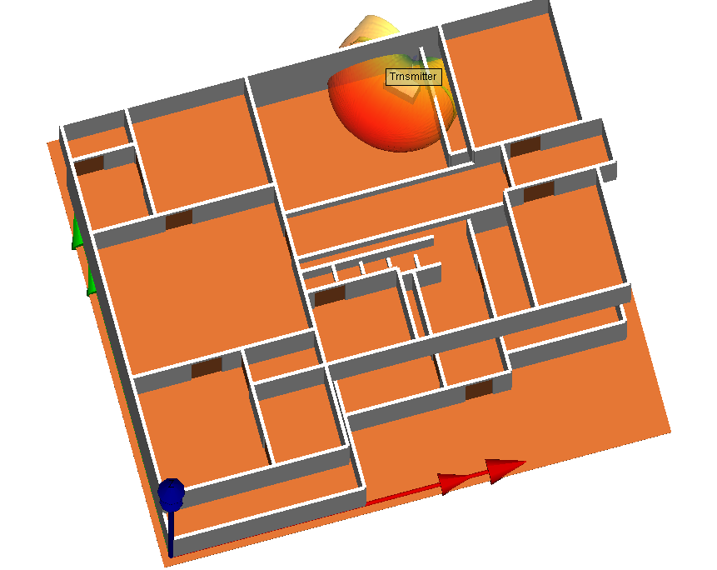
Floor Layout
3D Layout
*Position 2: Transmitter is in the corner of living room with a wooden chair in front of it.

Slide 16
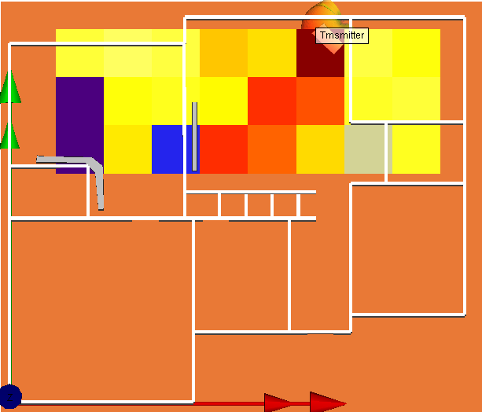
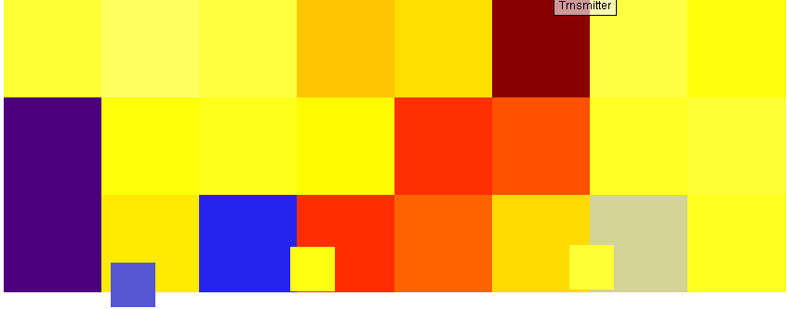
3D Layout with Simulation Results
Simulation Results Color-Map
*To show the Simulation Color-map More clearly, 2nd floor has been made invisible.

Slide 17
Direct Comparison Between RSSI of Measurement and Simulation Results Using Matlab Color-Map
RSSI(dBm) Measurement
RSSI(dBm) Simulation
*In the master bedroom and garden room there is almost similar signal both in measurement and simulation. For kitchen, there is a metal refrigerator (marked ‘O’) and other metal kitchen appliances (marked ‘O’), for which there is no signal in measurement and as well as in the simulation.

Slide 18
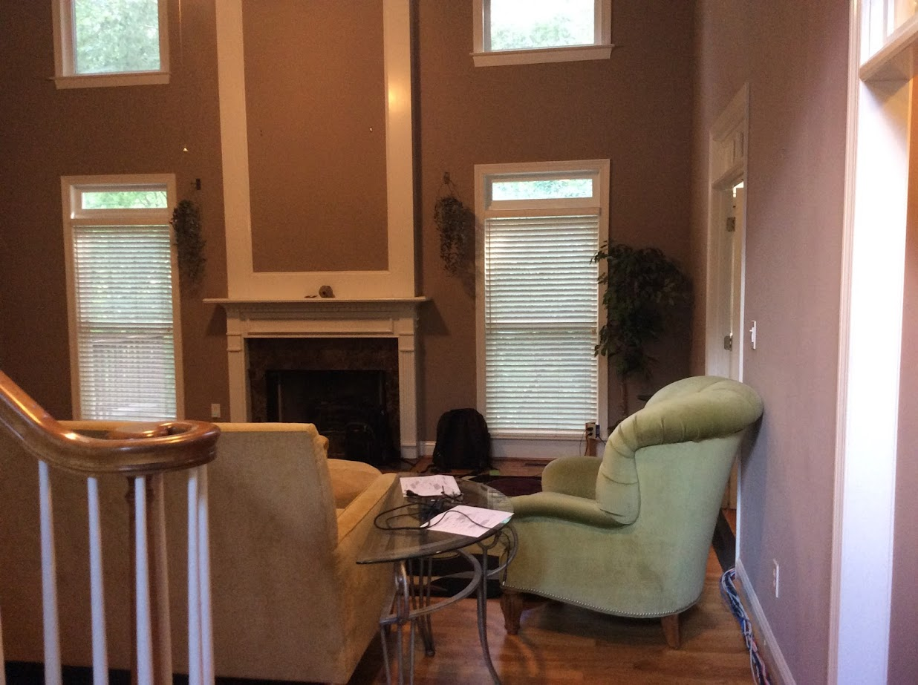
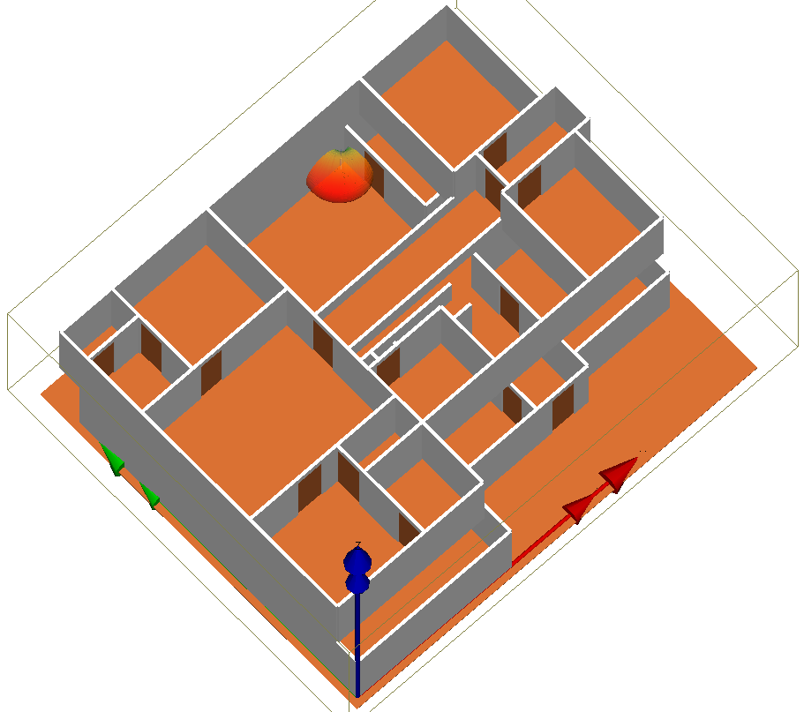
6. Comparison of Measurement and Simulation (with Fridge and TV) for Position 3
*Setup position- Living room Corner without Chair in front of transmitter

Slide 19
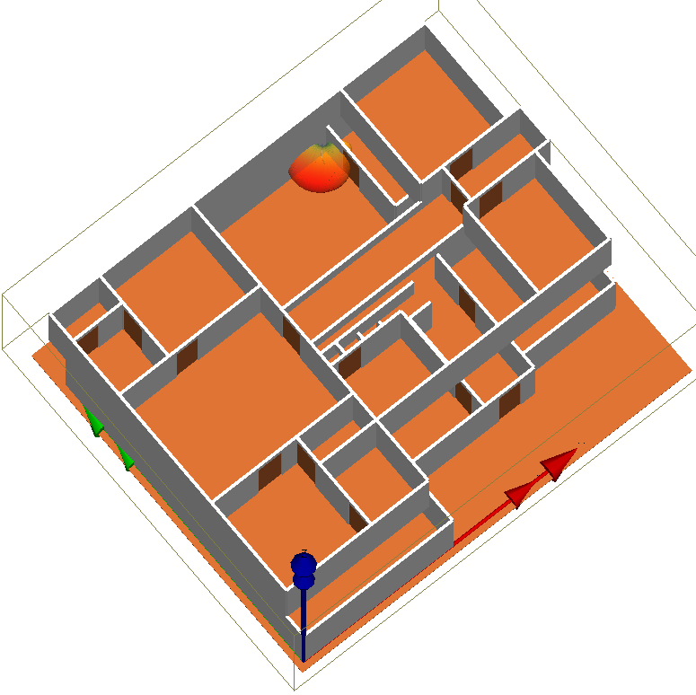
Floor Layout
3D Layout
*Position 3: Transmitter is in the corner of living room removing the wooden chair in front of it.

Slide 20
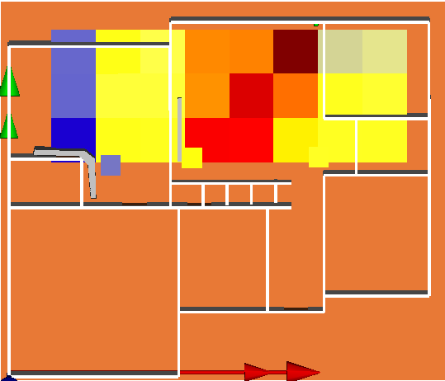

3D Layout with Simulation Results
Simulation Results Color-Map
*To show the simulation color-map more clearly, 2nd floor has been made invisible.

Slide 21
Direct Comparison Between RSSI of Measurement and Simulation Results using Matlab Color-Map
RSSI(dBm) Measurement
RSSI(dBm) Simulation
* Measurement and Simulation results are almost similar. For kitchen, there is a metal refrigerator (marked ‘O’) and other metal kitchen appliances (marked ‘O’), for which there is no signal in measurement as well as in the simulation in the bottom circle, and week signal in the upper circle.

Slide 22
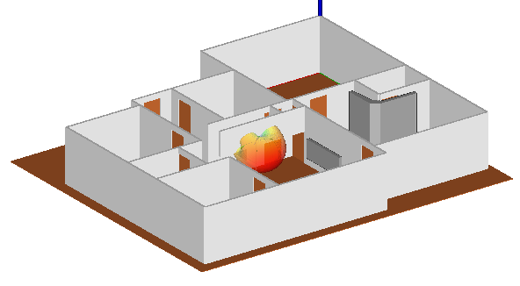
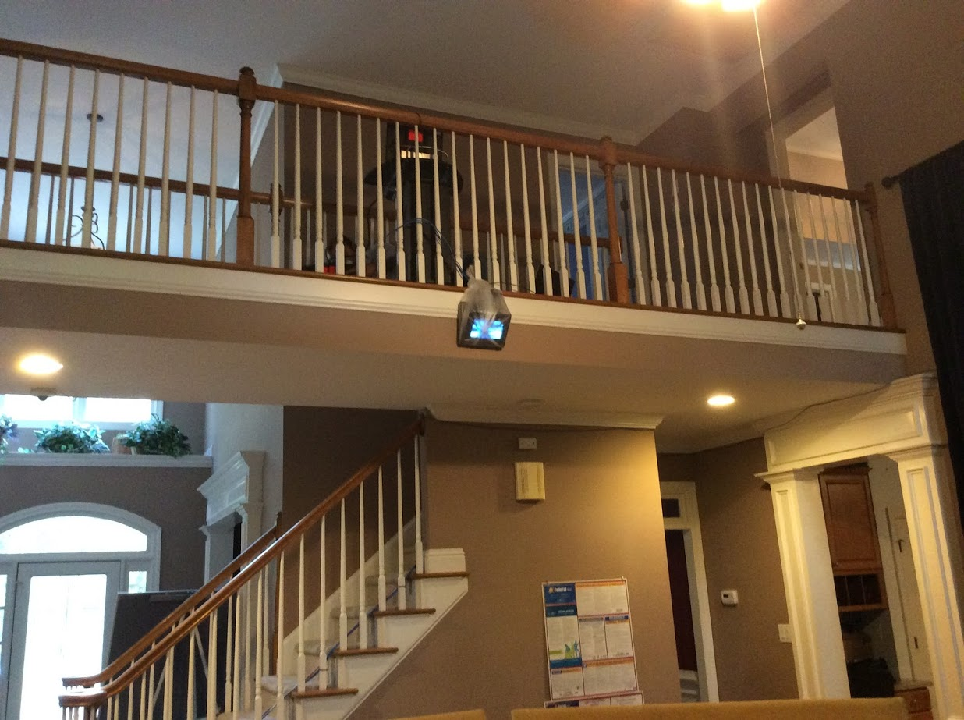
7. Comparison of Measurement and Simulation (with fridge and TV) for Position 4
Setup position: beside the walkway directive to living room

Slide 23
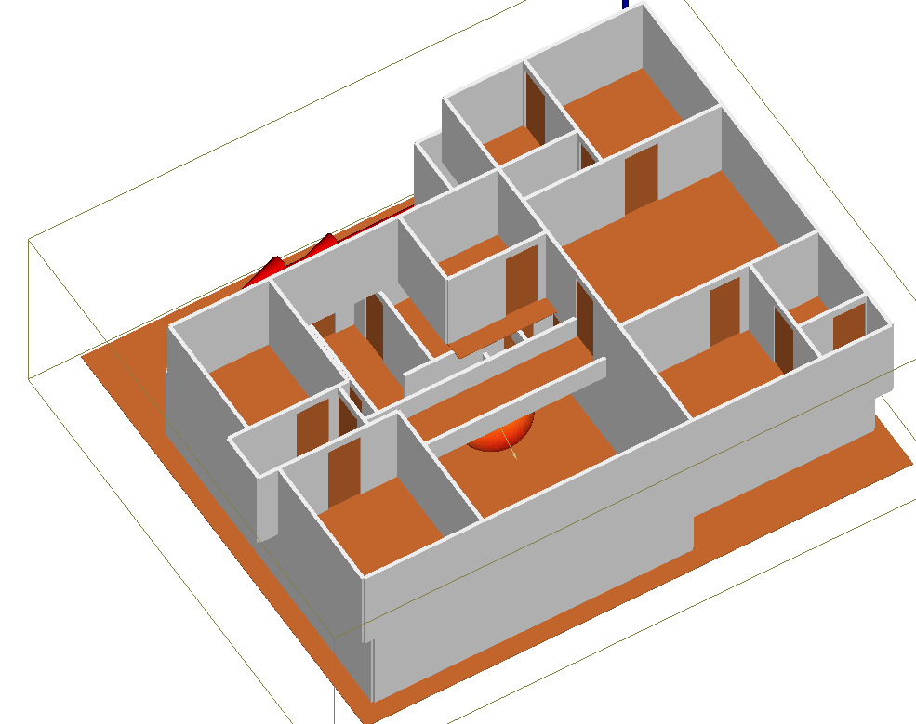
Floor Layout
3D Layout
*Position 4: Transmitter is besides the walkway directive to living room.

Slide 24
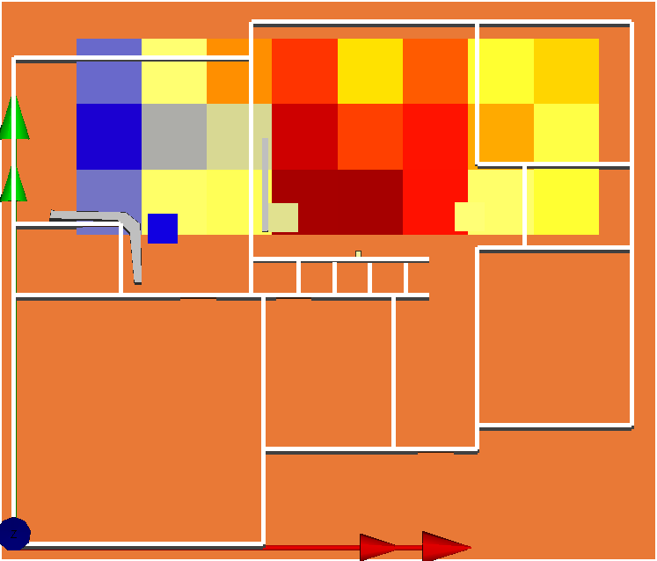

3D Layout with Simulation Results
Simulation Results Color-Map
*To show the simulation color-map more clearly, 2nd floor has been made invisible

Slide 25
Direct Comparison Between RSSI of Measurement and Simulation Results using Matlab Color-Map
RSSI(dBM) Mesurement
RSSI(dBm) Simulation
* In the master bedroom and garden room there is almost similar signal both in measurement and simulation. For kitchen, there is a metal refrigerator (marked ‘O’) and other metal kitchen appliances (marked ‘O’), for which there is no signal in measurement, as well as in the simulation.

Slide 26
Comments:
No Furniture except one wooden chair for measurement 2 has been used in the simulation.
Two metal objects (one refrigerator and kitchen appliance and other for TV) has been used in the simulation.
The transmitter was placed in the exact same position in simulation and measurement.

Slide 27
8. Summery/Observations:
Metal object has very degrading effects on signal strength.
Wooden and other furniture does not hamper the signal strength much unless they are located very close to the transmitter.
The simulation results agree well with measured ones.
The simulation result will be improved if the dimensions and material properties of metal objects and other variables are identified.

