Slide 1
Optimized Short SSW frame addressing scheme to reduce the false positive
Date: 2017-01-04
Authors:

Slide 2
Backgrounds
In [1], the addressing field is still TBD, it’s suggested to compress the two 48 bits TA and RA MAC addresses to 16 bits address
We assume it would be as : A(16bits):= CRC16( RA(48bits)||TA(48bits)), whereby the A denotes the Addressing field in the Short SSW frames and RA and TA both denote the addressing field inherent within 11ad SSW frames, CRC16 denotes the CRC 16-CCITT.
It’s also lack of quantitative analysis of the false positive (probability of collision in the context of OBSS environment).
We would like to propose using 16bits dual partial AIDs ( RA-AID(8bit),TA-AID(8bit) to fill up the address field which achieves better false positive probability and efficiency.
 | Packet Type | Addressing | CDOWN | RF Chain ID | Short SSW Feedback | Direction | Reserved | FCS
Bits: | 2 | 16 | 11 | 2 | 11 | 1 | 1 | 4
 | Packet Type | Addressing | CDOWN | RF Chain ID | Short SSW Feedback | Direction | Reserved | FCS
Bits: | 2 | 16 | 11 | 2 | 11 | 1 | 1 | 4
RA
AID1
TA
AID2

Slide 3
How to calculate the False Positive Rate
The false positive for hashed address calculation within a (P)BSS is based on [3]
(1)
Where n denotes number of STAs per BSS, H equals to 2^m, where m denotes number of bits.
Lemma 1: the false positive probability in OBSS (b>=2), the false positive for hashed address for OBSS with equal number of STAs per BSS, is calculated as
(2)
Where the b denotes the number of BSS, namely the OBSS.
Lemma 2: The false positive for dual AID calculation within OBSS with equal number of STAs is as:
(3)
Assuming p<1% is the good false positive rate which is equivalent of PER <10^(-2)

Slide 4
Hashed Address vs 16bits dual AIDs
b=1 (Single BSS)
b=2 (3 OBSS)
b=5 (5 OBSS)
b=8 (8 OBSS)

Slide 5
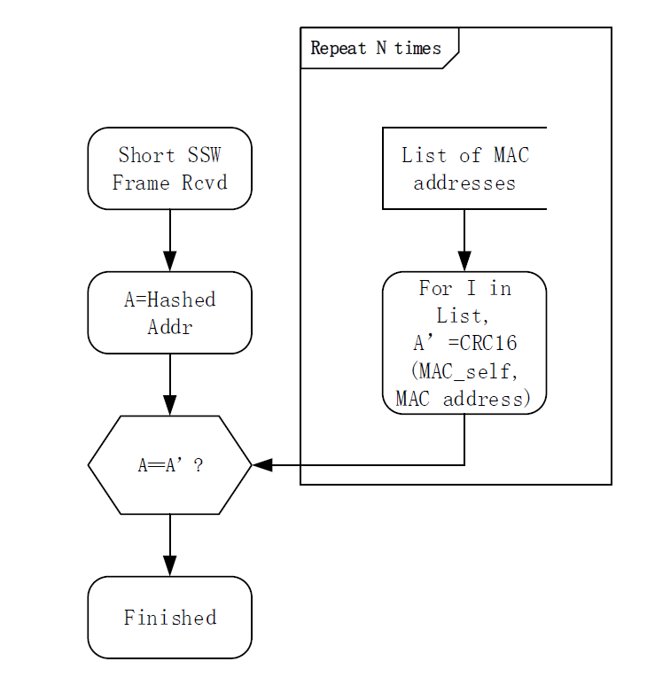
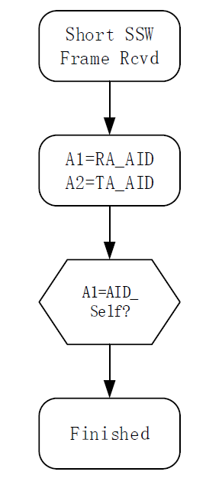
RX Decoding Efficiency
Decoding Sequence with Hashed Address scheme
Decoding Sequence with Dual AID schemes
In comparison, the hashed addresses scheme consumes more time in hashing and matching (the box), the time complexity is linearly depending on the size of the List of MAC addresses O(N) in a general case
.

Slide 6
Solution: for the AID=0 problem in OBSS
AID =0 problem definition: when DMG PCP/AP assigns the AID to DMG STA, it follows the rule specified in 9.4.1.8 [4]
  1-254 are assigned to STAs
  0 is assigned to PCP/Aps
  255 is assigned to b’cast address
  The 8 MSBs of the AID field to 0
  When operating in the OBSS, the false positive probability will be significantly greater when all PCP/APs are assigned with AID=0
In EDMG, PCP/AP may choose to randomly generate the 8 bits “EDMG BSS AID” applied to the 8 MSBs of the AIDs for both EDMG PCP/APs and EDMG STAs.
When the EDMG PCP/AP transmits or receives the short SSW frames, the AID field for EDMG PCP/AP should be filled with the 8 bits of EDMG BSS AID.
When the EDMG STA transmits or receives the short SSW frames, the AID field for EDMG STA should be filled with the 8 LSBs of the DMG AID field.
The delivery of the EDMG BSS AID:
For example, the EDMG BSS AID could be delivered to STA through EDMG capability information elements or EDMG operation elements:

Slide 7
BSS AID Generation
Option I: The BSS AID (8 MSBs of the EDMG AID field) is randomly generated by AP
Option II: 8 bit BSS Coloring scheme.

Slide 8
Benefit of address scrambling
By applying seed to the Addressing, collision can be further reduced compared with dual AIDs only. i.e. when SLS is failed, STA can re-try SLS with different seed.
Consistent collision rate with two seed (i.e. the rate that both successive two SLSs are failed) should be square of the collision rate per transmission if the scrambling is properly designed.

Slide 9
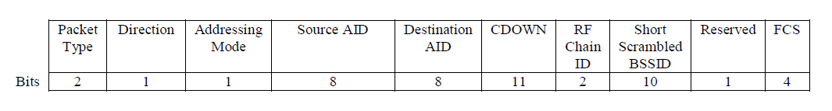
Dual AID with the Short Scrambled BSSID
The addressing is based on Dual AID for the Short SSW addressing fields.
In ISS, Short SSW packet includes Short Scrambled BSSID field, whose value is the 10 LSBs of CRC-16-CCITT of the BSSID.
The BSSID is scrambled with integer addition scrambling
before CRC calculation.

Slide 10
Integer addition scrambling
Add a scramble pattern to each 16bit-word of RA and TA
  i-th word’ = (i-th word + Pattern) mod 2¹⁶
    The additions should be integer additions instead of XOR
Suitable for computation with software/hardware
Recommended scramble patterns
  Pattern = (0x5795 * seed) mod 2¹⁵
Seed | Scramble Pattern (hex) | Seed | Scramble Pattern (hex)
0 | 0000 | 8 | 3CA8
1 | 5795 | 9 | 143D
2 | 2F2A | A | 6BD2
3 | 06BF | B | 4367
4 | 5E54 | C | 1AFC
5 | 35E9 | D | 7291
6 | 0D7E | E | 4A26
7 | 6513 | F | 21BB
BSSID = 57-89-65-58-2F-17
+
5795
=
+
5795
=
+
5795
=
Pattern
BSSID’= AF-1E-BC-ED-86-AC

Slide 11

Receiver procedure (+ collision rate)
When Assoc.
The false positive probability per transmission is:
The rate is independent from the Addressing scheme and
the number of STAs. The rate can be seemed as the upper limit.
Combined with some Addressing scheme, additional reduction
of collision rate may be achieved.
For example, when we use the dual AID with BSS AID scheme[4], the collision rate will be:
Construct SS-BSSID table
for SI=0to15
$p\left(b,J \right)=1−{ (\frac{J−1}{J})}^{b−1}$, where $J=2^{10}$
Receives SSSW packet
(1) Check if the received SS-BSSID matches to the current SS-BSSID according to the received seed
Check AID
$p\left(n,b,H, J \right)≈1−{ (\frac{J−1}{J}+\frac{1}{J}\frac{n}{H})}^{b−1}$ where $H=2^{8},J=2^{10}$
Finished

Slide 12
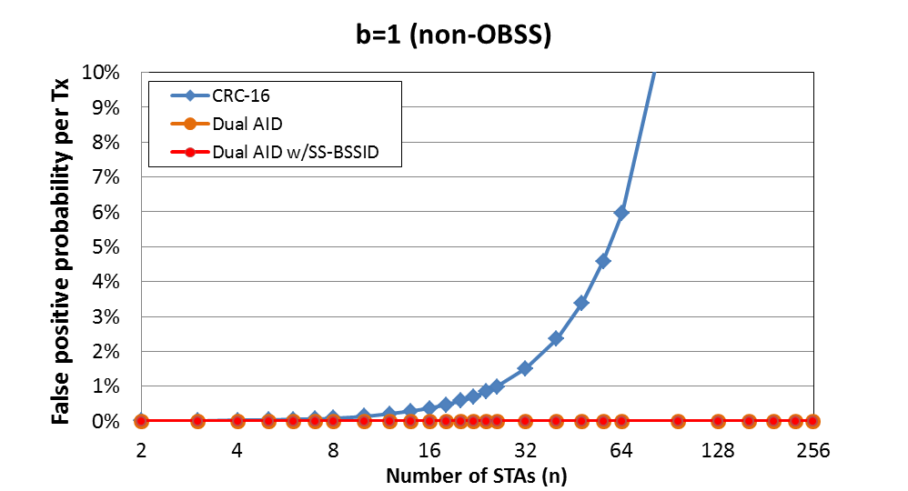
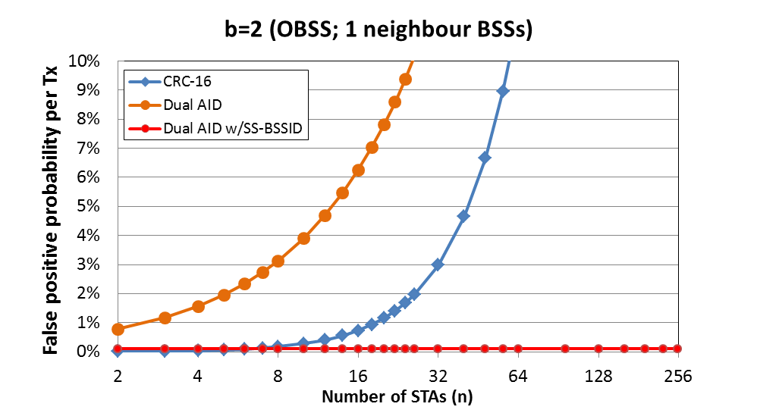
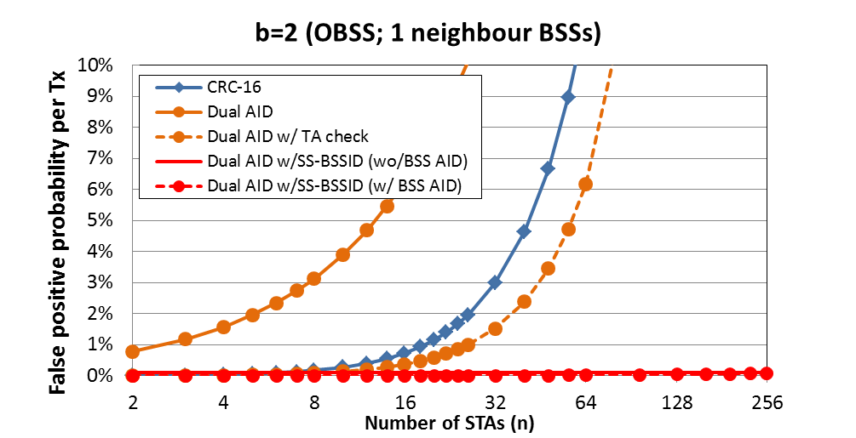
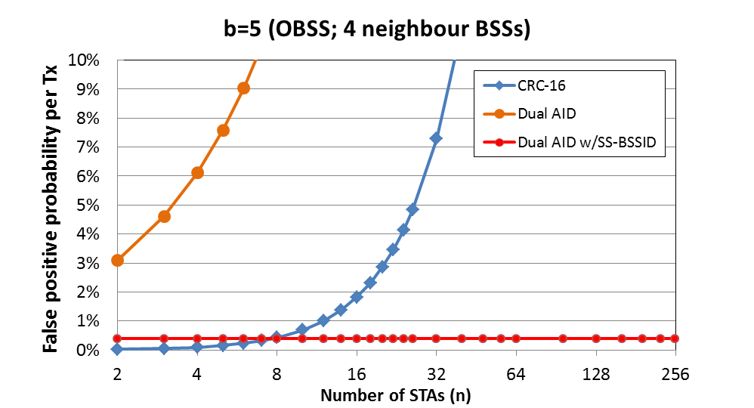
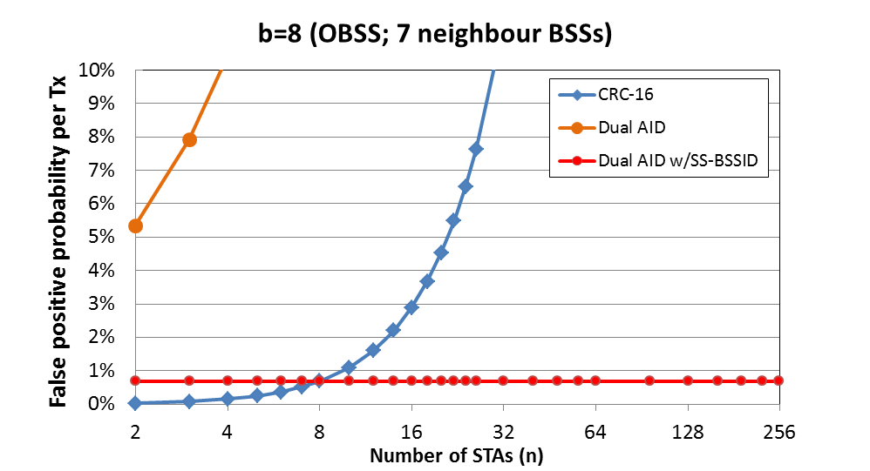
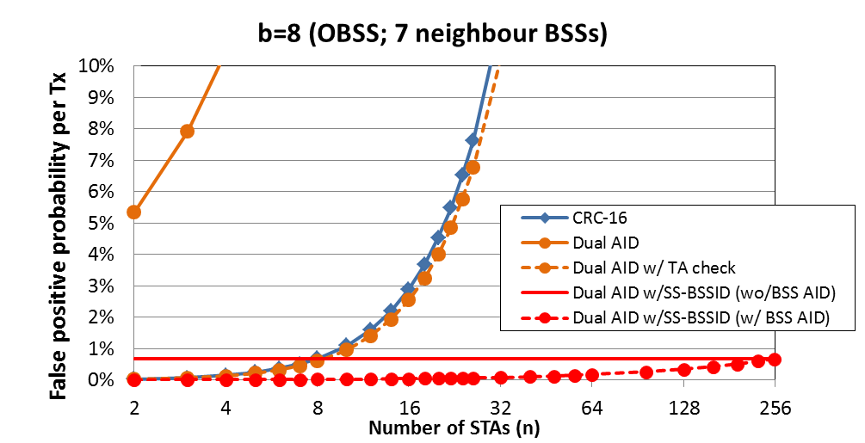
Collision probability analysis
Collision probability will be less than 1% with 10bit SS-BSSID for 8 BSSs and any number of STAs.
0.00%
0.10%
0.39%
0.68%

Slide 13
Conclusion
We conducted a collision rate analysis and showed that current solutions[1] suffered from significant performance degradation in OBSS environment.
The proposed method which uses Dual AID with the short scrambled BSSID (SS-BSSID) improves the performance in OBSS, as well as provides means for avoiding consistent collisions.
If the TA/RA is the AP itself, the TA/RA AID field should be filled with the 8 bits of the EDMG BSS AID

Slide 14
References
11-16-0416-01-00ay-short-ssw-format-for-11ay

Slide 15
Straw Poll1/Motion
Do you agree to define in the SFD, the 16 bits of address field within Short SSW frame to contain RA and TA AID fields. If the TA or RA is the AP itself, the TA or RA AID field should be filled with the 8 bits of the EDMG BSS AID . In case of ISS and Unicast, the Short SSW Feedback field should be replaced by the Short Scrambled BSSID(SS-BSSID) field”

Slide 16
Straw Poll2/Motion
Do you agree to add the following to the SFD
“The BSSID values are scrambled with the following formula before the calculation of SS-BSSID in the Short SSW packet.
    scrambled i-th word = (i-th word + scramble pattern) mod 2¹⁶,
    where each word is the part of the BSSID which is split by 16 bits, and + is integer addition.
    ”

Slide 17
Straw Poll3/Motion
Do you agree to add the following to the SFD
“Scramble patterns for SS-BSSID calculation are defined as follows:
Scramble pattern = (0x5795 * seed) mod 128
The seed is the scrambler initialization in the PHY header of the Short SSW packet. ”

