Slide 1
Training Field Structure Definition
Date: 2017-01-16
Authors:

Slide 2
Abstract
We propose and discuss AGC and TRN structures for the EDMG single-carrier and control modes.

Slide 3
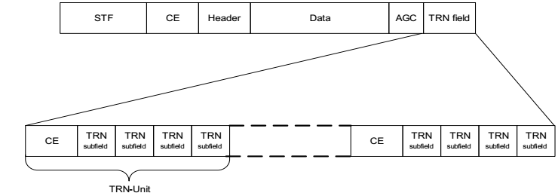
TRN
The following structure is defined in the 11ad spec for the TRN field:
where
  CE subfield: [-Gb128 –Ga128 Gb128 –Ga128 –Gb128 Ga128 –Gb128 –Ga128 –Gb128]
  TRN subfield: [Ga128 –Gb128 Ga128 Gb128 Ga128]
It should be noted that:
  The TRN field is composed of two different sequences (CE and TRN)
  Each TRN-Unit consists of one CE sequence (9×128) and 4 TRN subfields (5×128 each)

Slide 4
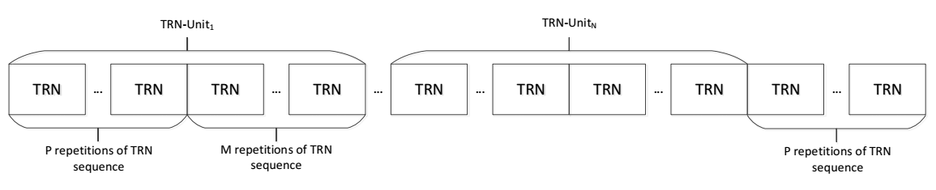
TRN
After analyzing different options to improve the TRN structure for different implementations and BF flows, we came to the conclusion that a structure which uses just one “subfield sequence” is advantageous.
We thus propose the following TRN structure:
    First P sequences in a TRN-Unit: Same AWV as preamble/data.
    Last M sequences in a TRN-Unit may use different AWV settings depending on whether transmit or receive training is used
  Additional P sequences at the end of the training field allow for frequency tracking.

Slide 5
TRN
In addition, we propose to keep the structure of a TRN-Unit configurable :
  P TRN sequences used for CE estimation and M TRN sequences used for BF training, where P and M are configurable values.
  The “optimal” values for P and M for different implementations and BF training flows may be different.
  Proposed values:
    P programmable takes on values 0, 1, 2, 4 (2 bits)
    M programmable – 1 - 16 (only multiples of N – see next slide) (4 bits)

Slide 6
TRN – Repetition Factor
Beamforming implementations can be simplified if the TRN sequences are longer.
To allow longer sequences for TX beam refinement, we allow a TX AWV held for N multiple contiguous TRN fields. For example, N = 2 and M = 8:
M=8
CE
TRN
TRN
TRN
TRN
TRN
TRN
TRN
TRN
CE
First TX AWV
N=2
Second TX AWV
First TX AWV
Third TX AWV

Slide 7
TRN – Repetition Factor
A few notes:
  Repeat parameter N only applies to the TRN sequences used for beamforming training. It does not apply to the P TRN fields that comprise the CE field.
  M (TRN-T fields per group) must be a multiple of N (repeated TRN-T fields)
  Repeat parameter N is allowed to take on values of 1, 2, 3, 4, and 8
  Only 2 bits required to signal this in BRP Request and EDMG Header A
  00 => N=1, 01 => N=2, 10 => N=3 or N=8 depending on the value of M (3,6, 9, 12) or (8, 16), 11 => N = 4
  Only needed for TRN-T training. For TRN-R implementations can do what they like.

Slide 8
TRN
Default values:
  Either (P = 2, M = 6, N = 3) or (P = 2, M = 8, N = 1) is used when capabilities of the RX are unknown.
  Mandatory for RX processing of TRN-T fields
  Configuration is determined by the transmitter
  Devices signal capabilities for other values
For TRN-R: 10 identical TRN-R fields are sent per TRN Unit
802.11ay TRN signaling in Header A
  SFD defines 8 bits in header for TRN-R/T units (1-255) and 8 bits for RX TRN-Units per Each TX TRN-Unit training configuration
  2 bits for P, 4 bits for M, and 2 bits for N
  24 bits total

Slide 9
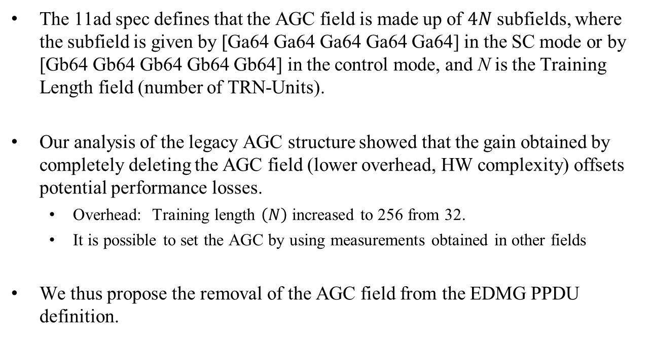
AGC
The 11ad spec defines that the AGC field is made up of $4N$ subfields, where the subfield is given by [Ga64 Ga64 Ga64 Ga64 Ga64] in the SC mode or by [Gb64 Gb64 Gb64 Gb64 Gb64] in the control mode, and N is the Training Length field (number of TRN-Units).
Our analysis of the legacy AGC structure showed that the gain obtained by completely deleting the AGC field (lower overhead, HW complexity) offsets potential performance losses.
  Overhead: Training length $\left(N\right)$ increased to 256 from 32.
  It is possible to set the AGC by using measurements obtained in other fields
We thus propose the removal of the AGC field from the EDMG PPDU definition.

Slide 10
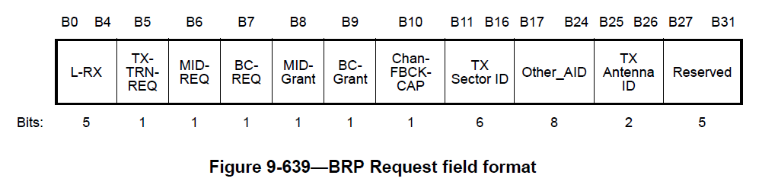
BRP Request Field
802.11ad has 5 reserved bits in the BRP-Request field (B27 to B31)
  We could use these for the E-DMG BRP Request
  More flexible to define a new BRP Request Field for E-DMG STAs
    Add at least one more octet for additional signaling

Slide 11
BRP Request Field
Field | Bits | Description
L-RX | 8 | Number of requested TRN-R/T training units (1-255)
TX/RX | 8 | Number of consecutive TRN-Units in the TRN field for which the transmitter uses the same set of transmit AWVs
P | 2 | Number of TRN fields in CE field (0, 1, 2 or 4)
M | 4 | Number of TRN fields per CE field (1-16)
N | 2 | TRN-T AWV repeat factor (1, 2, 3, 4, or 8)

Slide 12
EDMG Header bits
Need bits to define:
Field | Bits | Description
P | 2 | Number of TRN fields in CE field (0, 1, 2 or 4)
M | 4 | Number of TRN fields per CE field (1 - 16)
N | 2 | TRN-T AWV repeat factor (1, 2, 3, 4 or 8)

Slide 13
Capabilities
One of the mandatory settings must be used in initial beamforming before association
Mandatory for RX processing of TRN-T fields: (P = 2, N = 3, M = 6) and (P = 2, M = 8, N = 1)
After association, STAs may request other combinations
TRN-R/T field capabilities should be part of the core capabilities E-DMG capabilities element

Slide 14
Capabilities
Bit fields needed for transmit capabilities:
Field | Bits | Description
TP0 | 1 | Capable of transmitting with P = 0 (i.e. no CE field)
TP1 | 1 | Capable of transmitting with P = 1 (i.e. CE field consists of 1 TRN-R/T)
TP4 | 1 | Capable of transmitting with P = 4 (i.e. CE field consists of 4 TRN-R/T)
TN2 | 1 | Capable of transmitting with N = 2 (AWV repeated over 2 TRN-T fields)
TN4 | 1 | Capable of transmitting with N = 4 (AWV repeated over 4 TRN-T fields)
TN8 | 1 | Capable of transmitting with N = 8 (AWV repeated over 8 TRN-T fields)

Slide 15
Capabilities
A similar set of bits can be used for receive capabilities
Field | Bits | Description
RP0 | 1 | Capable of receiving with P = 0 (i.e. no CE field)
RP1 | 1 | Capable of receiving with P = 1 (i.e. CE field consists of 1 TRN-T)
RP4 | 1 | Capable of receiving with P = 4 (i.e. CE field consists of 4 TRN-T)
RN2 | 1 | Capable of receiving with N = 2 (AWV repeated over 2 TRN-T fields)
RN4 | 1 | Capable of receiving with N = 4 (AWV repeated over 4 TRN-T fields)
RN8 | 1 | Capable of receiving with N = 8 (AWV repeated over 8 TRN-T fields)

Slide 16
SP 1
Do you agree that (1) the AGC field currently defined for single-carrier and control mode EDMG PPDUs shall be removed and (2) the training field of EDMG PPDUs shall be defined as shown below for the single-carrier and control modes? In the proposed structure, the number of TRN sequences used for channel estimation (that is, transmitted with the same AWV as the preamble/data fields) (P) and for BF training (which may use different AWV settings depending on whether transmit or receive training is used) (M) in a TRN-Unit is configurable.

Slide 17
SP 2
Do you agree to incorporate the additions to the BRP Request Field (slide 11), EDMG Header A bits (slide 12), Mandatory features (slide 13), and Capabilities element (slides 14 and 15) to the SFD?

Slide 18
References

