Slide 1
TG ax
Proposal for DSC and OBSS_PD with Responses to Comments
Date: 2016-11
Authors:

Slide 2
Background
16/1064 proposed a unified approach to optionally use DSC to derive the OBSS_PD for the other two schemes.
In 16/1519 “Report from 11ax dominance investigation” comments on DSC by other members were included. These are addressed.
Three basic Spatial Reuse schemes have been proposed:
Color/inter-BSS (in D1.0)
  Identify traffic in an OBSS network, inter-BSS packets
  Ignore inter-BSS packets if below an OBSS_PD value
TPC (in D1.0)
  Adjust the transmit power of a STA based upon the CS/CCA threshold of the STA
    i.e. STA can increase CS/CCA threshold if it also reduces TXPWR
DSC (not in D1.0)
  Adjust the effective CS/CCA threshold of a STA based upon the RSSI of the network AP Beacons

Slide 3
Inter-BSS, Intra-BSS and OBSS_PD
Inter-BSS packets
  Traffic in an OBSS network to the STA
Intra-BSS packets
  Traffic in the same network as the STA
Basic idea
If packet is identified as inter-BSS, ignore it if below a certain signal level, OBSS_PD
  Do not set NAV, Can transmit over it
  BUT must adjust TXPWR
  No procedure or description on how to set OBSS_PD

Slide 4
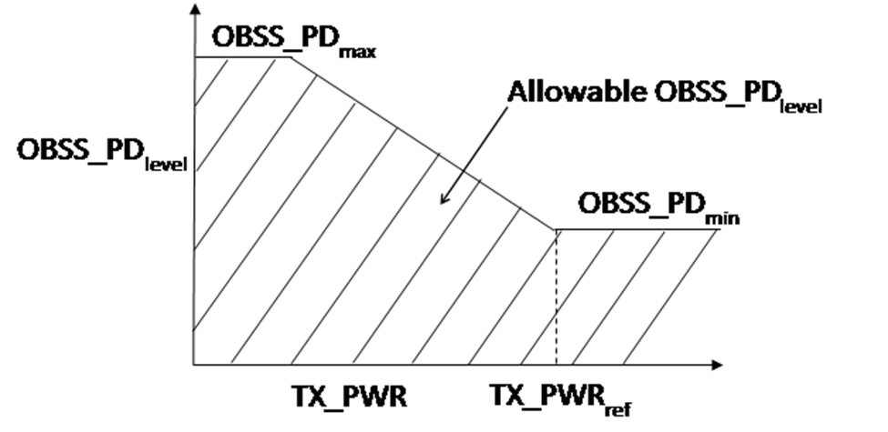
TPC
Transmit Power Control
  Reduce transmit power so that interference to OBSS is reduced
  Adjust OBSS_PD level in conjunction with Transmit power
  No procedure or description on how to set OBSS_PD
  “A STA can select an OBSS_PD level during its operation under SR mode. This level can be dynamically adjusted or can be static.”
From 16/1233r6

Slide 5
DSC
Dynamic Sensitivity Control (13/1012, etc)
  Adjust STA effective CS/CCA threshold based upon RSSI of wanted beacon from AP
  CCAeff = MIN (Upper Limit, RSSI _{beacon} ) – Margin
  CCAeff min = -82 dBm for 20 MHz.
  AP can advertise DSC Margin and Upper Limit to set the area of its BSS.
  STA can implement DSC (within limits) unilaterally
  AP can inhibit DSC (in case of outdoor, long distances for example)

Slide 6
Quotes from 16/1519r0 (Dominance Investigation)
“DSC as proposed does not distinguish between inter-BSS and intra-BSS. Raising the CCA would not be fair to legacy STAs. A contribution from Sony illustrated this issue. If CCA is raised, then TX power needs to be backed off as well. Modifying both CCA and TX power in tandem provide a better solution. There were technical issues with the Complainant’s proposal and that’s likely why he did not receive support in straw polls and votes.”
“Also wanted to distinguish between OBSS and intra-BSS – adopt BSS color from 11ah.”
RESPONSE: True, DSC in itself does not distinguish between inter-BSS and intra-BSS BUT DSC can be used to determine the OBSS_PD.
Ignoring an inter-BSS packet may be a problem if transmitting over it will block it. If the level of an interfering signal, wherever it is from, is high enough then it should not be transmitted over or ignored.

Slide 7
Intra and Inter
Later I will explain DSC and coverage in more detail

Slide 8
“DSC as proposed does not distinguish between inter-BSS and intra-BSS. Raising the CCA would not be fair to legacy STAs. A contribution from Sony illustrated this issue. If CCA is raised, then TX power needs to be backed off as well. Modifying both CCA and TX power in tandem provide a better solution. There were technical issues with the Complainant’s proposal and that’s likely why he did not receive support in straw polls and votes.”
RESPONSE: TPC works if all STAs (inter-BSS and intra-BSS) do it. Legacy STAs can cause significant blocking.
AP DL packets in an OBSS (at full power) may cause greater interference at the wanted AP as all UL packets at the wanted AP are at a reduced level if TPC used. Reducing signal levels by using TPC may make the Wi-Fi signals more vulnerable to other technologies (LAA?).

Slide 9
“The complainant’s proposal limits the flexibility for a chipset vendor to implement features to address dense environments.”
RESPONSE: Not true.
DSC is designed precisely to address dense environments, and many presentations have been made to show that it allows for optimum spatial reuse. Flexibility is provided by setting the DSC Upper Limit and the Margin values resulting in variation of the effective area coverage (see following slides).
Can argue that f ixing the CCA and TX power level relationship, plus having to check for inter or intra-BSS represents a much more set of stringent requirements which certainly will limit any flexibility for a chipset vendor.
Any new feature could be argued as limiting flexibility, I fail to see how DSC should be picked out on this point.

Slide 10
“The medium throughput gets better with DSC, but the performance of disadvantaged clients gets worse.”
ANS: Throughput does get better, and the performance worsening of “disadvantaged clients” is debatable and also compared to what? Inter-BSS can really disadvantage legacy devices if the OBSS_PD is set incorrectly (not explained at the moment in the draft). There has been no analysis that looked at this other than mine which showed the problem.
Legacy devices are possibly slightly disadvantaged, if at all, by a DSC STA, the logic is as follows:
  If OBSS legacy STA has started to transmit and a DSC STA transmits, both packets should be successful because of the DSC Margin
  If a DSC STA transmits then a legacy STA will defer, as it would to any other STA, DSC or legacy, so it is no worse off
  True, DSC STAs will tend to transmit more, (e.g. half way through a legacy transmission), and this can slightly decrease the legacy throughput in the worse case.
Incentive to implement DSC is strong. It can be implemented, in SW, on any HE or legacy device so easy for legacy STAs to implement.

Slide 11
DSC in practice

Slide 17

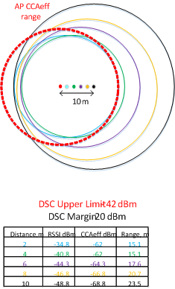
Setting DSC Upper Limit changes area

Slide 18
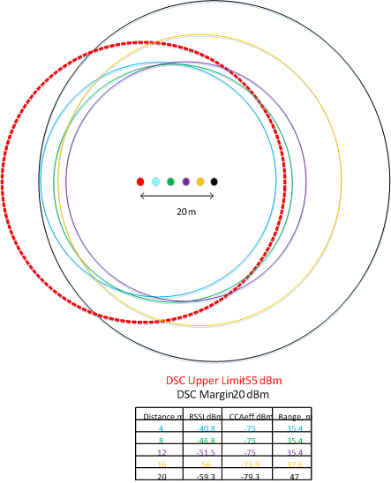
Setting DSC Upper Limit changes area

Slide 19
Proposal
No proposed change for OBSS_PD and TPC as presently in Draft
Link DSC and OBSS_PD for TPC and inter-BSS
  DSC STA calculates the effective CCA Threshold based upon the beacon RSSI (i.e. distance to the AP)
  CCAeff = MIN (Upper Limit, RSSI _{beacon} ) – Margin CCAeffmin = -82 dBm
  OBSS_PD threshold = CCAeff
    TPC STA calculates the TXPWR
    (TXPWR - TXPWRref ) = CCAmin – CCAeff
  Everything is optional

Slide 20
Summary –
Unified Proposal for Spatial Reuse
No change to OBSS_PD and TPC descriptions
DSC used to determine effective CCA threshold,
  CCA eff
OBSS_PD may be set to CCA eff
  Inter-BSS packets may be ignored if below OBSS_PD
  (TXPWR - TXPWRref )= OBSS_PDmin – OBSS_PD
Provides a standardized method for setting OBSS_PD.
    Enables spatial reuse to be simulated

Slide 21
Text
Full text is in 16/1063

Slide 22
Motion
Incorporate text in 16/1063r6 into the 11ax Draft.

