Slide 1
TG ax Proposal for DSC, ATPC, Inter-BSS with Responses to Comments
Date: 2016-11
Authors:

Slide 2
Background
16/1064 proposed a unified approach to optionally use DSC to derive the OBSS_PD for the other two schemes.
In 16/1519 “Report from 11ax dominance investigation” comments on DSC by other members were included. These are addressed.
Three basic Spatial Reuse schemes have been proposed:
Color/inter-BSS
Identify traffic in an OBSS network, inter-BSS packets
Ignore inter-BSS packets if below an OBSS_PD value
TPC
Adjust the transmit power of a STA based upon the CS/CCA threshold of the STA
i.e. STA can increase CS/CCA threshold if it also reduces TXPWR
DSC
Adjust the effective CS/CCA threshold of a STA based upon the RSSI of the network AP Beacons

Slide 3
Inter-BSS, Intra-BSS and OBSS_PD
Inter-BSS packets
Traffic in an OBSS network to the STA
Intra-BSS packets
Traffic in the same network as the STA
Basic idea
If packet is identified as inter-BSS, ignore it if below a certain signal level, OBSS_PD
Do not set NAV, Can transmit over it
No procedure or description on how to set OBSS_PD

Slide 4
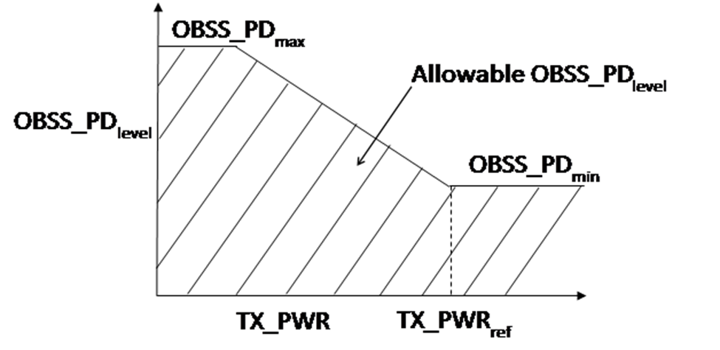
TPC
Transmit Power Control
Reduce transmit power so that interference to OBSS is reduced
Adjust OBSS_PD level in conjunction with Transmit power
No procedure or description on how to set OBSS_PD
“A STA can select an OBSS_PD level during its operation under SR mode. This level can be dynamically adjusted or can be static.”
From 16/1233r6

Slide 5
DSC
Dynamic Sensitivity Control (13/1012, etc)
Adjust STA effective CS/CCA threshold based upon RSSI of wanted beacon from AP
CCAeff = MIN (Upper Limit, RSSI _{beacon} ) – Margin
CCAeff min = -82 dBm for 20 MHz.
AP can advertise DSC Margin and Upper Limit to set the area of its BSS.
STA can implement DSC (within limits) unilaterally
AP can inhibit DSC (in case of outdoor, long distances for example)

Slide 6
Quotes from 16/1519r0 (Dominance Investigation)
“DSC as proposed does not distinguish between inter-BSS and intra-BSS. Raising the CCA would not be fair to legacy STAs. A contribution from Sony illustrated this issue. If CCA is raised, then TX power needs to be backed off as well. Modifying both CCA and TX power in tandem provide a better solution. There were technical issues with the Complainant’s proposal and that’s likely why he did not receive support in straw polls and votes.”
“Also wanted to distinguish between OBSS and intra-BSS – adopt BSS color from 11ah.”
ANS: True DSC does not distinguish between inter-BSS and intra-BSS because there is no advantage at all in doing so. The whole idea of DSC is to ensure that the effective CCA will cover all intra-BSS transmissions and contend and to lessen the extent of OBSS interference.
Simply ignoring an inter-BSS packet is wrong if transmitting over it will block it. If the level of an interfering signal, wherever it is from, is high enough then it should not be transmitted over or ignored. There is no reason at all to distinguish between inter or intra BSS packets as far as RSSI and CCA is concerned.
Additionally, ‘color’ only works if all STAs adopt it. If color not implemented, checking the BSSID takes time and can effectively negate any advantage.
TPC has problems. It only works if all STAs (inter-BSS and intra-BSS) do it. Legacy STAs can cause significant blocking. AP DL packets in the OBSS (at full power) will cause greater interference at the wanted AP as all UL packets at the wanted AP are at a reduced level if TPC used. Reducing signal levels by using TPC could also make the Wi-Fi signals more vulnerable to other technologies (LAA?).
Having said that the DSC proposal simply offers that the effective CCA, using DSC, may be used to determine OBSS_PD and the TX level.

Slide 7
“The complainant’s proposal limits the flexibility for a chipset vendor to implement features to address dense environments.”
ANS: A very general comment which has been countered by producing full analysis of every 11ax scenario.
DSC is precisely designed to address dense environments, it allows for optimum spatial reuse.
Fixing the CCA and TX power level relationship, plus having to check for inter or intra-BSS represents a much more set of stringent requirements which certainly will limit any flexibility for a chipset vendor.
DSC implementation is SW only and any legacy device could implement it. The details of how to use DSC have been provided in text.
Any new feature could be argued as limiting flexibility, I fail to see how DSC should be picked out on this point.
Lastly for TPC and color to work, all STAs in a dense area must implement it. DSC can provide improvements if only some STAs implement it – a really good incentive to do so.

Slide 8
“The medium throughput gets better with DSC, but the performance of disadvantaged clients gets worse.”
ANS: Throughput does get better, and the performance worsening of “disadvantaged clients” is debatable and also compared to what? Inter-BSS can really disadvantage legacy devices especially if the OBSS_PD is set incorrectly (not explained at the moment in the draft). There has been no analysis that looked at this, other than mine which showed the problem. Legacy devices are possibly slightly disadvantaged, if at all, by a DSC STA, the logic is as follows:
If OBSS legacy STA has started to transmit and a DSC STA transmits, both packets should be successful because of the DSC Margin
If a DSC STA transmits then a legacy STA will defer, as it would to any other STA, DSC or legacy, so it is no worse off
True, DSC STAs will tend to transmit more, (e.g. half way through a legacy transmission), and this can slightly decrease the legacy throughput in the worse case.
Color and TPC both rely on the other guy, i.e. all STAs must implement it for it to work in a dense area, DSC does not. DSC is the only spatial reuse scheme that does not rely on everyone else also having to comply.
Incentive to implement DSC is strong. It can be implemented, in SW, on any legacy device.
Inter-BSS SR can worsen the performance of legacy clients to a much greater extend than DSC. Note however if inter-BSS uses DSC to set the BSS_PD then this can be improved.

Slide 9
“Although there are technical issues with the Complainant’s proposal, it doesn’t prevent him from proposing his scheme under the current framework that was accepted by 802.11ax. The topic is still under discussion in the Task Group”
ANS: I have proposed the scheme many times. All discussions I have had previously were simply to reject it with no real attention to the analyses put forward.
It has been suggested to me that the DSC proposal and text must only allow the hard link between OBSS_PD and TPC with DSC deriving the effective CCA. As pointed out, this hard link will:
cause problems with legacy,
provide a more complicated restrictive scheme(s)
degrade Wi-Fi performance in presence of other technologies (LAA?)
In spite of this, the DSC proposal simply allows it to be used to determine the OBSS_PD when used with inter-BSS and TPC. (Note the TPC scheme is termed “ATPC” so as to distinguish it from the existing proposal which is untouched.)
So the TPC/CCAlink is maintained but it also allows DSC to be used independently which will result in spatial reuse for 11ax devices without having to wait until all legacy devices have been purged. Note: Over 7.5B legacy Wi-Fi devices still in use (WFA Madrid 2016)

Slide 10
Proposal
Link DSC, Adaptive (A)TPC, and inter-BSS
DSC STA calculates the effective CCA Threshold based upon the beacon RSSI (i.e. distance to the AP) CCAeff = MIN (Upper Limit, RSSI _{beacon} ) – Margin CCAeffmin = -82 dBm
ATPC STA calculates the TXPWR CCAeff = CCAmin+ (TXPWRref - TXPWR) (TXPWR - TXPWRref )= CCAmin – CCAeff
The CCAeff is only used on Inter-BSS packets OBSS_PD thres = CCAeff
Everything is optional
NOTE: TPC as proposed in 16/1223 is left alone. ATPC is the scheme where the CCAeff is used and the TX power set accordingly. Same relationship is kept.

Slide 11
Summary – Unified Proposal for Spatial Reuse
DSC may be used to determine effective CCA threshold,
CCA eff
ATPC may be used to determine TXPWR
based upon CCA eff
(TXPWR - TXPWRref )= OBSS_PDmin – CCAeff
Inter-BSS packets may be ignored if below OBSS_PD
OBSS_PD may be set to CCA eff
Satisfies all conditions as described in various presentations
Provides a standardized method for setting OBSS_PD.
Enables spatial reuse to be simulated

Slide 12
Adaptive CCA, ATPC and inter-BSS
Full text on this unified approach is in 16/1063

Slide 13
Motion
Incorporate text in 16/1063r3 into the 11ax Draft.

