Slide 1
Ranging on 11az
Date: 2016-10-25
Authors:

Slide 2
Background
802.11 rev-mc defines an FTM protocol for ranging between two devices using a single tx-antenna
Previous submissions:
Qualcomm has previously described MIMO channel sounding (based on leveraging Packet Extension) for improved accuracy (11-16-1013r2 Locationing Protocol for 11az)
Intel has described a sounding sequence based on bi-directional sounding using NDP frames (11-16-1260r0 Locationing Measurement Protocol for Unassociated STAs, 11-16-1015r0 Location Measurement Protocol for 11ax).
This proposal helps put things in context – identifying requirements for various phases accompanying the MIMO sounding-sequence
  Discovery
  Negotiation of Capabilities & Information Exchange
  Measurement Phase (Sounding)

Slide 3
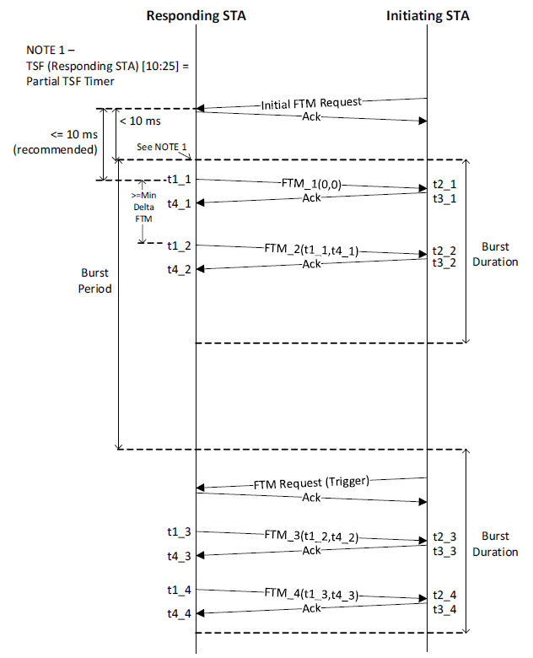
FTM – Sequence of Events in 802.11rev-mc
FTMInitiator (STA) discovers FTMResponders (AP)
  Active/Passive Scan/Out of Band
  Support of FTM known based on extended capability bit settings
FTMInitiator sends initial FTM frame(s) to FTMResponder(s) to negotiate capabilities/schedule FTM bursts
At scheduled times, FTMInitiator sends Trigger to FTMResponder to initiate FTM/ACK measurement sequence

Slide 4
Discovery in 802.11az
Expect that Capabilities (i.e. existence of an FTM Responder) are known using similar schemes as in FTM
Need a new capability field to indicate support for 11az

Slide 5
Negotiation in 11az
When ranging with
  Non-11az capable responder, initiator uses rev-mc FTM parameters IE
  11az capable responder, initiator uses FTMaz IE
    Can be FTM Parameter Element extended by new sub-elements
    Can be FTM Parameter Element extended by new IE
    Can be a new FTMaz IE
  11az may specify other non-ranging behavior – these may have other IEs
Eliminate protocol-bloat from a negotiated choice of protocol techniques
  Can we assume that all 11az devices shall also be capable of rev-mc based FTM (baseline)?

Slide 6
Negotiation in 11az
FTMaz IE MAY be
  A superset of FTM parameters IE (i.e. only one IE sent depending on capability of responder)
    Efficient over the air/fewer-bits
  An new IE adding the new information required by 11az over the existing FTM Parameters IE (i.e. two IEs sent OTA)
  A subelement to be carried along with FTM IE defined in Revmc
Discussion

Slide 7
Negotiated Capabilities
FTMaz Parameters Element
  Format & BW Capabilities
  Covers scheduling aspects of FTM bursts
Additional Parameters for 11az (assumes 11ax sounding capable)
  Measurement Configuration
    # of Tx-antennas Supported
    Min# of Tx-antennas preferred (eg: expectation of a min# of tx-antennas to be sounded during a AP triggered MU-uplink
    Min freq BW preferred (eg: for OFDMA based sounding)
    Measurement response – immediate OR stacked
    Sounding PE Duration
    …
  Measurement Parameters
    Time-stamp info (ToA, ToD)
    AoA
    AoD
    …
Parameters for VHT based Ranging (Sounding Sequence based on VHT)
Parameters for 11ax based Ranging (Sounding Sequence based on 11ax)
Trade off between signaling in capabilities and explicit support during negotiation phase

Slide 8
Measurement Sequence
At the scheduled start of a burst, FTMInitiator(s) sends an FTM trigger to the FTMResponder indicating their availability
Subsequently FTMResponder initiates MUtrigerred sounding sequences till the end of the burst
Measurement information can be carried in (1) immediate response frame OR (2) be stacked across multiple response frames

Slide 9
Measurement Sequence – Scheduling Groups based on # of resources
Depending on negotiation with various STAs – resources available to AP and resources requested by STA, AP schedules measurement sequences at different time offsets
In this example STAn requested for all resources available at the AP and is scheduled at a different time from STA1...STA2 which can be multiplexed in frequency/spatial resources and are scheduled separately

Slide 10
[RECAP] Triggered Frame Exchange
Single TXOP
MU operation MAY be used to sound multiple devices
Use of sounding PE eliminates additional overhead of NDP exchange – allow for piggybacking sounding on data
  Currently specified AMPDU contexts allow for piggybacking data/ack/management transmission
Framework allows device to relax its response-time (critical-path) based on capability
Framework allows flexibility to either entity to perform location computations
Unassociated STAs supported though wild-card trigger

Slide 11
[RECAP] Contention Based Frame Exchange
Simplest 802.11 construct of request/response – limited frame overhead
Supports both associated and unassociated STAs

Slide 12
Straw-polls
Do all 11az devices support rev-mc based FTM IE along with extensions for 11az (to support VHT, 11ax Ranging/Sounding)as:
- Superset IE i.e., a new IE that includes FTM IE + All 11az Parameters
  Y/N/A
- Additional sub elements to be included in FTM IE to include 11az Parameters
  Y/N/A
- New IE to carry 11az Parameters
  Y/N/A

