Slide 1
Discussion of WUR Packets Design
Date: 2016-11-07
Authors:
Name | Affiliation | Address | Email
Ke Yao | ZTE |  | yao.ke5@zte.com.cn
Bo Sun | ZTE |  | sun.bo1@zte.com.cn
Kaiying Lv | ZTE |  | lv.kaiying@zte.com.cn
Xuelin Zhang | ZTE |  | Zhang.x_l@zte.com.cn
Nan Li | ZTE |  | li.nan25@zte.com.cn

Slide 2
Background
WUR, as an add-on module to WLAN device, is considered to be a high efficient power saving method due to its ultra low power consumption.
WUR PAR and CSD have been submitted to IEEE 802 EC for approval.
  PAR mentioned that wake up packets carry control information.
The content of WUR packet is discussed in this proposal.

Slide 3
Principles of WUR Packet Design
In order to achieve cost efficient while maintaining low power consumption level:
  Transmission of WUR packets should be as less as possible
    Only part of WUR module needs to monitor WUR channel at all time
    Only when needed, the full WUR module will be triggered
  Logic of the WUR RX module should be as simple as possible
    Less WUR packet type to simplify receiving parser.
    Simple structure of each WUR packet type
Next slides provide some considerations on the WUR packet design.

Slide 4
Functionality of WUR Packet
To wake up WUR STA
  wake up packet is needed
  the primary requirement on WUR channel
To keep WUR link connection alive
  The packet which can be seen as heart-beating is needed
  WUR STA can stay in deep sleep mode for a very long time without worry about abnormal situation, such as AP’s WU message is unreachable.
To keep time alignment between AP and STA in WUR on/off mode
  Time information should be carried in certain WUR packets
  Long time in deep sleep mode may cause timing synchronization inaccurate.

Slide 5
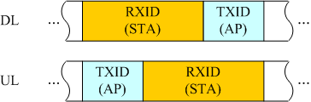
Wake Up Packet
Wake up packet should contain the following contents:
  Must to have
    Rx ID and Tx ID to uniquely identify the receiver
  Best to have
    1 bit indication of DL/UL to support imbalanced length of Tx/Rx ID
      AP and non-AP STA may have different length of Identifier
    Wake up auxillary information to support various operations after or during wake-up, such as
      the predefined information which should be fedback after wake up
      Target main module primary channel info to avoid scanning, for paging packet

Slide 6
Wake up auxiliary information
The predefined information can be used to
  Indicate the receiver to feedback certain information, such as
    Measurement of temperature, humidity, density of gas, speed of wind,… in sensor use cases
    Location information
    Power level/ battery remaining lifetime
  Indicate the receiver to do some predetermined type of operation, then feedback the status
    For remote control, smart home, smart industry, smart traffic, smart agriculture
  Indicate the receiver to access the network
The predefined information could be application dependent

Slide 7
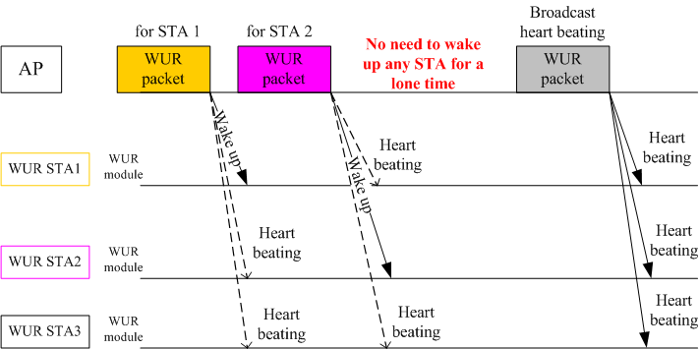
Heart Beating packet
Heart beating packet should at least contain:
  RxID and TxID (AP)
Ordinary wake up packets can be seen as heart beating packet for the third party receiver

Slide 8
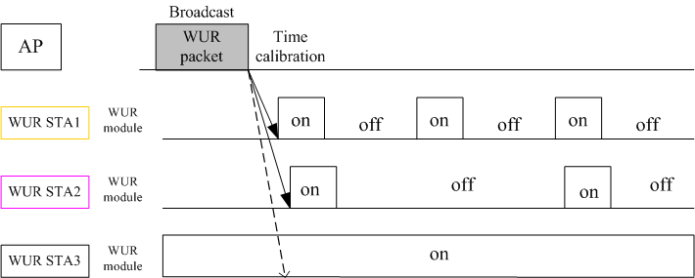
Packet for timing alignment
Packet for timing alignment contains:
  RxID: Broadcast ID
  TxID: AP
  Timing info
Mainly for on/off mode WUR, also helps always-on WUR to adjust time

Slide 9
Conclusion
Discussed what kind of packets should be supported on WUR channel
  WUR packet to wake up receiver
  WUR packet to keep WUR link connection alive
  WUR packet to keep time alignment
Provided considerations on the content of these packets for further WUR message design.

Slide 10
References
[1] 11-16-1045-06-0wur-a-par-proposal-wur-sg

