Slide 1
Channel Measurement Summary of the Rooftop to Street and Entrance Hall Scenario for 11ay
2016-11-08
Authors:
Name | Affiliation | Address | Phone | Email
Jian Luo, Yan Xin, George Calcev Kun Zeng | HUAWEI Technologies |  |  | Jianluo@Huawei.com Yan.xin@Huawei.com George.Calcev@huawei.com
Robert Müller, Diego Dupleich, Stephan Häfner, Reiner Thomä | Technische Universität Ilmenau |  |  | Mueller.Robert@tu-Ilmenau.de Reiner.thomae@tu-ilmrnau.de

Slide 2
Abstract
In this presentation, we summarize our measurements and the corresponding parameters which can be used for channel modelling and system tests. We show measurement results at 60GHz for the cases of an entrance hall and the outdoor rooftop to street level.
The goal of this campaign on measurement and analysis is to provide practical parameters for both indoor and outdoor scenarios in the 802.11ay channel model.
Furthermore, initial results for the fronthauling scenario are presented.

Slide 3
Outline
Motivation
60 GHz Outdoor Measurement Setup
60 GHz Outdoor Measurement Results and Parameters
60 GHz Large Indoor Measurement Setup
60 GHz Large Indoor Measurement Results and Parameters
Previews Fronthauling Results at 60 GHz
Conclusion

Slide 4
Motivation
Broadband and full polarimetric characterization of Cluster
  To understand the broadband and polarimetric scattering of different structures
Advanced system concepts → define measurement and modelling requirements
  Massive MIMO/pencil beamforming → large spatial bandwidth
  Adaptive or switched selection beamforming to mitigate shadowing
  Channel bonding → large bandwidth
Propagation channel
  Double directional measurements are needed to characterize the full channel
  Polarization is an important aspect
  High dynamic range is essential to measure the different propagation effects
Channel characterization for different usage cases

Slide 5
Outdoor Measurements at 60 GHz:
User Access Scenario
Measurement Setup

Slide 6
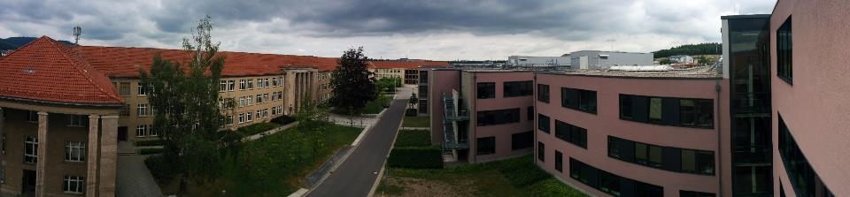
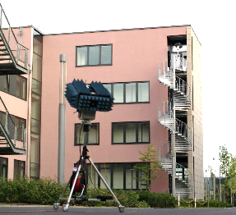
Outdoor Measurements
Measurement Setup
Dual-band measurements: 30 and 60 GHz
30°HPBW at Tx and Rx → Az: -150°:30°:180°
El: -30° :30°:30°
User Access Scenario
Tx located at a rooftop level (14m)
Rx located at person level (1.5m)
LOS and NLOS
Measurement Parameters
7 GHz bandwidth
Dual polarization measurement capability
25 dB AGC (Automatic Gain Control) with 3.5 dB steps
High instantaneous dynamic range: up to 75 dB
Multi-Link and Massive MIMO capabilities
Double directional measurements
23 dBm output power per polarization
Minimum cross polarization decoupling of 25 dB
Minimum receive power level approx. -105 dBm

Slide 7
Outdoor Measurements at 60 GHz:
User Access Scenario
Measurement Results

Slide 8
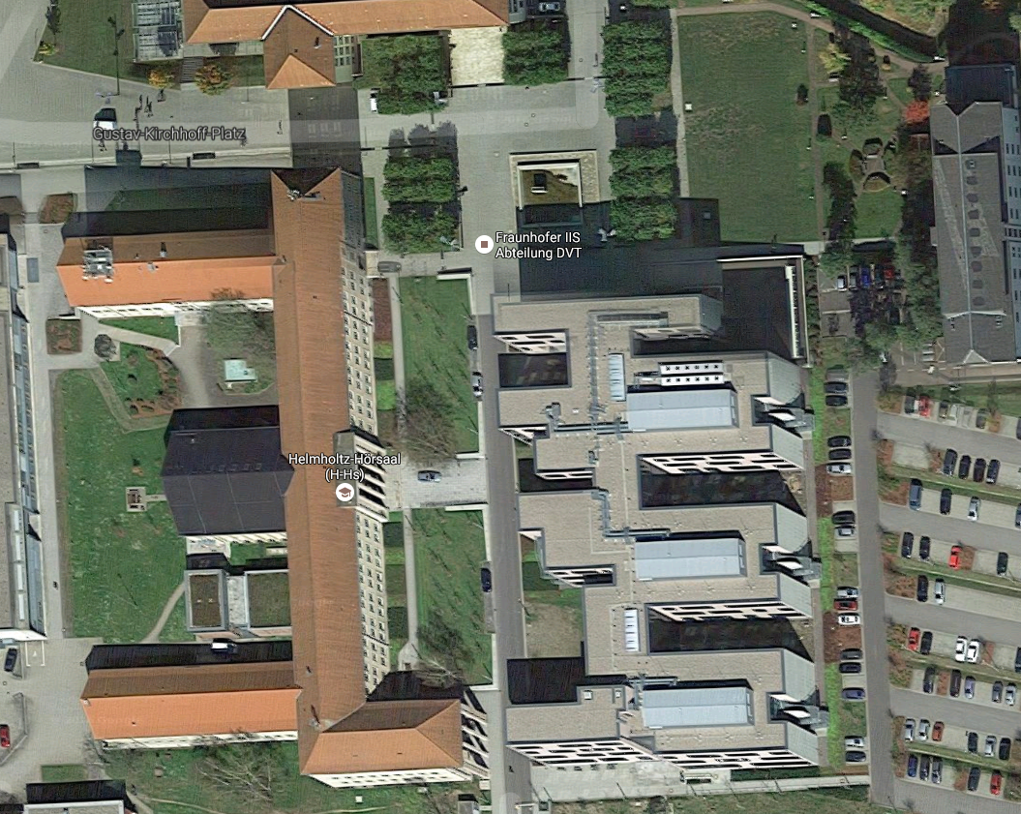
User access scenario at 60 GHz
0°
Synthetic omni-directional Received Power
Rx9
90°
Rx8
33 dB difference between best and worst case
Rx6
Rx7
Rx3
Rx1
Received power after Beam-Forming
Tx
Beam forming was done here with the best combination of the directional antennas at Tx and Rx and the beamwidth of 30° HBPW

Slide 9
Outdoor Measurements
0°
Synthetic omni-PDP
90°
Rx9
Rx1
Rx8
20 dB Threshold
Rx6
Rx7
Rx3
Rx1
Wrap around
Rx3
Tx
20 dB Threshold
With AGC and the high dynamic range system the unambiguous range of the system are to small with 600ns

Slide 10
Outdoor Measurements
0°
Synthetic omni-PDP
90°
Rx9
Rx8
Rx6
Rx7
Rx3
Rx6
Rx1
Rx7
Tx
The 60 GHz broadband NLOS links also work very well by satisfying the ISM regulation over a distance of approximately 100 m

Slide 11
Outdoor Measurements
0°
Synthetic omni-PDP
90°
Rx8
Rx9
Rx8
Rx6
Rx7
Rx3
Rx1
Rx9
Tx
After removing of the noise floor the SNR in the NLOS is better than 20 dB

Slide 12
Outdoor Measurements
0°
Bi-Azimuth Profile
90°
Rx1
Double reflection
Rx3
Rx1
Rx3
Tx
Double reflection
Open question are the Indoor to Outdoor propagation for different glasses and scenarios

Slide 13
Outdoor Measurements
0°
Double reflection
90°
Bi-Azimuth Profile
Rx9
Rx6
Rx8
Rx6
Rx7
Rx3
Rx1
Rx7
Tx

Slide 14
Outdoor Measurements
Reflection in this building
Bi-Azimuth Profile
Rx8
0°
90°
Rx9
Rx8
Rx9
Tx

Slide 15
Outdoor Measurements
0°
Marginal Power Angular Profiles at RX1
90°
Rx9
Rx8
Rx6
Rx7
Rx3
Rx1
Tx
30°3dB HPBW of the antenna is in this scenario a good choice

Slide 16
Outdoor Measurements
0°
Marginal Power Angular Profiles Rx6
90°
Rx9
Rx8
Rx6
Rx7
Rx3
Rx1
Tx

Slide 17
Outdoor Measurements
0°
Marginal Power Angular Profiles Rx9
90°
Rx9
Rx8
Rx6
Rx7
Rx3
Rx1
Tx

Slide 18
Outdoor Measurements at 60 GHz:
User Access Scenario
Parameters

Slide 19
Outdoor Measurements
List of parameters
Position | DS* [ns] | ED* [ns] | AS at Tx [°] | Es at Tx [°] | As at Rx [°] | Es at Rx [°] | Received Power [dB] | Visibility Condition
Rx1 | 20.31 | 278.57 | 20.94 | 15.76 | 45.15 | 19.28 | -120.26 | LOS
Rx3 | 20.67 | 115.95 | 18.40 | 15.75 | 41.49 | 18.24 | -123.23 | LOS
Rx6 | 86.14 | 594.11 | 20.81 | 12.59 | 50.22 | 13.98 | -147.56 | NLOS
Rx7 | 50.43 | 395.92 | 20.62 | 15.30 | 42.02 | 14.98 | -152.45 | NLOS
Rx8 | 41.03 | 584.87 | 43.92 | 17.06 | 38.38 | 12.69 | -150.65 | NLOS
Rx9 | 56.37 | 317.84 | 20.83 | 17.30 | 77.31 | 17.90 | -128.84 | LOS
* Considering 20 dB dynamic range

Slide 20
Conclusions
Multiple reflections identified
NLOS scenario still possible due to reflections
Beam former in the NLOS sometimes not better than an omni antenna characteristic
  That is an effect of the 30° 3dB HPBW of the measurement antennas. The gain in one direction don’t compensate the multipath components of the environment
  But the multipath components induce a higher fading in the channel

Slide 21
Large Indoor Measurements at 60 GHz:
Entrance Hall Scenario
Measurement Setup

Slide 22
Indoor Measurements
User access scenario at 60 GHz
Tx located at ground and first floor as access point
Rx located at person level
LOS. OLOS. and NLOS
30°HPBW at Tx and Rx
  Az: -150°:30°:180°
  El: -30°:30°:30°
Tx at ground floor
Tx at
first
floor
 | Visivility
Rx | Tx1 | Tx2
Rx1 | LOS | LOS
Rx2 | LOS | LOS
Rx3 | OLOS | OLOS
Rx4 | OLOS | NLOS
Rx5 | - | NLOS
Rx6 | LOS | NLOS
Rx7 | - | -
Rx8 | - | NLOS
Rx9 | LOS | NLOS

Slide 23
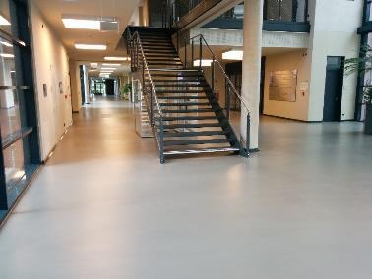
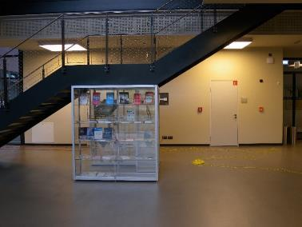
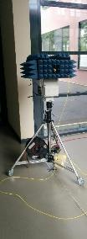
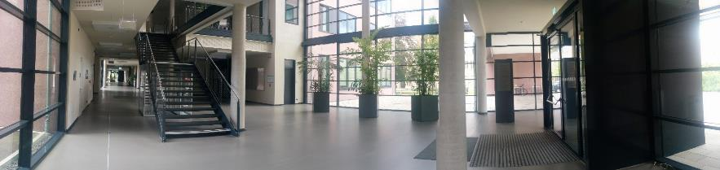
Indoor Measurements
Tx1
Rx9
Rx4
Rx3
Rx2
Rx1
Tx2
Tx1

Slide 24
Large Indoor Measurements at 60 GHz:
Entrance Hall
Measurement Results

Slide 25
Indoor Measurements
Entrance Hall Scenario at 60 GHz
Synthetic omni-directional Received Power
Received power after beam-forming
20 dB difference between best and worst case
Large difference compared to omni-directional case due to the filtering of scatterers

Slide 26
Indoor Measurements
Synthetic omni-PDP
Tx1
Tx1 - Rx1
Rx9
Rx3
Rx2
Rx1
Tx2 – Rx9
Tx1 – Rx4

Slide 27
Indoor Measurements
Bi-Azimuth Profile
Tx1 - Rx1 (LOS)
Tx1 – Rx4 (OLOS)
Tx1
Reflection on the window
Rx9
Rx3
Double reflection: first floor wall and entrance door reflection
Rx2
Rx1
LOS
Tx2 – Rx9 (NLOS)
Relative power of scatterers is more uniformly distributed due to the OLOS
Entrance door reflection

Slide 28
Indoor Measurements
Marginal Power Angular Profiles
Tx1 – Rx1
Tx1
Rx9
Rx9
Rx3
Rx3
Rx2
Rx1
The metallic structures from the windows and doors contribute a lot of power in this scenario
Double and triple bounce reflections contribute in the LOS and in NLOS a lot of power, which is important for robust system design
  Multi-Bounce must be considered in the channel model
  We measure more than triple bounce reflections with an high signal level
  We prefer to include minimum triple bounce refection in the channel model

Slide 29
Indoor Measurements
Marginal Power Angular Profiles
Tx2 – Rx9
Tx1
Rx9
Rx9
Rx3
Rx3
Rx2
Rx2
Rx1
Rx1

Slide 30
Indoor Measurements
List of parameters
Position | DS* [ns] | ED* [ns] | AS at Tx [°] | Es at Tx [°] | As at Rx [°] | Es at Rx [°] | Received Power [dB]
Tx1
Rx1 | 11.98 | 60.94 | 37.11 | 15.71 | 54.96 | 16.92 | -132.72
Rx2 | 20.38 | 282.70 | 35.47 | 14.84 | 56.61 | 16.40 | -132.88
Rx3 | 25.19 | 282.70 | 40.52 | 15.86 | 63.01 | 21.37 | -1344.96
Rx4 | 31.40 | 134.55 | 55.09 | 18.71 | 84.43 | 20.66 | -136.98
Rx6 | 12.45 | 283.17 | 22.40 | 16.49 | 47.38 | 17.95 | -129.50
Rx9 | 2.46 | 13.59 | 23.58 | 19.69 | 27.02 | 18.20 | -132.96
Tx2
Rx1 | 19.79 | 94.23 | 42.32 | 22.49 | 76.15 | 24.22 | -138.73
Rx2 | 20.45 | 87.67 | 43.73 | 20.93 | 70.34 | 25.47 | -137.25
Rx3 | 28.37 | 126.58 | 45.03 | 22.09 | 79.68 | 21.62 | -138.83
Rx4 | 32.31 | 143.46 | 40.75 | 20.62 | 76.47 | 19.43 | -141.20
Rx5 | 38.19 | 157.05 | 51.31 | 19.98 | 64.79 | 20.91 | -145.35
Rx6 | 33.90 | 167.37 | 43.63 | 18.12 | 50.05 | 18.70 | -145.72
Rx8 | 25.54 | 138.77 | 56.29 | 18.96 | 33.94 | 18.70 | -148.72
Rx9 | 25.54 | 124.24 | 49.44 | 20.34 | 45.13 | 19.24 | -149.75
* Considering 20 dB dynamic range

Slide 31
Conclusions
Multiple scatterers are identified
The NLOS scenario is still possible to set up transmission links due to reflections for different Tx locations
Relative power of the scatters depends on the visibility condition (Light-reflecting scatters also reflect better mmWaves) such as LOS and NLOS.

Slide 32
Outdoor Measurements at 60 GHz:
Fronthauling Scenario
Measurement Setup

Slide 33
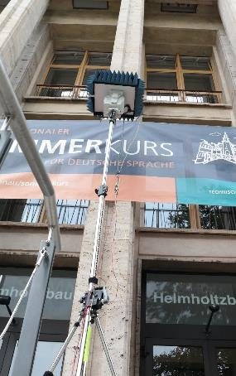
Outdoor Measurements
Measurement set-up
Dual-band measurements: 30 and 60 GHz
30°HPBW at Tx and Rx → Az: -150°:30°:180°
El: -30° :30°:30°
User Access Scenario
Tx located at a rooftop level (14m)
Rx located at low level accses point (4m)
LOS and NLOS
Measurement Parameters
Max. 7 GHz bandwidth
Dual polarization measurement capability
25 dB AGC (Automatic Gain Control) with 3.5 dB steps
High instantaneous dynamic range: up to 75 dB
Multi-Link and Massive MIMO capabilities
Double directional measurements

Slide 34
Outdoor Measurements
0°
Front-hauling scenario
Synthetic Omni-directional Received Power
90°
Position | GPS Data (lat, long) | Distance to Tx | Visibility Condition
Rx1 | (50.6815, 10.9396) | 23m | OLOS
Rx2 | (50.6818, 10.9395) | 52m | LOS
Rx3 | (50.6823, 10.9394) | 110m | OLOS by vegetation
Rx4 | (50.6822, 10.9398) | 89m | NLOS
Rx5 | (50.6822, 10.9400) | 89m | NLOS
Tx | (50.6814, 10.9399)
Rx3
Rx4
Rx5
Rx2
Rx1
Tx
Max – Min: approx. 27.5 dB difference

Slide 35
Outdoor Measurements
0°
Front-hauling scenario
Normalized power of the beam carrying the strongest path
90°
Position | GPS Data (lat, long) | Distance to Tx | Visibility Condition
Rx1 | (50.6815, 10.9396) | 23m | OLOS
Rx2 | (50.6818, 10.9395) | 52m | LOS
Rx3 | (50.6823, 10.9394) | 110m | OLOS by vegetation
Rx4 | (50.6822, 10.9398) | 89m | NLOS
Rx5 | (50.6822, 10.9400) | 89m | NLOS
Tx | (50.6814, 10.9399)
Rx4
Rx3
Rx5
Rx2
Rx1
Tx
Max – Min: approx. 31 dB difference

Slide 36
Outdoor Measurements
0°
Synthetic omni-PDP
90°
Rx1
Rx4
Rx3
Rx5
Rx2
Rx2
Rx1
Tx

Slide 37
Outdoor Measurements
0°
0°
Synthetic omni-PDP
90°
90°
Rx3
Rx4
Rx3
Rx5
Rx2
Rx4
Rx1
Tx

Slide 38
Outdoor Measurements
Rx1
Marginal Power Angular Profiles
0°
90°
Rx4
Main path comes from reflection on the building
Rx3
Rx5
Rx2
Rx1
Tx

Slide 39
Outdoor Measurements
Rx2
Marginal Power Angular Profiles
0°
90°
Rx4
Rx3
Rx5
Rx2
LOS
Rx1
Tx
Back reflection

Slide 40
Outdoor Measurements
Rx3
Marginal Power Angular Profiles
0°
90°
Rx4
Rx3
Rx5
Rx2
LOS
Rx1
Tx
Back reflection

Slide 41
Outdoor Measurements
Rx4
Marginal Power Angular Profiles
0°
90°
Rx4
Rx3
Rx5
Rx2
Rx1
Tx

Slide 42
Outdoor Measurements
Rx5
Marginal Power Angular Profiles
0°
90°
Rx4
Rx3
Rx5
Rx2
Rx1
Tx

Slide 43
Outdoor Measurements
Reflection on the Zusebau
Bi-azimuthal Power Spectrum
Rx1
0°
Reflection on the Helmholtzbau
LOS
90°
Rx4
Rx2
Rx3
Rx5
LOS
Rx2
Reflection on the Helmholtzbau
Rx3
Rx1
Tx
LOS

Slide 44
Outdoor Measurements
Rx4
Bi-azimuthal Power Spectrum
Reflection on the Kirschhoff-bau
0°
90°
Rx4
Rx3
Rx5
Rx5
Rx2
Double reflection on the Kirchhoff-bau and Zusebau
Double reflection on the Kirchhoff-bau and Zusebau
Rx1
Tx
Reflection on the Kirchhoff-bau

Slide 45
Conclusions
Up to 27.5 dB difference between LOS and NLOS scenarios (omni-directional case)
Up to 31 dB using single beam beamforming
One access point can serve multiple front-hauling devices with a considerable link budget
Many reflections → Reflections are suitable as main links (Rx1 situation)
Next Steps
  Parameter generation of outdoor fronthauling measurements at 60 GHz for the 11ay channel model
  Polarization results for outdoor measurements
  Clustering Analysis

