Slide 1
WUR Usage Model
Nov 2016
Date: 2016-11-07
Authors:
Ross Jian Yu, etc., Huawei Technologies

Slide 2
Background
Nov 2016
In the PAR proposal for wake-up radio[1], several key points have been proposed:
In scenarios where low latency is a requirement, the WUR should decrease overall power consumption of the STA without significant increase in impact to the latency (relative to the current maximum latency of the nominal duration of one beacon interval, 102.4 ms) in transferring user data packets.
In order to enable a wider set of use cases, both AP and non-AP types of STAs can be equipped with a WUR that can receive wake-up messages.
Based on the above key points, this presentation provides a number of usage models to help guide standardization effort.
Ross Jian Yu, etc., Huawei Technologies

Slide 3
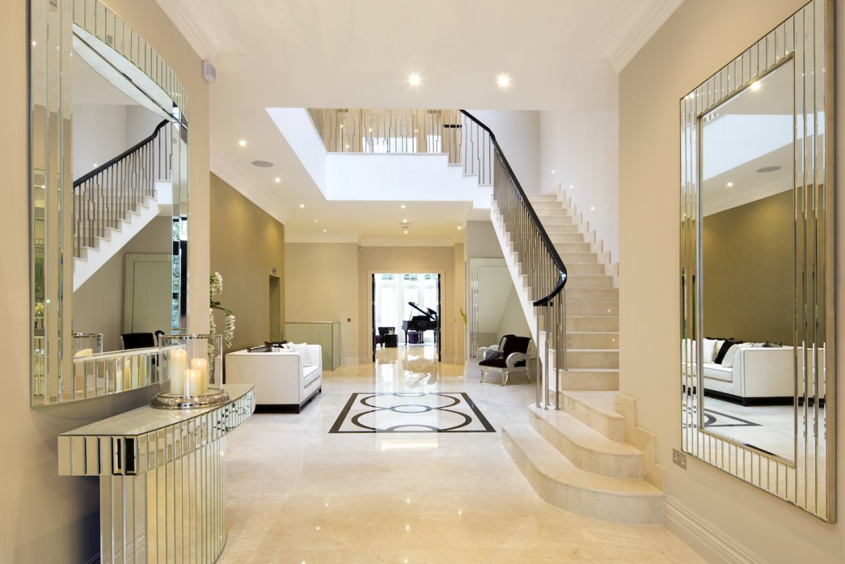
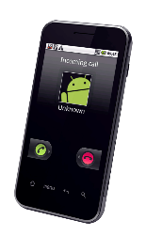
Usage Model 1: Smart Home
Environment: In a house/apartment, an AP and several devices are arranged naturally from the perspective of the house/apartment occupant. Some STAs (e.g., home appliances) don’t need to consider the power assumption whilst some STAs (e.g., smart-curtain, smart-door) are equipped with coin batteries which expect to last for several years. Besides, a few sensors are used to collect the information of the house. Normal 802.11 traffic data exists in the network, e.g., The server transmits video to the TV through the AP. The TV transmits video to the mobile phone.
Light sensor

Slide 4
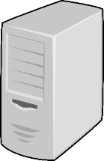
Usage Model 1: Smart Home
Sub-model 1: the sensor transmits the light condition to the server through the AP, which determines whether the curtain needs to be open or closed. Then the server tells the curtain the open/close command through the AP. The AP transmits a Wake-up Packet (WUP) to the WUR of the smart curtain. After the Main Radio (MR) is awake, the AP transmits a message to let the smart-curtain open/close the curtains.
Light condition
Message
Light condition
WUP to WUR, then message to MR
Sub-model 1

Slide 5
Usage Model 1: Smart Home
Sub-model 2: the owner of the house uses his mobile phone to tell the smart curtain that he wants to open/close the curtain through the AP. The AP transmits a WUP to the WUR of the smart curtain. After the MR is awake, the AP transmits a message to let the smart-curtain open/close the curtains.
Requirement:
The WUP transmission should enable coexistence with legacy IEEE 802.11 devices operating in the same band.
The AP should consider the case where some STAs are equipped with WURs whilst some STAs are not.
Message
WUP to WUR, then message to MR
Sub-model 2

Slide 6
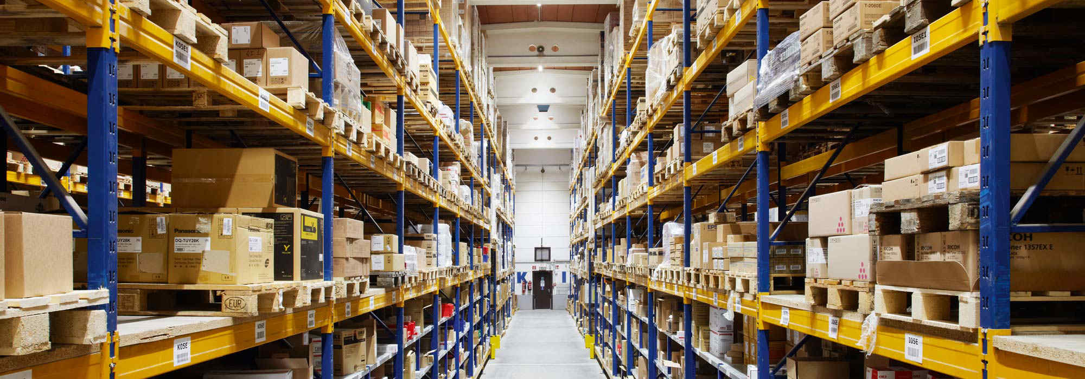
Usage Model 2: Warehouse
Environment: In a warehouse, there exists one AP. In each container/box or on each shelf, there are one or several sensors equipped with coin battery. The server will frequently collect the temperature/humidity/location from the sensors through the AP. Besides, the workers are equipped with mobile phones, and may also try to collect those information with their mobile phones through the AP. Normal 802.11 traffic data exists in the network, e.g., The server collects surveillance video from the cameras and transmit the video to the computer through the AP.

Slide 7
Usage Model 2: Warehouse
Sub-model 1: The server wants to request the status of one box through the AP. The AP transmits a WUP to the WUR of the sensor. After the MR is awake, the AP transmits a status query command to let the sensor feedback the status.
Sub-model 2: the worker of the warehouse uses his mobile phone to request the status of one box through the AP. The AP transmits a WUP to the WUR of the sensor. After the MR is awake, the AP transmits a status query command to let the sensor feedback the status. Then the AP transmits the status to the mobile phone.
Status query command
Status query
Status feedback
WUP to WUR, then status query command to MR
status feedback
WUP to WUR, then status query command to MR
status feedback
Status feedback
Box with sensor
Box with sensor
Sub-model 1
Sub-model 2

Slide 8
Usage Model 2: Warehouse
Requirement:
The WUP transmission should enable coexistence with legacy IEEE 802.11 devices operating in the same band.
The system should consider the case where large number of STAs equipped with WURs exist.

Slide 9
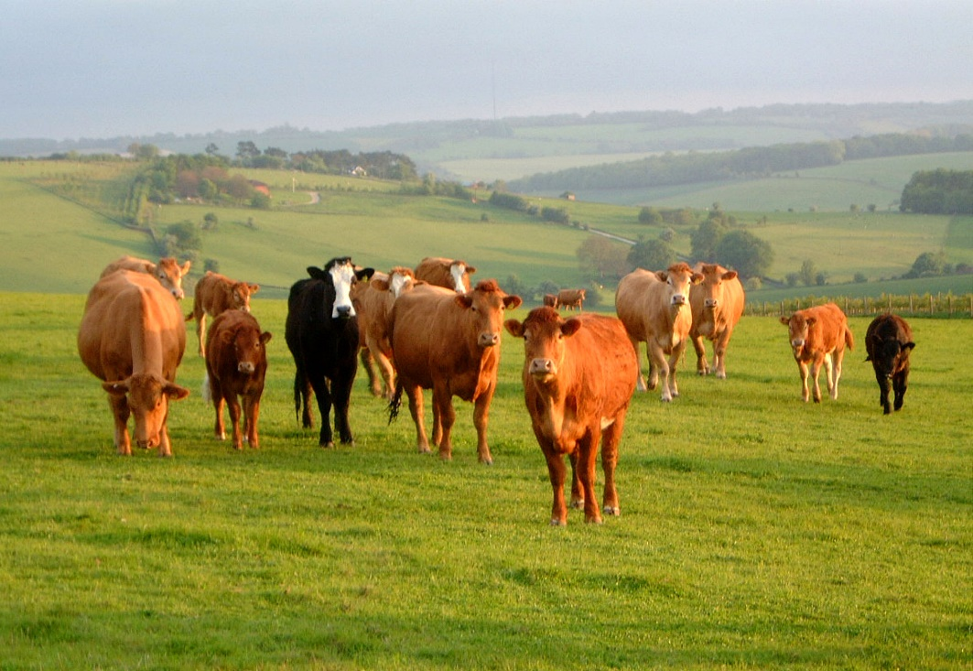
Usage Model 3: Outdoor Cattle Farms
Environment: In an outdoor cattle farms, a cattle farmer uses his mobile phone as an mobile AP. Every cow is equipped with a sensor. The cattle farmer can use his mobile phone to frequently collect the temperature/location of each cow. The sensors may also transmit some emergency report to the mobile AP.

Slide 10
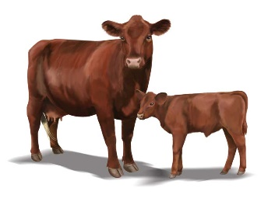
Usage Model 3: Outdoor Cattle Farms
Sub-model 1: the mobile AP transmits a WUP to the WUR of the sensors. After the MR is awake, the AP transmits a status query common to let the sensors feedback the status.
Sub-model 2: when some emergency/critical event happens, the sensors will transmit a WUP to the mobile AP, when the MR of the mobile AP is awake, the sensors will send the emergency/critical event to the mobile AP.
WUP to WUR, then status query command to MR
WUP to WUR, then emergency report to MR
status feedback
Cattle with sensor
Cattle with sensor
Sub-model 1
Sub-model 2

Slide 11
Usage Model 3: Outdoor Cattle Farms
Requirement:
The WUP transmission should enable coexistence with legacy IEEE 802.11 devices operating in the same band.
The supported range of the wake-up signal will be no less than the supported range of the primary IEEE 802.11 signal of at least 20MHz payload bandwidth.
Delay should be a critical factor in case of emergency report.

Slide 12
Usage Model 4 : Wearable Devices
Scenario: Re-connection
Smart watch was paired/connected with smart phone (group owner).
User took smart watch outside, and then smart watch and smart phone was disconnected.
User took smart watch back, and would like to read the data saved in smart watch via smart phone.
Requirement:
Smart watch keeps WUR ON, waiting for re-connecting with smart phone.
Smart phone
Smart phone
Smart phone
WUP to WUR, then message to MR
disconnected
WUR signal to WUR, then re-connect
Smart watch, equipped with WUR
WUR ON
WUR ON
User took smart watch outside
User took smart watch back

Slide 13
Summary and the Next Step
We present several usage models to derive from some key points of the PAR.
More details will be added to the usage models.

Slide 14
Reference
11-16-1045-05-0wur-a-par-proposal-wur-sg
11-16-0974-00-0wur-wur-usage-scenarios-and-applications
Note that the figures are searched from google or from [2]

