Slide 1
Further Details on Multi-Stage, Multi-Resolution Beamforming Training in 802.11ay
Date: 2016-11-07
Authors:

Slide 2
Introduction
In 802.11ay, enhancements to the 802.11ad beamforming training procedures have been agreed on for complexity reduction, efficiency and to enable MIMO BF training [1][2][3][4].
In [6], we proposed a multi-stage, multi-resolution beamforming training (MR BFT) framework to further increase the BF training efficiency in scenarios with high resolution beams.
In this contribution, we study the implementation of MR BFT by using the 802.11ad Beam Refinement Protocol (BRP) and propose improvements to the BRP procedure to enable efficient MR BRP.

Slide 3
Multi-Stage, Multi-Resolution BFT
802.11ay has agreed to support up to 2048 sectors with the proposal of a new short Sector Sweep (SSW) frame to allow for the use of massive arrays [4].
To further increase the efficiency of the beamforming training procedure with high resolution beamforming, we propose that 802.11ay support the use of a multi-stage, multi-resolution beamforming framework [5].
  In this framework, beams of increasing angular resolution can be used at different stages of the sector sweep, beam refinement or tracking procedure.

Slide 4
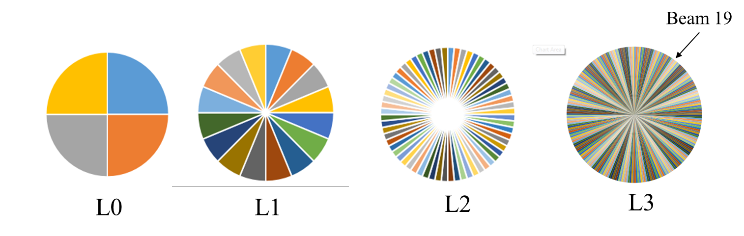
Multi-Stage, Multi-Resolution BFT
L0: Sector Level Sweep: Identify Sector of angular spread 90 degrees
L1: BFT Level 1:
  4 beams per sector with angular spread 22.5 degrees
L2: BFT Level 2:
  4 beams per beam Level 1 or 16 beams per sector with angular spread 5.625 degrees
L3: BFT Level 3/ Non-hierarchical BRP:
  4 beams per beam Level 2 or 64 beams per sector with angular spread 1.046 degrees.

Slide 5
Example
Beam = Sector 1, beam 19
Single Resolution beam sweep : 64 beam sweeps and 1 feedback frame
Beam = Sector 1, L1:beam 2, L2:beam 1, L3:beam 3
Multi-stage, Multi-resolution beam sweep: 12 beam sweeps and 3 feedback frames

Slide 6
Advantages of MR BFT
The overhead due to training can be reduced.
  This is important especially in massive, multiple antenna scenarios where multiple transmit-receive pairs are needed.
  The procedure can also be combined with beam down-selection.
It allows for the interruption of the BFT procedure at anytime
  This allows flexibility in case of a BI boundary, allocation boundary etc.
  It also ensures that a connection between the transmitter-receiver pair can be made without the need to sweep through all the beams.
The initiator or responder can request training at a particular resolution level and dynamically trade-off BFT efficiency and beam accuracy.
A node can request for BFT with a resolution fallback in case of a change in the channel which is advantageous for beam tracking

Slide 7
Implementation of MR BFT using 802.11ad BRP
Multi-resolution (three levels)
Single-resolution (one level)
3 TX-training frames with 4 sectors each
3 feedback frames
No TRN-R
Longer TRN-T
1 TX-training with 64 sectors
1 feedback frame

Slide 8
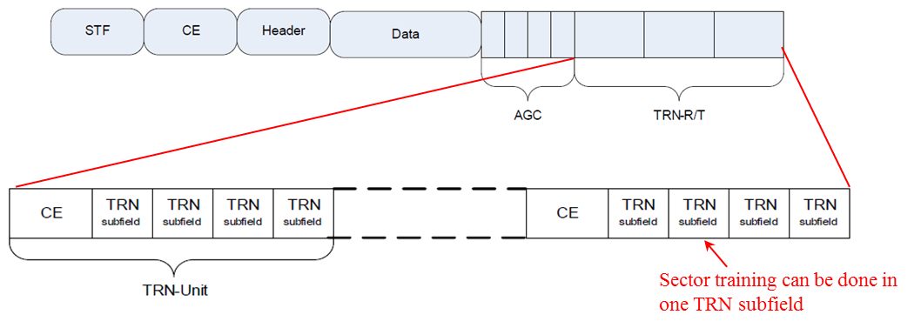
Implementation using 802.11ad BRP (ctd)
PPDU Format

Slide 9
TxOP Comparison Assumptions
Tc=0.57 ns
MAC data=42 Bytes (assumes no channel measurement feedback)
  Using any MCS would lead to a codeword less than the minimum block requirement
  Zero padding to aBRPminSCblocks=18 (this affects BRP_training frame size)
AGC and TRN-T
  Training length N:1<= N<= 32 (N~5 bits)
  AGC=4N*64*5=1280N
  TRN-T=(CE+TRN_subfield*4)*N=(1024+128+128*5*4)*N=3712N
IFS (Interframe spacing)
  At least a SIFS interval and at most a BRPIFS interval to ensure sufficient time for the complete transmission of frames
  SIFS=3 us; BRPIFS=44 us
Analysis will compare SR BRP with MR BFT
  Vary number of beams and MR levels: 16 beams ( 2 level), 64 beams (3 level), 256 beams (4 level)
    Note: 802.11ad BRP packet supports up to 32*4=128 beams. However, we assume 256 beams can be trained within one packet here. Otherwise, two separate BRP training packets are needed for SR’
  Study effect of IFS (3 usec <= IFS <= 44 usec) and BRP_training size (1 <= SCBlock <= 18)
  Assume BRP feedback frame size will stay the same

Slide 10
TxOP Comparison
Multi-resolution beamforming training
  TXOP_SIFS=# of levels*(BRP_training+SIFS+BRP_feedback+SIFS)-SIFS
  TXOP_BRPIFS=# of levels*(BRP_training+BRPIFS+BRP_feedback+BRPIFS)-BRPIFS
Single-resolution beamforming training
  TXOP_SIFS=BRP_training+SIFS+BRP_feedback
  TXOP_BRPIFS=BRP_training+BRPIFS+BRP_feedback
Observations
  Multi-resolution beamforming training has a shorter training packet but a larger number of training and feedback packets
  IFS, BRP_training and BRP feedback have impact on the time duration

Slide 11
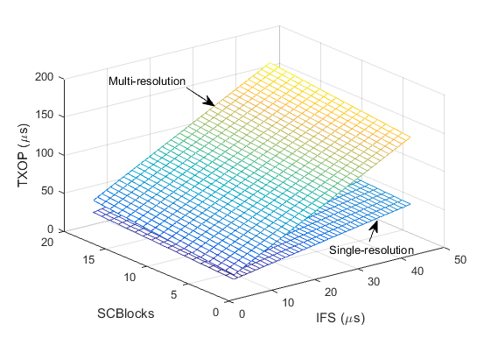
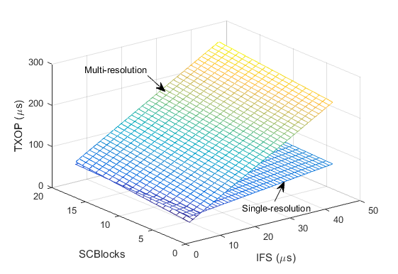
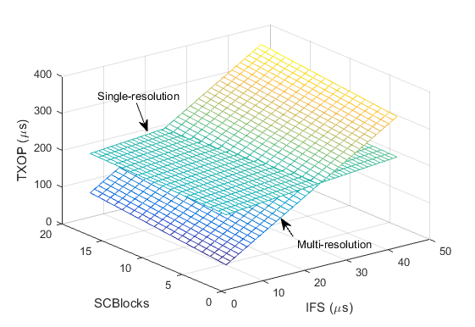
Results
2-Level Results: 16 beams
3-Level Results: 64 beams
MR BFT with existing BRP parameters
Parameters
BRP_training size: 1 <= SCBlocks <=18
IFS duration: SIFS (3) <= IFS<=BRPIFS (44)
Observation
As resolution increases, MR BFT shows improved performance over SR BFT if BRP_training size and IFS are modified
4-Level Results: 256 beams

Slide 12
Results Summary
Observations
Observation 1 (O1): Optimizing both IFS and BRP training frame size show improvements for both SR and MR BFT.
  SR drops from 241 usec to 215 usec
  MR drops from 381 usec to 213 usec
Observation 2 (O2): MR BFT shows improved performance over SR BFT as the beam resolution increases
  Note that up to 2048 beams may be supported
O1
O2

Slide 13
Desired Updates to 802.11ad BRP
Implementation of multi-resolution BF training using existing BRP protocol:
  Not very efficient due to aBRPminSCblocks and IFS
    Could be improved by reducing aBRPminSCblocks
      This implies the introduction of a short BRP frame design
    Could be improved by allowing for a smaller maximum BRPIFS
      This may be possible due to improved hardware compared to 802.11ad
      To allow for backwards compatibility, the maximum BRPIFS may be signaled.
  Need for standardized method of identifying resolutions/groups for tracking
    The resolution/group may be signaled during the BRP procedure or during feedback.

Slide 14
Conclusion
Multi-stage Multi-resolution BFT offers improvements in BF training efficiency and beam tracking for high resolution beams.
Although the existing 802.11ad BRP procedure may support MR BFT, the following elements should be optimized to improve the efficiency of the refinement
  The BRP training frame size
  The IFS allowed during the procedure
  Signaling to enable standardized way to identify the groups

Slide 15
Straw Poll 1
Do you agree to add the following text into the 802.11ay SFD?
  11ay should update the 802.11ad BRP procedure to improve the efficiency of Beam Refinement

Slide 16
Straw Poll 2
Do you agree to add the following text into the 802.11ay SFD?
  11ay should design a short BRP packet to improve the efficiency of the BRP i.e. aBRPminSCblocks <=18

Slide 17
Straw Poll 3
Do you agree to add the following text into the 802.11ay SFD?
  11ay should allow the modification and signaling of BRPIFS for 802.11ay Beam Refinement to improve the efficiency of the beam refinement

Slide 18
Straw Poll 4
Do you agree to add the following text into the 802.11ay SFD?
  11ay should allow for grouping and signaling of a set of beams of a desired resolution. The specific signaling is TBD.

Slide 19
References
IEEE 802.11-16/0100r3, MIMO BF Training Enhancements, Wang et. al., Jan 2016
IEEE 802.11-16/0316r0, Low Complexity Beamtraining for Hybrid MIMO, Fellhauer et. al., March 2016
IEEE 802.11-16/0420r1, BF Training for SU MIMO, Huang et. al., March 2016
IEEE 802.11-15/1358r5, Specification Framework for TGay, Cordeiro, August 2016
Noh, Song, Michael D. Zoltowski, and David J. Love. "Multi-Resolution Codebook Based Beamforming Sequence Design in Millimeter-Wave Systems." 2015 IEEE Global Communications Conference (GLOBECOM). IEEE, 2015.
IEEE 802.11-16/1175r0, Multi-Stage, Multi-Resolution Beamforming Training for 802.11ay, September 2016

