Slide 1
Closed Loop SU-MIMO Performance with Quantized Feedback
Date: 2016-11-07
Authors:

Slide 2
Introduction
TGay has agreed that 11ay will support Single User Multiple Input Multiple Output (SU-MIMO) transmission [1]
However, the agreement is based on Open Loop SU-MIMO (OL SU MIMO) only
The 11ay specification shall support SU-MIMO with predetermined and/or no precoding matrices [1]
The 11ay specification shall define SU-MIMO transmission with and without phase hopping of EDMG-PPDU for EDMG OFDM PHY. An EDMG STA may support transmission and reception of SU-MIMO with phase hopping
With/without precoding is TBD; Period of phase hopping is TBD
In [2] and [6], we have shown the performance gains of Closed Loo SU-MIMO (CL SU-MIMO) with ideal feedback over OL SU-MIMO
In this contribution, we show the BER performance of CL SU-MIMO with quantized feedback over OL SU-MIMO.
The quantized feedback is based on the 802.11ad BRP feedback framework,

Slide 3
Baseband Precoding Methods
Open loop:
Use the first N_{ss} columns of an orthogonal matrix as a precoding matrix across all antennas*
No channel knowledge needed at transmitter
Closed loop with Ideal Feedback:
Use SVD based on the time domain channel matrix of the strongest path
Full Channel State Information (CSI) knowledge at transmitter
Closed loop with Quantized Feedback:
Use SVD based on the time domain channel matrix of the strongest path
Quantized Channel State Information (CSI) knowledge at transmitter
* One PAA with dual polarization is considered as two antennas

Slide 4
Simulation Assumptions
Based on 11ad SC PHY
2 spatial streams with spatial stream parser
Vertical Encoding
MCS index is the same for all streams per PPDU, single CRC per PPDU
MMSE receiver
Enterprise Cubicle (CB) scenario in 11ay/ad channel model
STAs located on the table at a height of 0.7m in the cubicle
AP positioned in the middle below the ceiling at a height of 2.9 m
Real channel estimation at receiver
Detailed assumptions can be found in the appendix

Slide 5
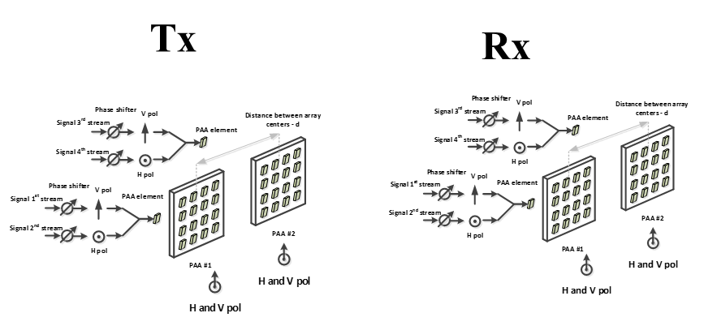
Simulated SU-MIMO Configurations
Beamforming implemented in all configurations
Analog beamforming: Using phase shifter at each antenna to align Tx and Rx beams
Digital beamforming: Spatial streams are precoded (as described in slide “Baseband Precoding Methods”) and distributed to all antennas
We simulate Configuration #4 of the SU-MIMO PAA configurations [3]
4x4 channel, 2 PAAs with dual polarization on each side

Slide 6
Quantized Feedback
Assume Enhanced BRP feedback used to estimate effective channel
BRP feedback based on the effective MIMO channel.
11ad type BRP feedback modified for 11ay MIMO Channel
Each channel tap is reported as an in-phase and quadrature component pair, with each component value represented as a twos complement number between –128 and 127.
Example:

Slide 7
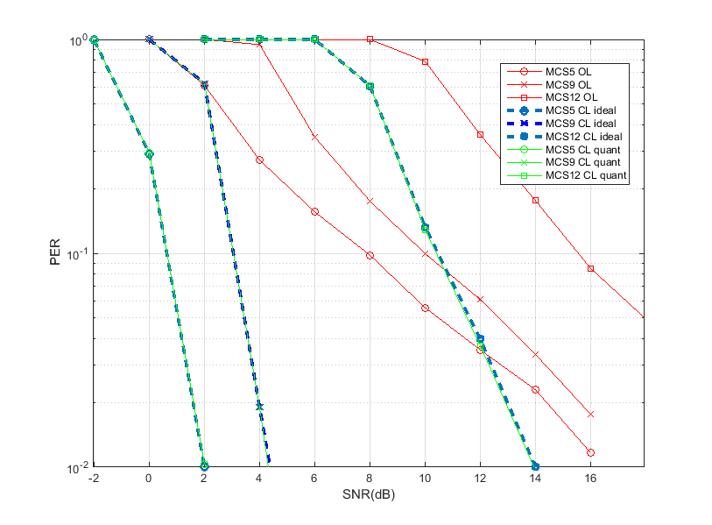
Conf #4, Nss=2
Observations:
CL better than open loop
Loss using quantized (realistic) feedback is minimal due to the 8-bit quantization per complex dimension

Slide 8
Conclusion
The performance of CL SU MIMO is better than OL SU MIMO
CL SU MIMO however requires additional overhead in the form of feedback
A simple extension of 11ad BRP element feedback can support CL SU-MIMO with minimal loss when compared with ideal feedback
Note that further optimization of the feedback may be possible.

Slide 9
References
Carlos Cordeiro, “Specification Framework for TGay”, IEEE 802.11-15/01358r4
Rui Yang, et al, “Open Loop vs Closed Loop SU-MIMO for 11ay”, IEEE doc. 11-15/0642r1
A. Maltsev, et al, “Channel models for ieee 802 11ay”, IEEE doc. 11-15/1150r4
R. Maslennikov, et al, “Implementation of 60 GHz WLAN Channel Model,” IEEE doc. 11-10/0854r3.
Artyom Lomayev, et al, “EDMG STF and CEF Design for SC PHY in 11ay”, IEEE doc. 11-16/0994r1
L. Sun, et al, “Link Level Performance Comparisons of Open Loop, Closed Loop and Antenna Selection for SU-MIMO” 11-16/0911r1

Slide 10
Straw Poll
Do you agree to insert the following in clause 7 of the SFD:
The 11ay specification shall support SU-MIMO with matrices derived from channel feedback

Slide 11
Appendix

Slide 12
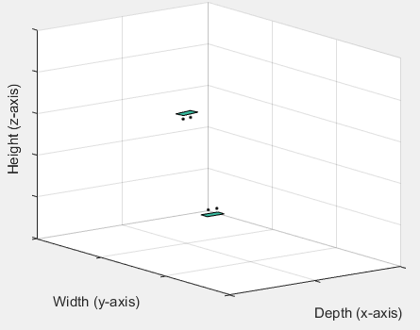
Channel parameters
For channel with LOS components [3],
TX/RX analog beamforming for both polarizations of PAA#i are based on the LOS direction between TX PAA#i ↔ RX PAA#i
For channel without LOS components
Beam forming based on the AoD/AoA of strongest signal path between TX PAA#i ↔ RX PAA#i
Channel bandwidth 2.64 GHz, center frequency 60.48 GHz
Each PAA has 16 elements (8 X 2)
Distance between antenna elements 0.0025m
Distance between center of PAAs 10cm
For AP-STA scenario, STA is placed at a plane 2m below AP in the cubicle 1. Random rotation around z-axis between STA/AP.

