Slide 1
PAR Verification Simulation Follow-up
Date: 2016-11-7
Authors:

Slide 2
Abstract
So far, our system simulation results for 11ax PAR verification show performance gain for certain Evaluation Methodology [2] simulation scenarios is limited to < 2x.
11ax PAR calls for “enable at least one mode of operation capable of supporting at least four times improvement in the average throughput per station (measured at the MAC data service access point) in a dense deployment scenario, while maintaining or improving the power efficiency per station.”
The scenarios in [2] involve dense deployments with multiple BSS. It may take time to identify the right ‘mode(s)’ of operation, but we should also consider new scenarios.
Here we review the latest results and point our possible new directions.

Slide 3
Multiple BSS Simulation Setup
Topologies: residential scenario and indoor BSS scenario in the 11ax simulation scenarios document [1]
Partial results of this presentation were presented in Warsaw meeting [4]
PHY abstraction and SINR calculation
Follow 11ax evaluation methodology [2].
MAC protocols, such as CCA, backoff, trigger frame, and etc.
Based on 11ax draft D0.3 [3].
Parameters | Default Value
Traffic type | Full buffer UDP UL/DL traffic
UDP packet size | 100 Bytes
MCS | 5
AP/STA # of TX/TX antenna | 1
Access Protocol parameters | EDCA with default parameters
Bandwidth | 80 MHz
Aggregation | 64 MPDU per AMPDU
RTS/CTS | No
OFDMA allocation | Five 242-tone RUs and one 26-tone RU
OBSS PD | -75 dBm

Slide 4
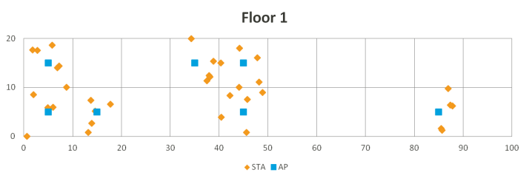
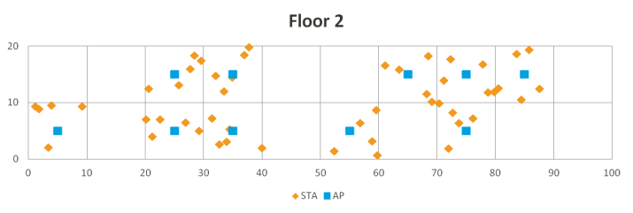
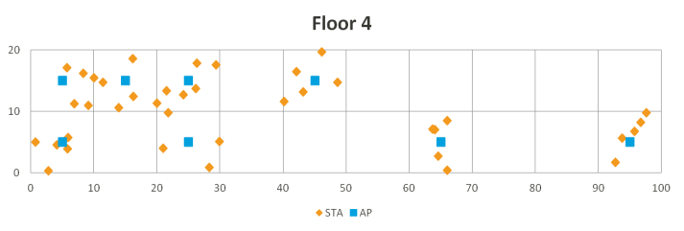
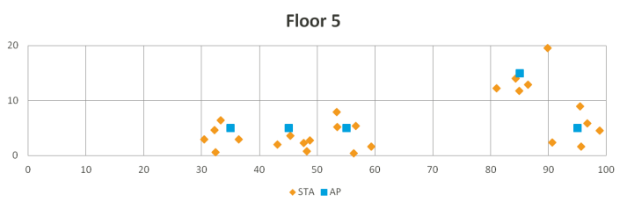
Topology 1: Residential Scenario
Setting
5 floors with 2 x 10 apartments on each floor
Each BSS has 5 STAs
AP is at the center of each apartment. STAs’ locations are randomly assigned
Each apartment is 10m x 10m x 3m
Frequency reuse factor 3: 1/3 of the apartments are deployed with AP/STA

Slide 5
Topology 2: Indoor BSS Scenario
Setting
Frequency reuse factor is 1
There are 19 BSSs with 30 STAs in each BSS
Total of 570 STAs
Radius of each BSS is 10m with AP at the center of a hexagon area and STAs randomly placed within the hexagon.

Slide 6
Simulation Results (1/2)
Residential scenario
DL
Better PER provides gains for 11ax MU.
With OBSS PD, the extra TX opportunities give more performance gain.
11ax with OBSS_PD has 1.6 times throughput gain over 11ac
UL
Highlights cost of trigger frame overhead: UL OFDMA gets better PER but total throughput is lower. Need OBSS PD to provide more trigger frame transmission opportunities to have performance gain.
11ax with OBSS_PD has 1.3 times throughput gain over 11ac

Slide 7
Simulation Results (2/2)
With more parameter tuning
 | STAs per BSS | Total STAs | MCS | 11ax with OBSS_PD Performance gain over 11ac
Residential | 5 | 180 | 5 | UL: 1.3 DL: 1.6
Residential | 13 | 416 | 5 | UL: 1.6 DL: 1.9
Residential | 13 | 416 | 8 | UL: 1.75 DL: 1.5
Residential | 13 | 416 | 9 | UL: 1.85 DL: 1.5
Residential with 20m x 20m apartment size | 13 | 416 | 8 | UL: 1.74 DL: 1.5
Indoor BSS | 30 | 570 | 8 | UL: 1.6 DL: 1.7

Slide 8
Summary
In the residential scenario,
Increasing STA size (5->13) improves DL gain
Using higher UL MCS (5->8, 9) improves UL gain
Indoor BSS scenario with more STAs and no frequency reuse does not show additional performance gain
We do see > 4x gain with certain single BSS scenarios, but they are not the ‘dense’ STA and BSS scenarios we target in the EVM [2].
Next Steps?

Slide 9
Strawpoll
While we continue to look for additional gain under new modes - combination of 11ax features, do we:
Option 1
Continue to use current EVM [2] scenarios.
Option 2
Modify scenarios in the EVM [2]. E.g.
Adding single BSS scenarios
New OBSS scenarios
Strawpoll: Option 1 or Option 2

Slide 10
References
11-14-0980-16-00ax-simulation-scenarios.docx
11-14-0571-12-00ax-evaluation-methodology.docx
Draft P802.11ax_D0.3.pdf
11-16-1143-01-00ax-11ax-par-verification

