Slide 1
L-Header spoofing and bit reuse
Date: 2016-11-8
Authors:

Slide 2
Background
4 reserved bits in L-Header are running out while more free bits in L-Header are desired for EDMG.
2 bits in use
1+ bit should be kept for future use
In this presentation we consider reuse of the Length field in L-Header for EDMG.
Field name | Num. of bits | Start bit
Scrambler Initialization | 7 | 0
MCS | 5 | 7
Length | 18 | 12
Additional PPDU | 1 | 30
Packet Type | 1 | 31
Training Length | 5 | 32
Aggregation | 1 | 37
Beam Tracking Request | 1 | 38
Last RSSI | 4 | 39
Turnaround | 1 | 43
Reserved | 4 | 44
HCS | 16 | 48
Extended SC MCS Indication | 1 | 44
Reserved | 1 | 45
EDMG (EDMG-Header-A) Indication | 1 | 46
Reserved | 1 | 47

Slide 3
Spoofing overview
In an EDMG PPDU, actual MCS and length are included in the EDMG-Header-A/B [1].
The L-Header includes spoof MCS and length so that legacy STAs can compute the TXTIME of the EDMG PPDU.
EDMG PPDU
TXTIME
L-STF
L-CEF
L-Header
EDMG-Header-A
E-STF
E-CEF
Data
spoof MCS, Length
actual MCS, Length
Legacy STA sees:
TXTIME – calculated by spoof MCS and Length
L-STF
L-CEF
L-Header
DMG payload
[1] 11-16/1358r6 Specification Framework for TGay

Slide 4
maximum TXTIME for EDMG
The maximum duration of a DMG PPDU (aPPDUMaxTime) is 2ms.
We suggest to specify that the maximum duration of an EDMG PPDU is 2 ms, as same as DMG.
Significant efficiency improvement may not be expected with a longer PPDU.
Overhead for preamble and BA could be less than 1% (20us) for 2ms PPDU.
Potential risks of compatibility with 11ad are reduced.
We haven’t seen any problems which encourage to reduce the maximum duration.

Slide 5
How does legacy STA calculate TXTIME?
Example: DMG SCPHY MCS6 (see appendix for the details)
$$TXTIME[us]=\left(\left\lceil \left\lceil \frac{Length}{42}\right\rceil ∙\frac{672}{896}\right\rceil ∙512+4416\right)/1760$$
Data octets per
LDPC codeword
Data bits per
Symbol block

Slide 6
How does legacy STA calculate TXTIME? (cont’d)
Since 11ad SC-PHY employs LDPC coding, and the packet consists of SC-FDE blocks, there are multiple length values which have the same TXTIME.
the same TXTIME
MCS 6
Length=127
Symbol Block 512 sym
Preamble/Header
Data
448sym
GI
64sym
padding bits, padding symbols
Length=168
Preamble/Header

Slide 7
How does legacy STA calculate TXTIME? (cont’d)
In case of MCS6 for example, there are at least 42 length values which have the same TXTIME.
Length = 42n+1 ~ 42n+42 have the same TXTIME
This means the lower bits of the Length field in L-Header are not important for TXTIME calculation.
$$TXTIME[us]=\left(\left\lceil \left\lceil \frac{Length}{42}\right\rceil ∙\frac{3}{4}\right\rceil ∙512+4416\right)/1760$$

Slide 8
Reuse of Length field in L-Header
We suggest to reuse LSBs of the Length field in the L-Header for EDMG purpose.
Bandwidth preview will be proposed[2]
EDMG PPDU
TXTIME
L-STF
L-CEF
L-Header
EDMG-Header-A
E-STF
E-CEF
Data
spoof MCS, Length
actual MCS, Length
MSBs:
used for TXTIME indication
(spoofing)
LSBs:
reused for EDMG purpose
[2]11-16/1395r0 EDMG Header-A Fields preview in L-Header

Slide 9
How many bits can be reused?
The number of reusable bits depends on the spoof MCS in the L-Header. (see appendix for the details)
5 bits will be available if we use MCS 2 or above for spoof MCS.
MCS in L-Header | Reusable bits
1 | 4
2 | 5
3 | 5
4 | 5
5 | 6
6 | 5
MCS in L-Header | Reusable bits
7 | 5
8 | 5
9 | 6
10 | 6
11 | 6
12 | 6

Slide 10
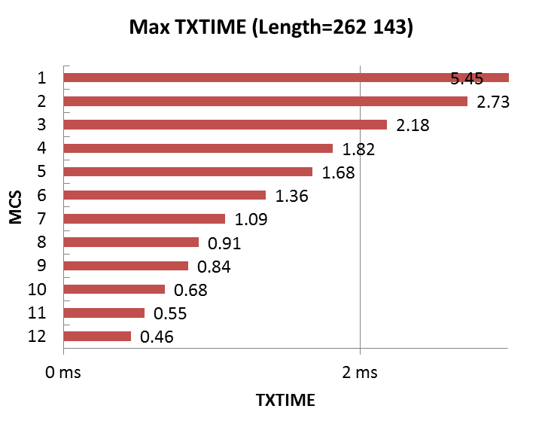
Consideration for spoof MCS
By using MCS 2 or 3, spoofing is properly performed for up to 2ms PPDUs.
We suggest to rule out use of MCS1 for spoofing, while use MCS2 or above.
TXTIME of DMG PPDUs when Length=262143 (max. in 11ad)
5.46

Slide 11
Summary of Length bits reuse
We suggest to use 5 LSBs of Length field in L-Header for EDMG purpose.
EDMG PPDU
TXTIME : no grater than 2ms
L-STF
L-CEF
L-Header
EDMG-Header-A
E-STF
E-CEF
Data
spoof MCS, Length
actual MCS, Length
set to MCS2 or above
13 MSBs:
used for TXTIME indication
(spoofing)
5 LSBs:
reused for EDMG purpose

Slide 12
Conclusion
We propose to define the maximum PPDU duration of EDMG PPDU as 2ms.
We show that 5 LSBs of Length field in L-Header can be reused for EDMG purpose.

Slide 13
References
[1] 11-16/1358r6 Specification Framework for TGay
[2] 11-16/1395r0 EDMG Header-A Fields preview in L-Header

Slide 14
Straw poll
Do you agree to add the following to the SFD
“The maximum PPDU duration of EDMG PPDU is 2ms."

Slide 15
Appendix

Slide 16

TXTIME calculation in DMG SC
TXTIME of DMG PPDU is computed as follows TXTIME[us] = ((2176+1152+64) + (2+N_{BLKS}) * 512)) / 1760 MHz = (N_{BLKS}*512+4416)/1760
N_{BLKS} is calculated as follows
Thus, TXTIME is:
parameters α (dependent of modulation) and β (dependent of coding rate) are shown in the table.
STF
CEF
GI followed by Header
Header
Payload
Symbols/Block
MCS | α | β
1 | 672/448 = 3/2 | 21
2 | 672/448 = 3/2 | 42
3 | 672/448 = 3/2 | 52.5
4 | 672/448 = 3/2 | 63
5 | 672/448 = 3/2 | 68.25
6 | 672/896 = 3/4 | 42
7 | 672/896 = 3/4 | 52.5
8 | 672/896 = 3/4 | 63
9 | 672/896 = 3/4 | 68.25
10 | 672/1792 = 3/8 | 42
11 | 672/1792 = 3/8 | 52.5
12 | 672/1792 = 3/8 | 63
$$N_{BLKS}=\left\lceil \frac{N_{CW}∙L_{CW}}{N_{CBPB}}\right\rceil =\left\lceil \left\lceil \frac{Length∙8}{\frac{L_{CW}}{ρ}∙R}\right\rceil ∙\frac{L_{CW}}{N_{CBPB}}\right\rceil =\left\lceil \left\lceil \frac{Length}{β}\right\rceil ∙α\right\rceil$$
$$TXTIME[us]=\left(\left\lceil \left\lceil \frac{Length}{β}\right\rceil ∙α\right\rceil ∙512+4416\right)/1760$$

Slide 17
The number of reusable bits
There are at least w choices of the length value in L-Header for the given TXTIME.
b LSBs of the Length field in L-Header can be reused, where $b=\log_{2}\left\lfloor w\right\rfloor$
$w=\left\lfloor β\right\rfloor ×\left\lfloor 1/α\right\rfloor$
MCS | α | β | w | b
1 | 3/2 | 21 | 21 | 4
2 | 3/2 | 42 | 42 | 5
3 | 3/2 | 52.5 | 52 | 5
4 | 3/2 | 63 | 63 | 5
5 | 3/2 | 68.25 | 68 | 6
6 | 3/4 | 42 | 42 | 5
7 | 3/4 | 52.5 | 52 | 5
8 | 3/4 | 63 | 63 | 5
9 | 3/4 | 68.25 | 68 | 6
10 | 3/8 | 42 | 84 | 6
11 | 3/8 | 52.5 | 104 | 6
12 | 3/8 | 63 | 126 | 6

Slide 18
Example of spoof Length calculation
Without reuse of 5 LSBs
With reuse of 5 LSBs (r : the value in reused 5 bits)
MCS | α | β | w | b
1 | 3/2 | 21 | 21 | 4
2 | 3/2 | 42 | 42 | 5
3 | 3/2 | 52.5 | 52 | 5
4 | 3/2 | 63 | 63 | 5
5 | 3/2 | 68.25 | 68 | 6
6 | 3/4 | 42 | 42 | 5
7 | 3/4 | 52.5 | 52 | 5
8 | 3/4 | 63 | 63 | 5
9 | 3/4 | 68.25 | 68 | 6
10 | 3/8 | 42 | 84 | 6
11 | 3/8 | 52.5 | 104 | 6
12 | 3/8 | 63 | 126 | 6
$$Length=\left\lfloor \left\lfloor n/α\right\rfloor ×β\right\rfloor \\ where: n=(TXTIME×1760−4416)/512$$ $n shall be a positive integer$
$$n=(TXTIME×1760−4416)/512$$
$$L=\left\lfloor \left\lfloor n/α\right\rfloor ×β\right\rfloor$$
$$m=\left\{\begin{matrix}0 & L mod 32≥r \\ 32 & otherwise\end{matrix}\right.$$
$$Length=(L−L mod 32+r)−m$$
replace the 5 LSBs of L with r
correction for keeping
the desired TXTIME

