Slide 1
EDMG Header-A Fields preview in L-Header
Date: 2016-November-07
Authors:
Name | Company | Email
Alecsander Eitan | Qualcomm | eitana@qti.qualcomm.com
Assaf Kasher | Qualcomm | akasher@qti.qualcomm.com
Hiroyuki Motozuka | Panasonic | motozuka.hiroyuki@jp.panasonic.com

Slide 2
Introduction
In order to correctly operate on the EDMG fields following the EDMG Header-A, the PHY needs advance warning on the packet format.
This presentation shows what should be signaled in the L-Header and how it can be signaled without affecting legacy compatibility.

Slide 3
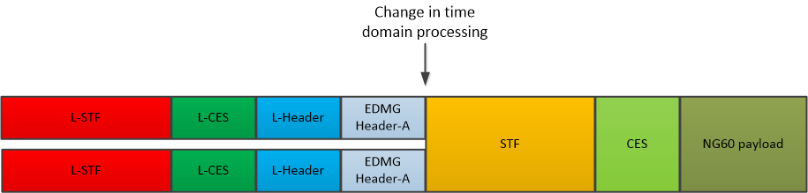
Recap – EDMG SU Packet structure
EDMG Header-A includes all the parameters for EDMG reception
L-Header includes spoofing values for DMG receivers

Slide 4
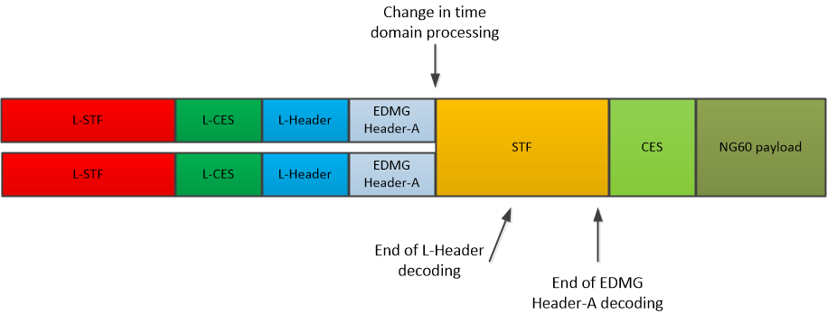
EDMG SU Headers reception timeline
EDMG receiver needs to adjust receiver processing after EDMG Header-A
Due to the pipeline structure of the receiver, there is an inherent delay in any header decoding

Slide 5
Decoding delay issue mitigation
By reusing some of the L-Header bits that are “not used”, a preview of the essential EDMG parameters can be signaled.
These preview parameters facilitates the EDMG receiver to be able to switch to the EDMG mode earlier.
  Avoid HW increase
  Avoid making EDMG-STF longer

Slide 6
What needs to be known at the beginning of the EDMG-STF
Bandwidth
  May change dynamically in a TxOP.
  Not the full bandwidth representation is required in the preview
SC/OFDM modulation
  Different time domain processing
SISO/MIMO indication
GI type (Short/Normal/Long)

Slide 7
Bandwidth coding
For contiguous bandwidth allocations, all combinations of 1-4 channels can be indicated with labels 0-5 based on the principle that the receiver knows on what channel the signal is received and the channels of the BSS.
Combinations of channel aggregation of two 2.16GHz channels are indicated by:
  Code 6 for separation of 2
  Code 7 for separation of 3
  Code 8 for separation of 4 and above
  Code 9 for aggregation of adjacent channels
Combinations of aggregation of two 4.32GHz channels are indicated by code 10

Slide 8
Bandwidth coding – table format
Index | Description | # of combinations
0 | 2.16 GHz | 8
1 | 4.32 GHz CB, lower channel-odd | 4
2 | 4.32 GHz CB, lower channel-even | 3
3 | 6.48 GHz CB, lowest channel-odd | 3
4 | 6.48 GHz CB, lowest channel-even | 3
5 | 8.64 GHz CB | 5
6 | 2.16+2.16 GHz CA, separation of 2 | 6
7 | 2.16+2.16 GHz CA, separation of 3 | 5
8 | 2.16+2.16 GHz CA, separation of 4 and above | 10
9 | 2.16+2.16 GHz CA, contiguous | 7
10 | 4.32+4.32 GHz CA | 15
11 | reserved | 0
12 | reserved | 0
13 | reserved | 0
14 | reserved | 0
15 | reserved | 0

Slide 9
Suggested Preview
Lower 5 bits of Length field (bits 0..4) {Note1}
  Bandwidth code (4 bits) – lower 4 bits (3..0)
  Reserved (0 at this time) – bit 4
LastRSSI field (bits 0..3)
  SC/OFDM (1bit) – bit 0.
  SISO/MIMO (1bit) – bit 1.
  Short/Normal/Long GI (2bit) – bits 0..1
{Note1} The ability to reuse the lower 5bits of L-Header Length field is presented in 11-16-1422-00-00ay-L-Header-Spoofing-and-Bit-Reuse

Slide 10
Summary
This presentation details the EDMG parameters to be signaled in the L-Header to assist EDMG receivers.
(BW code, SC/OFDM, SISO/MIMO, GI type)
This presentation details the bits allocation in L-Header for the above information.
Reuse of these L-Header bits is not affecting DMG and EDMG receivers.

Slide 11
Motion
Do you agree to add to the SFD:
In EDMG PPDU frames the lower 4 bits of the Length field and the LastRSSI field should be set according to the values detailed in slides 9 and 7. In addition, bit 5 of the Length field to be set to 0 (reserved)

Slide 12
Backup

Slide 13
How many bits may be re-used in the L-Header?
Move some of the fields to the EDMG-A header as they are not specifically needed in the L-Header and not necessary for non-addressed legacy devices:
LastRSSI – 4 bits
  Of no interest except to the intended receiver
  Sniffers can use the version in the EDMG-A header.
Packet type – 1 bit
  Of no interest except to the intended receiver
Aggregation bit
  Used only by the addressed MAC
Turnaround – 1 bit
TRN Length - 5 bits
  Used in length calculation – spoofing can take that into account
  Needs to be repeated in the EDMG-A header to enable longer training anyway
Lower 5 bits of Length field – 5 bits (see doc 11-16-1422-00-00ay)
Total of 16 bits

