Slide 1
Packet structure for SC EDMG PPDU for each GI length
Date: 2016-November-07
Authors:
Name | Company | Address | Phone | Email
Alecsander Eitan | Qualcomm |  |  | eitana@qti.qualcomm.com

Slide 2
SC EDMG PPDU Format
EDMG supports 3 GI lengths: Short, Normal & Long
Normal GI length corresponds to same time as 11ad GI
  ( = 64x1/1.76GHz)
All GIs are Golay sequences
Short GI has ½ length of the Normal GI
Long GI has double length of Normal GI

Slide 3
Agenda
Clarify the place of guard intervals (GI) in a SC EDMG packet structure
(this presentation is only about the SISO case)
  Emphasis on GI locations
  How is the GI length change done
  Definition of the Short and Long GI

Slide 4
SC CB1 PPDU format

Slide 5
What sequence to use for GI in SC-SISO CB1
We propose to use the same sequence (Ga64) that is used in 11ad to maintain compatibility and enable smooth transition between the legacy part and the new part.
We would like to maintain the property that each data part of a SC-BLK is surrounded on both sides with GIs of the same type
This enables using a consistent algorithm for frequency offset and phase tracking

Slide 6
SC CB1 PPDU format
Very similar to 11ad PPDU format.
  Addition of 2 EDMG Header-A SC blocks
  No EDMG-STF or EDMG-CEF
GI between every 2 data/header symbols and at the end of the packet.
This structure is suitable only for Normal GI (same as in 11ad)

Slide 7
SC-SISO CB1 – Short/Normal/Long GI
The drawing show the proposed packet structures for SC SISO CB1 with normal, short and long GI.

Slide 8
The Transition
It works if the short/normal/long GI have the property drawn on the right hand figure
The GI32 is the last part of GI64
The GI64 is the first part of GI128

Slide 9
GI Sequences
Use current Ga64 for the normal size GI.
Use the negation of the sequence A generated with:
𝐷=[2 1 4 8 16] and 𝑊=[1 1 −1 −1 1]
for GI32 (Short)
Use the negation of the sequence generated by:
𝐷=[2 1 4 8 16 32 64] and 𝑊=[1 1 −1 −1 1 1 1] f
or GI128 (Long)

Slide 10
SC CB>1 PPDU format

Slide 11
SC CB>1 Packet structure
Primary and Secondary sections (till EDMG-STF start)
  GI as in 11ad (on Primary and each Secondary)
  Before L-header and between every two header symbol
  After the EDMG Header A second symbol
WB section (starting immediately after EDMG-CEF)
  Before every data symbol
  After the last symbol.
  Use GI corresponding to GI type (Short/Normal/Long) and CB value (32xCB/64xCB/128xCB)

Slide 12
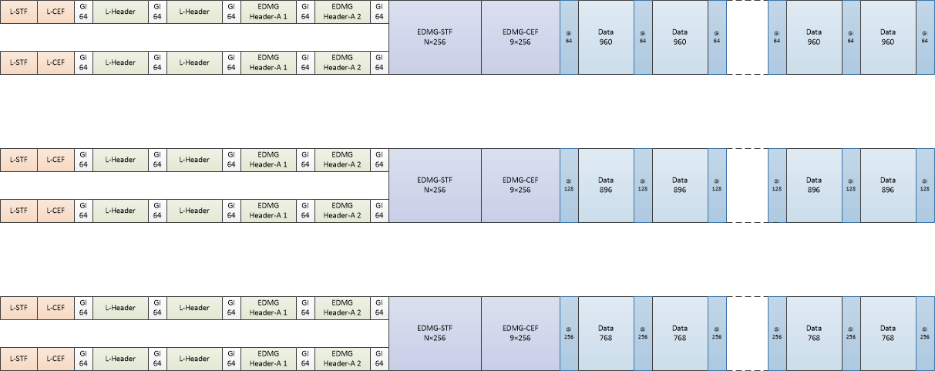
SC-SISO CB2 – Short/Normal/Long GI

Slide 13
GI Sequences (except CB3)
GI Length for Short/Normal/Long:
  CB=2 64/128/256
  CB=3 96/192/384
  CB=4 128/256/512
Ga and Gb are defined by:
  Ga64 and Gb64:
  D_{K} = [1 8 2 4 16 32], W_{K} = [-1,-1,-1,-1,+1,-1]
  Ga128 and Gb128:
  D_{K} = [1 8 2 4 16 32 64], W_{K} = [-1,-1,-1,-1,+1,-1,-1]
  Ga256 and Gb256:
  D_{K} = [1 8 2 4 16 32 64 128], W_{K} = [-1,-1,-1,-1,+1,-1,-1,+1]
  Ga512 and Gb512:
  D_{K} = [1 8 2 4 16 32 64 128 256], W_{K} = [-1,-1,-1,-1,+1,-1,-1,+1,+1]

Slide 14
Summary
This presentation clarifies the location and size of the GI sequences in SC SISO PPDU for all CB and GI length options.
This presentation includes a definition and method for GI length change in the challenging case of CB1.

Slide 15
Straw Poll
Do you agree to add to the SFD:
SC SISO to use 11ad Ga64, and derives, for CB=1 without additional EDMG STF & CEF, as in slides 7-9, for Short and Long GI cases
SC CB>1 Frame Format to be as in slide 11 & 13.

