Slide 1
EVM Definition for UL Triggered PPDU
Date: 2016-11-07
Authors:
Name | Affiliation | Address | Phone | Email
Ron Porat | Broadcom |  |  | rporat@broadcom.com
Sriram Venkateswaran
Matthew Fischer |  |  |  | mfischer@broadcom.com
Zhou Lan
Leo Montreuil
Andrew Blanksby
Vinko Erceg
Mingyue Ji

Slide 2
Authors (continued)
Name | Affiliation | Address | Phone | Email
Alice Chen | Qualcomm | 5775 Morehouse Dr. San Diego, CA, USA |  | alicel@qti.qualcomm.com
Albert Van Zelst |  | Straatweg 66-S Breukelen, 3621 BR Netherlands |  | allert@qti.qualcomm.com
Alfred Asterjadhi |  | 5775 Morehouse Dr. San Diego, CA, USA |  | aasterja@qti.qualcomm.com
Arjun Bharadwaj |  | 5775 Morehouse Dr. San Diego, CA, USA |  | arjunb@qti.qualcomm.com
Bin Tian |  | 5775 Morehouse Dr. San Diego, CA, USA |  | btian@qti.qualcomm.com
Carlos Aldana |  | 1700 Technology Drive San Jose, CA 95110, USA |  | caldana@qca.qualcomm.com
George Cherian |  | 5775 Morehouse Dr. San Diego, CA, USA |  | gcherian@qti.qualcomm.com
Gwendolyn Barriac |  | 5775 Morehouse Dr. San Diego, CA, USA |  | gbarriac@qti.qualcomm.com
Hemanth Sampath |  | 5775 Morehouse Dr. San Diego, CA, USA |  | hsampath@qti.qualcomm.com
Lin Yang |  | 5775 Morehouse Dr. San Diego, CA, USA |  | linyang@qti.qualcomm.com
Menzo Wentink |  | Straatweg 66-S Breukelen, 3621 BR Netherlands |  | mwentink@qti.qualcomm.com
Naveen Kakani |  | 2100 Lakeside Boulevard Suite 475, Richardson TX 75082, USA |  | nkakani@qti.qualcomm.com
Raja Banerjea |  | 1060 Rincon Circle San Jose CA 95131, USA |  | rajab@qit.qualcomm.com
Richard Van Nee |  | Straatweg 66-S Breukelen, 3621 BR Netherlands |  | rvannee@qti.qualcomm.com

Slide 3
Authors (continued)
Name | Affiliation | Address | Phone | Email
Rolf De Vegt | Qualcomm | 1700 Technology Drive San Jose, CA 95110, USA |  | rolfv@qca.qualcomm.com
Sameer Vermani |  | 5775 Morehouse Dr. San Diego, CA, USA |  | svverman@qti.qualcomm.com
Simone Merlin |  | 5775 Morehouse Dr. San Diego, CA, USA |  | smerlin@qti.qualcomm.com
Tao Tian |  | 5775 Morehouse Dr. San Diego, CA, USA |  | ttian@qti.qualcomm.com
Tevfik Yucek |  | 1700 Technology Drive San Jose, CA 95110, USA |  | tyucek@qca.qualcomm.com
VK Jones |  | 1700 Technology Drive San Jose, CA 95110, USA |  | vkjones@qca.qualcomm.com
Youhan Kim |  | 1700 Technology Drive San Jose, CA 95110, USA |  | youhank@qca.qualcomm.com

Slide 4
Authors (continued)
Robert Stacey | Intel | 2111 NE 25th Ave, Hillsboro OR 97124, USA | +1-503-724-893 | robert.stacey@intel.com
Shahrnaz Azizi |  |  |  | shahrnaz.azizi@intel.com
Po-Kai Huang |  |  |  | po-kai.huang@intel.com
Qinghua Li |  |  |  | quinghua.li@intel.com
Xiaogang Chen |  |  |  | xiaogang.c.chen@intel.com
Chitto Ghosh |  |  |  | chittabrata.ghosh@intel.com
Laurent Cariou |  |  |  | laurent.cariou@intel.com
Yaron Alpert |  |  |  | yaron.alpert@intel.com
Assaf Gurevitz |  |  |  | assaf.gurevitz@intel.com
Ilan Sutskover |  |  |  | ilan.sutskover@intel.com

Slide 5
Authors (continued)
Name | Affiliation | Address | Phone | Email
Hongyuan Zhang | Marvell | 5488 Marvell Lane, Santa Clara, CA, 95054 | 408-222-2500 | hongyuan@marvell.com
Yakun Sun |  |  |  | yakunsun@marvell.com
Lei Wang |  |  |  | Leileiw@marvell.com
Liwen Chu |  |  |  | liwenchu@marvell.com
Jinjing Jiang |  |  |  | jinjing@marvell.com
Yan Zhang |  |  |  | yzhang@marvell.com
Rui Cao |  |  |  | ruicao@marvell.com
Sudhir Srinivasa |  |  |  | sudhirs@marvell.com
Bo Yu |  |  |  | boyu@marvell.com
Saga Tamhane |  |  |  | sagar@marvell.com
Mao Yu |  |  |  | my@marvel..com
Xiayu Zheng |  |  |  | xzheng@marvell.com
Christian Berger |  |  |  | crberger@marvell.com
Niranjan Grandhe |  |  |  | ngrandhe@marvell.com
Hui-Ling Lou |  |  |  | hlou@marvell.com

Slide 6
Authors (continued)
Name | Affiliation | Address | Phone | Email
Jianhan Liu | Mediatek USA | 2860 Junction Ave, San Jose, CA 95134, USA | +1-408-526-1899 | jianhan.Liu@mediatek.com
Thomas Pare |  |  |  | thomas.pare@mediatek.com
ChaoChun Wang |  |  |  | chaochun.wang@mediatek.com
James Wang |  |  |  | james.wang@mediatek.com
Tianyu Wu |  |  |  | tianyu.wu@mediatek.com
Russell Huang |  |  |  | russell.huang@mediatek.com
James Yee | Mediatek | No. 1 Dusing 1st Road, Hsinchu, Taiwan | +886-3-567-0766 | james.yee@mediatek.com
Alan Jauh |  |  |  | alan.jauh@mediatek.com
Frank Hsu |  |  |  | frank.hsu@mediatek.com
Joonsuk Kim | Apple |  |  | joonsuk@apple.com
Aon Mujtaba |  |  |  | mujtaba@apple.com
Guoqing Li |  |  |  | guoqing_li@apple.com
Eric Wong |  |  |  | ericwong@apple.com
Chris Hartman |  |  |  | chartman@apple.com

Slide 7
Authors (continued)
Name | Affiliation | Address | Phone | Email
David X. Yang | Huawei | F1-17, Huawei Base, Bantian, Shenzhen |  | david.yangxun@huawei.com
Jiayin Zhang |  | 5B-N8, No.2222 Xinjinqiao Road, Pudong, Shanghai | +86-18601656691 | zhangjiayin@huawei.com
Jun Luo |  | 5B-N8, No.2222 Xinjinqiao Road, Pudong, Shanghai |  | jun.l@huawei.com
Yi Luo |  | F1-17, Huawei Base, Bantian, Shenzhen | +86-18665891036 | Roy.luoyi@huawei.com
Yingpei Lin |  | 5B-N8, No.2222 Xinjinqiao Road, Pudong, Shanghai |  | linyingpei@huawei.com
Jiyong Pang |  | 5B-N8, No.2222 Xinjinqiao Road, Pudong, Shanghai |  | pangjiyong@huawei.com
Zhigang Rong |  | 10180 Telesis Court, Suite 365, San Diego, CA 92121 NA |  | zhigang.rong@huawei.com
Jian Yu |  | F1-17, Huawei Base, Bantian, Shenzhen |  | ross.yujian@huawei.com
Ming Gan |  | F1-17, Huawei Base, Bantian, Shenzhen |  | ming.gan@huawei.com
Yunsong Yang |  | 10180 Telesis Court, Suite 365, San Diego, CA 92121 NA |  | yangyunsong@huawei.com
Junghoon Suh |  | 303 Terry Fox, Suite 400 Kanata, Ottawa, Canada |  | Junghoon.Suh@huawei.com
Peter Loc |  |  |  | peterloc@iwirelesstech.com
Edward Au |  | 303 Terry Fox, Suite 400 Kanata, Ottawa, Canada |  | edward.ks.au@huawei.com
Teyan Chen |  | F1-17, Huawei Base, Bantian, Shenzhen |  | chenteyan@huawei.com
Yunbo Li |  | F1-17, Huawei Base, Bantian, Shenzhen |  | liyunbo@huawei.com

Slide 8
Authors (continued)
Name | Affiliation | Address | Phone | Email
Jinmin Kim | LG Electronics | 19, Yangjae-daero 11gil, Seocho-gu, Seoul 137-130, Korea |  | Jinmin1230.kim@lge.com
Kiseon Ryu |  |  |  | kiseon.ryu@lge.com
Jinyoung Chun |  |  |  | jiny.chun@lge.com
Jinsoo Choi |  |  |  | js.choi@lge.com
Jeongki Kim |  |  |  | jeongki.kim@lge.com
Dongguk Lim |  |  |  | dongguk.lim@lge.com
Suhwook Kim |  |  |  | suhwook.kim@lge.com
Eunsung Park |  |  |  | esung.park@lge.com
JayH Park |  |  |  | Hyunh.park@lge.com
HanGyu Cho |  |  |  | hg.cho@lge.com
Thomas Derham | Orange |  |  | thomas.derham@orange.com
Bo Sun | ZTE | #9 Wuxingduan, Xifeng Rd., Xi'an, China |  | sun.bo1@zte.com.cn
Kaiying Lv |  |  |  | lv.kaiying@zte.com.cn
Yonggang Fang |  |  |  | yfang@ztetx.com
Ke Yao |  |  |  | yao.ke5@zte.com.cn
Weimin Xing |  |  |  | xing.weimin@zte.com.cn
Brian Hart | Cisco Systems | 170 W Tasman Dr, San Jose, CA 95134 |  | brianh@cisco.com
Pooya Monajemi |  |  |  | pmonajem@cisco.com

Slide 9
Authors (continued)
Name | Affiliation | Address | Phone | Email
Fei Tong | Samsung | Innovation Park, Cambridge CB4 0DS (U.K.) | +44 1223 434633 | f.tong@samsung.com
Hyunjeong Kang |  | Maetan 3-dong; Yongtong-Gu Suwon; South Korea | +82-31-279-9028 | hyunjeong.kang@samsung.com
Kaushik Josiam |  | 1301, E. Lookout Dr, Richardson TX 75070 | (972) 761 7437 | k.josiam@samsung.com
Mark Rison |  | Innovation Park, Cambridge CB4 0DS (U.K.) | +44 1223 434600 | m.rison@samsung.com
Rakesh Taori |  | 1301, E. Lookout Dr, Richardson TX 75070 | (972) 761 7470 | rakesh.taori@samsung.com
Sanghyun Chang |  | Maetan 3-dong; Yongtong-Gu Suwon; South Korea | +82-10-8864-1751 | s29.chang@samsung.com
Yasushi Takatori | NTT | 1-1 Hikari-no-oka, Yokosuka, Kanagawa 239-0847 Japan | +81 46 859 3135 | takatori.yasushi@lab.ntt.co.jp
Yasuhiko Inoue |  |  | +81 46 859 5097 | inoue.yasuhiko@lab.ntt.co.jp
Shoko Shinohara |  |  | +81 46 859 5107 | Shinohara.shoko@lab.ntt.co.jp
Yusuke Asai |  |  | +81 46 859 3494 | asai.yusuke@lab.ntt.co.jp
Koichi Ishihara |  |  | +81 46 859 4233 | ishihara.koichi@lab.ntt.co.jp
Junichi Iwatani |  |  | +81 46 859 4222 | Iwatani.junichi@lab.ntt.co.jp
Akira Yamada | NTT DOCOMO | 3-6, Hikarinooka, Yokosuka-shi, Kanagawa, 239-8536, Japan | +81 46 840 3759 | yamadaakira@nttdocomo.com

Slide 10
Authors (continued)
Name | Affiliation | Address | Phone | Email
Masahito Mori | Sony Corp. |  |  | Masahito.Mori@jp.sony.com
Yusuke Tanaka |  |  |  | YusukeC.Tanaka@jp.sony.com
Yuichi Morioka |  |  |  | Yuichi.Morioka@jp.sony.com
Kazuyuki Sakoda |  |  |  | Kazuyuki.Sakoda@am.sony.com
William Carney |  |  |  | William.Carney@am.sony.com
Tomoko Adachi | Toshiba |  |  | tomo.adachi@toshiba.co.jp
Narendar Madhavan |  |  |  | narendar.madhavan@toshiba.co.jp
Kentaro Taniguchi |  |  |  | kentaro.taniguchi@toshiba.co.jp
Toshihisa Nabetani |  |  |  | toshihisa.nabetani@toshiba.co.jp
Tsuguhide Aoki |  |  |  | tsuguhide.aoki@toshiba.co.jp
Koji Horisaki |  |  |  | kouji.horisaki@toshiba.co.jp
David Halls |  |  |  | david.halls@toshiba-trel.com
Filippo Tosato |  |  |  | filippo.tosato@toshiba-trel.com
Zubeir Bocus |  |  |  | zubeir.bocus@toshiba-trel.com
Fengming Cao |  |  |  | fengming.cao@toshiba-trel.com
Parag Kulkarni |  |  |  | parag.kulkarni@toshiba-trel.com

Slide 11
Authors (continued)
Minho Cheong | Newracom, Inc. | 9008 Research Dr, Irvine, CA 92618 | +1-949-390-7146 | minho.cheong@newracom.com
Reza Hedayat |  |  |  | reza.hedayat@newracom.com
Young Hoon Kwon |  |  |  | younghoon.kwon@newracom.com
Yongho Seok |  |  |  | yongho.seok@newracom.com
Daewon Lee |  |  |  | daewon.lee@newracom.com
Yujin Noh |  |  |  | yujin.noh@newracom.com
Sigurd Schelstraete | Quantenna | 3450 W. Warren Ave, Fremont, CA 94538 |  | Sigurd@quantenna.com
Huizhao Wang |  |  |  | hwang@quanetnna.com

Slide 12
Outline
Currently EVM is defined for HE SU and HE MU frames. However UL Trigger based PPDU (UL MU-MIMO and UL OFDMA) require more careful design as, unlike HE SU and HE MU, noise from multiple sources increase the total cumulative noise seen at the AP and degrades performance
16 users → 12dB potentially increase in EVM related noise
In this contribution we provide three enhancements to improve the performance of UL Trigger based PPDU:
Improve the EVM for low MCS. The current EVM for MCS0 and MCS1 can be tightened without significant impact to transmit power – those MCS can contribute the highest amount of EVM noise to adjacent STA in UL OFDMA.
Require better EVM when the transmit power is below a pre-defined level – makes sure that EVM improves with a reduced transmit power.
Define an EVM spectral mask – this is similar in concept to the out-of-band power spectral mask but with the difference that for synchronized UL OFDMA we are only concerned with the in-band impact of one STA on the EVM of other STA.

Slide 13
Proposals
The first two proposals aim to control/reduce the used tone EVM for trigger based PPDU:
Proposal 1: change the used tone EVM for MCS0 and MCS1 to the value used for MCS2.
Proposal 2: if the TX power is below the maximum power of MCS7 then the used tone EVM is below -27dB (the EVM of MCS7)
Max Tx power of MCS7 is measured by setting in trigger frame target RSSI field to 127 (max Tx power for the assigned MCS) for the same OFDMA and MU MIMO assignment
Note this proposal helps the AP in managing inter RU (for UL OFDMA) and inter spatial stream (for UL MU-MIMO) interference by setting the right target RSSI.
The third proposal aims to control the unused tone EVM as described in the following slides

Slide 14
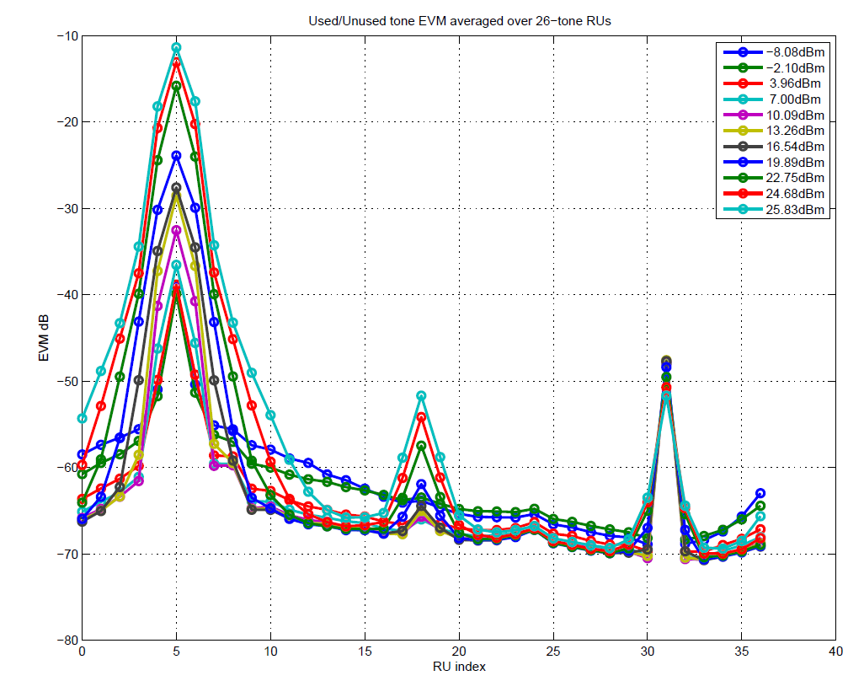
Used, Unused tone EVM with TX RU-26 at idx 5, MCS0
X-axis is RU-26 index in 80MHz tone-map, range 0:36
Y-axis
value at RU idx 5 is Error_{RMS} of occupied RU
values at other indices are UnusedtoneError_{RMS}, averaged over the tones of that particular RU
Each curve corresponds to different TX power, typical values mentioned in the legend
At higher powers, delta between adjacent RU and used RU is low due to PA compression
EVM spikes due to LO and IQ mismatch are typically below a floor, say -35dB

Slide 15
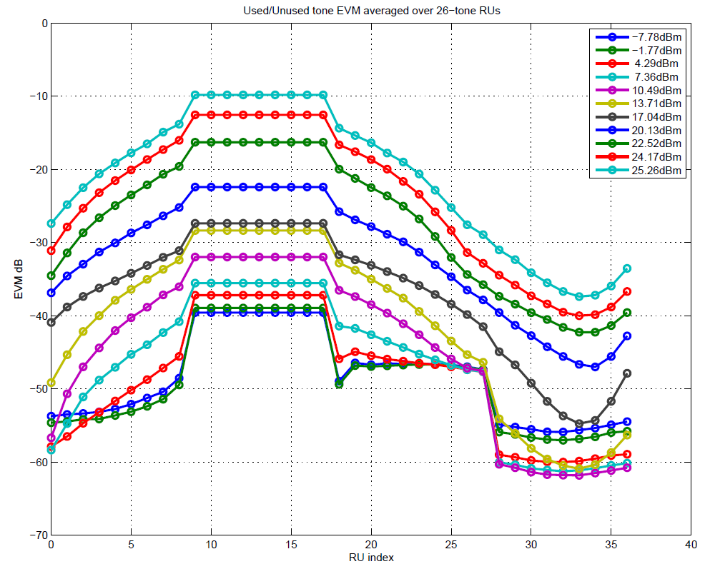
Used, Unused tone EVM with TX RU-242, MCS0
TX RU-242 occupies RU-26 indices (9-17)
Unused tone EVM scales with occupied RU width, similar to OOB emissions

Slide 16
Proposed staircase EVM mask for UnusedToneEVM
Unused tone EVM is computed separately for each unused RU26 by averaging the EVM in the tones that make up that RU26.
Mask defined at 3 points
Mask scales with the assigned RU bandwidth defined in units of 26RU
RU-26: r = 1
RU-52: r = 2
RU-106: r = 4
RU-242: r = 9
RU-484: r = 18
Mask drops at 10dB/BW and incorporates a floor at -35dB
In the equation below m defines the gap to the used RU from either side and is a positive integer with m=1 being the adjacent RU26
max(Used Tone Error_{RMS} – 2dB, -35dB), m in [1:r]
max(Used Tone Error_{RMS} – 12dB, -35dB), m in [r+1:2r]}
max(Used Tone Error_{RMS} – 22dB, -35dB), m in [2r+1:3r]}
-35dB otherwise
UnusedToneError_{RMS}(m) ≤

Slide 17
Summary
Proposed three techniques to control interference for UL MU-MIMO and UL OFDMA whereby multiple sources can contribute to highly elevated noise levels

Slide 18
SP #1
Do you support adding to D0.5 the proposals on slide 13 and 16?

