Slide 1
NDP feedback report
Authors:
Date: 2016-05-10
Name | Affiliation | Address | Phone | Email
Laurent Cariou | Intel | 2111 NE 25th Ave, Hillsboro OR 97124, USA | +1-503-724-893 | laurent.cariou@intel.com
Shahrnaz Azizi |  |  |  | shahrnaz.azizi@intel.com
Po-Kai Huang |  |  |  | po-kai.huang@intel.com
Qinghua Li |  |  |  | quinghua.li@intel.com
Xiaogang Chen |  |  |  | xiaogang.c.chen@intel.com
Chitto Ghosh |  |  |  | chittabrata.ghosh@intel.com
Robert Stacey |  |  |  | robert.stacey@intel.com
Yaron Alpert |  |  |  | yaron.alpert@intel.com
Assaf Gurevitz |  |  |  | assaf.gurevitz@intel.com
Ilan Sutskover |  |  |  | ilan.sutskover@intel.com
Feng Jiang |  |  |  | feng1.jiang@intel.com

Slide 2
Authors (continued)
Name | Affiliation | Address | Phone | Email
Hongyuan Zhang | Marvell | 5488 Marvell Lane, Santa Clara, CA, 95054 | 408-222-2500 | hongyuan@marvell.com
Lei Wang |  |  |  | Leileiw@marvell.com
Liwen Chu |  |  |  | liwenchu@marvell.com
Jinjing Jiang |  |  |  | jinjing@marvell.com
Yan Zhang |  |  |  | yzhang@marvell.com
Rui Cao |  |  |  | ruicao@marvell.com
Sudhir Srinivasa |  |  |  | sudhirs@marvell.com
Bo Yu |  |  |  | boyu@marvell.com
Saga Tamhane |  |  |  | sagar@marvell.com
Mao Yu |  |  |  | my@marvel..com
Xiayu Zheng |  |  |  | xzheng@marvell.com
Christian Berger |  |  |  | crberger@marvell.com
Niranjan Grandhe |  |  |  | ngrandhe@marvell.com
Hui-Ling Lou |  |  |  | hlou@marvell.com

Slide 3
Authors (continued)
Name | Affiliation | Address | Phone | Email
David X. Yang | Huawei | F1-17, Huawei Base, Bantian, Shenzhen |  | david.yangxun@huawei.com
Jiayin Zhang |  | 5B-N8, No.2222 Xinjinqiao Road, Pudong, Shanghai | +86-18601656691 | zhangjiayin@huawei.com
Jun Luo |  | 5B-N8, No.2222 Xinjinqiao Road, Pudong, Shanghai |  | jun.l@huawei.com
Yi Luo |  | F1-17, Huawei Base, Bantian, Shenzhen | +86-18665891036 | Roy.luoyi@huawei.com
Yingpei Lin |  | 5B-N8, No.2222 Xinjinqiao Road, Pudong, Shanghai |  | linyingpei@huawei.com
Jiyong Pang |  | 5B-N8, No.2222 Xinjinqiao Road, Pudong, Shanghai |  | pangjiyong@huawei.com
Zhigang Rong |  | 10180 Telesis Court, Suite 365, San Diego, CA 92121 NA |  | zhigang.rong@huawei.com
Jian Yu |  | F1-17, Huawei Base, Bantian, Shenzhen |  | ross.yujian@huawei.com
Ming Gan |  | F1-17, Huawei Base, Bantian, Shenzhen |  | ming.gan@huawei.com
Yuchen Guo |  | F1-17, Huawei Base, Bantian, Shenzhen |  | guoyuchen@huawei.com
Yunsong Yang |  | 10180 Telesis Court, Suite 365, San Diego, CA 92121 NA |  | yangyunsong@huawei.com
Junghoon Suh |  | 303 Terry Fox, Suite 400 Kanata, Ottawa, Canada |  | Junghoon.Suh@huawei.com
Peter Loc |  |  |  | peterloc@iwirelesstech.com
Edward Au |  | 303 Terry Fox, Suite 400 Kanata, Ottawa, Canada |  | edward.ks.au@huawei.com
Teyan Chen |  | F1-17, Huawei Base, Bantian, Shenzhen |  | chenteyan@huawei.com
Yunbo Li |  | F1-17, Huawei Base, Bantian, Shenzhen |  | liyunbo@huawei.com

Slide 4
Authors (continued)
Name | Affiliation | Address | Phone | Email
Alice Chen | Qualcomm | 5775 Morehouse Dr. San Diego, CA, USA |  | alicel@qti.qualcomm.com
Albert Van Zelst |  | Straatweg 66-S Breukelen, 3621 BR Netherlands |  | allert@qti.qualcomm.com
Alfred Asterjadhi |  | 5775 Morehouse Dr. San Diego, CA, USA |  | aasterja@qti.qualcomm.com
Bin Tian |  | 5775 Morehouse Dr. San Diego, CA, USA |  | btian@qti.qualcomm.com
Carlos Aldana |  | 1700 Technology Drive San Jose, CA 95110, USA |  | caldana@qca.qualcomm.com
George Cherian |  | 5775 Morehouse Dr. San Diego, CA, USA |  | gcherian@qti.qualcomm.com
Gwendolyn Barriac |  | 5775 Morehouse Dr. San Diego, CA, USA |  | gbarriac@qti.qualcomm.com
Hemanth Sampath |  | 5775 Morehouse Dr. San Diego, CA, USA |  | hsampath@qti.qualcomm.com
Lin Yang |  | 5775 Morehouse Dr. San Diego, CA, USA |  | linyang@qti.qualcomm.com
Lochan Verma |  | 5775 Morehouse Dr. San Diego, CA USA |  | lverma@qti.qualcomm.com
Menzo Wentink |  | Straatweg 66-S Breukelen, 3621 BR Netherlands |  | mwentink@qti.qualcomm.com
Naveen Kakani |  | 2100 Lakeside Boulevard Suite 475, Richardson TX 75082, USA |  | nkakani@qti.qualcomm.com
Raja Banerjea |  | 1060 Rincon Circle San Jose CA 95131, USA |  | rajab@qit.qualcomm.com
Richard Van Nee |  | Straatweg 66-S Breukelen, 3621 BR Netherlands |  | rvannee@qti.qualcomm.com

Slide 5
Authors (continued)
Name | Affiliation | Address | Phone | Email
Rolf De Vegt | Qualcomm | 1700 Technology Drive San Jose, CA 95110, USA |  | rolfv@qca.qualcomm.com
Sameer Vermani |  | 5775 Morehouse Dr. San Diego, CA, USA |  | svverman@qti.qualcomm.com
Simone Merlin |  | 5775 Morehouse Dr. San Diego, CA, USA |  | smerlin@qti.qualcomm.com
Tevfik Yucek |  | 1700 Technology Drive San Jose, CA 95110, USA |  | tyucek@qca.qualcomm.com
VK Jones |  | 1700 Technology Drive San Jose, CA 95110, USA |  | vkjones@qca.qualcomm.com
Youhan Kim |  | 1700 Technology Drive San Jose, CA 95110, USA |  | youhank@qca.qualcomm.com

Slide 6
Authors (continued)
Name | Affiliation | Address | Phone | Email
Jianhan Liu | Mediatek USA | 2860 Junction Ave, San Jose, CA 95134, USA | +1-408-526-1899 | jianhan.Liu@mediatek.com
Thomas Pare |  |  |  | thomas.pare@mediatek.com
ChaoChun Wang |  |  |  | chaochun.wang@mediatek.com
James Wang |  |  |  | james.wang@mediatek.com
Tianyu Wu |  |  |  | tianyu.wu@mediatek.com
Russell Huang |  |  |  | russell.huang@mediatek.com
James Yee | Mediatek | No. 1 Dusing 1st Road, Hsinchu, Taiwan | +886-3-567-0766 | james.yee@mediatek.com
Alan Jauh |  |  |  | alan.jauh@mediatek.com
Frank Hsu |  |  |  | frank.hsu@mediatek.com

Slide 7
Authors (continued)
Name | Affiliation | Address | Phone | Email
Ron Porat | Broadcom |  |  | rporat@broadcom.com
Sriram Venkateswaran
Matthew Fischer |  |  |  | mfischer@broadcom.com
Zhou Lan
Leo Montreuil
Andrew Blanksby
Vinko Erceg
Thomas Derham
Mingyue Ji

Slide 8
Authors (continued)
Name | Affiliation | Address | Phone | Email
Jinmin Kim | LG Electronics | 19, Yangjae-daero 11gil, Seocho-gu, Seoul 137-130, Korea |  | Jinmin1230.kim@lge.com
Kiseon Ryu |  |  |  | kiseon.ryu@lge.com
Jinyoung Chun |  |  |  | jiny.chun@lge.com
Jinsoo Choi |  |  |  | js.choi@lge.com
Jeongki Kim |  |  |  | jeongki.kim@lge.com
Dongguk Lim |  |  |  | dongguk.lim@lge.com
Suhwook Kim |  |  |  | suhwook.kim@lge.com
Eunsung Park |  |  |  | esung.park@lge.com
JayH Park |  |  |  | Hyunh.park@lge.com
HanGyu Cho |  |  |  | hg.cho@lge.com
Bo Sun | ZTE | #9 Wuxingduan, Xifeng Rd., Xi'an, China |  | sun.bo1@zte.com.cn
Kaiying Lv |  |  |  | lv.kaiying@zte.com.cn
Yonggang Fang |  |  |  | yfang@ztetx.com
Ke Yao |  |  |  | yao.ke5@zte.com.cn
Weimin Xing |  |  |  | xing.weimin@zte.com.cn
Brian Hart | Cisco Systems | 170 W Tasman Dr, San Jose, CA 95134 |  | brianh@cisco.com
Pooya Monajemi |  |  |  | pmonajem@cisco.com

Slide 9
Authors (continued)
Name | Affiliation | Address | Phone | Email
Yasushi Takatori | NTT | 1-1 Hikari-no-oka, Yokosuka, Kanagawa 239-0847 Japan | +81 46 859 3135 | takatori.yasushi@lab.ntt.co.jp
Yasuhiko Inoue |  |  | +81 46 859 5097 | inoue.yasuhiko@lab.ntt.co.jp
Shoko Shinohara |  |  | +81 46 859 5107 | Shinohara.shoko@lab.ntt.co.jp
Yusuke Asai |  |  | +81 46 859 3494 | asai.yusuke@lab.ntt.co.jp
Koichi Ishihara |  |  | +81 46 859 4233 | ishihara.koichi@lab.ntt.co.jp
Junichi Iwatani |  |  | +81 46 859 4222 | Iwatani.junichi@lab.ntt.co.jp
Akira Yamada | NTT DOCOMO | 3-6, Hikarinooka, Yokosuka-shi, Kanagawa, 239-8536, Japan | +81 46 840 3759 | yamadaakira@nttdocomo.com

Slide 10
Authors (continued)
Name | Affiliation | Address | Phone | Email
Masahito Mori | Sony Corp. |  |  | Masahito.Mori@jp.sony.com
Yusuke Tanaka |  |  |  | YusukeC.Tanaka@jp.sony.com
Yuichi Morioka |  |  |  | Yuichi.Morioka@jp.sony.com
Kazuyuki Sakoda |  |  |  | Kazuyuki.Sakoda@am.sony.com
William Carney |  |  |  | William.Carney@am.sony.com
Narendar Madhavan | Toshiba |  |  | narendar.madhavan@toshiba.co.jp
Masahiro Sekiya
Toshihisa Nabetani
Tsuguhide Aoki
Tomoko Adachi
Kentaro Taniguchi
Daisuke Taki
Koji Horisaki
David Halls
Filippo Tosato
Zubeir Bocus
Fengming Cao

Slide 11
Authors (continued)
Name | Affiliation | Address | Phone | Email
Minho Cheong | Newracom, Inc. | 9008 Research Dr, Irvine, CA 92618 | +1-949-390-7146 | minho.cheong@newracom.com
Reza Hedayat |  |  |  | reza.hedayat@newracom.com
Young Hoon Kwon |  |  |  | younghoon.kwon@newracom.com
Yongho Seok |  |  |  | yongho.seok@newracom.com
Daewon Lee |  |  |  | daewon.lee@newracom.com
Yujin Noh |  |  |  | yujin.noh@newracom.com
Sigurd Schelstraete | Quantenna |  |  | Sigurd@quantenna.com
Huizhao Wang |  |  |  | hwang@quantenna.com
Sungeun Lee | Cypress Semiconductor Corporation |  |  | sungeun.lee@cypress.com
Saishankar Nandagopalan |  |  |  | snan@cypress.com
Sungeun Lee | Cypress Semiconductor Corporation |  |  | sungeun.lee@cypress.com
Saishankar Nandagopalan |  |  |  | snan@cypress.com
Stephane Baron | Canon |  |  | stephane.baron@crf.canon.fr
Pascal Viger |  |  |  | pascal.viger@crf.canon.fr
Patrice Nezou |  |  |  | patrice.nezou@crf.canon.fr

Slide 12
Background
Being able to get very short simultaneous feedback from a high number of STAs (all STAs) is very helpful to improve 11ax system and power efficiencies
Many feedbacks only require 1 bit: PS-Poll (power efficiency), Channel Availability (collisions avoidance)
We show in the following slide that a very short simultaneous resource request feedback (1 or several bits) capable of supporting a high number of STAs is really what we need for an efficient UL MU simultaneous scheduling in addition to the existing piggybacked buffer information
See annex:
30 times less overhead for resource request feedback than polling method in one example scenario
Low and stable latency for resource request feedback, compared to possibly high and unpredictable latency with CSMA-CA in dense environments

Slide 13
Need for short resource request
For UL MU, the AP schedules everything.
For all STAs that already accessed the channel, they can piggyback buffer status information,
But the AP doesn’t know when new bursts arrive in STAs buffer (small packets, or first packets of a longer burst of data)
→ we need a mechanism to collect that information in a regular manner (every 20-50ms) to improve the latency to access channel.
Now, what are the constraints for this mechanism:
Being able to ask all STAs in the BSS (100s), while only some of them will answer (10s).
Because of this first point, this mechanism is by nature inefficient
a lot of resources that are allocated to STAs will be empty.
For that reason, we need to reduce the overhead, especially as this resource request phase should happen frequently
the way to do so is to just enable STAs to raise hand and no transmit more data
The AP doesn’t need more than one or a few bits of information for this resource request.

Slide 14
How to define this feedback mechanism?
UL MU transmission in response to a trigger frame
Separate the time/frequency/space dimensions in many small orthogonal allocations for the UL MU transmission
For example: 72 allocations available per 20MHz with 8x8 P-matrix
One orthogonal allocation assigned to one user to avoid collisions
No data payload (sort of NDP), simply use the PHY preamble on one orthogonal allocation to send the feedback
with spreading gain for PHY robustness

Slide 15
Conclusion
This new short UL MU feedback mechanism is very useful to improve 11ax efficiency
Support the simultaneous short feedback of high number of STAs (possibly all) without collision
Needed to improve UL MU operation, power save efficiency, latency for channel access

Slide 16
Spec text changes
TGax Editor: Insert the following subclause, 25.5.2.7 NDP feedback report procedure
25.5.2.7 NDP feedback report procedure
NDP feedback report is a mechanism for an HE AP to collect short feedbacks from a very high number of HE STAs, in an efficient manner. The feedbacks (e.g. resource requests) are sent without data payloads in response to a trigger frame. The feedbacks are not for channel sounding.

Slide 17
Straw poll
Do you agree to accept the spec changes proposed in document 16/1367r0

Slide 18
Annex

Slide 19
In dense BSSs, largely more efficient than scheduled buffer status report and CSMA-CA
Example:
A BSS with 36 STAs that want to access channel, 110 STAs in the BSS
80MHz:
UL OFDMA: 36 users
Short UL MU feedback: 144 users
Solution 1: scheduled MAC buffer status report with UL OFDMA
AP needs to schedule the feedback from the 100 STAs: need 4 feedback phases, each with trigger frame, (longer) UL OFDMA with MAC payload, ACK
UL OFDMA: 750Kbps, 50Bytes with MAC header: 581us duration
Solution 2: resource request with short UL MU feedback with HE-LTF
AP needs only one feedback phase to poll all STAs, instead of 4
and the sequence is smaller as the feedback frame is only (HE-STF and HE-LTF (max 72us, min 16us)) compared to a full PHY header and MAC payload (581us):
Solution 2 provides more than 30 times less overhead

Slide 20
In dense BSSs, largely more efficient than scheduled buffer status report and CSMA-CA
Example:
A BSS with 10 STAs having arriving packets in their buffer every 20ms
Can not be scheduled with UL OFDMA
Solution 1: CSMA-CA access
50Bytes @ 26Mbps using legacy format to be more efficient: 300us airtime occupation per STA (contention + Tx)
3ms occupied for these transmissions per 20ms: 15% airtime occupation
Solution 2: short resource request
1 request every 20ms to collect all requests: 260us
1.3% airtime occupation
Solution 3: scheduled buffer status feedback
Will depend on the number of STAs and bandwidth
100 total STAs, 20MHz: 11 * 754us = 8.3ms
41% airtime occupation

Slide 21
In dense BSSs, largely more efficient than scheduled buffer status report and CSMA-CA
Example:
A BSS with 10 STAs having arriving packets in their buffer every 20ms
Can not be scheduled with UL OFDMA
Latency
Solution 1: CSMA-CA access
42ms mean latency to access channel
Solution 2: short resource request
1 request every 20ms to collect all requests: 260us
1.3% airtime occupation
Mean latency 10ms
Solution 3: scheduled buffer status feedback
Will depend on the number of STAs and bandwidth
100 total STAs, 20MHz: 11 * 754us = 8.3ms
41% airtime occupation
Mean latency will be higher because this is not a viable solution, seeing the overhead

Slide 22
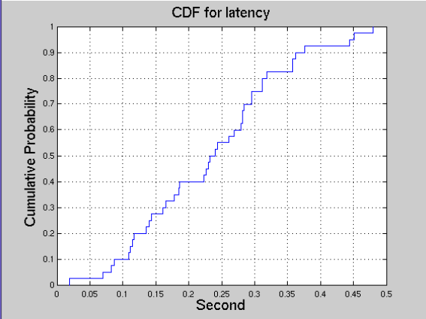
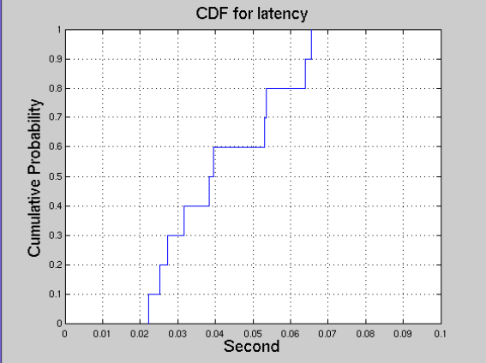
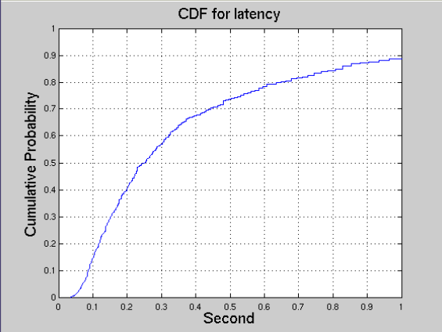
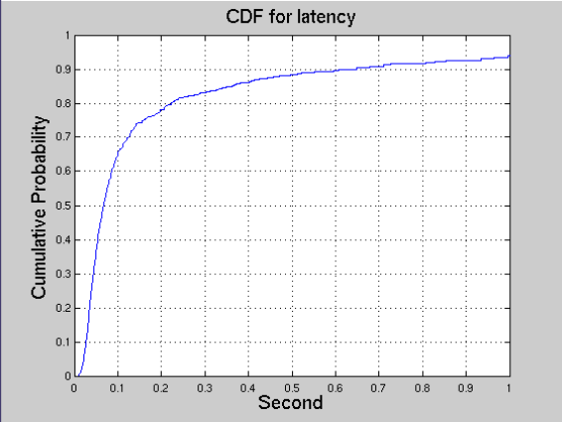
CSMA-CA latency in dense environments
Simple BSS
UL
1AP and 40 STAs
TXOP: 4ms
2.4G 20MHz channel
Observation:
Mean: 235ms
Simple BSS
UL, 1AP and 10 STAs per BSS
TXOP: 4ms
Observation:
Mean: 42ms
Scenario 3
UL
19AP and 30 STAs per BSS
TXOP: 4ms
2.4G 20MHz channel
Observation for CDF of 570 STAs :
Mean 230ms
Very long tail i.e., some STAs have very poor latency performance
Scenario 1
UL, scenario 1, 100AP and 10 STAs per BSS
TXOP: 4ms
Random channel selection among 3 channels
Observation:
Mean
Very long tail, i.e., some STAs have very poor latency performance

Slide 23
CSMA-CA latency in dense environments Very large benefits from short feedback with HE-LTFs
Latency to access the channel with CSMA-CA can be very high, especially in dense environments:
10% of the STAs have more than 600 ms !! latency to access channel in scenario 1
30% of the STAs have more than 500 ms !! latency to access channel in scenario 1, 10% have more than 1s
The results are for CSMA-CA only. The scenario of interest would be to have most of the traffic with UL OFDMA and only traffic not known by the AP to be transmitted with CSMA-CA (to be compared with using short feedbacks with HE-LTFs for this latter type of traffic)
As AP channel access for UL OFDMA should emulate the same behavior of CSMA-CA for fairness and equity, the latency results should be very similar
Short feedbacks with HE-LTFs enables those STAs to access channel with a very low latency
STA informs the AP that it has something to transmit (10ms mean latency)
AP can then efficiently BSR or short data Tx in its TxOP gained for UL MU

