Slide 1
Uplink Training for Downlink Multi-User MIMO
Date: 2016-09-12
Authors:

Slide 2
Introduction
Training with Tx/Rx beam sectorization is the current training method for DL MU-MIMO in 802.11ay
This method is transparent to any uplink-downlink channel differences
Problems: time consuming (as much training as number of sectors), beam accuracy can be low (more accuracy -> more training overhead)
This method is presented as Myth #3 in [1]: it does not exploit the full potential of Massive MIMO systems

Slide 3
Introduction
Alternative approach: perform uplink training
Pros: Less training overhead, superior beam accuracy, not sensitive to LOS assumption
Cons: UL/DL channel reciprocity not guaranteed -> possibly requires calibration

Slide 4
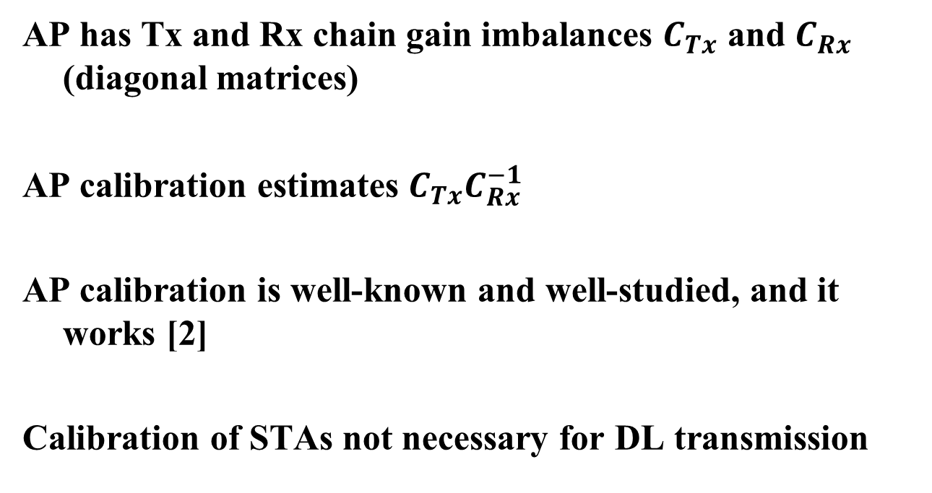
Calibration for Channel Reciprocity
AP has Tx and Rx chain gain imbalances $C_{Tx}$ and $C_{Rx}$ (diagonal matrices)
AP calibration estimates $C_{Tx}C_{Rx}^{−1}$
AP calibration is well-known and well-studied, and it works [2]
Calibration of STAs not necessary for DL transmission

Slide 5
Uplink Training Procedure
Assuming calibration has been performed
AP transmits an uplink training trigger frame to a specific group of STAs
Each STA in the group transmits a training packet
AP estimates (jointly) the received channel (or any transformation of the channel)
AP uses the estimated channel for downlink transmission

Slide 6
Uplink Training Procedure
Trigger
Frame
Estimate CSI
Beamformed
Data
AP
Training
Packet
STA 1
Training
Packet
STA 2
These packets are short!

Slide 7
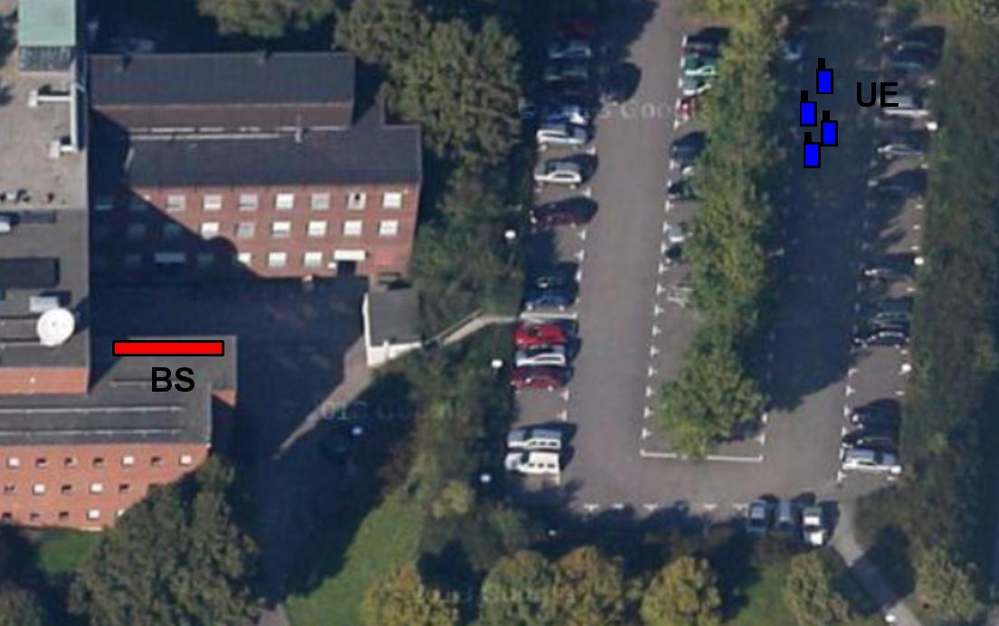
Massive MIMO Deployment (2.3 GHz)
0.5 m between UEs, 40-50 m between BS and UE, 8 m linear array

Slide 8
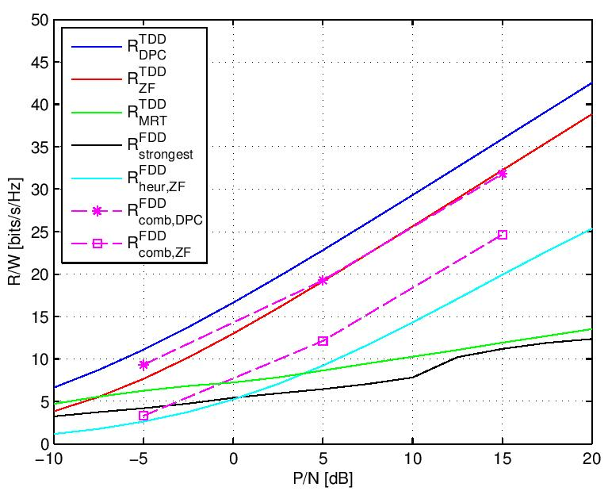
Performance
TDD significantly better than hybrid beamforming and FDD

Slide 9
Summary
Proposed an uplink training procedure for beamforming construction
Pros: Significantly less training overhead, enables superior beamforming
Cons: Possibly calibration assumptions (although verified in practice to work)

Slide 10
References
[1] E. Björnsson, E. G. Larsson, T. Marzetta, ”Massive MIMO: Ten Myths and One Critical Question”, IEEE Comm. Mag., Feb. 2016
[2] J. Vieira et. al., ” Reciprocity Calibration for Massive MIMO: Proposal, Modeling and Validation”, IEEE Trans. Wire. Comm., 2016

Slide 11
Straw Poll
Do you believe the uplink training mechanism presented here is worth considering for further study?
Y/N/A:

Slide 12
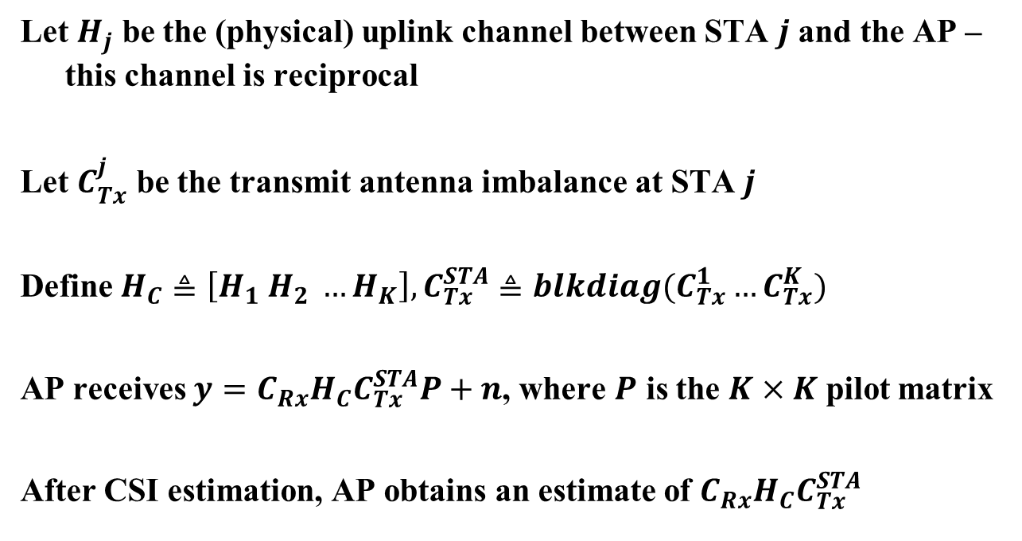
Mathematical Derivation
Let $H_{j}$ be the (physical) uplink channel between STA $j$ and the AP – this channel is reciprocal
Let $C_{Tx}^{j}$ be the transmit antenna imbalance at STA $j$
Define $H_{C}≜\left[H_{1} H_{2} …H_{K}\right], C_{Tx}^{STA}≜blkdiag(C_{Tx}^{1}…C_{Tx}^{K})$
AP receives $y=C_{Rx}H_{C}C_{Tx}^{STA}P+n$, where $P$ is the $K×K$ pilot matrix
After CSI estimation, AP obtains an estimate of ${C_{Rx}H}_{C}C_{Tx}^{STA}$

Slide 13
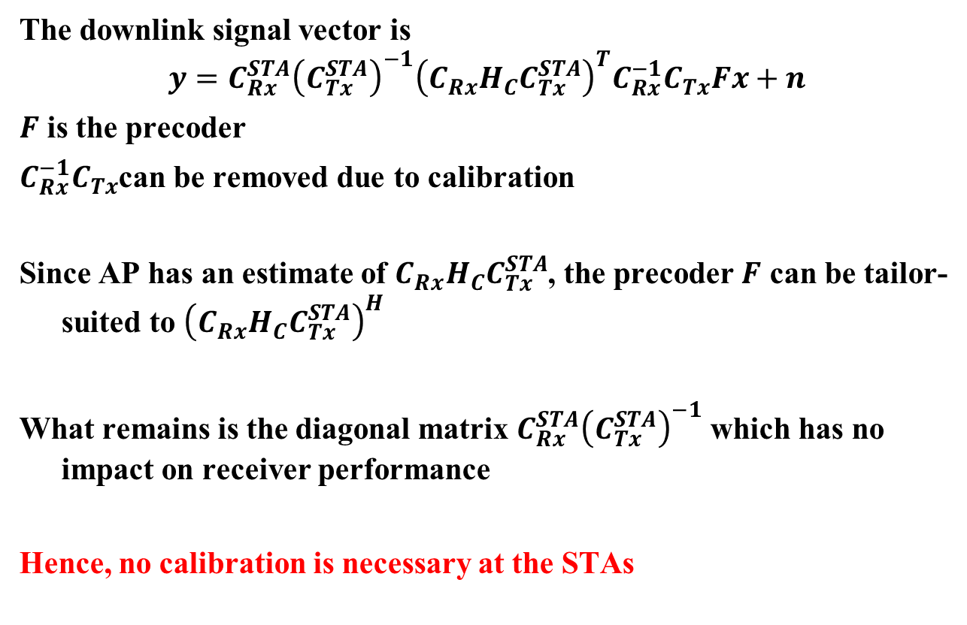
Mathematical Derivation
The downlink signal vector is
$$y=C_{Rx}^{STA}{\left(C_{Tx}^{STA}\right)}^{−1}{\left(C_{Rx}H_{C}C_{Tx}^{STA}\right)}^{T}C_{Rx}^{−1}C_{Tx}Fx+n$$
$F$ is the precoder
$C_{Rx}^{−1}C_{Tx}$can be removed due to calibration
Since AP has an estimate of ${C_{Rx}H}_{C}C_{Tx}^{STA}$, the precoder $F$ can be tailor-suited to ${\left(C_{Rx}H_{C}C_{Tx}^{STA}\right)}^{H}$
What remains is the diagonal matrix $C_{Rx}^{STA}{\left(C_{Tx}^{STA}\right)}^{−1}$ which has no impact on receiver performance
Hence, no calibration is necessary at the STAs

