Slide 1
Efficient Positioning Method Applicable in Dense Multi User Scenarios
Date: 2016-09-13
Authors:

Slide 2
Abstract
Firstly, we propose a new method for positioning, which can be used in dense multiuser scenarios. The main objective is to reduce the number of transmissions needed.
Secondly, the proposed method is extended in order to be used for infrastructure-centric localization and applications, such as secure geo-fencing etc.

Slide 3
Localization in Dense Multi User Scenarios
The Fine Timing Measurement (FTM) protocol generates additional traffic overhead and is hardly applicable in scenarios with a large number of users
According to [1], 384 µs is the minimum time per single FTM exchange
  With 1000 users and 0.5 Hz update rate (one update per 2 seconds) the medium is consumed for 19% of the time. [1]
  With N co-channel APs, the overhead gets N-fold worse [1]
  Averaging is usually used for improving the measurement precision. This additionally increases the overhead

Slide 4
Hyperbolic Navigation
The hyperbolic navigation approach described in [2] is partially solving this issue
  AP1 and AP2 perform a RTT measurement between them
  AP1 sends a frame to AP2 and AP2 back to AP1
  The frames need to have similar (and relatively long) lengths in order to achieve precise time of arrival estimation
  The number of transmissions by the access points is 6 for a 2D case and 8 for a 3D case, in the most general case, without any additional constraints

Slide 5
Proposed solution (1)
The proposed solution has similarities with GPS
  Except: Sequential transmission with virtual synchronization of APs
  AP1 transmits a timing frame (TF) frame to AP2, AP2 to AP3 and so on
  Replies from AP2 to AP1, AP3 to AP2 and so on, can be very short ACKs
  STAs also receive the TFs form the APs
AP1
AP2
AP3
AP4
TF
TF
ACK
TF
ACK
TF
ACK
STA

Slide 6
Proposed solution (2)
In order to obtain the position, the STAs passively listen to the transmitted frames
  The ToAs of TFs in STAs can be used to calculate the position
  The ToAs describe the radius of the distances from the STA to the APs
  Location estimation from the measured radiuses is a nonlinear problem which can be easily linearized
  Adding additional APs, in order to improve the localization position, leads to solving an overdetermined system of equations
In the TFs, the forwarding times as well as the APs positions can be also included
Main advantages over the hyperbolic approach is the reduced number of transmissions or shorter overall transmission time
  2D case: 6 transmissions (hyperbolic) vs 4 transmissions (proposed)
  3D case: 8 transmissions (hyperbolic) vs 5 transmissions (proposed)

Slide 7
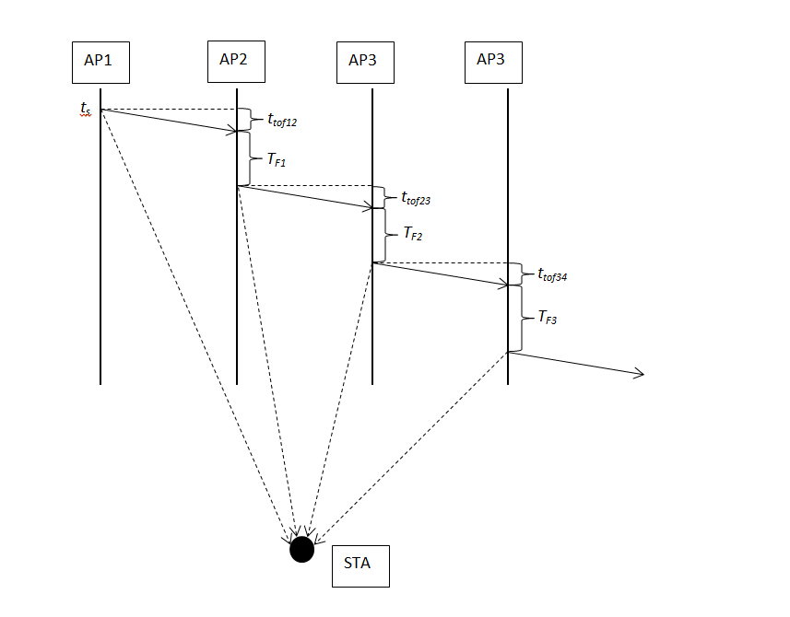
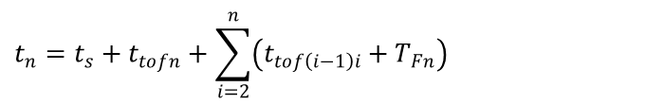
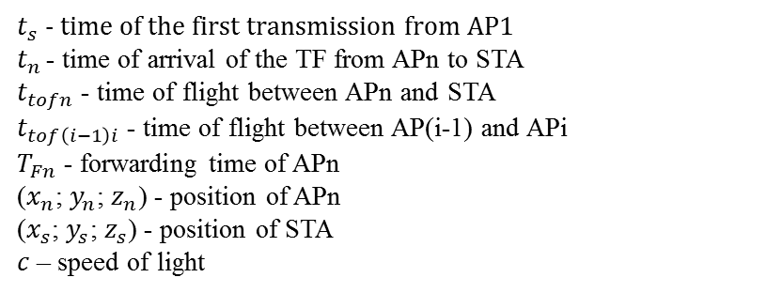

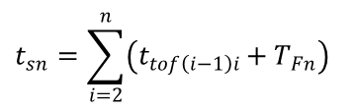

Passive positioning
$$t_{n}=t_{s}+t_{tofn}+\sum_{i=2}^{n}{\left(t_{tof\left(i−1\right)i}+T_{Fn}\right)}$$
$$t_{tofn}=\frac{1}{c}\sqrt{{\left(x_{n}−x_{s}\right)}^{2}+{\left(y_{n}−y_{s}\right)}^{2}+{\left(z_{n}−z_{s}\right)}^{2}}$$
$$t_{sn}=\sum_{i=2}^{n}{\left(t_{tof\left(i−1\right)i}+T_{Fn}\right)}$$
$$t_{n}=t_{s}+\frac{1}{c}\sqrt{{\left(x_{n}−x_{s}\right)}^{2}+{\left(y_{n}−y_{s}\right)}^{2}+{\left(z_{n}−z_{s}\right)}^{2}}+t_{sn}$$
$t_{s}$ - time of the first transmission from AP1
$t_{n }$- time of arrival of the TF from APn to STA
$t_{tofn}$ - time of flight between APn and STA
$t_{tof\left(i−1\right)i}$ - time of flight between AP(i-1) and APi
$T_{Fn}$ - forwarding time of APn
($x_{n}$; $y_{n}$; $z_{n}$) - position of APn
($x_{s}$; $y_{s}$; $z_{s}$) - position of STA
$c$ – speed of light

Slide 8
Extension to the proposed solution (1)
This extension mainly affects use cases where infrastructure centric localization such as geo-fencing is required
  Internet access in coffee shop possible only inside
  Wireless network access in a company – different rights, depending on location. No access outside from the premises of the company.
Main idea is to extend the solution so that the APs can be used to actively locate the STAs, independently of the position estimated by the STA itself.
  Tampering with the position would be almost impossible. This is difficult to achieve with the methods where the STAs are only receiving the signals. They can report any position to the infrastructure.

Slide 9
Extension to the proposed solution (2)
After the APs transmit the TFs in round robin fashion, the stations transmit their TFs also in round robin fashion
  Trigger frames can be used to schedule the STAs transmissions
Estimation of the location can be performed in 2 ways
  ToA, using the ToA of the TF transmitted by the STAs and received by the APs
  Two Way Ranging (TWR) as shown (AP1 to STA1 and STA1 back to AP1; AP2 to STA1 and STA1 back to AP2; etc.)
AP1
AP2
AP3
AP4
STA1
STA2

Slide 10
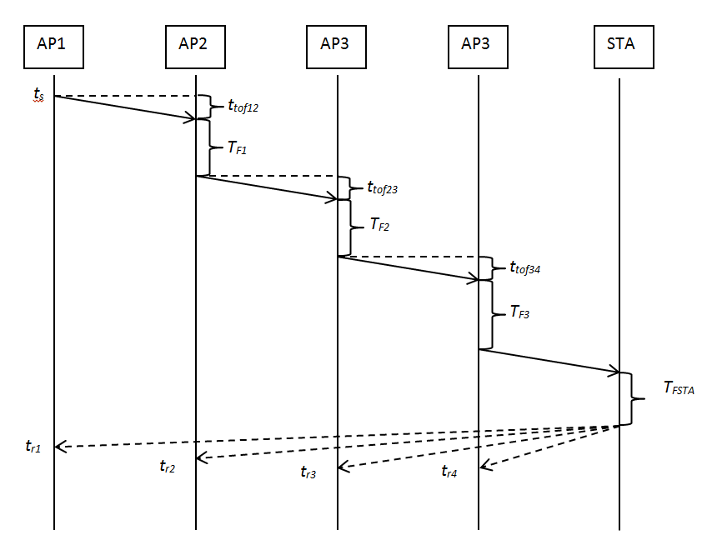

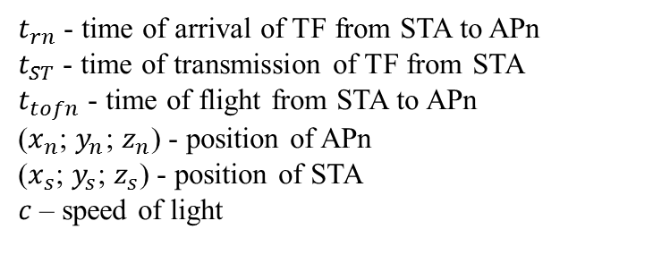


Infrastructure positioning
$$t_{rn}=t_{ST}+t_{tofn}$$
$$t_{tofn}=\frac{1}{c}\sqrt{{\left(x_{n}−x_{s}\right)}^{2}+{\left(y_{n}−y_{s}\right)}^{2}+{\left(z_{n}−z_{s}\right)}^{2}}$$
$$t_{rn}=t_{ST}+\frac{1}{c}\sqrt{{\left(x_{n}−x_{s}\right)}^{2}+{\left(y_{n}−y_{s}\right)}^{2}+{\left(z_{n}−z_{s}\right)}^{2}}$$
$t_{rn}$ - time of arrival of TF from STA to APn
$t_{ST}$ - time of transmission of TF from STA
$t_{tofn}$ - time of flight from STA to APn
($x_{n}$; $y_{n}$; $z_{n}$) - position of APn
($x_{s}$; $y_{s}$; $z_{s}$) - position of STA
$c$ – speed of light

Slide 11
Extension to the proposed solution (3)
The APs can locate the user in use cases where this is required
The first and the second approach can coexist, i.e. users that do not want to disclose their own position do not need to do so
Additional position estimation performed by the APs, can be combined with the position estimated by the STAs, in order to improve the precision

Slide 12
Conclusion
The proposed approach further reduces the number of transmissions needed to perform localization of mobile stations
It can be extended such that the APs
(i.e. the infrastructure) can also locate STAs
  STAs that do not need this functionality can still perform localization on their own
The number of APs can be increased in order to improve the localization precision; Channel usage increases linearly with the number of APs

Slide 13
References
[1] Brian Hart et al., Scalable Location, IEEE 802.11-14/1235r0
[2] Erik Lindskog, Client Positioning Using Timing Measurements between Access Points, IEEE 802.11-13/0072r0

Slide 14
Straw Poll
1.) Should the 802.11az protocol support at least one mode of operation that enables STAs to obtain their location by passively receiving measurement frames from fixed APs?
Yes: No: Need more info: Abstain:
2.) Should wireless connectivity between access points be supported to allow sequential transmission of timing frames, and hence, facilitating virtual synchronization of APs?
Yes: No: Need more info: Abstain:

