Slide 1
Packet extension factor calculation fix
Date: 2016-09-12
Authors:
Name | Affiliation | Address | Phone | Email
Hongyuan Zhang | Marvell | 5488 Marvell Lane, Santa Clara, CA, 95054 | 408-222-2500 | yzhang@marvell.com
Yan Zhang |  |  |  | hongyuan@marvell.com
Lei Wang |  |  |  | Leileiw@marvell.com
Liwen Chu |  |  |  | liwenchu@marvell.com
Jinjing Jiang |  |  |  | jinjing@marvell.com
Rui Cao |  |  |  | ruicao@marvell.com
Sudhir Srinivasa |  |  |  | sudhirs@marvell.com
Bo Yu |  |  |  | boyu@marvell.com
Saga Tamhane |  |  |  | sagar@marvell.com
Mao Yu |  |  |  | my@marvel..com
Xiayu Zheng |  |  |  | xzheng@marvell.com
Christian Berger |  |  |  | crberger@marvell.com
Niranjan Grandhe |  |  |  | ngrandhe@marvell.com
Hui-Ling Lou |  |  |  | hlou@marvell.com

Slide 2
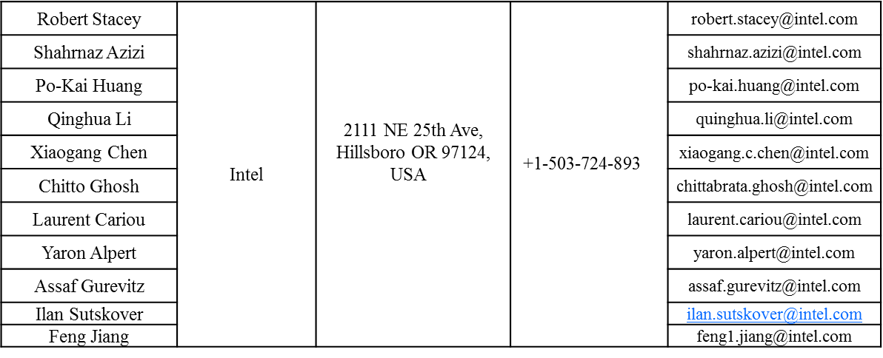
Authors (continued)
Name | Affiliation | Address | Phone | Email
Ron Porat | Broadcom |  |  | rporat@broadcom.com
Sriram Venkateswaran |  |  |  | mfischer@broadcom.com
Matthew Fischer
Zhou Lan
Leo Montreuil
Andrew Blanksby
Vinko Erceg

Slide 3
Authors (continued)
Name | Affiliation | Address | Phone | Email
Alice Chen | Qualcomm | 5775 Morehouse Dr. San Diego, CA, USA |  | alicel@qti.qualcomm.com
Albert Van Zelst |  | Straatweg 66-S Breukelen, 3621 BR Netherlands |  | allert@qti.qualcomm.com
Alfred Asterjadhi |  | 5775 Morehouse Dr. San Diego, CA, USA |  | aasterja@qti.qualcomm.com
Arjun Bharadwaj |  | 5775 Morehouse Dr. San Diego, CA, USA |  | arjunb@qti.qualcomm.com
Bin Tian |  | 5775 Morehouse Dr. San Diego, CA, USA |  | btian@qti.qualcomm.com
Carlos Aldana |  | 1700 Technology Drive San Jose, CA 95110, USA |  | caldana@qca.qualcomm.com
George Cherian |  | 5775 Morehouse Dr. San Diego, CA, USA |  | gcherian@qti.qualcomm.com
Gwendolyn Barriac |  | 5775 Morehouse Dr. San Diego, CA, USA |  | gbarriac@qti.qualcomm.com
Hemanth Sampath |  | 5775 Morehouse Dr. San Diego, CA, USA |  | hsampath@qti.qualcomm.com
Lin Yang |  | 5775 Morehouse Dr. San Diego, CA, USA |  | linyang@qti.qualcomm.com
Menzo Wentink |  | Straatweg 66-S Breukelen, 3621 BR Netherlands |  | mwentink@qti.qualcomm.com
Naveen Kakani |  | 2100 Lakeside Boulevard Suite 475, Richardson TX 75082, USA |  | nkakani@qti.qualcomm.com
Raja Banerjea |  | 1060 Rincon Circle San Jose CA 95131, USA |  | rajab@qit.qualcomm.com
Richard Van Nee |  | Straatweg 66-S Breukelen, 3621 BR Netherlands |  | rvannee@qti.qualcomm.com

Slide 4
Authors (continued)
Name | Affiliation | Address | Phone | Email
Rolf De Vegt | Qualcomm | 1700 Technology Drive San Jose, CA 95110, USA |  | rolfv@qca.qualcomm.com
Sameer Vermani |  | 5775 Morehouse Dr. San Diego, CA, USA |  | svverman@qti.qualcomm.com
Simone Merlin |  | 5775 Morehouse Dr. San Diego, CA, USA |  | smerlin@qti.qualcomm.com
Tao Tian |  | 5775 Morehouse Dr. San Diego, CA, USA |  | ttian@qti.qualcomm.com
Tevfik Yucek |  | 1700 Technology Drive San Jose, CA 95110, USA |  | tyucek@qca.qualcomm.com
VK Jones |  | 1700 Technology Drive San Jose, CA 95110, USA |  | vkjones@qca.qualcomm.com
Youhan Kim |  | 1700 Technology Drive San Jose, CA 95110, USA |  | youhank@qca.qualcomm.com

Slide 5
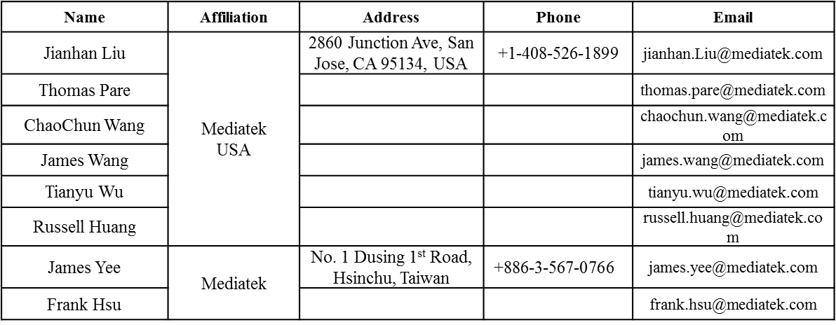
Authors (continued)

Slide 6
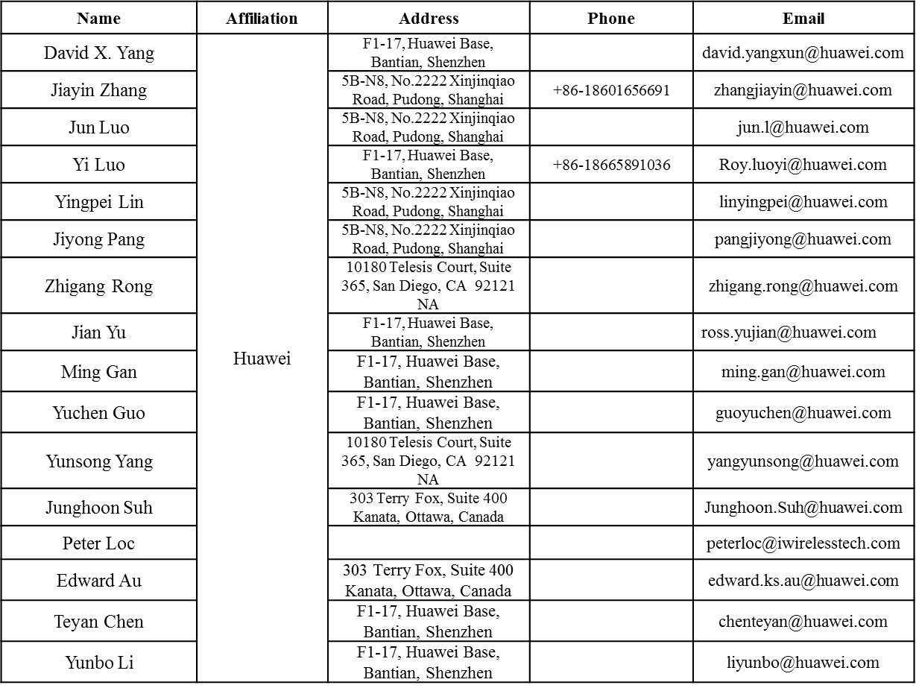
Authors (continued)

Slide 7
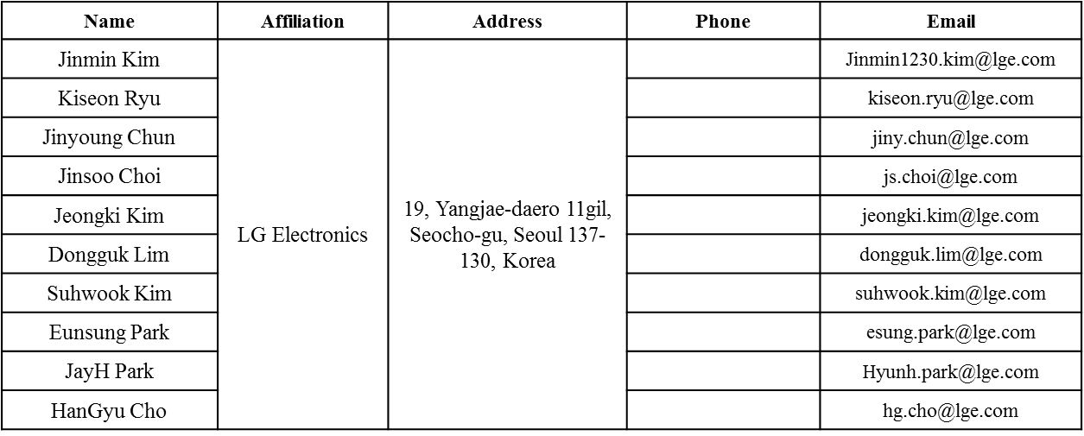
Authors (continued)
Bo Sun | ZTE | #9 Wuxingduan, Xifeng Rd., Xi'an, China |  | sun.bo1@zte.com.cn
Kaiying Lv |  |  |  | lv.kaiying@zte.com.cn
Yonggang Fang |  |  |  | yfang@ztetx.com
Ke Yao |  |  |  | yao.ke5@zte.com.cn
Weimin Xing |  |  |  | xing.weimin@zte.com.cn
Brian Hart | Cisco Systems | 170 W Tasman Dr, San Jose, CA 95134 |  | brianh@cisco.com
Pooya Monajemi |  |  |  | pmonajem@cisco.com

Slide 8
Authors (continued)
Name | Affiliation | Address | Phone | Email
Fei Tong | Samsung | Innovation Park, Cambridge CB4 0DS (U.K.) | +44 1223 434633 | f.tong@samsung.com
Hyunjeong Kang |  | Maetan 3-dong; Yongtong-Gu Suwon; South Korea | +82-31-279-9028 | hyunjeong.kang@samsung.com
Kaushik Josiam |  | 1301, E. Lookout Dr, Richardson TX 75070 | (972) 761 7437 | k.josiam@samsung.com
Mark Rison |  | Innovation Park, Cambridge CB4 0DS (U.K.) | +44 1223 434600 | m.rison@samsung.com
Rakesh Taori |  | 1301, E. Lookout Dr, Richardson TX 75070 | (972) 761 7470 | rakesh.taori@samsung.com
Sanghyun Chang |  | Maetan 3-dong; Yongtong-Gu Suwon; South Korea | +82-10-8864-1751 | s29.chang@samsung.com
Yasushi Takatori | NTT | 1-1 Hikari-no-oka, Yokosuka, Kanagawa 239-0847 Japan | +81 46 859 3135 | takatori.yasushi@lab.ntt.co.jp
Yasuhiko Inoue |  |  | +81 46 859 5097 | inoue.yasuhiko@lab.ntt.co.jp
Shoko Shinohara |  |  | +81 46 859 5107 | Shinohara.shoko@lab.ntt.co.jp
Yusuke Asai |  |  | +81 46 859 3494 | asai.yusuke@lab.ntt.co.jp
Koichi Ishihara |  |  | +81 46 859 4233 | ishihara.koichi@lab.ntt.co.jp
Junichi Iwatani |  |  | +81 46 859 4222 | Iwatani.junichi@lab.ntt.co.jp
Akira Yamada | NTT DOCOMO | 3-6, Hikarinooka, Yokosuka-shi, Kanagawa, 239-8536, Japan | +81 46 840 3759 | yamadaakira@nttdocomo.com

Slide 9
Authors (continued)
Name | Affiliation | Address | Phone | Email
Masahito Mori | Sony Corp. |  |  | Masahito.Mori@jp.sony.com
Yusuke Tanaka |  |  |  | YusukeC.Tanaka@jp.sony.com
Yuichi Morioka |  |  |  | Yuichi.Morioka@jp.sony.com
Kazuyuki Sakoda |  |  |  | Kazuyuki.Sakoda@am.sony.com
William Carney |  |  |  | William.Carney@am.sony.com
Sigurd Schelstraete | Quantenna |  |  | Sigurd@quantenna.com
Huizhao Wang |  |  |  | hwang@quantenna.com
Minho Cheong | Newracom | 9008 Research Dr. Irvine, CA 92618 |  | minho.cheong@newracom.com
Reza Hedayat |  |  |  | reza.hedayat@newracom.com
Young Hoon Kwon |  |  |  | younghoon.kwon@newracom.com
Yongho Seok |  |  |  | yongho.seok@newracom.com
Daewon Lee |  |  |  | daewon.lee@newracom.com
Yujin Noh |  |  |  | yujin.noh@newracom.com

Slide 11
Discussion
For 80MHz bandwidth, N_{SD_short} value used in packet extension is less than N_{SD}/4. Therefore a_factor can be greater than 4 if it is calculated by Equation (26-64) in Draft 0.4 clause 26.3.11.2.
For example, 80MHz bandwidth SU transmission at MCS11 with 1 spatial stream, and data packet size of 8000 bits, STBC disabled.
In this case, total data size is 8016bits, and N_{DBPS} = floor(980*10*5/6) = 8166 bits. Excess bits = 8016. N_{SD_short} = 240 tones. N_{DBPS,short} = 240*10*5/6=2000.
If we use equation (2-64), a_factor = ceil(Excess bits, N_{DBPS,short} )= 5, which is wrong.

Slide 12
Solution
Change spec text in clause 26.3.11.2 in Draft 4.0 (P198L55) to “Then based on N_{Excess}, compute the initial number of symbol segments in the last OFDM symbol(s), a-factor value or a_{init}, as shown in Equation (26-64)
This change guarantees that a_{init} range is within [1,4].

Slide 13
SP1
Do you agree to adopt the spec text changes as shown in doc 11/16-1242r0?

