Slide 1
Outdoor measurement for a rooftop to street scenario at 60 GHz
Date: 2016-09-14
Authors:
Name | Affiliation | Address | Phone | Email
Jian Luo, Yan Xin, George Calcev | HUAWEI Technologies |  |  | Jianluo@Huawei.com Yan.xin@Huawei.com George.Calcev@huawei.com
Robert Müller, Diego Dupleich, Stephan Häfner, Reiner Thomä | Technische Universität Ilmenau |  |  | Mueller.Robert@tu-Ilmenau.de Reiner.thomae@tu-ilmrnau.de

Slide 2
Abstract
In this presentation, we show the characterization of a rooftop to street scenario in a street canyon configuration. We show that transmission in the 60GHz band works for distances of about 100m and multi bounce.
The goal of this measurement campaign and analysis is to obtain parameters for outdoor scenarios for the 802.11ay channel model.
The measurement can thus be used as a basis for calibration of a ray tracer and also for modeling of clusters for channel modeling.

Slide 3
Outline
Motivation
60 GHz Outdoor Measurement Setup
60 GHz Measurement Results
Conclusion

Slide 4
Motivation
Broadband and full polarimetric characterization of Cluster
  To understand the broadband and polarimetric scattering of different structure
Advanced system concepts → define measurement and modelling requirements
  Massive MIMO/pencil beamforming → large spatial bandwidth
  Adaptive or switched selection beamforming to mitigate shadowing
  Channel bonding → large bandwidth
Propagation channel
  Double directional measurements are needed to characterize the full channel
  Polarization is an important aspect
  High dynamic range is essential to measure the different propagation effects
Channel characterization for different usage cases

Slide 5
60 GHz Outdoor
Measurement Setup

Slide 6
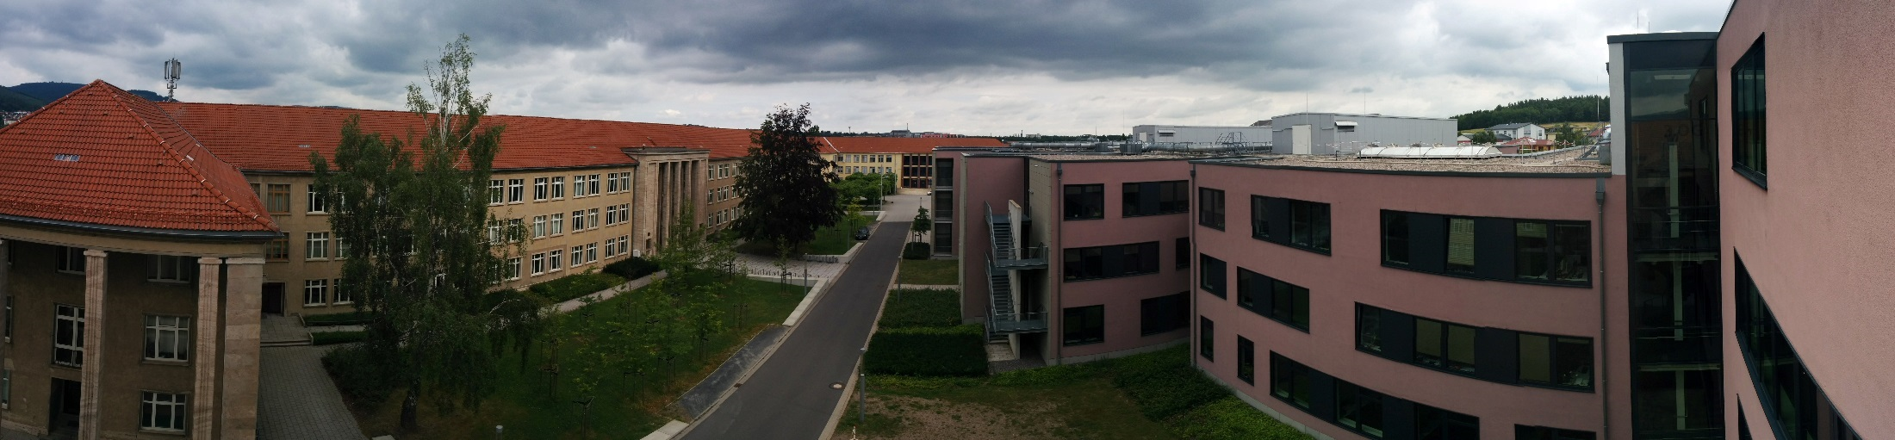
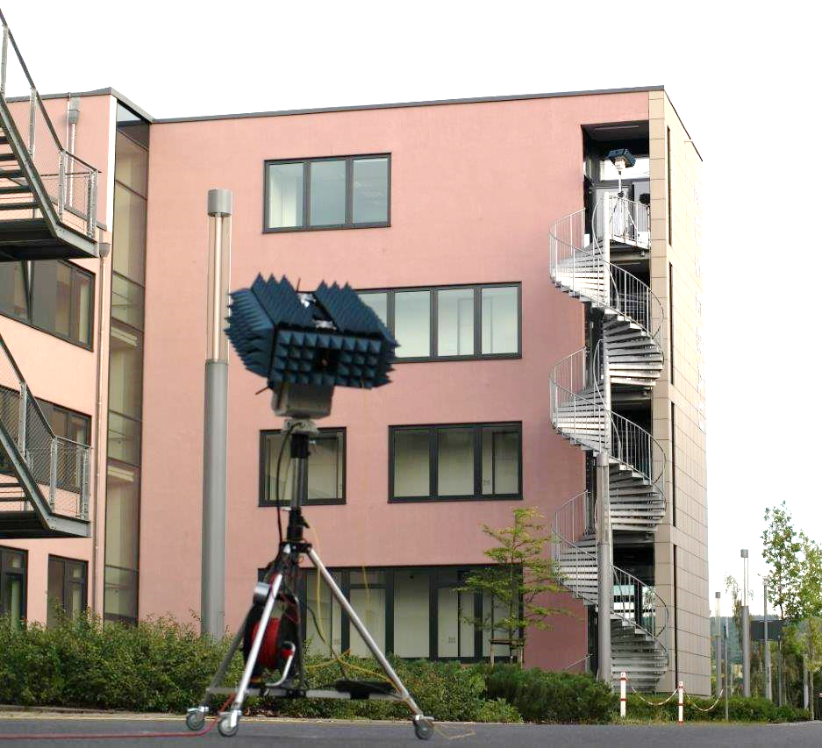
Outdoor Measurements
Measurement set-up
Dual-band measurements: 30 and 60 GHz
30°HPBW at Tx and Rx → Az: -150°:30°:180°
El: -30° :30°:30°
User Access Scenario
Tx located at a rooftop level (14m)
Rx located at person level (1.5m)
LOS and NLOS
Measurement Parameters
7 GHz bandwidth
Dual polarization measurement capability
25 dB AGC (Automatic Gain Control) with 3.5 dB steps
High instantaneous dynamic range: up to 75 dB
Multi-Link and Massive MIMO capabilities
Double directional measurements

Slide 7
60 GHz
Measurement Results

Slide 8
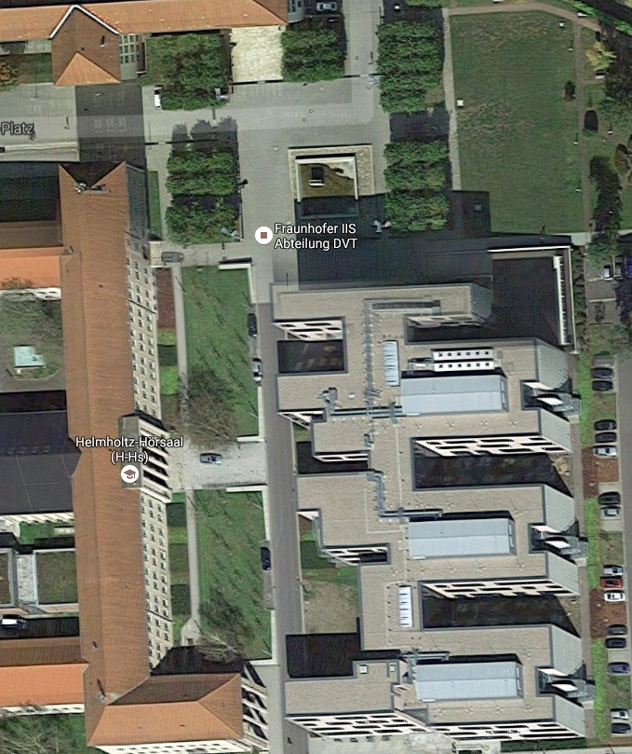
Outdoor Measurements
Synthetic omni-PDP
Rx1
0°
25 dB Threshold
90°
Rx9
Rx6
Rx8
Rx7
Rx3
10m
Rx3
Rx1
25 dB Threshold
45m
Tx

Slide 9
Outdoor Measurements
Synthetic omni-PDP
Rx6
0°
25 dB Threshold
90°
Rx9
Rx6
Rx8
10m
Rx7
Rx3
Rx7
85m
Rx1
25 dB Threshold
Tx

Slide 10
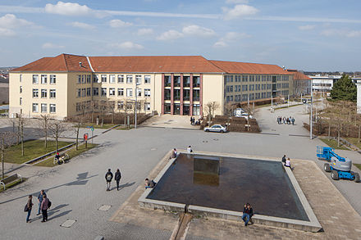
Outdoor Measurements
Synthetic omni-PDP
Rx8
25 dB Threshold
0°
90°
Rx9
Rx6
Rx8
Rx7
LOS
NLOS
Rx3
Rx9
Rx1
25 dB Threshold
Tx

Slide 11
Outdoor Measurements
Rx1 - LOS
Marginal Power Angular Profiles
0°
90°
Rx6
Rx9
Rx7
Rx8
Rx3
Rx1
Tx
All other direction (Az. + El.) are coherent summed
→ The most power are available in the LOS case → Tx 0° and Rx 180°

Slide 12
Outdoor Measurements
Rx3 - LOS
Marginal Power Angular Profiles
0°
90°
Rx9
Rx6
Rx8
Rx7
Rx3
Rx1
Tx
All other direction (Az. + El.) are coherent summed
→ The most power are available in the LOS case → Tx 0° and Rx 180°

Slide 13
Outdoor Measurements
Rx9 - LOS
Marginal Power Angular Profiles
0°
90°
Rx9
Rx6
Rx8
Rx7
Rx3
Rx1
Tx
All other direction (Az. + El.) are coherent summed
→ The reflection from the back building are very strong

Slide 14
Outdoor Measurements
Rx6 - NLOS
Marginal Power Angular Profiles
0°
90°
Rx9
Rx6
Rx8
Rx7
Rx3
Rx1
Tx
All other direction (Az. + El.) are coherent summed
→ Many scatters available which can be used for MIMO

Slide 15
Outdoor Measurements
Rx7 - NLOs
Marginal Power Angular Profiles
0°
90°
Rx9
Rx6
Rx8
Rx7
Rx3
Rx1
Tx
All other direction (Az. + El.) are coherent summed
→ Many scatters available which can be used for MIMO

Slide 16
Outdoor Measurements
Rx8 - NLOS
Marginal Power Angular Profiles
0°
90°
Rx9
Rx6
Rx8
Rx7
Rx3
Rx1
Tx
All other direction (Az. + El.) are coherent summed
→ Many scatters available which can be used for MIMO

Slide 17
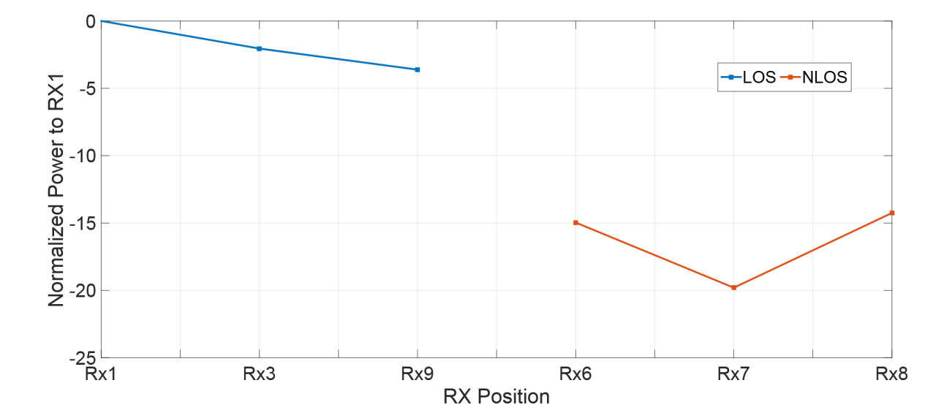
Outdoor Measurements
0°
User access scenario
Synthetic Omni-directional Received Power
90°
Rx9
Rx6
Rx8
Rx7
Rx3
Rx1
Tx
The different for the total power between LOS and NLOS is max. 20 dB
The max. distance is around 100m
Output power 23 dBm

Slide 18
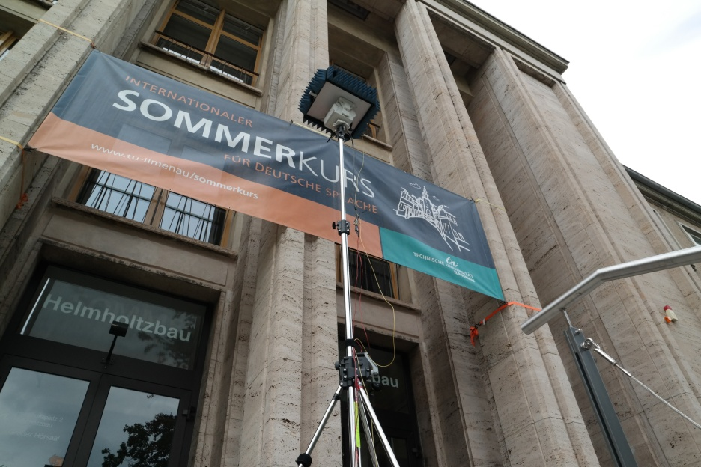
Conclusions
Up to 20 dB difference between LOS and NLOS scenarios
Significant paths besides LOS → late components, which can be destroy the SNR
Reflectors works better at mm-Wave than as micro wave
Next Steps
  Parameter generation of outdoor measurements at 60 GHz for the TGay channel model
  Analysis of the Front hauling measurements
  Analysis of the cluster properties for different beamforming strategies

