Slide 1
SR Field SRP Table for He Trigger-Based PPDU
Date: 2016-09-11
Authors:
Name | Affiliation | Address | Phone | Email
James Wang | Mediatek USA | 2860 Junction Ave, San Jose, CA 95134, USA | +1-408-526-1899 | james.wang@mediatek.com
Thomas Pare |  |  |  | thomas.pare@mediatek.com
ChaoChun Wang |  |  |  | chaochun.wang@mediatek.com
Jianhan Liug |  |  |  | Jianhan. liu@mediatek.com
Tianyu Wu |  |  |  | tianyu.wu@mediatek.com
Russell Huang |  |  |  | russell.huang@mediatek.com
James Yee | Mediatek | No. 1 Dusing 1st Road, Hsinchu, Taiwan | +886-3-567-0766 | james.yee@mediatek.com
Alan Jauh |  |  |  | alan.jauh@mediatek.com
Frank Hsu |  |  |  | frank.hsu@mediatek.com

Slide 2
Authors (continued)
Name | Affiliation | Address | Phone | Email
Ron Porat | Broadcom |  |  | rporat@broadcom.com
Sriram Venkateswaran
Matthew Fischer |  |  |  | mfischer@broadcom.com
Zhou Lan
Leo Montreuil
Andrew Blanksby
Vinko Erceg
Mingyue Ji
Name | Affiliation | Address | Phone | Email
Chittabrata Ghosh | Intel | 2200 Mission College Blvd., Santa Clara, CA 95054, USA | +1-415-244-8904 | chittabrata.ghosh@intel.com
Robert Stacey |  |  |  | robert.stacey@intel.com
Eldad Perahia |  |  |  | eldad.perahia@intel.com
Shahrnaz Azizi |  |  |  | shahrnaz.azizi@intel.com
Po-Kai Huang |  |  |  | po-kai.huang@intel.com
Qinghua Li |  |  |  | quinghua.li@intel.com
Laurent Cariou |  |  |  | laurent.cariou@intel.com
Xiaogang Chen |  |  |  | xiaogang.c.chen@intel.com
Rongzhen Yang |  |  |  | rongzhen.yang@intel.com
Yaron Alpert |  |  |  | yaron.alpert@intel.com
Avi Mansour |  |  |  | avi.mansour@intel.com

Slide 3
Authors (continued)
Name | Affiliation | Address | Phone | Email
Hongyuan Zhang | Marvell | 5488 Marvell Lane, Santa Clara, CA, 95054 | 408-222-2500 | hongyuan@marvell.com
Yakun Sun |  |  |  | yakunsun@marvell.com
Lei Wang |  |  |  | Leileiw@marvell.com
Liwen Chu |  |  |  | liwenchu@marvell.com
Jinjing Jiang |  |  |  | jinjing@marvell.com
Yan Zhang |  |  |  | yzhang@marvell.com
Rui Cao |  |  |  | ruicao@marvell.com
Sudhir Srinivasa |  |  |  | sudhirs@marvell.com
Bo Yu |  |  |  | boyu@marvell.com
Saga Tamhane |  |  |  | sagar@marvell.com
Mao Yu |  |  |  | my@marvel..com
Xiayu Zheng |  |  |  | xzheng@marvell.com
Christian Berger |  |  |  | crberger@marvell.com
Niranjan Grandhe |  |  |  | ngrandhe@marvell.com
Hui-Ling Lou |  |  |  | hlou@marvell.com

Slide 4
Authors (continued)
Name | Affiliation | Address | Phone | Email
Alice Chen | Qualcomm | 5775 Morehouse Dr. San Diego, CA, USA |  | alicel@qti.qualcomm.com
Albert Van Zelst |  | Straatweg 66-S Breukelen, 3621 BR Netherlands |  | allert@qti.qualcomm.com
Alfred Asterjadhi |  | 5775 Morehouse Dr. San Diego, CA, USA |  | aasterja@qti.qualcomm.com
Arjun Bharadwaj |  | 5775 Morehouse Dr. San Diego, CA, USA |  | arjunb@qti.qualcomm.com
Bin Tian |  | 5775 Morehouse Dr. San Diego, CA, USA |  | btian@qti.qualcomm.com
Carlos Aldana |  | 1700 Technology Drive San Jose, CA 95110, USA |  | caldana@qca.qualcomm.com
George Cherian |  | 5775 Morehouse Dr. San Diego, CA, USA |  | gcherian@qti.qualcomm.com
Gwendolyn Barriac |  | 5775 Morehouse Dr. San Diego, CA, USA |  | gbarriac@qti.qualcomm.com
Hemanth Sampath |  | 5775 Morehouse Dr. San Diego, CA, USA |  | hsampath@qti.qualcomm.com
Lin Yang |  | 5775 Morehouse Dr. San Diego, CA, USA |  | linyang@qti.qualcomm.com
Menzo Wentink |  | Straatweg 66-S Breukelen, 3621 BR Netherlands |  | mwentink@qti.qualcomm.com
Naveen Kakani |  | 2100 Lakeside Boulevard Suite 475, Richardson TX 75082, USA |  | nkakani@qti.qualcomm.com
Raja Banerjea |  | 1060 Rincon Circle San Jose CA 95131, USA |  | rajab@qit.qualcomm.com
Richard Van Nee |  | Straatweg 66-S Breukelen, 3621 BR Netherlands |  | rvannee@qti.qualcomm.com

Slide 5
Authors (continued)
Name | Affiliation | Address | Phone | Email
Rolf De Vegt | Qualcomm | 1700 Technology Drive San Jose, CA 95110, USA |  | rolfv@qca.qualcomm.com
Sameer Vermani |  | 5775 Morehouse Dr. San Diego, CA, USA |  | svverman@qti.qualcomm.com
Simone Merlin |  | 5775 Morehouse Dr. San Diego, CA, USA |  | smerlin@qti.qualcomm.com
Tao Tian |  | 5775 Morehouse Dr. San Diego, CA, USA |  | ttian@qti.qualcomm.com
Tevfik Yucek |  | 1700 Technology Drive San Jose, CA 95110, USA |  | tyucek@qca.qualcomm.com
VK Jones |  | 1700 Technology Drive San Jose, CA 95110, USA |  | vkjones@qca.qualcomm.com
Youhan Kim |  | 1700 Technology Drive San Jose, CA 95110, USA |  | youhank@qca.qualcomm.com
Joonsuk Kim | Apple |  |  | joonsuk@apple.com
Aon Mujtaba |  |  |  | mujtaba@apple.com
Guoqing Li |  |  |  | guoqing_li@apple.com
Eric Wong |  |  |  | ericwong@apple.com
Chris Hartman |  |  |  | chartman@apple.com

Slide 6
Authors (continued)
Name | Affiliation | Address | Phone | Email
David X. Yang | Huawei | F1-17, Huawei Base, Bantian, Shenzhen |  | david.yangxun@huawei.com
Jiayin Zhang |  | 5B-N8, No.2222 Xinjinqiao Road, Pudong, Shanghai | +86-18601656691 | zhangjiayin@huawei.com
Jun Luo |  | 5B-N8, No.2222 Xinjinqiao Road, Pudong, Shanghai |  | jun.l@huawei.com
Yi Luo |  | F1-17, Huawei Base, Bantian, Shenzhen | +86-18665891036 | Roy.luoyi@huawei.com
Yingpei Lin |  | 5B-N8, No.2222 Xinjinqiao Road, Pudong, Shanghai |  | linyingpei@huawei.com
Jiyong Pang |  | 5B-N8, No.2222 Xinjinqiao Road, Pudong, Shanghai |  | pangjiyong@huawei.com
Zhigang Rong |  | 10180 Telesis Court, Suite 365, San Diego, CA 92121 NA |  | zhigang.rong@huawei.com
Jian Yu |  | F1-17, Huawei Base, Bantian, Shenzhen |  | ross.yujian@huawei.com
Ming Gan |  | F1-17, Huawei Base, Bantian, Shenzhen |  | ming.gan@huawei.com
Yunsong Yang |  | 10180 Telesis Court, Suite 365, San Diego, CA 92121 NA |  | yangyunsong@huawei.com
Junghoon Suh |  | 303 Terry Fox, Suite 400 Kanata, Ottawa, Canada |  | Junghoon.Suh@huawei.com
Peter Loc |  |  |  | peterloc@iwirelesstech.com
Edward Au |  | 303 Terry Fox, Suite 400 Kanata, Ottawa, Canada |  | edward.ks.au@huawei.com
Teyan Chen |  | F1-17, Huawei Base, Bantian, Shenzhen |  | chenteyan@huawei.com
Yunbo Li |  | F1-17, Huawei Base, Bantian, Shenzhen |  | liyunbo@huawei.com

Slide 7
Authors (continued)
Name | Affiliation | Address | Phone | Email
Jinmin Kim | LG Electronics | 19, Yangjae-daero 11gil, Seocho-gu, Seoul 137-130, Korea |  | Jinmin1230.kim@lge.com
Kiseon Ryu |  |  |  | kiseon.ryu@lge.com
Jinyoung Chun |  |  |  | jiny.chun@lge.com
Jinsoo Choi |  |  |  | js.choi@lge.com
Jeongki Kim |  |  |  | jeongki.kim@lge.com
Dongguk Lim |  |  |  | dongguk.lim@lge.com
Suhwook Kim |  |  |  | suhwook.kim@lge.com
Eunsung Park |  |  |  | esung.park@lge.com
JayH Park |  |  |  | Hyunh.park@lge.com
HanGyu Cho |  |  |  | hg.cho@lge.com
Thomas Derham | Orange |  |  | thomas.derham@orange.com
Bo Sun | ZTE | #9 Wuxingduan, Xifeng Rd., Xi'an, China |  | sun.bo1@zte.com.cn
Kaiying Lv |  |  |  | lv.kaiying@zte.com.cn
Yonggang Fang |  |  |  | yfang@ztetx.com
Ke Yao |  |  |  | yao.ke5@zte.com.cn
Weimin Xing |  |  |  | xing.weimin@zte.com.cn
Brian Hart | Cisco Systems | 170 W Tasman Dr, San Jose, CA 95134 |  | brianh@cisco.com
Pooya Monajemi |  |  |  | pmonajem@cisco.com

Slide 8
Authors (continued)
Name | Affiliation | Address | Phone | Email
Fei Tong | Samsung | Innovation Park, Cambridge CB4 0DS (U.K.) | +44 1223 434633 | f.tong@samsung.com
Hyunjeong Kang |  | Maetan 3-dong; Yongtong-Gu Suwon; South Korea | +82-31-279-9028 | hyunjeong.kang@samsung.com
Kaushik Josiam |  | 1301, E. Lookout Dr, Richardson TX 75070 | (972) 761 7437 | k.josiam@samsung.com
Mark Rison |  | Innovation Park, Cambridge CB4 0DS (U.K.) | +44 1223 434600 | m.rison@samsung.com
Rakesh Taori |  | 1301, E. Lookout Dr, Richardson TX 75070 | (972) 761 7470 | rakesh.taori@samsung.com
Sanghyun Chang |  | Maetan 3-dong; Yongtong-Gu Suwon; South Korea | +82-10-8864-1751 | s29.chang@samsung.com
Yasushi Takatori | NTT | 1-1 Hikari-no-oka, Yokosuka, Kanagawa 239-0847 Japan | +81 46 859 3135 | takatori.yasushi@lab.ntt.co.jp
Yasuhiko Inoue |  |  | +81 46 859 5097 | inoue.yasuhiko@lab.ntt.co.jp
Shoko Shinohara |  |  | +81 46 859 5107 | Shinohara.shoko@lab.ntt.co.jp
Yusuke Asai |  |  | +81 46 859 3494 | asai.yusuke@lab.ntt.co.jp
Koichi Ishihara |  |  | +81 46 859 4233 | ishihara.koichi@lab.ntt.co.jp
Junichi Iwatani |  |  | +81 46 859 4222 | Iwatani.junichi@lab.ntt.co.jp
Akira Yamada | NTT DOCOMO | 3-6, Hikarinooka, Yokosuka-shi, Kanagawa, 239-8536, Japan | +81 46 840 3759 | yamadaakira@nttdocomo.com

Slide 9
Authors (continued)
Name | Affiliation | Address | Phone | Email
Masahito Mori | Sony Corp. |  |  | Masahito.Mori@jp.sony.com
Yusuke Tanaka |  |  |  | YusukeC.Tanaka@jp.sony.com
Yuichi Morioka |  |  |  | Yuichi.Morioka@jp.sony.com
Kazuyuki Sakoda |  |  |  | Kazuyuki.Sakoda@am.sony.com
William Carney |  |  |  | William.Carney@am.sony.com
Tomoko Adachi | Toshiba |  |  | tomo.adachi@toshiba.co.jp
Narendar Madhavan |  |  |  | narendar.madhavan@toshiba.co.jp
Kentaro Taniguchi |  |  |  | kentaro.taniguchi@toshiba.co.jp
Toshihisa Nabetani |  |  |  | toshihisa.nabetani@toshiba.co.jp
Tsuguhide Aoki |  |  |  | tsuguhide.aoki@toshiba.co.jp
Koji Horisaki |  |  |  | kouji.horisaki@toshiba.co.jp
David Halls |  |  |  | david.halls@toshiba-trel.com
Filippo Tosato |  |  |  | filippo.tosato@toshiba-trel.com
Zubeir Bocus |  |  |  | zubeir.bocus@toshiba-trel.com
Fengming Cao |  |  |  | fengming.cao@toshiba-trel.com
Parag Kulkarni |  |  |  | parag.kulkarni@toshiba-trel.com

Slide 10
Authors (continued)
Minho Cheong | Newracom, Inc. | 9008 Research Dr, Irvine, CA 92618 | +1-949-390-7146 | minho.cheong@newracom.com
Reza Hedayat |  |  |  | reza.hedayat@newracom.com
Young Hoon Kwon |  |  |  | younghoon.kwon@newracom.com
Yongho Seok |  |  |  | yongho.seok@newracom.com
Daewon Lee |  |  |  | daewon.lee@newracom.com
Yujin Noh |  |  |  | yujin.noh@newracom.com
Sigurd Schelstraete | Quantenna | 3450 W. Warren Ave, Fremont, CA 94538 |  | Sigurd@quantenna.com
Huizhao Wang |  |  |  | hwang@quanetnna.com

Slide 11
Re-Cap: HE Trigger-Based PPDU and SRP
Trigger frame from STA2 (AP) for UL MU carries SRP, OBSS Color, and the uplink duration.
  Uplink STA (STA1) copies SRP from trigger frame into SR field of SIG A
SR STA uses RSSI_{trigger frame} from the trigger frame and SRP is in UL HE Trigger-based PPDU transmitted by UL STA to make adjustment for satisfying SR conditions.
STA2 (AP)
Trigger
STA1s
on-going frame
Transmission
STA2 (AP)
UL MU
UL MU
Space Loss
STA1 (UL STA)
Trigger frame carries SRP (not in SIG A) for UL STAs
RSSI_{trigger frame}
UL _MU
SRP (Trigger-Based PPDU)
STA4 (SR responder)
SIG A: SRP
SR transmission duration
TX_PWR adjusted based on RSSI and SRP . TX Power_{STA2} < SRP – RSSI_{trigger frame}
SRP= TX PWR + Acceptable Receiver Interference level
STA3 (SR initiator)

Slide 12
Preliminary Simulation of SRP-Based SR (OA-CCA)
One Shot
19 existing links contribute: 251.9 mcs0 PHY rate
50 extra SR links contribute: 217 mcs0 PHY rate
System gain of OA-CCA: 86%
Average 1000 Shots
Target 0% PER: (Old)
  20 existing links contribute: 261.6 mcs0 PHY rate
  51 extra SR links contribute: 206 mcs0 PHY rate
  System gain of OA-CCA: 78.7%
Target 10% PER: (New)
  20 existing links contribute: 259.8 mcs0 PHY rate
  62 extra SR links contribute: 267.5 mcs0 PHY rate
  System gain of OA-CCA: 102.9%
* Detailed simulation conditions in backup charts (5 Floors, 100 Apartments, no SR back off, full utilization of PPDU)

Slide 13
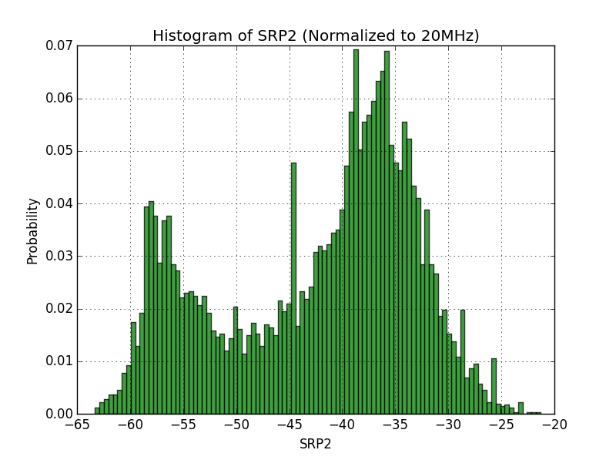
PDF of SRP2

Slide 14
Proposed SRP Table
SR Table for SR field(s) in SIG A (54 dB range, 3 or 6 dB increment) for HE trigger-base PPDU
SRP= TX PWR_{AP} + Acceptable Receiver Interference level_{AP}
  Adjustment range for parameters (referenced to the antenna port):
  TX_PWR_{AP}: -10 dBm to 26 dBm
  Acceptable Receiver Interference Level_{AP}: -82dBm to -36 dBm
If SRP is below <-80 dBm, set to Spatial Reuse to 0001, if SRP is above -26 dBm, set Spatial reuse to 1110
Set Spatial Reuse to 0000 for SR disallowed flag, Value 1111 is reserved
Same table is used for AP and STA.
SR Field | SRP | SR Field | SRP
0001 | -80 dBm | 1000 | -44 dBm
0010 | -74 dBm | 1001 | -41 dBm
0011 | -68 dBm | 1010 | -38dBm
0100 | -62 dBm | 1011 | -35dBm
0101 | -56 dBm | 1100 | -32 dBm
0110 | -50 dBm | 1101 | -29 dBm
0111 | -47 dBm | 1110 | -26 dBm

Slide 15
Straw Poll/Motion
Move to adopt the following SRP values for the corresponding entries in Spatial Reuse fields (in Spatial Reuse 1, Spatial Reuse 2, Spatial Reuse 3, and Spatial Reuse 4) for He Trigger-based PPDU
SRP= TX PWR_{AP} + Acceptable Receiver Interference level_{AP}
  Adjustment range for parameters (referenced to the antenna port)
  TX_PWR_{AP}: -10 dBm to 26 dBm
  Acceptable Receiver Interference Level_{AP}: -82dBm to -36 dBm
If SRP is below <-80 dBm, set to Spatial Reuse to 0001, if SRP is above -26 dBm, set Spatial reuse to 1110
Set Spatial Reuse to 0000 for SR disallowed flag, Value 1111 is reserved
Same table is used for AP and STA.
  Yes
  No
  Abstain
Spatial Reuse | SRP | Spatial Reuse | SRP
0001 | -80 dBm | 1000 | -44 dBm
0010 | -74 dBm | 1001 | -41 dBm
0011 | -68 dBm | 1010 | -38dBm
0100 | -62 dBm | 1011 | -35dBm
0101 | -56 dBm | 1100 | -32 dBm
0110 | -50 dBm | 1101 | -29 dBm
0111 | -47 dBm | 1110 | -26 dBm

Slide 16
Preliminary Simulation Results

Slide 17
Simulation Parameters
PHY parameters
BW | All BSSs at 5GHz [80 MHz]
STA TX Power | 15 dBm per antenna
AP TX Power | 20 dBm per antenna
AP number of TX/RX antennas | 1/1
STA number of TX/RX antennas | 1/1
AP antenna gain | 0 dBi
STA antenna gain | -2 dBi
Noise Figure | 7dB
Rx sensitivity | -76dBm/80MHz (a packet with lower rx power is dropped)
Link Adaption | Assign best MCS based on 10% PER
PHY abstraction | RBIR, BCC
Slide 17

Slide 18
5 Floors, 100 Apartments
One Shot
1AP & 1STA per Apt.
AP: Center of cell
STA: Random location in cell
Link role: Random select UL/DL
Freq. Reuse Factor: 1
All Nodes are 11ax
Has SRP2
Keep track of all other SRP2 & RSSI to determine if SR link can be formed

Slide 19
Existing Link MCS
One Shot
Deploy existing link by 11ax EVM with CCA -76dBm
19 existing links can be deployed
9
9
9
9
9
9
9
9
9
9
9
9
9
8
9
9
9
9
9

Slide 20
Existing Link SR Link MCS
One Shot
Add new SR link one by one using OA-CCA, where potential SR links will make decision by collecting all following info
SRP2 from existing TX
RSSI from existing intended RX
2
9
0
2
8
2
7
3
9
3
9
2
1
9
1
9
2
4
1
2
2
9
Existing PPDU
No harm guaranteed
0
2
9
0
9
3
3
Adding
new SR link
using OA-CCA
New SR PPDU
2
4
9
3
2
9
No harm guaranteed
3
0
9
1
1
2
9
Existing PPDU
5
4
1
5
9
2
9
Existing PPDU
No harm guaranteed
4
9
2
2
9
4
Existing SR PPDU
Adding
new SR link
using OA-CCA
No harm guaranteed
New SR PPDU
8
2
0
4
4
9
0
No harm guaranteed
9
9
3
9
0
3
9
Existing PPDU

Slide 21
Preliminary Simulation of SRP-Based SR (OA-CCA)
One Shot
19 existing links contribute: 251.9 mcs0 PHY rate
50 extra SR links contribute: 217 mcs0 PHY rate
System gain of OA-CCA: 86%
Average 1000 Shots
Target 0% PER: (Old)
  20 existing links contribute: 261.6 mcs0 PHY rate
  51 extra SR links contribute: 206 mcs0 PHY rate
  System gain of OA-CCA: 78.7%
Target 10% PER: (New)
  20 existing links contribute: 259.8 mcs0 PHY rate
  62 extra SR links contribute: 267.5 mcs0 PHY rate
  System gain of OA-CCA: 102.9%

Slide 22
PDF of SRP2

Slide 23
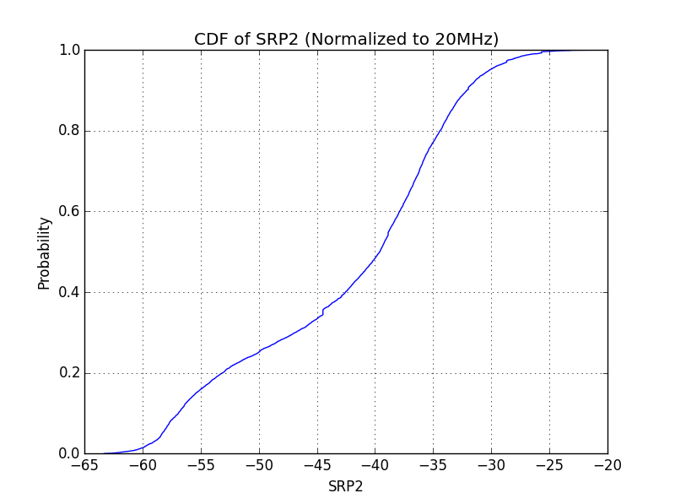
CDF of SRP2

Slide 24
Conclusion of Simulation
Only steady state behavior is simulated on Python simulator
  No collision
  No PPDU duration is wasted for SR
    No random back off before SR
    First SR link can ride on full length of all existing link’s PPDU
    Later SR link can ride on full length of all existing link and earlier SR link’s PPDU
  Max possible number of SR link is considered
    No SR_disallow is set for earlier SR link
Upper bound performance of OA-CCA is demonstrated in scenario 1 topology
  78.7% (target PER 0%)
  102.9% (target PER 10%)
Next
  Explore the impact of
    Different apartment size
    Different percentage of 11ax and legacy devices

