Slide 1
Demand of Being Woken Up While Moving Follow-up
Date: 2016-09-12
Authors:
Name | Affiliation | Address | Email
Ke Yao | ZTE |  | yao.ke5@zte.com.cn
Bo Sun | ZTE |  | sun.bo1@zte.com.cn
Xuelin Zhang | ZTE |  | Zhang.x_l@zte.com.cn
Nan Li | ZTE |  | li.nan25@zte.com.cn
Zhiqiang Han | ZTE |  | Han.zhiqiang@zte.com.cn

Slide 2
Background
WUR is aiming to promote the 802.11’s performance of power-saving especially for IoT implementations.
IoT has very broad market instances with rich implementations. Some of them may request the IoT terminals to be woken up from sleeping mode after moving to another AP[1].
We explained the requirement for such moving use case and studied the feasibility in this contribution.

Slide 3
Recap the WUR Moving Requirement
WUR STAs which move to another AP within a certain domain such as WUR group can be woken up on demand
    Note: WUR group refers to a group of BSSs within which a served IoT terminal uses an unique wake-up ID
  Some applications request the IoT terminals to be moved when they are in deep sleep mode
  WUR module is supposed to keep open and stay in a fixed channel(s) waiting for the wake-up signals
  The WUR Moving feature means the WUR STAs can be woken up by a new AP of the same WUR group.

Slide 4
Analytics of Support to WUR Moving
To support WUR moving
    Note: WUR STA refers to a STA with WUR module, while WUR AP means an AP support to wake up WUR STA.
  The WUR AP should be capable of paging a WUR STA with a global ID which is not connected to it.
    The WUR AP may send wake up message to a non-associated WUR STA
    The WUR AP may change its original WU signal channel when there are more than one wake up signal channels
    The WUR AP needs to support an extra discovery delay when it cannot get response from a WUR STA that’s ever connected to it within a regular delay.
      The WUR AP should not disassociate the WUR STA before the extra discovery delay.
  The WUR STA should be able to be woken up with a global ID in a range larger than BSS, e.g. ESS or even larger.
    The WUR STA needs to respond to a WUR AP which is not its original BSS AP. This will be discussed in following slides.

Slide 5
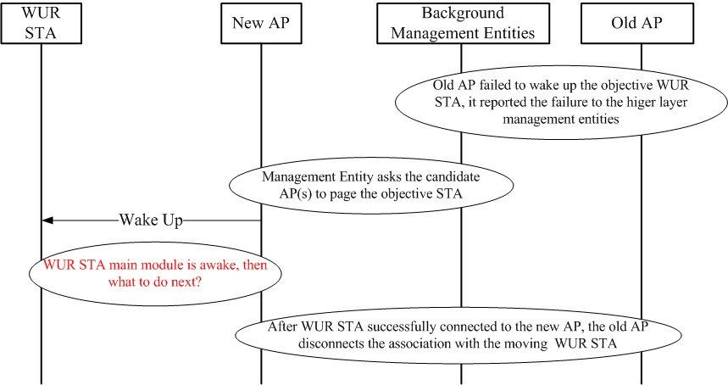
Illustration of WUR Moving Support

Slide 6
WUR STA Response - Approaches
Approach 1: complete access procedure in 802.11i
  WUR STA performs the complete association procedure which is widely used nowadays to access to the new AP
Approach 2: FILS (Fast Initiate Link Setup) in 802.11ai
  Make use of the FILS scheme to speed up access process

Slide 7
Approach 1: complete access procedure in 802.11i
WUR STA performs the complete association procedure to access to the new AP
  Scanning
  Authentication, association, key negotiation
  IP address assignment
  Communication with its application server
Pros and Cons
  Keep the current widely used access procedure, no need to modify for WUR moving
  Large delay, high overhead, low power efficiency
Scenarios
  Can be used for all kinds of WLAN devices
  Not practical for some very low traffic requirement, especially the frequently changing AP application

Slide 8
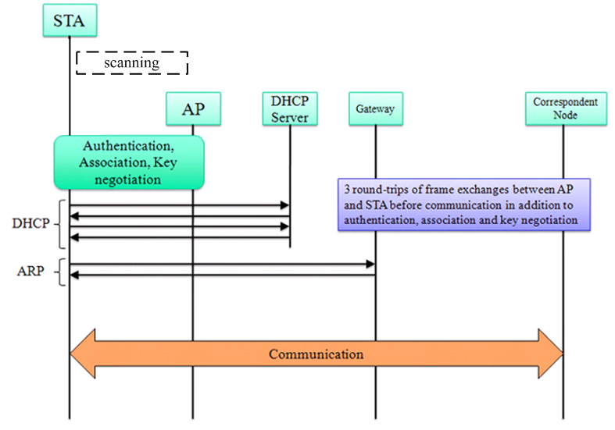
Approach 1 Cont.
The normal procedure for a STA to access an AP [3]
Tens of message exchanges among STA, AP and other entities
Several hundreds of ms !!

Slide 9
Approach 2: FILS in 802.11ai
WUR STA could also perform Fast Initiate Link Setup procedure to access the new AP
  Scanning is simplified in 11ai
  Authentication, association, key negotiation and IP address assignment can be combined to 4 steps.
Pros and Cons
  Delay and power consumption become more acceptable
  May rely on the maturity of 802.11ai
Scenarios
  Can be used for most applications

Slide 10
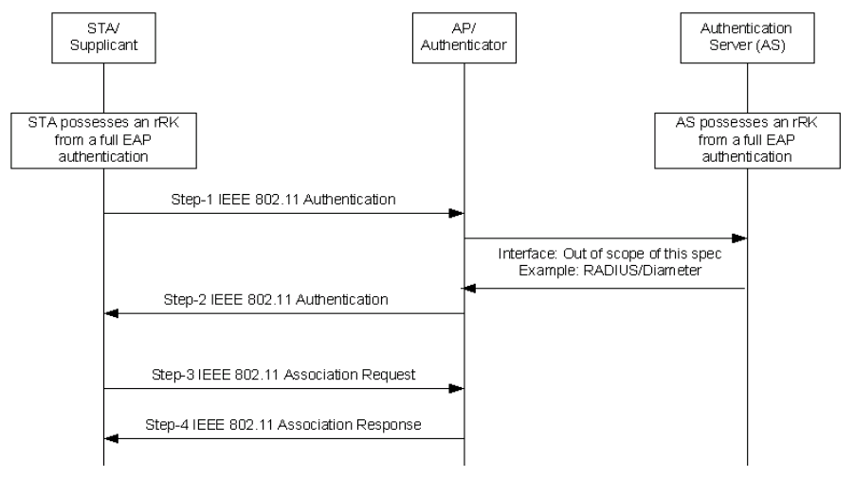
Approach 2 Cont.
FILS shared key authentication [2]
The access time is expected to be
shortened to less than 100ms

Slide 11
Further considerations
Since Approach 2 is not very time-consuming, it should be suitable for most IoT moving applications.
Considering higher power efficiency demand, some methods could be deployed to further reduce the delay, at the price of modification on the current access procedure.
  Design simpler access procedure especially for WUR moving
    The old AP may share the WUR STA’s information with the new AP to reduce the WUR STA’s transmission burden

Slide 12
Summary
We discussed the WUR moving conception and function support.
Possible approaches were introduced
  Approch 2 seems to be acceptable.
  Whether or not need to modify the current access procedure for better power efficiency depends on the tradeoff between complexity and power save requirement in the real implementations.

Slide 13
References
[1] 11-16-0931-00-0wur-demand-on-roaming-for-wur
[2] Draft P802.11ai_D10.0
[3] 11-11-0977-06-00ai-tgai-upper-layer-setup-proposal

Slide 14
Straw Poll
Do you agree that WUR moving should be supported by WUR standard?
Y
N
A

