Slide 1
Hotel lobby
SU-MIMO channel modeling:
2x2 golden set generation
Date: 2016-09-13
Authors:

Slide 2
Introduction
Proposed for 802.11ay channel models, both enhanced 802.11ad legacy and new Q-D models, represent the channel as a set of clustered propagation rays with defined parameters.
Based on that, CIRs can be obtained for given TX and RX antenna patterns and beamforming parameters.
For LLS and SLS system performance evaluation, it is desirable to have a set of ready-to-use CIRs (“golden set”), without necessity to do the whole channel generation and beamforming procedures.
Present contribution is focused on the channel model golden set generation procedure for base 802.11ay 2x2 SU-MIMO scenarios

Slide 3
Hybrid beamforming
2x2 SU-MIMO configuration #1 is considered
Two stages beamforming
  Coarse phased array beamforming: beams selection
  Fine MIMO processing in the baseband: final adjust
Channel after coarse beamforming may be represented as a typical 2x2 MIMO channel
“Golden set” of 2x2 MIMO CIRs is suitable for LLS simulations

Slide 4
Golden set generation steps
Calculating the channel represented as the set of rays with powers, AoA, AoD and delay parameters
  Given channel model (802.11ad legacy or 802.11ay Q-D models) is used
  TX STA is fixed in accordance with considered scenario, RX STAs are uniformly covering the area
For given TX-RX positions, select TX and RX beamforming that maximize metric
  MIMO channel capacity or total throughput may serve as a metric
Apply chosen TX and RX beamforming and generate channel impulse responses or the channel transfer matrix for main links (H₁₁, H₂₂) and for cross links (H₁₂, H₂₁₎

Slide 5
Beamforming selection procedures
SISO beamforming selection: Sweeping over N sectors
  Exhaustive search over TX-RX sectors combinations – N² complexity
MIMO beamforming selection: Sector Sweep
  Search over two TX and two RX sectors – N⁴ complexity
Ray-based search for MIMO beamforming selection
  Search over the existing paths (obtained from ray-tracing), orienting the beams along M rays: M² complexity for SISO and MIMO
Ray-based search were selected for 2x2 MIMO channel beamforming

Slide 6
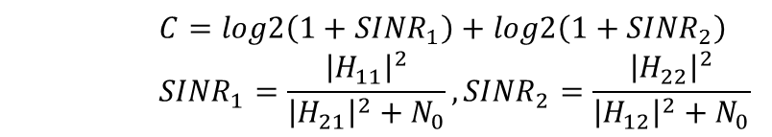
Channel selection metric
To select best channel H (defined by selected TX and RX beamforming) the simple per-subcarrier capacity metric was used:
Capacity is calculated under assumption of simple spatial separation of the streams, without RX MIMO processing.
To obtain single value to maximize, per-subcarrier capacity is averaged over the all band
The more complex metrics, with RX MIMO processing, such as OL-MIMO MMSE capacity (and throughput) were tested and produced almost the same results in term of beamforming
    $$C=log2\left(1+{SINR}_{1}\right)+log2\left(1+{SINR}_{2}\right)$$
    $${SINR}_{1}=\frac{{\left|H_{11}\right|}^{2}}{{\left|H_{21}\right|}^{2}+N_{0}}, {SINR}_{2}=\frac{{\left|H_{22}\right|}^{2}}{{\left|H_{12}\right|}^{2}+N_{0}}$$

Slide 7
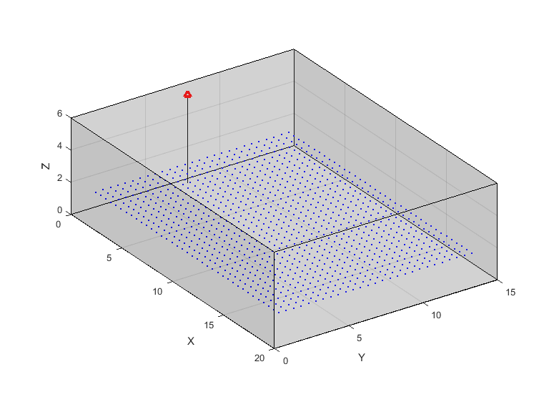
Hotel lobby scenario
Deployment:
  Room size is 20x15x6 m (X-Y-Z)
  STA placed every 0.5 m with 1m shift from the nearest all, AP place at 0.5m from the wall.
Scenario and model: Large hotel lobby, Q-D model ([1], section 5.3)
  D-rays: up to second order + 5 R-rays
  Intra cluster structure
Parameter | Value
AP height, H_{tx} | 5.5 m
AP position | Center, 0.5m from the wall
STA height, H_{rx} | 1.5m
Room height | 6 m
Room width | 15 m
Room length | 20 m
Floor material | Concrete
Floor ε_{rf} | 4 + 0.2j
Floor roughness standard deviation σ_{f} | 0.1 mm
Walls material | Concrete
Walls ε_{rw} | 4 + 0.2j
Walls roughness standard deviation σ_{w} | 0.2 mm
Ceiling material | Plasterboard
Ceiling ε_{rc} | 6.25+0.3j
Ceiling roughness standard deviation σ_{c} | 0.2 mm
[1] doc.: IEEE 802.11-15/1150r4 ”Channel Models for IEEE 802.11ay”

Slide 8
Hotel lobby golden set: SU-MIMO mode
SU-MIMO configuration #1 ([1],section 3.2.1)
  Co-polarized antennas (vertical polarization)
[1] doc.: IEEE 802.11-15/1150r4 ”Channel Models for IEEE 802.11ay”

Slide 9
Hotel lobby golden set: antennas setup
TX and RX antenna arrays
  “Gaussian” antenna pattern (equivalent to 2x8 antenna array).
      Gain 15 dBi, front-to-back ration: 15 dB, 10 dBm power
      Beamwidth [15°, 60°]
      Vertical polarizations
  Ideal beamsteering
      Antenna broadside is rotated in the desired direction
For more realistic / implementation dependent results, antenna arrays with realistic beamsteering and random orientations can be used

Slide 10
2x2 MIMO channel analysis
To illustrate the properties of generated 2x2 MIMO channel, the distributions of different basic metrics over all STAs were calculated
  Distribution of SINRs per subcarrier for both streams
  Distribution of total capacity in both streams
  Distribution of throughput estimates, assuming SC transmission
To comply with the sum capacity metric, the Horizontal MIMO were modeled: different MCSs for different streams
NLOS were modeled by blocking rays within 20° angle around LOS

Slide 11
2x2 MIMO channel analysis: 2D distributions
LOS channel
NLOS channel
SISO
MIMO
(2x TX power)

Slide 12
Summary
A methodology for generation of 2x2 SU-MIMO channel realizations golden set for LLS and SLS simulations was proposed
The reduced complexity beam selection procedure for 2x2 MIMO channel generation was investigated
The CIRs golden set for Hotel lobby scenario 2x2 MIMO was generated and analyzed for LOS and NLOS cases
SLS simulations have shown that generated CIRs have a good spatial separation and 2x2 MIMO scheme outperforms SISO scheme for considered cases

