Slide 1
GI Overhead/Performance Impact on Open-Loop SU-MIMO
Date: 2016-09-10
Authors:

Slide 2
Introduction
802.11ad uses 64 chip guard interval (GI) for single carrier (SC) PHY. Should 11ay use the same GI length?
  TGay has agreed on a EDMG PPDU format which includes several non-legacy fields (EDMG-header-A, STF, CEF, Header-B) [1]. These additional fields increase the overhead of the data transmission.
  LoS is the dominant path in several uses cases. Narrow beams resulting from PAA pairs with a large number of elements reduce the delay spread of a point-to-point channel.
This contribution investigates the use of shorter GI in specific scenarios.
  Performance/overhead results show that in certain scenarios the use of a shorter GI is justified.

Slide 3
PPDU Format in 802.11ay
Current EDMG PPDU format for SC PHY[1]:
EDMG preamble part introduces extra overhead
  Even though multi data stream transmissions can be applied to data part, EDMG transmission may not be always be as efficient as legacy DMG transmission.
Overhead reduction is desirable for EDMG PPDU

Slide 4
Guard Interval
In 802.11ad, SC data blocks (448 symbols ) are separated by guard intervals (64 symbols).
  The 64 GI symbols are modulated symbols from a Golay sequence.
The usage of GI:
  GI is a time period to mitigate inter-block interference
  GI functions as a cyclic prefix which allows the use of frequency domain equalizer (FDE) at the receiver
  GI is a periodic known sequence to assist with AGC and phase tracking
However, GI is extra overhead for data transmission. Is 64 GI always necessary?
In this contribution, a different GI size is evaluated using link level simulation. Overhead comparison is also provided.
  We focus on the impact from the inter-block interference assuming an FDE
64
448 symbols
64
448 symbols
64
448 symbols
64

Slide 5
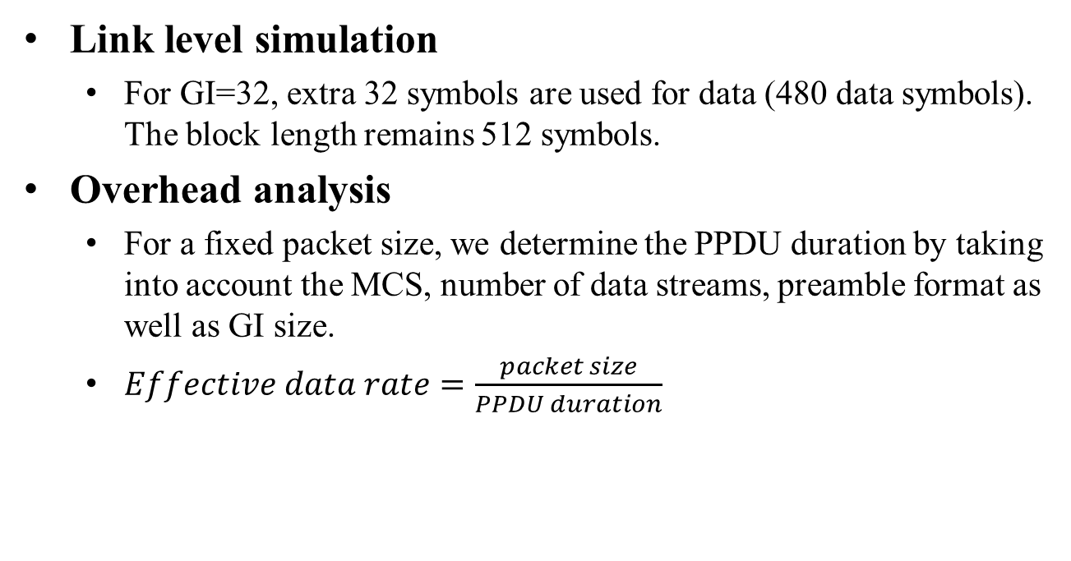
GI Evaluation Methodology
Link level simulation
  For GI=32, extra 32 symbols are used for data (480 data symbols). The block length remains 512 symbols.
Overhead analysis
  For a fixed packet size, we determine the PPDU duration by taking into account the MCS, number of data streams, preamble format as well as GI size.
  $Effective data rate=\frac{packet size}{PPDU duration}$

Slide 6
Link level simulation

Slide 7
Simulation Assumptions
Based on 11ad SC PHY
Spatial stream parser:
MCS index is the same for all streams per PPDU, and a single CRC is used per PPDU
MMSE receiver with FDE
  Ideal channel estimation at receiver
Enterprise cubicle scenario in 11ay/ad channel model [2]
STAs are randomly placed in the cubicle 1 in the center of the CR, 0.9m above the floor
AP is positioned at x=2.8, y=6, z=2.9m on the ceiling
Detailed assumptions can be found in the appendix
PSDU size is 8192 bytes
Stream 1
Encoder Output Bits
b1
b3
b5
b1
b2
b3
b4
b5
b6
Stream 2
b2
b4
b6

Slide 8
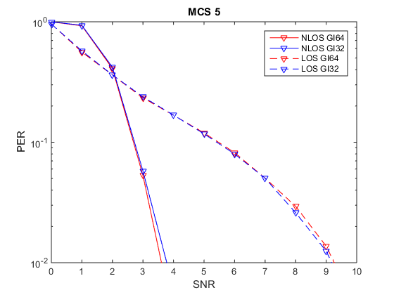
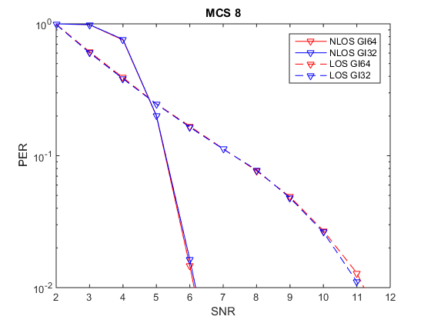
PER performance (MCS5/8)
MCS5 (BPSK) and MCS8 (QPSK), there are little or no differences in PER performance
NLOS channel improves PER at high SNR. This gain is from frequency diversity such that it is less likely that all frequency tones are stuck in similarly ill-conditioned channels

Slide 9
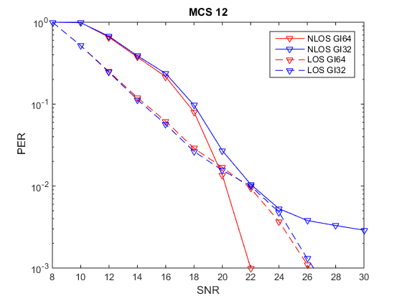
PER performance (MCS12)
For LOS scenario, short and long GI have similar performances
For NLOS scenario, with short GI at high SNR, ISI becomes dominant, but the SNR difference is less than 2 dB for PER = 1%
NLOS multipath degrades performance at low SNR but improves performance at high SNR

Slide 10
Overhead analysis

Slide 11
Overhead Analysis Parameters
GI/data block size:
  GI=64: 448 data symbols with 64 GI symbols
  GI=32: 480 data symbols with 32 GI symbols
Packet size:
  Small packet: 1200 Bytes
  Large packet: 8192 Bytes
Channel bandwidth: 2.16Ghz
Number of data streams (Nss)
  2 data streams for EDMG PPDU
  Single data stream for DMG PPDU
PPDU format: EDMG PPDU and DMG PPDU
  EDMG STF duration: 512 * Tc
  EDMG CEF duration: 1152 * Tc
  EDMG Header-B is not considered
  Tc is SC chip time, 0.57 ns
MCS: 1-12 (including SC BPSK, QPSK and 16QAM)

Slide 12
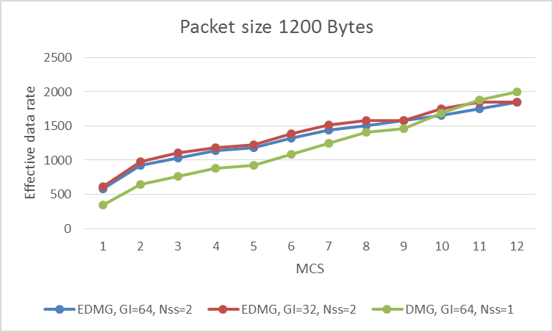
Small Packet Overhead Analysis
MCS | Gain (%) (GI32-GI64)/GI64
1 | 5.7
2 | 6.1
3 | 6.9
4 | 3.8
5 | 4
6 | 4.5
7 | 4.9
8 | 5.1
9 | 0.3
10 | 5.6
11 | 6
12 | 0.4
GI32 vs GI64
  GI 32 shows up to 6.9 percent gain over GI 64 in effective data rate.
  In general, the higher the MCS, the lower the gain due to GI. This is because with higher MCS, fewer number of SC blocks are required to carry the information bits, resulting in less gain from GI reduction.
EDMG vs DMG
  DMG single data transmission outperforms EDMG two stream transmission at higher MCSs. This is because with higher MCSs, the ratio of data part over the entire PPDU becomes smaller. Thus the savings from the data part cannot compensate the loss from the preamble part.

Slide 13
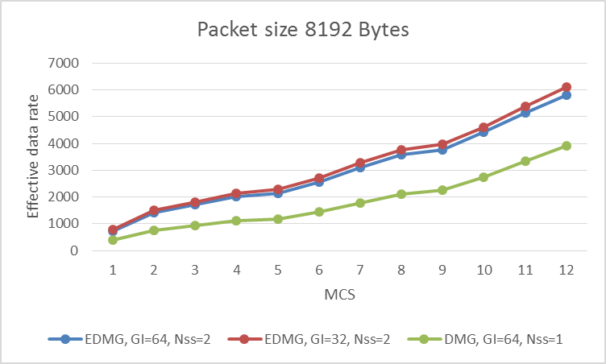
Large Packet Overhead Analysis
MCS | Gain (%) (GI32-GI64)/GI64
1 | 6.6
2 | 6.7
3 | 6.5
4 | 5.7
5 | 6.1
6 | 6.1
7 | 5.9
8 | 5.1
9 | 5.4
10 | 4.2
11 | 4.9
12 | 5.6
GI32 vs GI64
  GI 32 shows up to 6.7 percent gain over GI 64 in effective data rate.
  In general, the higher the MCS, the lower the gain due to GI. This is because with higher MCS, fewer number of SC blocks are required to carry the information bits, resulting in less gain from GI reduction.
EDMG vs DMG
  With large packet sizes, EDMG two data stream transmission always outperforms DMG single stream transmission.

Slide 14
Conclusions
EDMG preamble adds additional overheads in a PPDU
  short EDMG frame with high MCS is not efficient
Using GI length of 32 symbols is sufficient for some of the indoor scenarios.
  (32 GI, 480 data) block for 2.16GHz channel should be considered as an option.

Slide 15
Straw Poll
Should TGay study the option of shorter GI for SC PHY?

Slide 16
References
Carlos Cordeiro, “Specification Framework for TGay”, IEEE 802.11-15/01358r5
A. Maltsev, et al, “Channel models for ieee 802 11ay”, IEEE doc. 11-15/1150r6
R. Maslennikov, et al, “Implementation of 60 GHz WLAN Channel Model,” IEEE doc. 11-10/0854r3.

Slide 17
Appendix

Slide 18
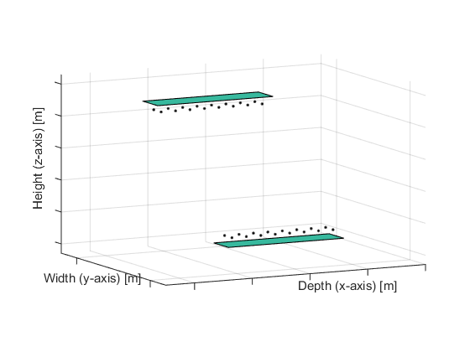
Channel parameters
For channel with LOS components [3],
  TX/RX analog beamforming for both polarizations of PAA#i are based on the LOS direction between TX PAA#i ↔ RX PAA#i
For channel without LOS components
  Beam forming based on the AoD/AoA of strongest signal path between TX PAA#i ↔ RX PAA#i
Channel bandwidth 1.76 GHz, center frequency 60GHz
Each PAA has 2 elements
Distance between antenna elements 0.0025m
Distance between center of PAAs 10cm
For AP-STA scenario, STA is placed at a plane 2m below AP in the cubicle 1. Random rotation around z-axis between STA/AP.

