Slide 1
Scalable A-BFT
Date: 2016-09-10
Authors:

Slide 2
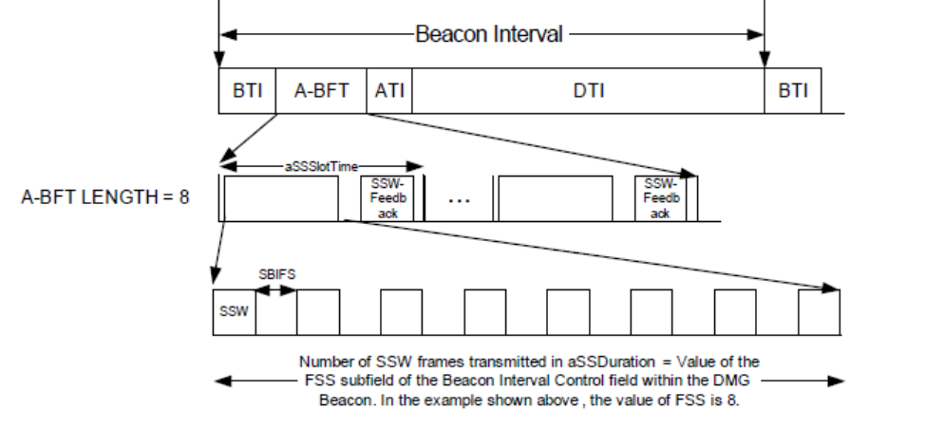
11ad A-BFT
No. of SSW slots indicated in A-BFT Length subfield ∈ Beacon Interval Control field ∈ DMG Beacon
A-BFT Length subfield is 3 bits, i.e. up to 8 SSW slots
DMG STAs randomly choose one of the SSW slots
Collisions may occur when more than 1 DMG STA chooses the same SSW slot

Slide 3
Motivation
Some 11ay use cases require support of large numbers of EDMG STAs
  Augmented/Virtual Reality in commuter scenarios
  Video/Mass-Data Distribution/Video on Demand System
8 SSW slots per beacon interval may not suffice
Goal is to increase number of SSW slots
  Using minimum number of control bits
  Supporting variety of DMG vs. EDMG STA distributions
  Maximizing trunking efficiency
  Striving for fair access to SSW slots for DMG vs. EDMG STAs
Previous proposals from other companies to increase number of A-BFT slots do not address these requirements

Slide 4
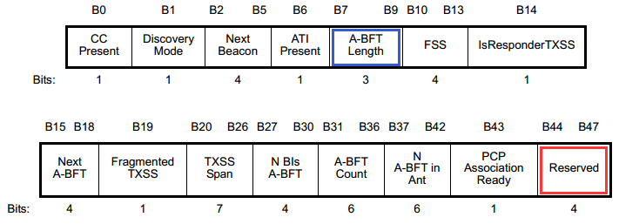
Proposal
Number of possible SSW slots in A-BFT for DMG STAs remains the same
Both DMG and EDMG STAs allowed to access legacy SSW slots ⇒ maximizes trunking efficiency
Use 2 reserve bits from Beacon Interval Control field to indicate a multiplier, which is applied to value of A-BFT Length to indicate additional SSW slots for use by EDMG STAs ⇒ minimizes use of control bits
Instruct EDMG STAs to use additional SSW slots first, only use legacy SSW slots if they can’t gain access to additional SSW slots ⇒ maintains fairness

Slide 5
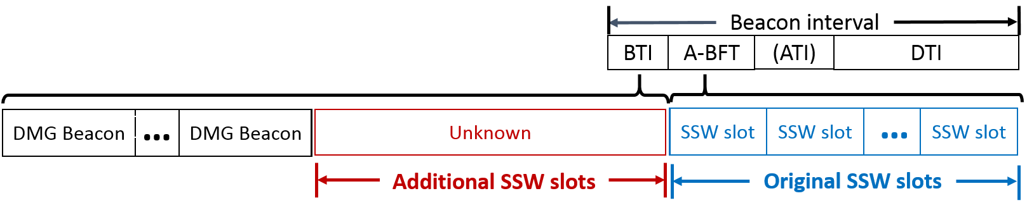
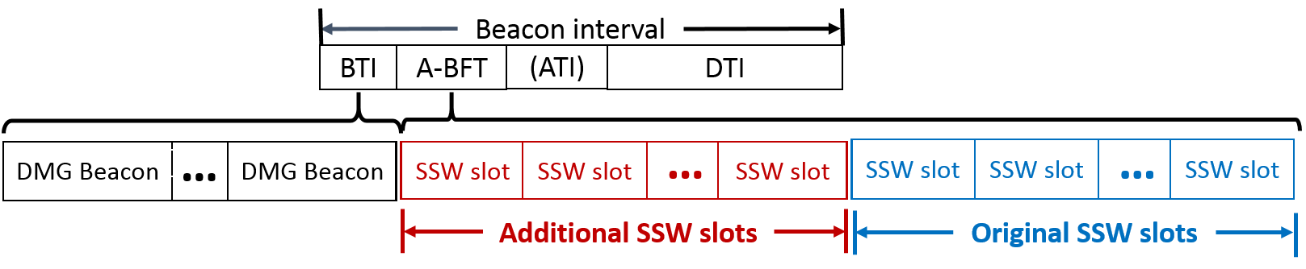
Backwards Compatibility (1 of 2)
Two options for inserting additional SSW slots
  Option 1: before legacy SSW slots
  Option 2: after legacy SSW slots
Option 1: If additional SSW slots are inserted before legacy SSW slots:
  Adjust Duration field in DMG Beacon to accommodate additional SSW slots
  DMG STAs won’t understand new slots, but they will wait Duration to start A-BFT
  EDMG STAs will know Duration field has been adjusted, subtract length of additional SSW slots from its value, and start A-BFT at beginning of additional slots
  Fairness is automatic
  Works for CBAP only = 1

Slide 6
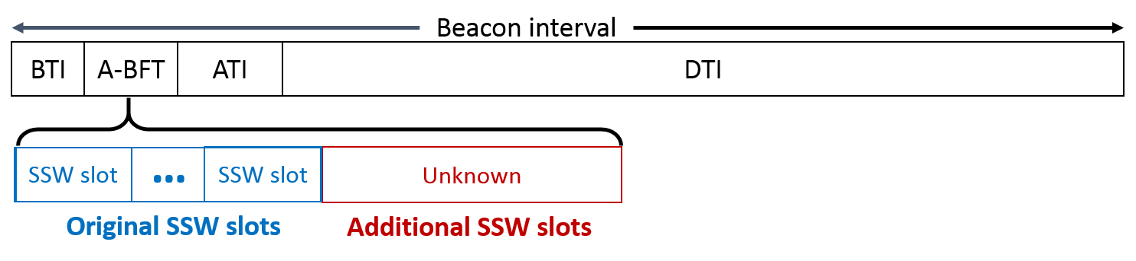
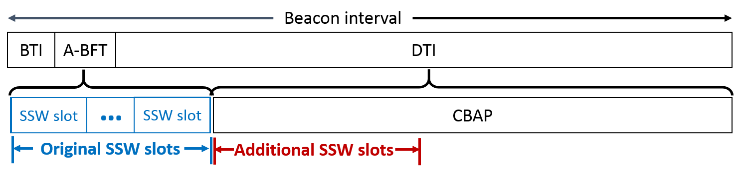
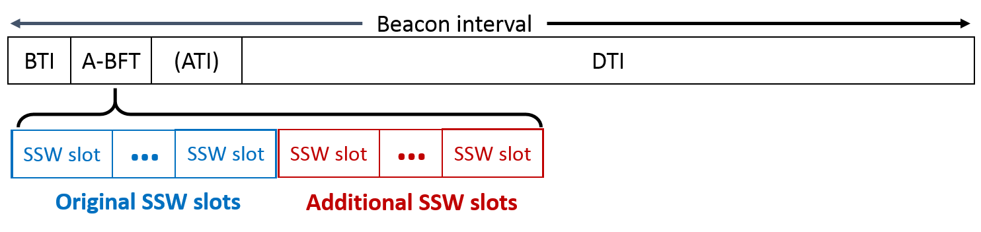
Backwards Compatibility (1 of 2)
Option 2: If additional SSW slots are inserted after original SSW slots,
  If there is an ATI, DMG STAs will know start of ATI based on info from BTI, so no additional signaling required
  If no ATI (CBAP only = 1), AP/PCP must refrain from adding slots or use Extended Schedule element to schedule DTI
  EDMG STAs consider additional SSW slots part of A-BFT, whether or not ATI present
  To maintain fairness, EDMG STAs can be instructed to restrict use of legacy SSW slots to “retries”, incurring one beacon interval delay

Slide 7
Conclusion
Proposed schemes provide additional SSW slots for 11ay use cases with dense deployments
Compared to previous proposals, these schemes:
  Provide greater flexibility in the number of additional SSW slots
  Require fewer control bits
  Maximize trunking efficiency
  Maintain some level of fair access between EDMG and DMG STAs

Slide 8
Straw Poll 1
Would you agree to include the following in the SFD:
“The number of additional SSW slots in the beacon interval, for use by EDMG STAs only, shall be equal to the value of A-BFT Length multiplied by Multiplier, where the Multiplier is indicated using reserve bits from the Beacon Interval Control field.”
Yes:
No:
Abstain:

Slide 9
Straw Poll 2
Where would you prefer to insert additional SSW slots for use by EDMG STAs only?
Option 1: Just before the legacy A-BFT
(requires adjusting Duration field, works with CBAP only = 1, fairness is automatic)
Option 2: Just after the legacy A-BFT
(requires Extended Scheduling Element or prohibited use when CBAP only = 1, fairness requires 1 beacon interval delay for EDMG STAs)
Option 1:
Option 2:
No preference:

