Slide 1
WUR and Efficiency Tradeoffs
Date: 2016-09-12
Authors:
Name | Affiliations | Address | Phone | email
Reza Hedayat Minho Cheong Young Hoon Kwon Yongho Seok Daewon Lee Yujin Noh | Newracom | 9008 Research Drive, Irvine, CA 92618 |  | reza.hedayat at newracom. com
Reza Hedayat, Newracom

Slide 2
Inefficiency in WiFi environments
Dense WiFi environment suffer from implementations that cause large overhead due to various reasons such as too many management frames, poor frequency planning, … [4]
Many field measurements show a significant portion of the frames are management frames such as Probe Request, Probe Response, and Beacon frames [4,5]
Reza Hedayat, Newracom

Slide 3
Inefficiency in WiFi environments
Poor frequency planning is another cause of inefficiency
Particularly in 2.4GHz. In 5GHz, the spectrum is partitioned in 20MHz-alighned segments that is well-respected in industry
Due to early implementations, an AP may establish a 20MHz BSS centered at any of the 13-14 5MHz channels
This causes interference among partially-overlapped OBSS
Fortunately, the industry gradually moves to use the recommended practice of using channels 1, 6 and 11. This leaves some spectrum gaps useful for narrow-band technologies
2.4GHz Unlicensed Spectrum
Reza Hedayat, Newracom

Slide 4
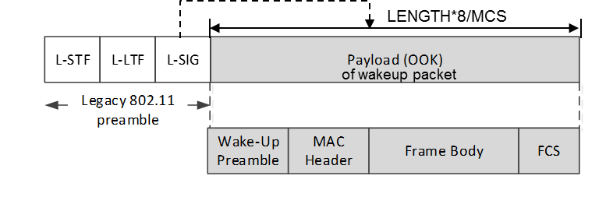
Currently-proposed WU Frame Design
Wakeup frame (WUF) [2]
Legacy 802.11 preamble (OFDM) + LP-WUR signal waveform (OOK)
Legacy 802.11 preamble provides coexistence with legacy STAs
Legacy preamble, 20MHz
Narrowband payload, 4MHz
CRC
Wakeup packet may carry other information
Receiver address
Wakeup preamble (e.g. PN sequence)
Example signal waveform
1bit /1 OFDM symbol period (= 4usec) = 250kbps
Legacy 802.11
preamble
Wake-up
preamble
MAC Header + Frame Body + FCS
Reza Hedayat, Newracom

Slide 5
Currently-proposed WU Frame Design
WUR technology is expected to be a narrow-band and low-throughput technology
A WUR sends WU frames with low throughput; e.g. 0.25 Mbps [1-3]
WU frames need to carry: WU preamble, MAC header, AP/STA ID, WUF body, CRC …
Given the low-throughput design with legacy preamble [1-3]
WU frames are expected to be 500-1000 us long
Other unintended STAs receiving a WU frame have to defer
In high density environments, similar to use cases considered in 802.11ax, too many WU frames could consume a non-negligible portion of the wireless medium
Reza Hedayat, Newracom

Slide 6
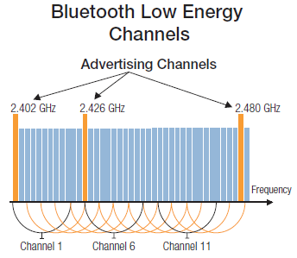
Coexistence in 2.4GHz
Given the dominance of 802.11 devices in 2.4GHz unlicensed spectrum, other narrow-band technologies found a way to coexist without causing or receiving significant interference from 802.11 devices
Several narrowband technologies use the spectrum gap between channels 1 and 6, and between 6 and 11
Reza Hedayat, Newracom

Slide 7
Potential WU Frame Design Principle in 2.4GHz - I
Considering the design/practice of other narrow-band and low-throughput technologies in 2.4GHz, WUR operating in 2.4GHz could do the same
Design the OOK pulse with 2-4MHz bandwidth,
Use a WU frames without legacy preamble; only OOK pulses.
Center frequency for OOK pulse is in the spectrum gap between the non-overlapping channels:
between channels 1 and 6 (2.422-2.427GHz), or
between channels 6 and 11 (2.447-2.452GHz), or
after channel 11 (in some regulatory domains)
This enhances coexistence with Bluetooth LE and other technologies.
Any potential 802.11 that happens to operate in channels other than 1, 6 and 11 can defer to such WU frames using legacy energy detect (ED) mechanism
Reza Hedayat, Newracom

Slide 8
Potential WU Frame Design Principle in 2.4GHz - I
L-STF
L-LTF
L-SIG
20MHz
WU packet payload (modulation e.g. OOK)
Narrowband signal, e.g. 4MHz [1-3]
Ch. 1
Ch. 6
Ch. 11
2.422-2.427GHz
2.447-2.452GHz
Some regulatory domains
WU packet payload
Narrowband signal e.g. 2-4 MHz
Reza Hedayat, Newracom

Slide 9
Potential WU Frame Design Principle in 2.4GHz - II
Benefits
Channel occupancy due to WU frames would be none
A few fixed channels for WUR operation simplifies the designs and allows for a low-power WUR design
Given less path loss, a WUR at 2.4GHz would be a good choice for 2.4/5GHz APs
Almost all 802.11 APs are either 2.4GHz, or 2.4/5GHz (no 5GHz-only APs)
No additional detection burden on BSS/OBSS legacy STAs; additional power saving benefits for unintended STAs
Design based on such principle enhances coexistence with Bluetooth LE and some other narrow-band technologies in 2.4GHz
Reza Hedayat, Newracom

Slide 10
Potential WU Frame Design Principle in 2.4GHz - III
Implementation considerations
Adjacent band signal rejection capability has some impact in WUR receiver architecture
Adjacent band signal interference and design impact to WUR needs further study
A single fixed frequency LO can be designed to have much lower power consumption than frequency tunable PLL
Impact of power consumption and support of multiple center frequencies by WUR needs further study
Reza Hedayat, Newracom

Slide 11
Advertisement channel for 802.11
Additional benefits of a few fixed narrow-band channels for WUR operation is the potential realization of an 802.11 advertisement channel that is also low-power
A few unique WUR bands in 2.422-2.427GHz and 2.447-2.452GHz, could act as advertisement channels
AP send WU frames with a few additional parameters (e.g. channel number and approximate arrival of the next Beacon) so that STAs realize the presence of the AP/BSS
This eliminates the need of probing for WUR-capable APs by WUR-capable STAs
No need for probing; additional power saving benefits
And no Probe Request/Response overhead
Reza Hedayat, Newracom

Slide 12
Conclusion
We propose a principle for WU frame design in the 2.4GHz spectrum gaps between channels 1/6 and channels 6/11 without legacy preamble
We suggest to allow coexistence with existing 802.11 devices in the 2.4GHz spectrum gaps using ED and PD
Suggestion for WUR PAR:
Existing language: “The new amendment enables coexistence with legacy IEEE 802.11 devices operating in the same band.”
Suggested language: “The new amendment enables coexistence with legacy IEEE 802.11 devices operating in the same band using energy detect (ED) or preamble detect (PD).”
Reza Hedayat, Newracom

Slide 13
References
11-15-1307-01-0wng-low-power-wake-up-receiver-for-802-11
11-16-0341-00-lrlp-low-power-wake-up-receiver-follow-up
11-16-0381-00-lrlp-discussion-of-wake-up-receivers-for-lrlp
11-13-0545-01-0hew-WLAN QoE, End User Perspective, Opportunities to Improve
11-16-0977-00-0wng-Measurements of 802.11 behavior in different environments
Reza Hedayat, Newracom

