Slide 1
11ax Sounding Mode Reductions
Date: 2016-08-30
Authors:
Name | Affiliation | Address | Phone | Email
Hongyuan Zhang | Marvell | 5488 Marvell Lane, Santa Clara, CA, 95054 | 408-222-2500 | yzhang@marvell.com
Yan Zhang |  |  |  | hongyuan@marvell.com
Lei Wang |  |  |  | Leileiw@marvell.com
Liwen Chu |  |  |  | liwenchu@marvell.com
Jinjing Jiang |  |  |  | jinjing@marvell.com
Rui Cao |  |  |  | ruicao@marvell.com
Sudhir Srinivasa |  |  |  | sudhirs@marvell.com
Bo Yu |  |  |  | boyu@marvell.com
Saga Tamhane |  |  |  | sagar@marvell.com
Mao Yu |  |  |  | my@marvel..com
Xiayu Zheng |  |  |  | xzheng@marvell.com
Christian Berger |  |  |  | crberger@marvell.com
Niranjan Grandhe |  |  |  | ngrandhe@marvell.com
Hui-Ling Lou |  |  |  | hlou@marvell.com

Slide 2
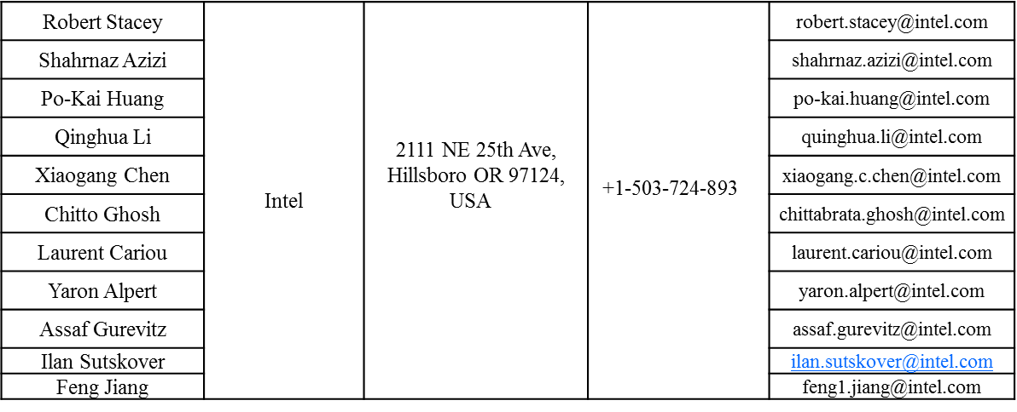
Authors (continued)
Name | Affiliation | Address | Phone | Email
Ron Porat | Broadcom |  |  | rporat@broadcom.com
Sriram Venkateswaran |  |  |  | mfischer@broadcom.com
Matthew Fischer
Zhou Lan
Leo Montreuil
Andrew Blanksby
Vinko Erceg

Slide 3
Authors (continued)
Name | Affiliation | Address | Phone | Email
Alice Chen | Qualcomm | 5775 Morehouse Dr. San Diego, CA, USA |  | alicel@qti.qualcomm.com
Albert Van Zelst |  | Straatweg 66-S Breukelen, 3621 BR Netherlands |  | allert@qti.qualcomm.com
Alfred Asterjadhi |  | 5775 Morehouse Dr. San Diego, CA, USA |  | aasterja@qti.qualcomm.com
Arjun Bharadwaj |  | 5775 Morehouse Dr. San Diego, CA, USA |  | arjunb@qti.qualcomm.com
Bin Tian |  | 5775 Morehouse Dr. San Diego, CA, USA |  | btian@qti.qualcomm.com
Carlos Aldana |  | 1700 Technology Drive San Jose, CA 95110, USA |  | caldana@qca.qualcomm.com
George Cherian |  | 5775 Morehouse Dr. San Diego, CA, USA |  | gcherian@qti.qualcomm.com
Gwendolyn Barriac |  | 5775 Morehouse Dr. San Diego, CA, USA |  | gbarriac@qti.qualcomm.com
Hemanth Sampath |  | 5775 Morehouse Dr. San Diego, CA, USA |  | hsampath@qti.qualcomm.com
Lin Yang |  | 5775 Morehouse Dr. San Diego, CA, USA |  | linyang@qti.qualcomm.com
Menzo Wentink |  | Straatweg 66-S Breukelen, 3621 BR Netherlands |  | mwentink@qti.qualcomm.com
Naveen Kakani |  | 2100 Lakeside Boulevard Suite 475, Richardson TX 75082, USA |  | nkakani@qti.qualcomm.com
Raja Banerjea |  | 1060 Rincon Circle San Jose CA 95131, USA |  | rajab@qit.qualcomm.com
Richard Van Nee |  | Straatweg 66-S Breukelen, 3621 BR Netherlands |  | rvannee@qti.qualcomm.com

Slide 4
Authors (continued)
Name | Affiliation | Address | Phone | Email
Rolf De Vegt | Qualcomm | 1700 Technology Drive San Jose, CA 95110, USA |  | rolfv@qca.qualcomm.com
Sameer Vermani |  | 5775 Morehouse Dr. San Diego, CA, USA |  | svverman@qti.qualcomm.com
Simone Merlin |  | 5775 Morehouse Dr. San Diego, CA, USA |  | smerlin@qti.qualcomm.com
Tao Tian |  | 5775 Morehouse Dr. San Diego, CA, USA |  | ttian@qti.qualcomm.com
Tevfik Yucek |  | 1700 Technology Drive San Jose, CA 95110, USA |  | tyucek@qca.qualcomm.com
VK Jones |  | 1700 Technology Drive San Jose, CA 95110, USA |  | vkjones@qca.qualcomm.com
Youhan Kim |  | 1700 Technology Drive San Jose, CA 95110, USA |  | youhank@qca.qualcomm.com

Slide 5
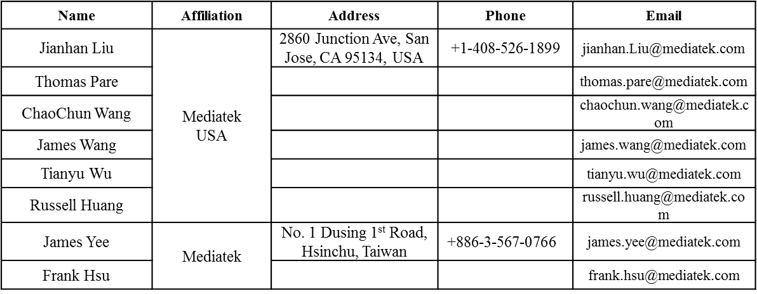
Authors (continued)

Slide 6
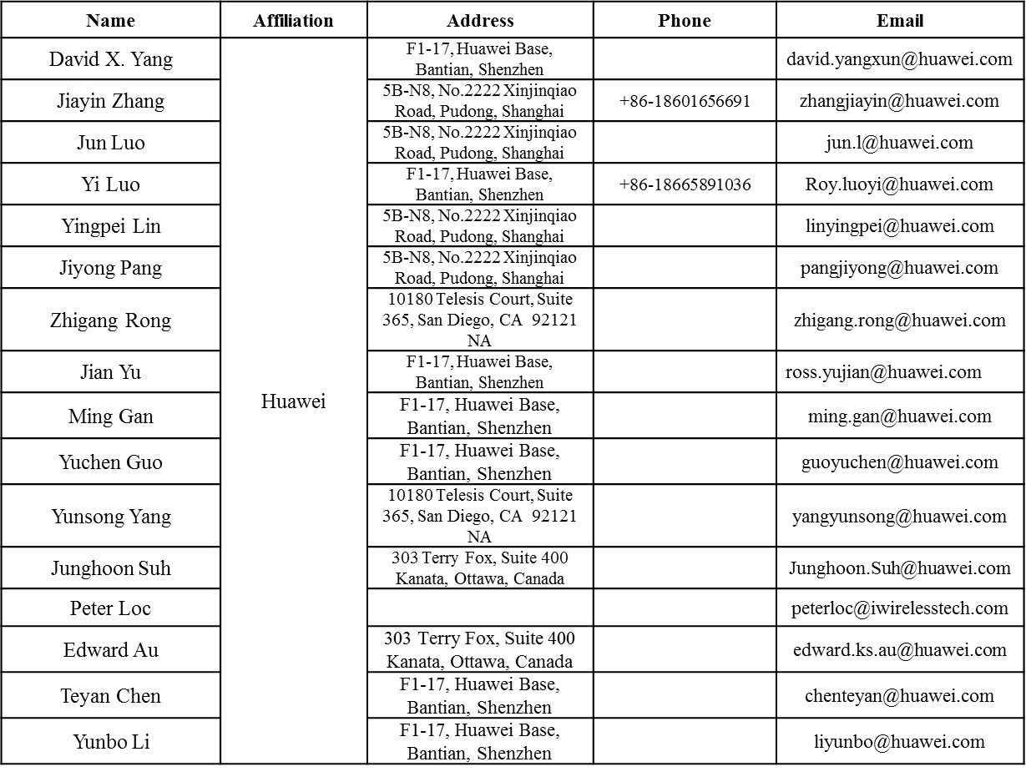
Authors (continued)

Slide 7
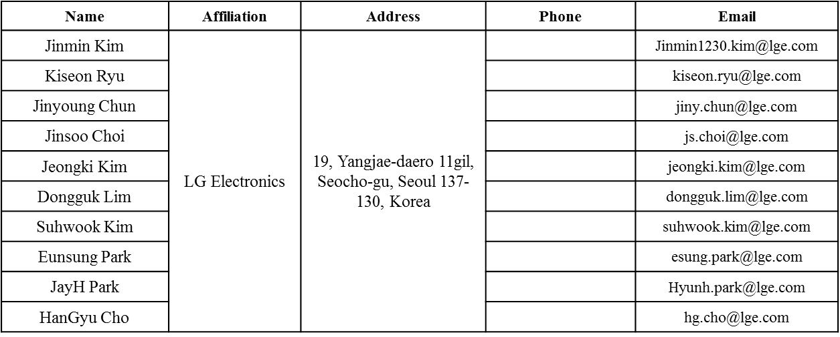
Authors (continued)
Bo Sun | ZTE | #9 Wuxingduan, Xifeng Rd., Xi'an, China |  | sun.bo1@zte.com.cn
Kaiying Lv |  |  |  | lv.kaiying@zte.com.cn
Yonggang Fang |  |  |  | yfang@ztetx.com
Ke Yao |  |  |  | yao.ke5@zte.com.cn
Weimin Xing |  |  |  | xing.weimin@zte.com.cn
Brian Hart | Cisco Systems | 170 W Tasman Dr, San Jose, CA 95134 |  | brianh@cisco.com
Pooya Monajemi |  |  |  | pmonajem@cisco.com

Slide 8
Authors (continued)
Name | Affiliation | Address | Phone | Email
Fei Tong | Samsung | Innovation Park, Cambridge CB4 0DS (U.K.) | +44 1223 434633 | f.tong@samsung.com
Hyunjeong Kang |  | Maetan 3-dong; Yongtong-Gu Suwon; South Korea | +82-31-279-9028 | hyunjeong.kang@samsung.com
Kaushik Josiam |  | 1301, E. Lookout Dr, Richardson TX 75070 | (972) 761 7437 | k.josiam@samsung.com
Mark Rison |  | Innovation Park, Cambridge CB4 0DS (U.K.) | +44 1223 434600 | m.rison@samsung.com
Rakesh Taori |  | 1301, E. Lookout Dr, Richardson TX 75070 | (972) 761 7470 | rakesh.taori@samsung.com
Sanghyun Chang |  | Maetan 3-dong; Yongtong-Gu Suwon; South Korea | +82-10-8864-1751 | s29.chang@samsung.com
Yasushi Takatori | NTT | 1-1 Hikari-no-oka, Yokosuka, Kanagawa 239-0847 Japan | +81 46 859 3135 | takatori.yasushi@lab.ntt.co.jp
Yasuhiko Inoue |  |  | +81 46 859 5097 | inoue.yasuhiko@lab.ntt.co.jp
Shoko Shinohara |  |  | +81 46 859 5107 | Shinohara.shoko@lab.ntt.co.jp
Yusuke Asai |  |  | +81 46 859 3494 | asai.yusuke@lab.ntt.co.jp
Koichi Ishihara |  |  | +81 46 859 4233 | ishihara.koichi@lab.ntt.co.jp
Junichi Iwatani |  |  | +81 46 859 4222 | Iwatani.junichi@lab.ntt.co.jp
Akira Yamada | NTT DOCOMO | 3-6, Hikarinooka, Yokosuka-shi, Kanagawa, 239-8536, Japan | +81 46 840 3759 | yamadaakira@nttdocomo.com

Slide 9
Authors (continued)
Name | Affiliation | Address | Phone | Email
Masahito Mori | Sony Corp. |  |  | Masahito.Mori@jp.sony.com
Yusuke Tanaka |  |  |  | YusukeC.Tanaka@jp.sony.com
Yuichi Morioka |  |  |  | Yuichi.Morioka@jp.sony.com
Kazuyuki Sakoda |  |  |  | Kazuyuki.Sakoda@am.sony.com
William Carney |  |  |  | William.Carney@am.sony.com
Sigurd Schelstraete | Quantenna |  |  | Sigurd@quantenna.com
Huizhao Wang |  |  |  | hwang@quantenna.com
Minho Cheong | Newracom | 9008 Research Dr. Irvine, CA 92618 |  | minho.cheong@newracom.com
Reza Hedayat |  |  |  | reza.hedayat@newracom.com
Young Hoon Kwon |  |  |  | younghoon.kwon@newracom.com
Yongho Seok |  |  |  | yongho.seok@newracom.com
Daewon Lee |  |  |  | daewon.lee@newracom.com
Yujin Noh |  |  |  | yujin.noh@newracom.com

Slide 11
I. Sounding Modes
Sounding Sequences
Non-Triggered Sequence
Triggered Sequence
Feedback Types:
SU-type Feedback over full BW
MU-type Feedback over full BW
SU-Type Feedback over partial BW (Multiple 26-RUs)—for DLOFDMA SU Beamforming
MU-Type Feedback over partial BW (Multiple 26-RUs)—for DL-MUMIMO Beamforming in one RU in case of DL-OFDMA
CQI-only feedback—To assist DL-OFDMA RU allocation
HE NDPA
HE NDP
Trigger
UL trigger-based PPDU CSI From HE STAs
Trigger
UL trigger-based PPDU CSI From HE STAs
SIFS
SIFS
SIFS
SIFS
SIFS
0..N times

Slide 12
Discussions
It is desirable to reduce number of sounding modes, especially the mandatory modes.
Non-Triggered Sounding Sequence is preferred to be solely used for SU-Type feedback over full BW.
Matching the 11ac implementation.
Triggered Sounding Sequence is preferred to be used for MU-Type feedback over full BW.
Giving more time to prepare the more complicated MU-Type feedback.

Slide 13
Proposed 11ax Sounding Modes and M/O
Non-Triggered Sequence:
(Mandatory for beamformee) SU-type Feedback for the Full-BW.
(No support for beamformee) MU-type Feedback, CQI Feedback, SU-type partial BW Feedback.
Triggered Sequence:
(Mandatory for beamformee) MU-type Feedback over the full BW
(Optional for beamformee) SU-Type Feedback over partial BW (Multiple 26-RUs)
(Optional for beamformee) MU-Type Feedback over partial BW (Multiple 26-RUs)
(Optional for beamformee) CQI-only feedback with any start & end 26-RUs

Slide 14
Proposed 11ax Sounding Feedback Types
For Triggered sounding sequence:
AP sets the feedback type in NDPA, which means that each triggered STA needs to implement all possible feedback options. This makes STA sounding feedback implementation very complicated.
The following capability bits are proposed to reduce STA feedback options for Triggered Sounding Sequence :
1 bit for SU-Type Feedback over partial BW with any start & end 26-RUs
1 bit for MU-Type feedback over partial BW with any start & end 26-Rus
1 bit for CQI-only feedback with any start & end 26-RUs

Slide 15
Straw Poll 1
Do you agree to adopt the spec text changes as shown in doc 11/16-1134r1?

