Slide 1
TG ax A Unified Approach to Spatial Reuse
Date: 2016-10
Authors:

Slide 2
Background
Three basic Spatial Reuse schemes have been proposed:
Color/inter-BSS
Identify traffic in an OBSS network, inter-BSS packets
Ignore inter-BSS packets if below an OBSS_PD value
TPC
Adjust the transmit power of a STA based upon the CS/CCA threshold of the STA
i.e. STA can increase CS/CCA threshold if it also reduces TXPWR
DSC
Adjust the effective CS/CCA threshold of a STA based upon the RSSI of the network AP Beacons
Revision 0 posted August 2016.

Slide 3
Inter-BSS, Intra-BSS and OBSS_PD
Inter-BSS packets
Traffic in an OBSS network to the STA
Intra-BSS packets
Traffic in the same network as the STA
Basic idea
If packet is identified as inter-BSS, ignore it if below a certain signal level, OBSS_PD
Do not set NAV, Can transmit over it

Slide 4
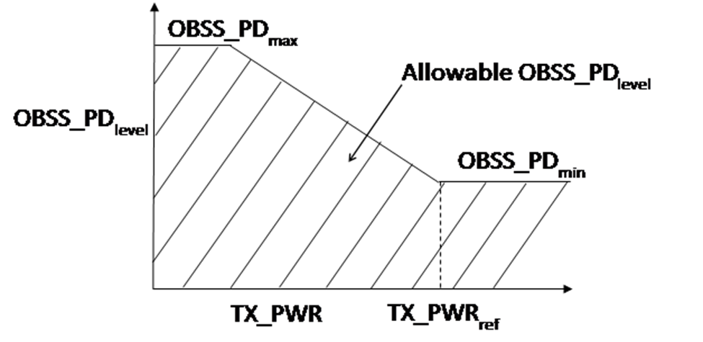
TPC
Transmit Power Control
Reduce transmit power so that interference to OBSS is reduced
Adjust OBSS_PD level in conjunction with Transmit power
From 16/1233r6

Slide 5
TPC and OBSS_PD
Couples TPC with OBSS_PD
OBSS_PD is CS/CCA for inter-BSS packets
OBSS_PDthres = OBSS_PD min + (TXPWRref - TXPWR)
And OBSS_PDmin <= OBSS_PDthres <= OBSS_PDmax
Recommended
-82 dBm <= OBSS_PDthres <= -62 dBm
Sets relationship between the inter-BSS CCA and TXPWR
TXPWR = TXPWRref + OBSS_PDmin – OBSS_PDthres
“A STA can select an OBSS_PD level during its operation under SR mode. This level can be dynamically adjusted or can be static.”

Slide 6
DSC
Dynamic Sensitivity Control (13/1012, etc)
Adjust STA effective CS/CCA threshold based upon RSSI of beacon from AP
CCAeff = MIN (Upper Limit, RSSI _{beacon} ) – Margin
CCAeff min = -82 dBm for 20 MHz.

Slide 7
Linking TPC with CS/CCA (DSC)
Presentations on reducing TXPWR with increased CCA threshold for 11ax first suggested in:
14/523 Laurent Cariou (Orange) “MAC simulation results for Dynamic sensitivity control (DSC - CCA adaptation) and transmit power control (TPC)
15/1069 James Wang (MediaTek, et al) “Adaptive CCA and TPC”
At the moment the CCA setting is left open.

Slide 8
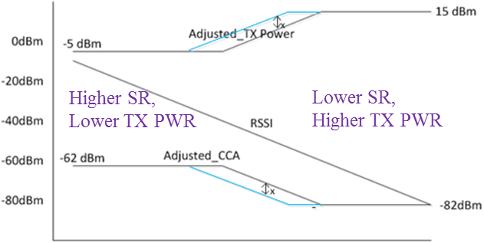
TPC and DSC
14/523
DSC (CCA control):
each STA adjusts CCA to CCA = Useful Rx Power – Margin
TP control:
each receiver requests transmitter to adjust TP so that it receives the useful Rx Power at ‘Margin’ dB above classical CCA (-82dBm)
15/1069
Adjusted_TX_Pwr = TX_Pwr_{nominal} –RSSI_{AP} +constant 1
Adjusted_OBSS_PD = OBSS_PD_{nominal} + RSSI_{AP} + constant 2
Limits the OBSS_PD threshold to be
-82dBm<Adj_CCA<-62 dBm
In both 14/523 and 15/1069, the CCA formulas are identical to DSC with a fixed DSC Upper Limit.

Slide 9
Proposal
Link DSC, Adaptive (A)TPC, and inter-BSS
DSC STA calculates the effective CCA Threshold based upon the beacon RSSI (i.e. distance to the AP) CCAeff = MIN (Upper Limit, RSSI _{beacon} ) – Margin CCAeffmin = -82 dBm
ATPC STA calculates the TXPWR CCAeff = CCAmin+ (TXPWRref - TXPWR) (TXPWR - TXPWRref )= CCAmin – CCAeff
The CCAeff is only used on Inter-BSS packets OBSS_PD thres = CCAeff
Everything is optional
NOTE: TPC as proposed in 16/1223 is left alone. ATPC is the scheme where the CCAeff is used and the TX power set accordingly. Same relationship is kept.

Slide 10
Proposed Parameters and unification
DSC parameters:
DSC Margin Set both to 0 for DSC prohibited
DSC Upper Limit
ATPC parameters:
ATPC CCA Min
Set to -82 dBm for 20 MHz (agrees with Std and min CCAeff)
ATPC CCA Max
Set to DSC Upper Limit – DSC Margin (maximum CCAeff)
Set both to zero for ATPC prohibited
TXPWRref
21 dBm (<3 SS), 23dBm (3+ SS) as proposed by 16/945, 16/1223
OBSS_PD
OBSS_PDthres = CCAeff

Slide 11
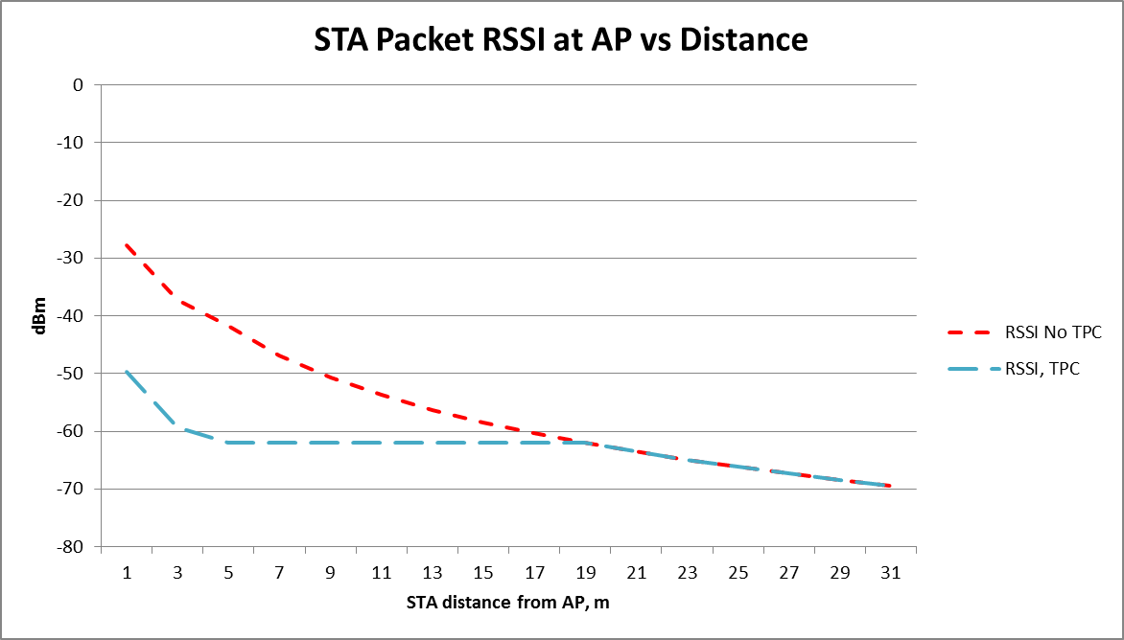
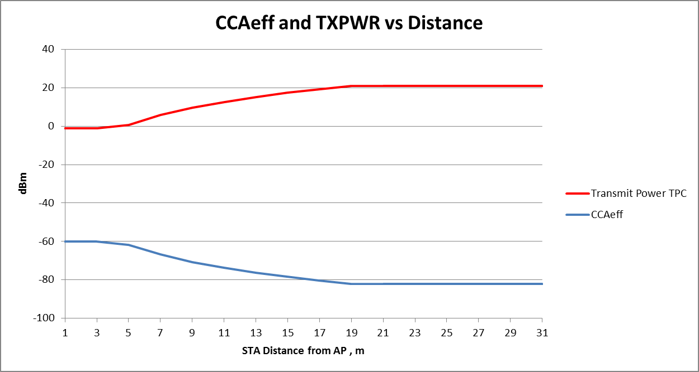
Result is as was envisaged by 15/1069 James Wang
AP
STA
TXPWRref = 21 dBm DSC Upper Limit = -40 dBm DSC Margin = 20 dB
ATPC CCA Min = -82 dBm ATPC CCA max = -60 dBm (-40–20)

Slide 12
Summary – Unified Proposal for Spatial Reuse
DSC may be used to determine effective CCA threshold,
CCA eff
ATPC may be used to determine TXPWR
based upon CCA eff
(TXPWR - TXPWRref )= OBSS_PDmin – CCAeff
Inter-BSS packets may be ignored if below OBSS_PD
OBSS_PD may be set to CCA eff
Satisfies all conditions as described in various presentations
Provides a standardized method for setting OBSS_PD.
Enables spatial reuse to be simulated

Slide 13
Adaptive CCA, ATPC and inter-BSS
Full text on this unified approach is in 16/1063

Slide 14
Motion
Incorporate text in 16/1063 into the 11ax Draft.

