Slide 1
TG ax
A Unified Approach to Spatial Reuse
Date: 2016-08
Authors:

Slide 2
Background
Three basic Spatial Reuse schemes have been proposed:
Color/inter-BSS
  Identify traffic in an OBSS network
TPC
  Adjust the transmit power of a STA based upon the CS/CCA threshold of the STA
  STA can increase CS/CCA threshold if it also reduces TXPWR
DSC
  Adjust the effective CS/CCA threshold of a STA based upon the RSSI of the AP Beacons

Slide 3
Color and inter-BSS
Inter-BSS packets
  Traffic in an OBSS network to the STA
Intra-BSS packets
  Traffic in the same network as the STA
Basic idea
If packet is identified as inter-BSS, ignore it if below OBSS PD
  Do not set NAV, Can transmit over it
Color bits in the HE Operation element (6 bits)
  Can also use BSSID

Slide 4
TPC
Transmit Power Control
  Reduce transmit power so that interference to OBSS is reduced
Previous
  TPC has been presented in 11k, 11v, 11e, 11h, 11aa, 11ac and now 11ax

Slide 5
TPC 16/945
Couples TPC with OBSS_PD
  OBSS_PD is CS/CCA for inter-BSS packets
OBSS_PDthres = OBSS_PD min + (TXPWRref - TXPWR)
And OBSS_PDmin <= OBSS_PDthres <= OBSS_PDmax
Recommended
-83 dBm <= OBSS_PDthres <= -62 dBm
Sets relationship between the inter-BSS CCA and TXPWR.

Slide 6
DSC
Dynamic Sensitivity Control (13/1012)
  Adjust STA effective CS/CCA threshold based upon RSSI of beacon from AP
  CCAeff = MIN (Upper Limit, RSSI _{beacon} ) – Margin

Slide 7
Linking TPC with DSC
Presentations on reducing TXPWR with increased CCA threshold for 11ax include:
  14/523 Laurent Cariou (Orange)
  “MAC simulation results for Dynamic sensitivity control (DSC - CCA adaptation) and transmit power control (TPC)
  15/1069 James Wang (MediaTek, et al)
  “Adaptive CCA and TPC”

Slide 8
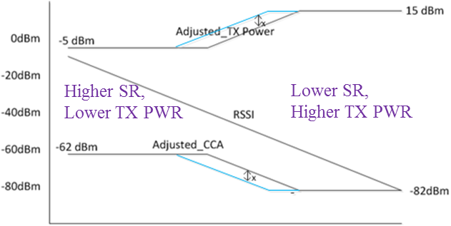
TPC and DSC
14/523
DSC (CCA control):
  each STA adjust CCA to CCA = Useful Rx Power – Margin
TP control:
    each receiver requests transmitter to adjust TP so that it receives the useful Rx Power at Margin dB above classical CCA (-82dBm)
15/1069
  Adjusted_TX_Pwr = TX_Pwr_{nominal} –RSSI_{AP} +constant 1
  Adjusted_OBSS_PD = OBSS_PD_{nominal} + RSSI_{AP} + constant 2
Limits the OBSS_PD threshold to be
  -82dBm<Adj_CCA<-62 dBm
In both 14/523 and 15/1069, the CCA formulas are identical to DSC with a fixed DSC Upper Limit.

Slide 9
Proposal
Link DSC, Adaptive (A)TPC, and inter-BSS
OPTIONS:
  DSC calculates the effective CCA Threshold based upon the beacon RSSI (or distance to the AP)
  CCAeff = MIN (Upper Limit, RSSI _{beacon} ) – Margin
  ATPC calculates the TXPWR
  CCAeff = CCAmin+ (TXPWRref - TXPWR)
  (TXPWR - TXPWRref )= CCAmin – CCAeff
  The CCAeff is only used on Inter-BSS packets
  OBSS_PD thres = CCAeff

Slide 10
Proposed Parameters
DSC parameters:
  DSC Margin
  DSC Upper Limit
ATPC parameters:
  ATPC CCA Min ≤ CCAeff ≤ ATPC CCA Max
  ATPC CCA Min
    Set to -82 dBm for 20 MHz (agrees with Std)
  ATPC CCA Max
    Set to DSC Upper Limit – DSC Margin (maximum CCAeff)
  TXPWRref
    21 dBm (<3 SS), 23dBm (3+ SS) as proposed by 16/945
OBSS_PD
  OBSS_PDthres = CCAeff

Slide 11
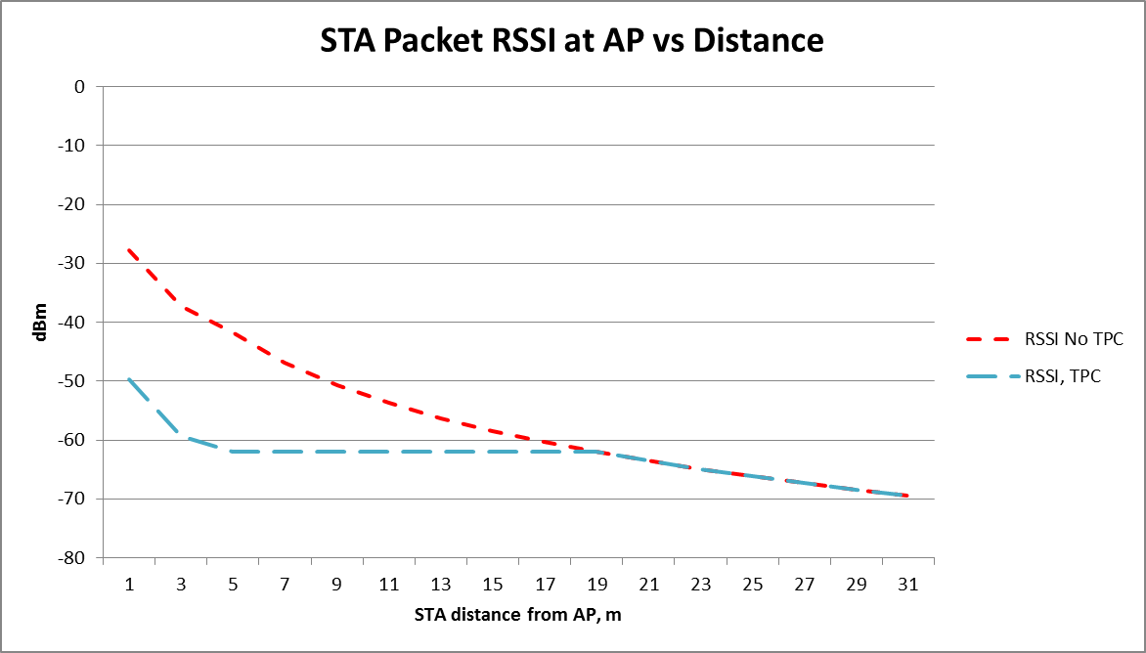
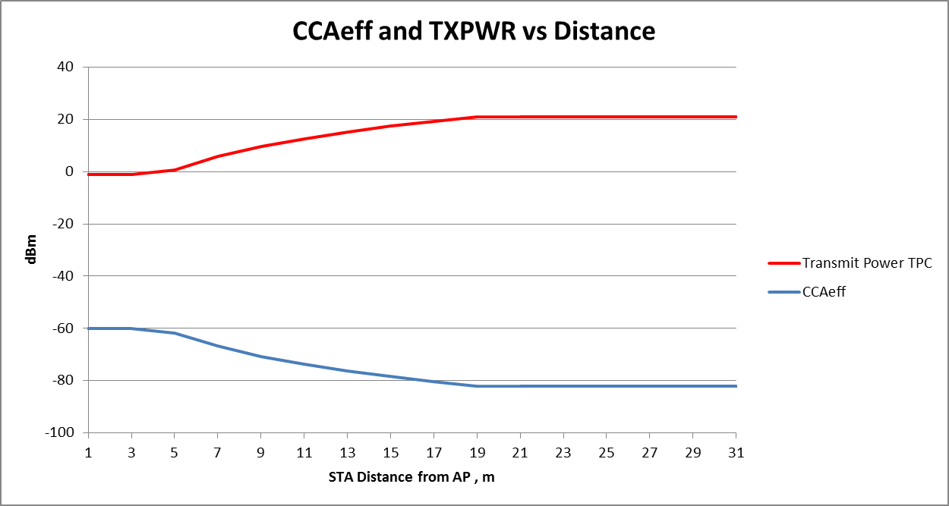
AP
STA
TXPWRref = 21 dBm DSC Upper Limit = -40 dBm DSC Margin = 20 dB
ATPC CCA Min = -82 dBm ATPC CCA max = -60 dBm (-40–20)

Slide 12
Summary –
Unified Proposal for Spatial Reuse
Color Based CCA
  Set OBSS PD may be set to CCA eff (as determined by DSC procedure).
  Inter-BSS packet can be ignored
DSC may be used to determine effective CCA threshold, CCA eff
ATPC may be used to determine TXPWR
  based upon CCA eff
Satisfies all conditions as described in various presentations

Slide 13
Adaptive CCA, ATPC and inter-BSS
Full text on this unified approach is in 16/1063

Slide 14
Motion
Incorporate text in 16/1063 into the 11ax Draft.

