Slide 1
TG ax A Unified Approach to Spatial Reuse
Date: 2016-08
Authors:

Slide 2
Background
Three basic Spatial Reuse schemes have been proposed:
Color
Identify traffic in an OBSS network
TPC
Adjust the transmit power of a STA based upon the CS/CCA threshold of the STA
STA can increase CS/CCA threshold if it also reduces TXPWR
DSC
Adjust the effective CS/CCA threshold of a STA based upon the RSSI of the AP Beacons

Slide 3
Color and inter-BSS
Inter-BSS packets
Traffic in an OBSS network to the STA
Intra-BSS packets
Traffic in the same network as the STA
Basic idea
If packet is identified as inter-BSS, ignore it
Do not set NAV, Can transmit over it
Color bits in the HE Operation element (6 bits)
Can also use BSSID
Observation:
Inter-BSS will not work if OBSS is Legacy, but BSSID can be used.

Slide 4
TPC
Transmit Power Control
Reduce transmit power so that interference to OBSS is reduced
Previous
TPC has been presented in 11k, 11v, 11e, 11h, 11aa, 11ac and now 11ax
Observation:
TPC works great if all STAs do it.

Slide 5
TPC 16/945
Couples TPC with OBSS_PD
OBSS_PD is CS/CCA for inter-BSS packets
OBSS_PDthres = OBSS_PD min + (TXPWRref - TXPWR)
And OBSS_PDmin <= OBSS_PDthres <= OBSS_PDmax
Recommended
-83 dBm <= OBSS_PDthres <= -62 dBm
Sets relationship between the inter-BSS CCA and TXPWR.
No description of how STA decides the balance of TXPWR and

Slide 6
DSC
Dynamic Sensitivity Control (13/1012)
Adjust STA effective CS/CCA threshold based upon RSSI of beacon from AP
CCAeff = MIN (Upper Limit, RSSI _{beacon} ) – Margin
Observation:
DSC is the converse of TPC, in place of reducing TXPWR, increase effective CCA threshold (or reduced RX sensitivity)_

Slide 7
Linking TPC with DSC
Presentations on reducing TXPWR with increased CCA threshold for 11ax include:
14/523 Laurent Cariou (Orange) “MAC simulation results for Dynamic sensitivity control (DSC - CCA adaptation) and transmit power control (TPC)
15/1069 James Wang (MediaTek, et al) “Adaptive CCA and TPC”

Slide 8
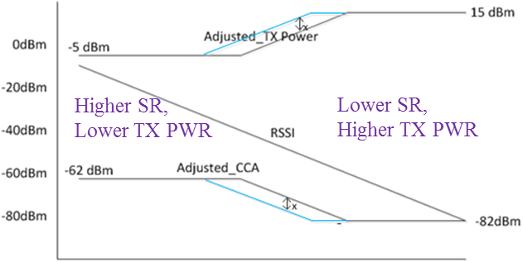
TPC and DSC
14/523
DSC (CCA control):
each STA adjust CCA to CCA = Useful Rx Power – Margin
TP control:
each receiver requests transmitter to adjust TP so that it receives the Useful Rx Power at Margin dB above classical CCA (-82dBm)
15/1069
Adjusted_TX_Pwr = TX_Pwr_{nominal} –RSSI_{AP} +constant 1
Adjusted_OBSS_PD = OBSS_PD_{nominal} + RSSI_{AP} + constant 2
Limits the OBSS_PD threshold to be
-82dBm<Adj_CCA<-62 dBm
In both 14/523 and 15/1069, the CCA formulas are identical to DSC with a fixed DSC Upper Limit.

Slide 9
Proposal
Link DSC, Adaptive (A)TPC, and inter-BSS
DSC calculates the effective CCS Threshold based upon the beacon RSSI (or distance to the AP) CCAeff = MIN (Upper Limit, RSSI _{beacon} ) – Margin
ATPC calculates the TXPWR CCAeff = CCAmin+ (TXPWRref - TXPWR) (TXPWR - TXPWRref )= CCAmin – CCAeff
The CCAeff is only used on Inter-BSS packets OBSS_PD thres = CCAeff

Slide 10
Parameters
DSC parameters:
DSC Margin
DSC Upper Limit
ATPC parameters:
ATPC CCA Min ≤ CCAeff ≤ ATPC CCA Max
ATPC CCA Min
Set to -82 dBm for 20 MHz (agrees with Std)
ATPC CCA Max
Set to DSC Upper Limit – DSC Margin (maximum CCAeff)
TXPWRref
21 dBm (<3 SS), 23dBm (3+ SS) as proposed by 16/945
OBSS_PD
OBSS_PDthres = CCAeff

Slide 11
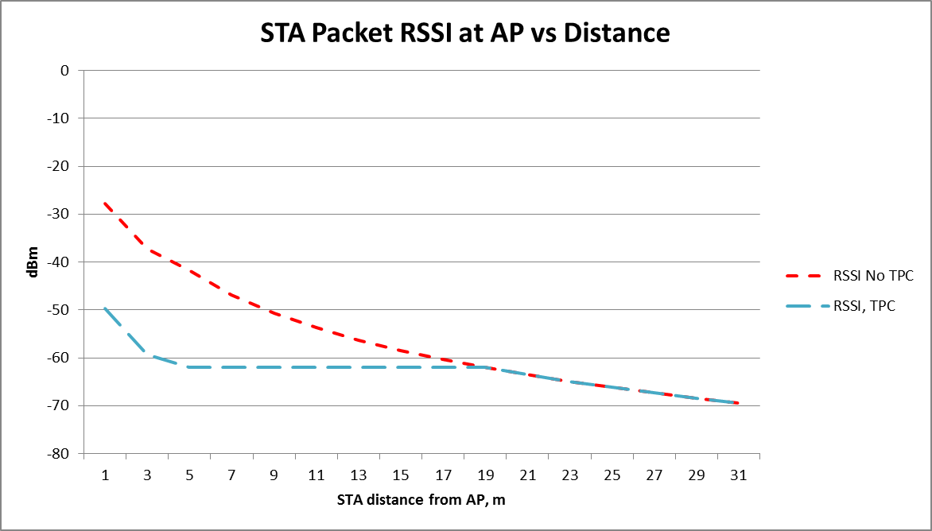
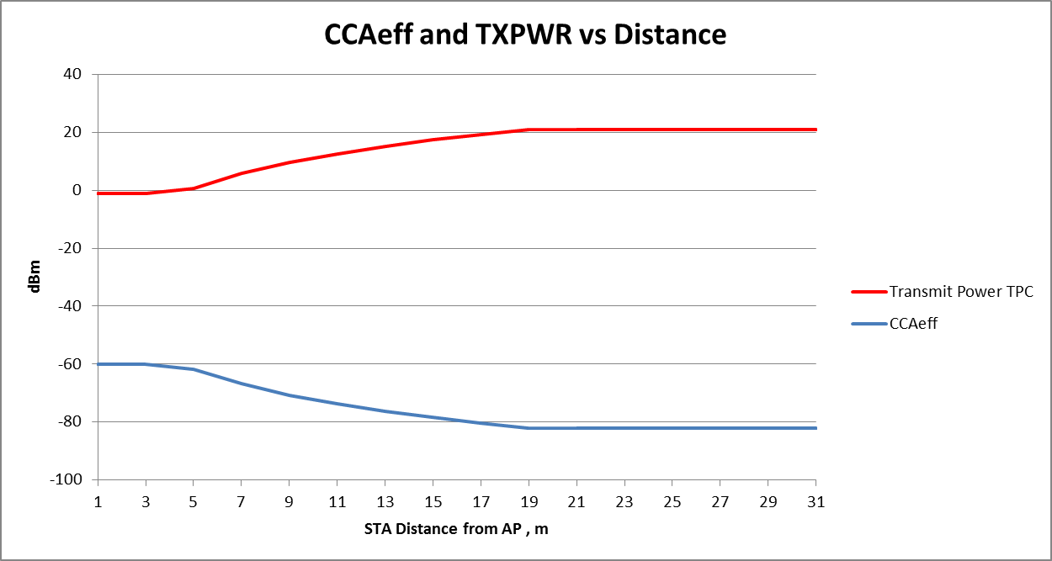
AP
STA
TXPWRref = 21 dBm DSC Upper Limit = -40 dBm DSC Margin = 20 dB
ATPC CCA Min = -82 dBm ATPC CCA max = -60 dBm (-40–20)

Slide 12
Summary – Unified Proposal for Spatial Reuse
Color Based CCA
No change
Inter-BSS packet can be ignored
DSC may be used to determine effective CCA threshold, CCA eff
ATPC may be used to determine TXPWR
CCAeff may be used only on inter-BSS packets
Satisfies all conditions as described in various presentations

Slide 13
Adaptive CCA, ATPC and inter-BSS
Full text on this unified approach is in 16/1063

Slide 14
Motion
Incorporate text in 16/1063 into the 11ax Draft.

