Slide 1
TGax MU Ad-hoc Agenda July 2016
Date: 2016-07-26

Slide 2
IEEE 802.11 TGax
High Efficiency WLAN
MU Ad Hoc
Co-Chairs:
Kaushik Josiam (Samsung)
Sigurd Schelstraete (Quantenna)
Kiseon Ryu (LG Electronics)

Slide 3
Meeting Protocol
Please announce your affiliation when you first address the group during a meeting slot
Slide 3

Slide 4
Attendance
https://murphy.events.ieee.org/imat/attendance/index
Register
Indicate attendance
See document 11-09-0517r0 for more details
Slide 4

Slide 5
Agenda Items
July 26 2016, 4:00PM – 6:00PM
Call meeting to order
Patent policy, etc. (Call for Potentially Essential Patents)
Set and approve agenda
Ad-hoc rules
This is the only MU Adhoc session this week
Technical Presentations approved by 802.11ax chair for presentation this week, and related straw polls
Any other technical presentations

Slide 6
Participants, Patents, and Duty to Inform
All participants in this meeting have certain obligations under the IEEE-SA Patent Policy. Participants:
  “Shall inform the IEEE (or cause the IEEE to be informed)” of the identity of each “holder of any potential Essential Patent Claims of which they are personally aware” if the claims are owned or controlled by the participant or the entity the participant is from, employed by, or otherwise represents
    “Personal awareness” means that the participant “is personally aware that the holder may have a potential Essential Patent Claim,” even if the participant is not personally aware of the specific patents or patent claims
  “Should inform the IEEE (or cause the IEEE to be informed)” of the identity of “any other holders of such potential Essential Patent Claims” (that is, third parties that are not affiliated with the participant, with the participant’s employer, or with anyone else that the participant is from or otherwise represents)
  The above does not apply if the patent claim is already the subject of an Accepted Letter of Assurance that applies to the proposed standard(s) under consideration by this group
Quoted text excerpted from IEEE-SA Standards Board Bylaws subclause 6.2
Early identification of holders of potential Essential Patent Claims is strongly encouraged
No duty to perform a patent search
Slide #1

Slide 7
Patent Related Links
  All participants should be familiar with their obligations under the IEEE-SA Policies & Procedures for standards development.
  Patent Policy is stated in these sources:
  IEEE-SA Standards Boards Bylaws
  http://standards.ieee.org/guides/bylaws/sect6-7.html#6
  IEEE-SA Standards Board Operations Manual
  http://standards.ieee.org/guides/opman/sect6.html#6.3
  Material about the patent policy is available at
  http://standards.ieee.org/board/pat/pat-material.html
If you have questions, contact the IEEE-SA Standards Board Patent Committee Administrator at patcom@ieee.org or visit http://standards.ieee.org/board/pat/index.html
This slide set is available at http://standards.ieee.org/board/pat/pat-slideset.ppt
Slide #2

Slide 8
Call for Potentially Essential Patents
If anyone in this meeting is personally aware of the holder of any patent claims that are potentially essential to implementation of the proposed standard(s) under consideration by this group and that are not already the subject of an Accepted Letter of Assurance:
  Either speak up now or
  Provide the chair of this group with the identity of the holder(s) of any and all such claims as soon as possible or
  Cause an LOA to be submitted
Slide #3

Slide 9
Other Guidelines for IEEE WG Meetings
All IEEE-SA standards meetings shall be conducted in compliance with all applicable laws, including antitrust and competition laws.
  Don’t discuss the interpretation, validity, or essentiality of patents/patent claims.
  Don’t discuss specific license rates, terms, or conditions.
    Relative costs, including licensing costs of essential patent claims, of different technical approaches may be discussed in standards development meetings.
      Technical considerations remain primary focus
  Don’t discuss or engage in the fixing of product prices, allocation of customers, or division of sales markets.
  Don’t discuss the status or substance of ongoing or threatened litigation.
  Don’t be silent if inappropriate topics are discussed … do formally object.
---------------------------------------------------------------
See IEEE-SA Standards Board Operations Manual, clause 5.3.10 and “Promoting Competition and Innovation: What You Need to Know about the IEEE Standards Association's Antitrust and Competition Policy” for more details.
Slide #4

Slide 10
Ad-hoc Group Straw poll rules
Document: 15/0075r0
A straw poll needs to achieves at least 75% at the ad-hoc level to be converted to a motion at the TG level.
In the case a consensus can not be reached within an Ad Hoc group (a stalemate that prohibits further progress), the subject is moved to the Task group, if an Ad Hoc straw poll vote to move the subject to the Taskgroup achieves >50% approval.
A straw poll affecting the Spec Framework has to start with,
  Do you agree to add to the TG Specification Frame work document?
  x.y.z. <feature description>
For further details, please see the operating rules for Tgax Ad-hoc groups
  https://mentor.ieee.org/802.11/dcn/15/11-15-0075-00-00ax-operating-rules-for-tgax-ad-hoc-groups.docx

Slide 11
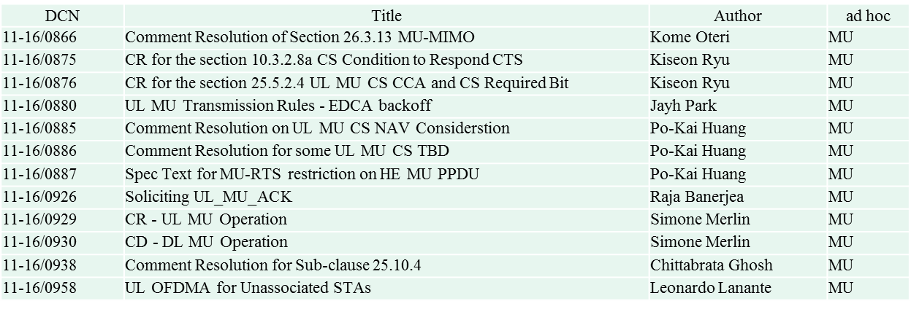
Submissions (MU)
12 MU Submissions

