Slide 1
Considerations on MAC-PHY interactions during SR operations
Date:
Authors:

Slide 2
Abstract
So far, spatial reuse operation is specified in draft D0.1[1]
  A STA should regard an inter-BSS PPDU with a valid PHY header and that has receiving power/RSSI below the OBSS PD level used by the receiving STA and that meets additional TBD conditions, as not having been received at all (e.g., should not update its NAV), except that the medium condition shall indicate BUSY during the period of time that is taken by the receiving STA to validate that the PPDU is from an inter-BSS, but not longer than the time indicated as the length of the PPDU payload.
Some comments (CIDs 2665, 2719) are concerned with how to adjust the backoff counter during the spatial reuse operations.
Comment resolutions should be carefully considered on the interactions between MAC and PHY layers for supporting SR operations.

Slide 3
Proposal
We agree with the commenters on elaborating the specific behaviors concerning backoff counter during the SR operations, and we propose that
  The baseline backoff procedure is maintained during the period of time that is taken by the receiving STA to validate the PPDU.
When an inter-BSS PPDU arrives at a STA,
  The backoff procedure of that STA is suspended if the channel is indicated as BUSY at the beginning of preamble based on the legacy CS mechanism.
  Then, after receiving HE-SIG-A / MAC header successfully,
    If the channel is determined to be IDLE using SR-based CS mechanism (inter-BSS frame & the receiving power < OBSS PD level) for the duration of a AIFS duration, then the backoff procedure is allowed to resume.
    If the channel is determined to be BUSY using SR-based CS mechanism, the receiving process continues and the backoff procedure is still suspended.

Slide 4
Proposal (cont’d)
Meanwhile it is also necessary to carefully consider the interaction of the backoff procedure with PHY and the interactions between MAC and PHY layers.
We propose to define the interaction mechanisms between MAC and PHY layers for supporting SR operations.
The details of the proposed solution are described in the following slides.

Slide 5
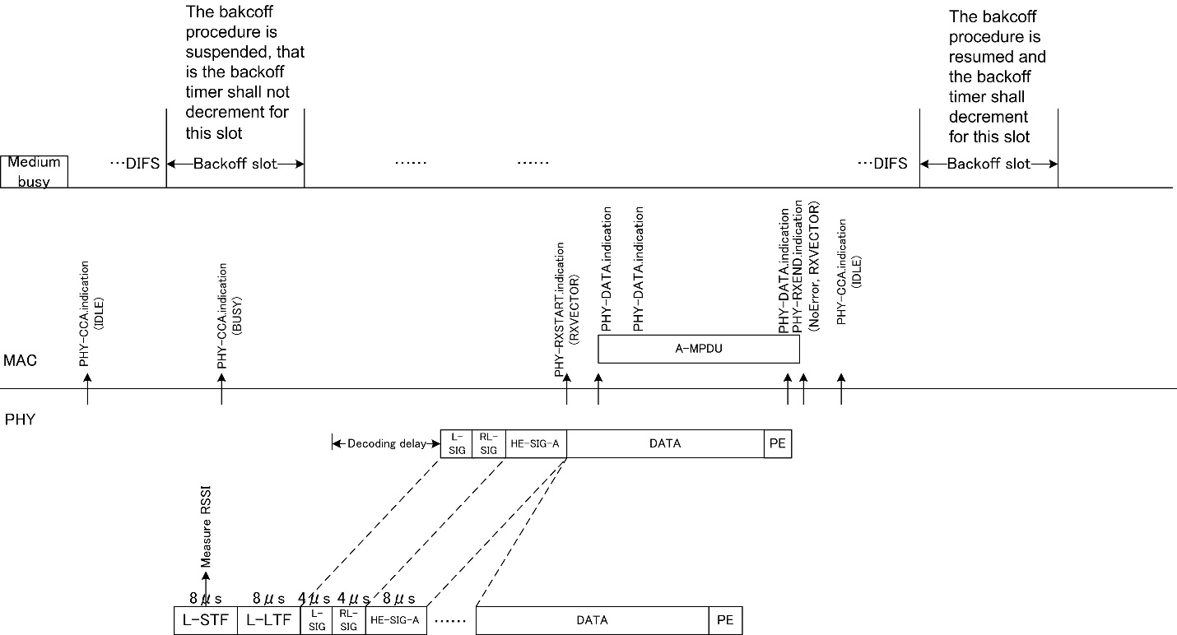
Intra-BSS PPDU reception
The MAC timing and PHY receive procedure of intra-BSS PPDU reception case is illustrated as follows
Fig.1 Intra-BSS PPDU reception

Slide 6
Intra-BSS PPDU reception (cont’d)
The MAC timing and PHY receive procedure for intra-BSS frame reception case is the same as the baseline procedure[2].
  When PHY detects the RX power is higher than CCA-SD at the beginning of the preamble, PHY issues PHY-CCA.indication (BUSY) primitive to indicate channel BUSY status to MAC. Then MAC suspends backoff procedure.
  After the PHY-CCA.indication (BUSY) primitive is issued, the PHY entity shall begin receiving the training symbols. Then after receiving valid L-SIG, RL-SIG and HE-SIG-A successfully, the PHY entity may issue a PHY-RXSTART.indication (RXVECTOR) primitive.
  Following training and signal fields, the Data field shall be received including a series of PHY-DATA.indication (DATA) primitive exchanges.
  After the reception of the final bit of the PPDU successfully, the PHY issues a PHY-RXEND.indication (NoError) primitive, then issues a PHY-CCA.indication (IDLE).
  The MAC is allowed to resume backoff procedure after determining that the channel remains IDLE for the duration of a AIFS.

Slide 7
Inter-BSS PPDU reception
According to the SR operation defined in 11ax D 0.1, the MAC timing and PHY receive procedure for inter-BSS PPDU reception case is illustrated as case A, B, and C respectively, and is not as in baseline.
  Case A: SR is allowed & RX power is lower than OBSS PD level
  Case B: SR is allowed & RX power is higher than OBSS PD level
  Case C: SR is not allowed

Slide 8
Proposal on Case A
Case A: SR is allowed & RX power is lower than OBSS PD level
Fig.2 Proposal on case A

Slide 9
Proposal on Case A (cont’d)
When SR is allowed and RX power is lower than OBSS PD level
  (We propose to define the interactions between PHY and MAC entities for supporting SR operation (the following c) ~ d) which are also shown in Fig.2 marked in blue))
  When PHY detects the RX power is higher than CCA-SD at the beginning of the preamble, PHY issues PHY-CCA.indication (BUSY) primitive to indicate channel BUSY status to MAC. Then MAC suspends backoff procedure.
  After the PHY-CCA.indication (BUSY) primitive is issued, the PHY entity shall begin receiving the training symbols. Then after receiving valid L-SIG, RL-SIG and HE-SIG-A successfully, the PHY entity may issue a PHY-RXSTART.indication (RXVECTOR) primitive.
  Subsequently, if the BSS COLOR, SPATIAL REUSE within the RXVECTOR indicate the receiving PPDU is an inter-BSS PPDU and SR is allowed, then the MAC issues a PHY-SR.request (OBSS PD level) to request to the PHY entity to compare the OBSS PD level.
  Then the PHY compares the RX power with OBSS PD level. The PHY may issue a PHY-RXEND.indication (SR based terminated) primitive if RX power is lower than OBSS PD level. As well as, the PHY shall issue a PHY-SR.confirm (IDLE) to MAC entity.
  The MAC is allowed to resume backoff procedure after determining that the channel remains IDLE for the duration of a AIFS.

Slide 10
Proposal on Case B
Case B: SR is allowed & RX power is higher than OBSS PD level
Fig.3 Proposal on case B

Slide 11
Proposal on Case B (cont’d)
When SR transmission is allowed and RX power is higher than PD_level
  (We propose new interactions between PHY and MAC entities for supporting SR operation (the following c) ~ d) which are also shown in Fig.3 marked in blue))
  When PHY detects the RX power is higher than CCA-SD at the beginning of the preamble, PHY issues PHY-CCA.indication (BUSY) primitive to indicate channel BUSY status to MAC. Then MAC suspends backoff procedure as shown in Fig..
  After the PHY-CCA.indication (BUSY) primitive is issued, the PHY entity shall begin receiving the training symbols. Then after receiving valid L-SIG, RL-SIG and HE-SIG-A successfully, the PHY entity may issue a PHY-RXSTART.indication (RXVECTOR) primitive.
  Subsequently, if the BSS COLOR, SPATIAL REUSE within the RXVECTOR indicate the receiving PPDU is an inter-BSS PPDU and SR transmission is allowded, the MAC issues PHY-SR.request (OBSS PD level) to indicate PHY entity.
  Then the PHY compares the RX power with OBSS PD level. If RX power is higher than OBSS PD level, the PHY continues to receive the PPDU and issues a PHY-SR.confirm (BUSY) to MAC entity at the same time.
  After the reception of the final bit of the PPDU successfully, the PHY issues a PHY-RXEND.indication (NoError) primitive, then issues a PHY-CCA.indication (IDLE).
  The MAC is allowed to resume backoff procedure after determining that the channel remains IDLE for the duration of a AIFS.

Slide 12
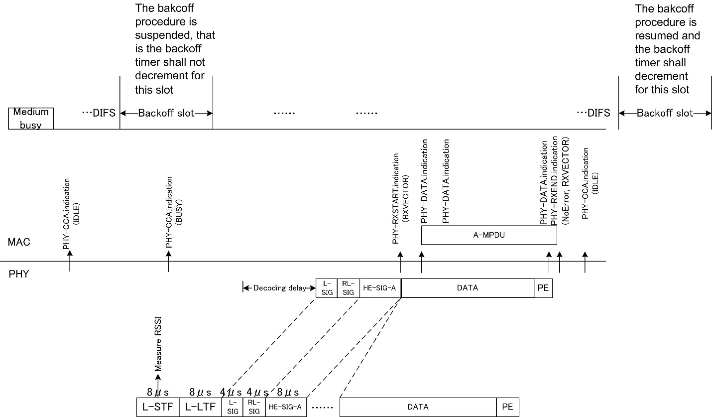
Proposal on Case C
Case C: SR is not allowed
Fig.4 Proposal on case C

Slide 13
Proposal on Case C (cont’d)
When SR transmission is not allowed
  When PHY detects the RX power is higher than CCA-SD at the beginning of the preamble, PHY issues PHY-CCA.indication (BUSY) primitive to indicate channel BUSY status to MAC. Then MAC suspends backoff procedure.
  After the PHY-CCA.indication (BUSY) primitive is issued, the PHY entity shall begin receiving the training symbols. Then after receiving valid L-SIG, RL-SIG and HE-SIG-A successfully, the PHY entity may issue a PHY-RXSTART.indication (RXVECTOR) primitive.
  Subsequently, if the BSS COLOR, SPATIAL REUSE within the RXVECTOR indicate the receiving PPDU is an inter-BSS PPDU but SR is NOT allowed, the PHY continues to receive the PPDU (as baseline CS).
  Following training and signal fields, the Data field shall be received including a series of PHY-DATA.indication (DATA) primitive exchanges.
  After the reception of the final bit of the PPDU successfully, the PHY issues a PHY-RXEND.indication (NoError) primitive, then issues a PHY-CCA.indication (IDLE).
  The MAC is allowed to resume backoff procedure after determining that the channel remains IDLE for the duration of a AIFS.

Slide 14
Conclusion
For intra-BSS frame reception, the MAC timing and PHY receive procedure is the same as the baseline procedure.
For inter-BSS frame reception, the MAC timing and PHY receive procedure can be categories into three cases.
  Case A: SR is allowed & RX power is lower than OBSS PD level
  Case B: SR is allowed & RX power is higher than OBSS PD level
  Case C: SR is not allowed
The proposed comment resolution is contained in 11-16/1025r0

Slide 15
References
11-16/0024r1, Draft Specifications, March 2016
Draft P802.11REVmc_D6.0

