Slide 1
EDCA rules - follow up 2
Date: 2016-07-28
Authors:

Slide 2
Introduction
Based on the motion passed in May meeting, The following concepts are present in the TGax SFD[1]
Allow the AP to choose any access category for contending to send the trigger frame
• The chosen AC may give to the AP higher priority in accessing the channel
compared to its associated STAs
There were some further discussions about more details related to the above approved motion should be specified[2, 3]
How to choose AC for a trigger frame
How to use different set of EDCA parameter
In this contribution, we would like to discuss about how to use different set of EDCA parameter.

Slide 3
Proposal
Basically, AP may follow baseline EDCA channel access mechanism which implies AP is allowed to use smaller EDCA parameters than its associated STAs [4].
How to use different set of EDCA parameters
Option 1: AP is allowed to choose EDCA parameters to raise its priority to access channel.
Option 2: AP broadcasts EDCA parameters to constrain associated STAs from accessing channel for a certain period.
Option 3: both option 1 and option 2

Slide 4
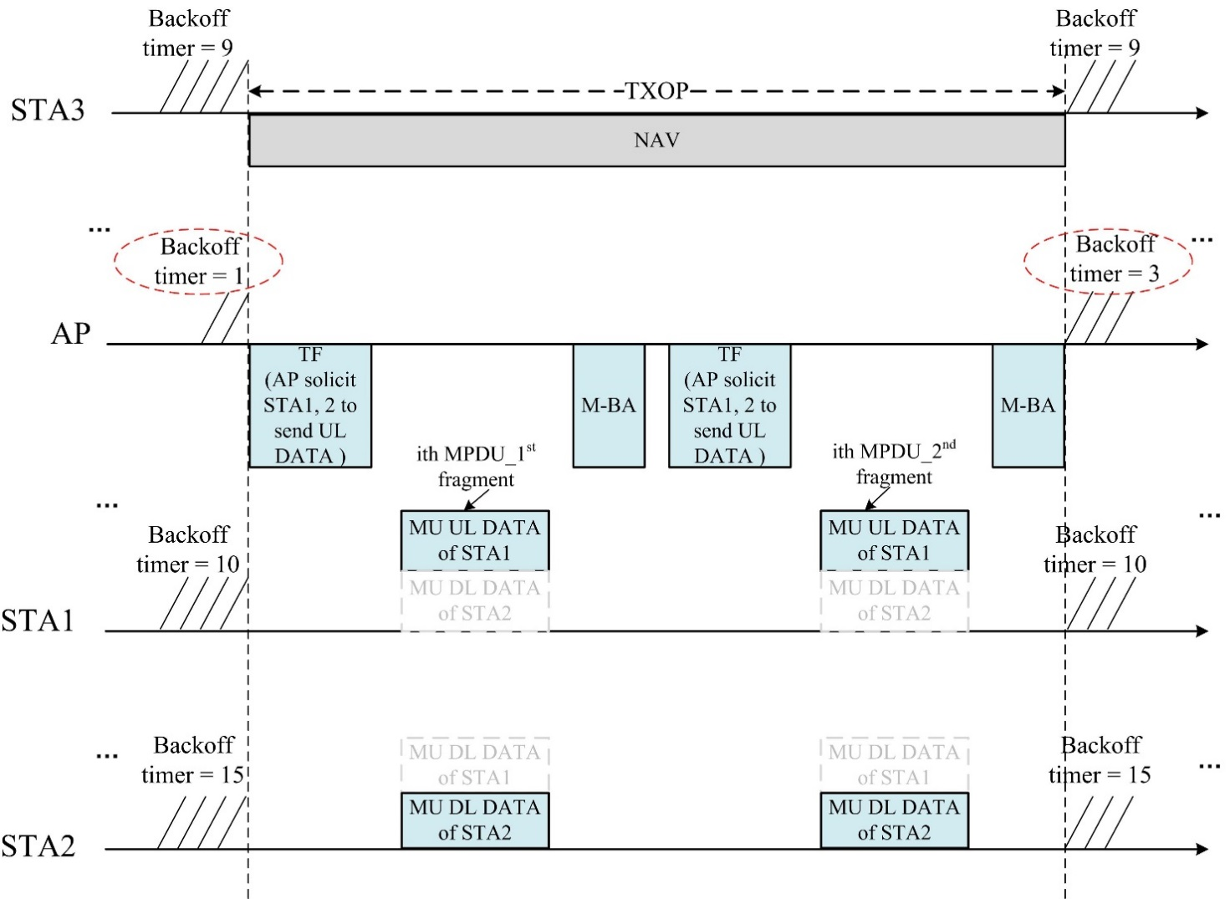
Proposal (con’t)
Option 1: AP is allowed to choose EDCA parameters to raise its priority to access channel.
Example ( TXOP limit = 0)
(a) At first, AP may keep obtaining several TXOPs with higher priority than its associated STAs.

Slide 5
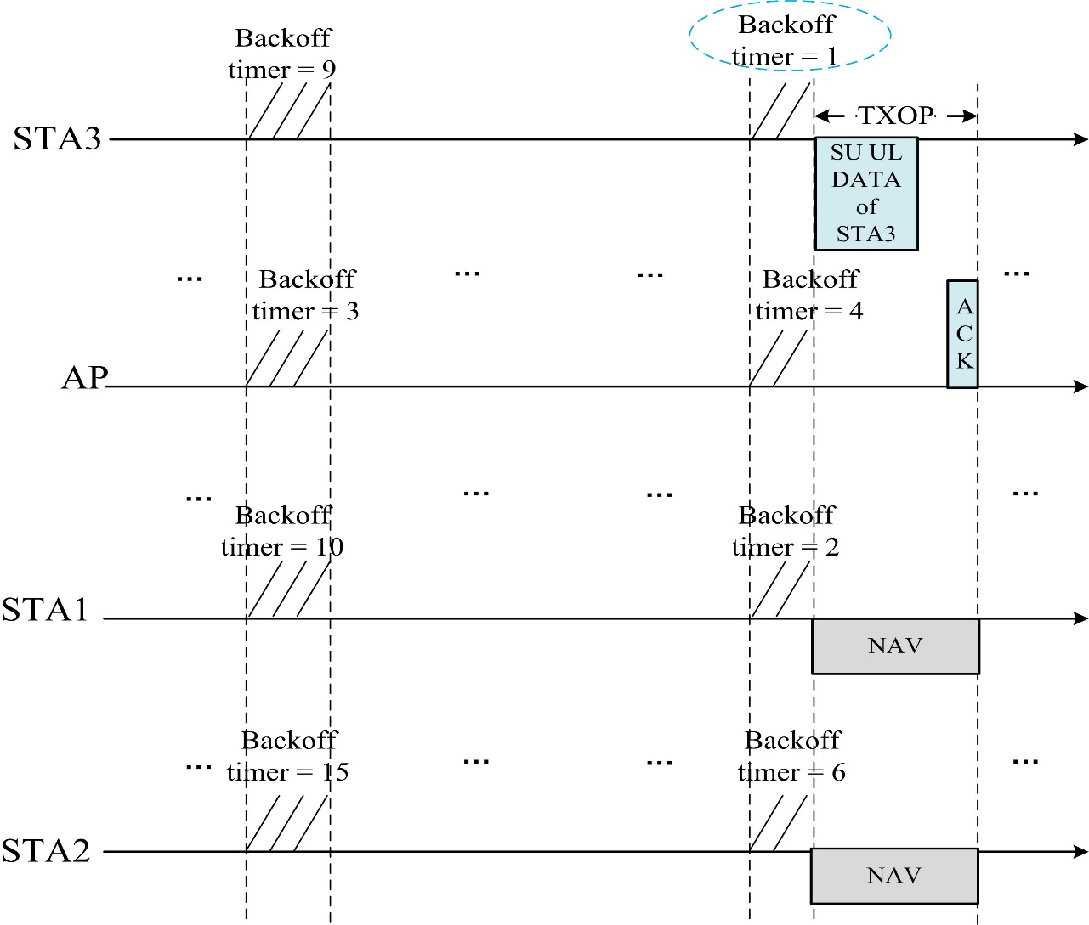
Proposal (con’t)
Option 1: AP is allowed to choose EDCA parameters to raise its priority to access channel.
Example ( TXOP limit = 0)
(b) Then, associated STAs may obtain TXOP after several TXOPs as well, because they keep decrementing the resumed backoff timer.

Slide 6
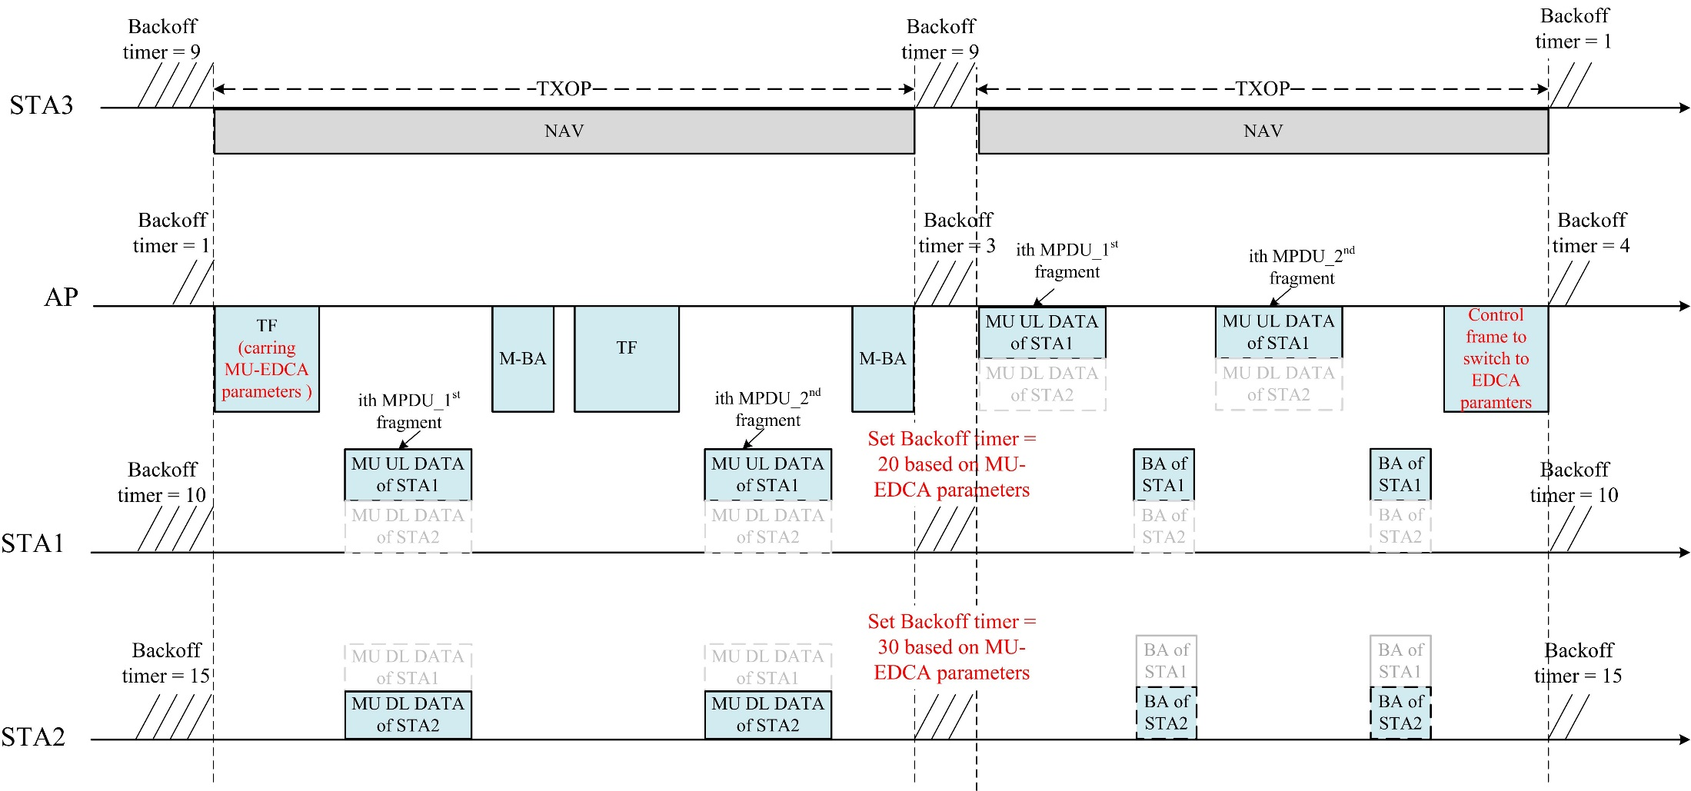
Proposal (con’t)
Option 2: AP broadcasts EDCA parameters to constrain associated STAs from accessing channel for a certain period.
Example:

Slide 7
Conclusion
Basically, AP may follow baseline EDCA channel access mechanism which implies AP is allowed to use smaller EDCA parameters than its associated STAs.
How to use different set of EDCA parameters
Option 1: AP is allowed to choose EDCA parameters to raise its priority to access channel.
Option 2: AP broadcasts EDCA parameters to constrain associated STAs from accessing channel for a certain period.
Option 3: both option 1 and option 2

Slide 8
SP
Which option do you prefer to decide how to use different set of EDCA parameters
Option 1: AP is allowed to choose EDCA parameters to raise its priority to access channel.
Option 2: AP broadcasts EDCA parameters to constrain associated STAs from accessing channel for a certain period.
Option 3: both option 1 and option 2

Slide 9
References
11-15-0132-17-00ax-spec-framework, May 2016
11-16-0762-00-00ax-edca-rules-for-sending-trigger-frames, June 2016
11-16-0768-00-00ax-tgax-teleconference-minutes-from-june-to-july-2016
Draft P802.11REVmc_D6.0

