Slide 1
EDCA rules - follow up 2
Date: 2016-07-28
Authors:

Slide 2
Introduction
Based on the motion passed in May meeting, The following concepts are present in the TGax SFD[1]
  Allow the AP to choose any access category for contending to send the trigger frame
  • The chosen AC may give to the AP higher priority in accessing the channel
  compared to its associated STAs
There were some further discussions about more details related to the above approved motion should be specified[2, 3]
  How to choose AC for a trigger frame
  How to use different set of EDCA parameter
In this contribution, we would like to discuss about how to use different set of EDCA parameter.

Slide 3
Proposal
Basically, AP may follow baseline EDCA channel access mechanism which implies AP is allowed to use smaller EDCA parameters than its associated STAs [4].
How to use different set of EDCA parameters
  Option 1: AP is allowed to choose smaller EDCA parameters to raise its priority to access channel.
  Option 2: AP broadcasts bigger EDCA parameters to constrain associated STAs from accessing channel for a certain period.

Slide 4
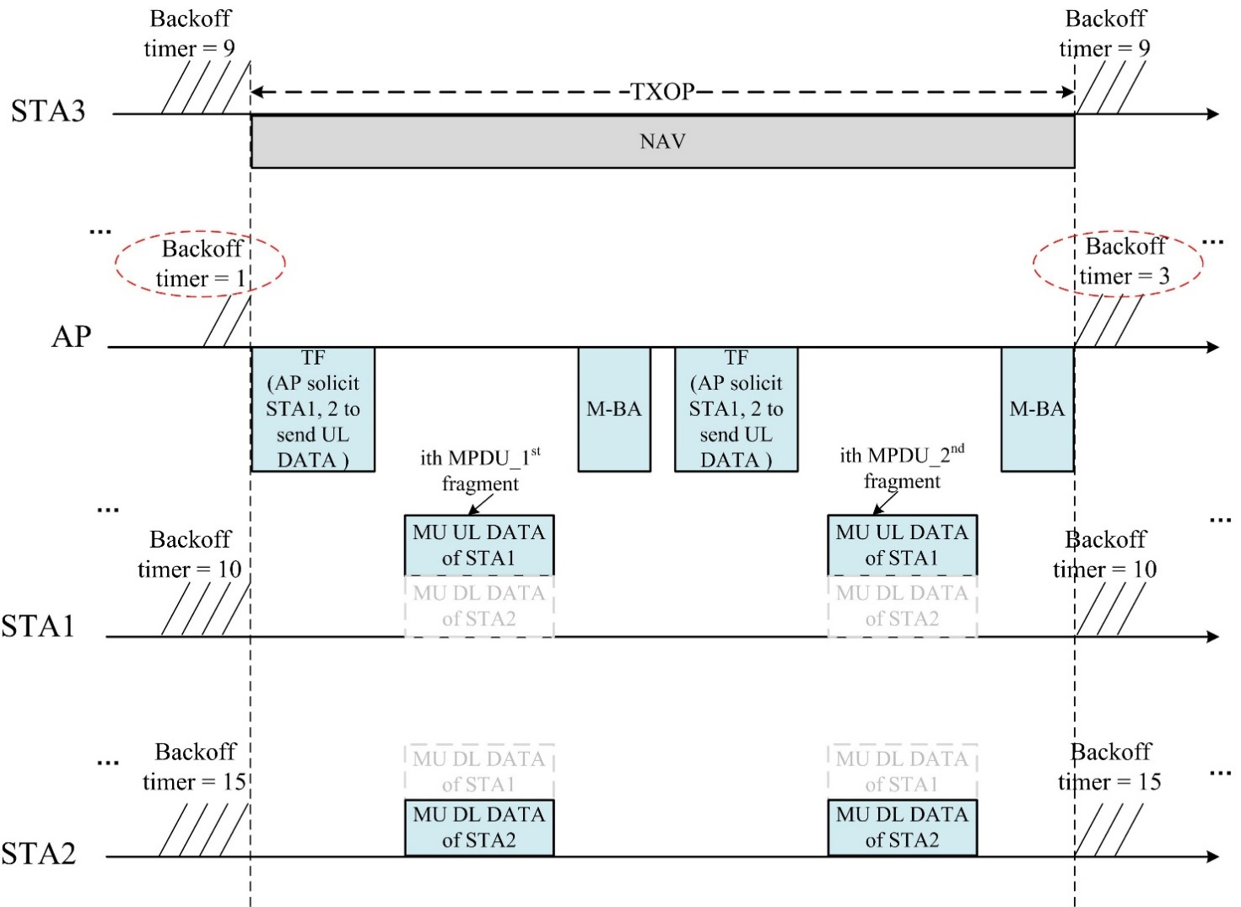
Proposal (con’t)
Option1: AP is allowed to choose smaller EDCA parameters to raise its priority to access channel.
  Example ( TXOP limit = 0)
(a) At first, AP may keep obtaining several TXOPs with higher priority than its associated STAs.

Slide 5
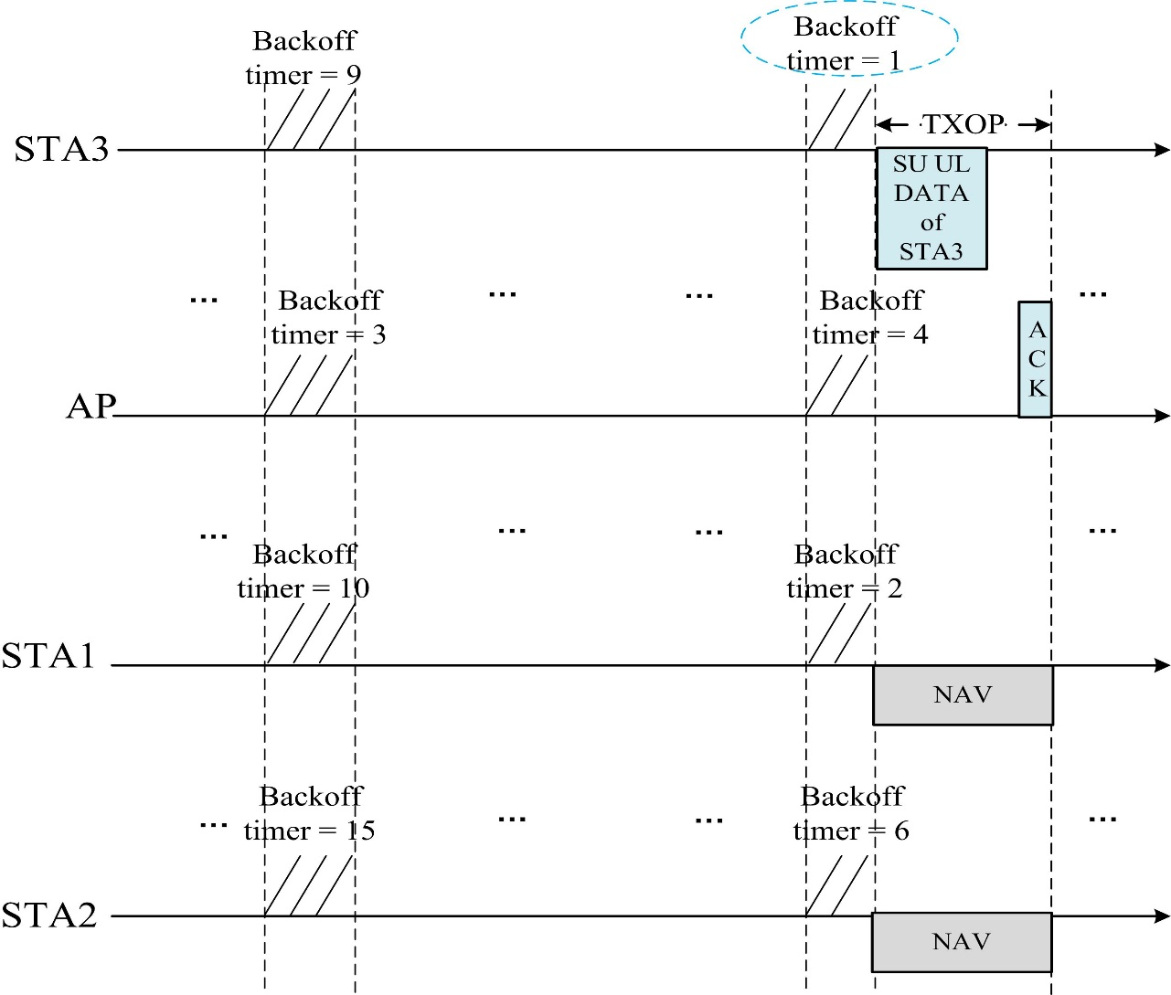
Proposal (con’t)
Option1: AP is allowed to choose smaller EDCA parameters to raise its priority to access channel.
  Example ( TXOP limit = 0)
(b) Then, associated STAs may obtain TXOP after several TXOPs as well, because they keep decrementing the resumed backoff timer.

Slide 6
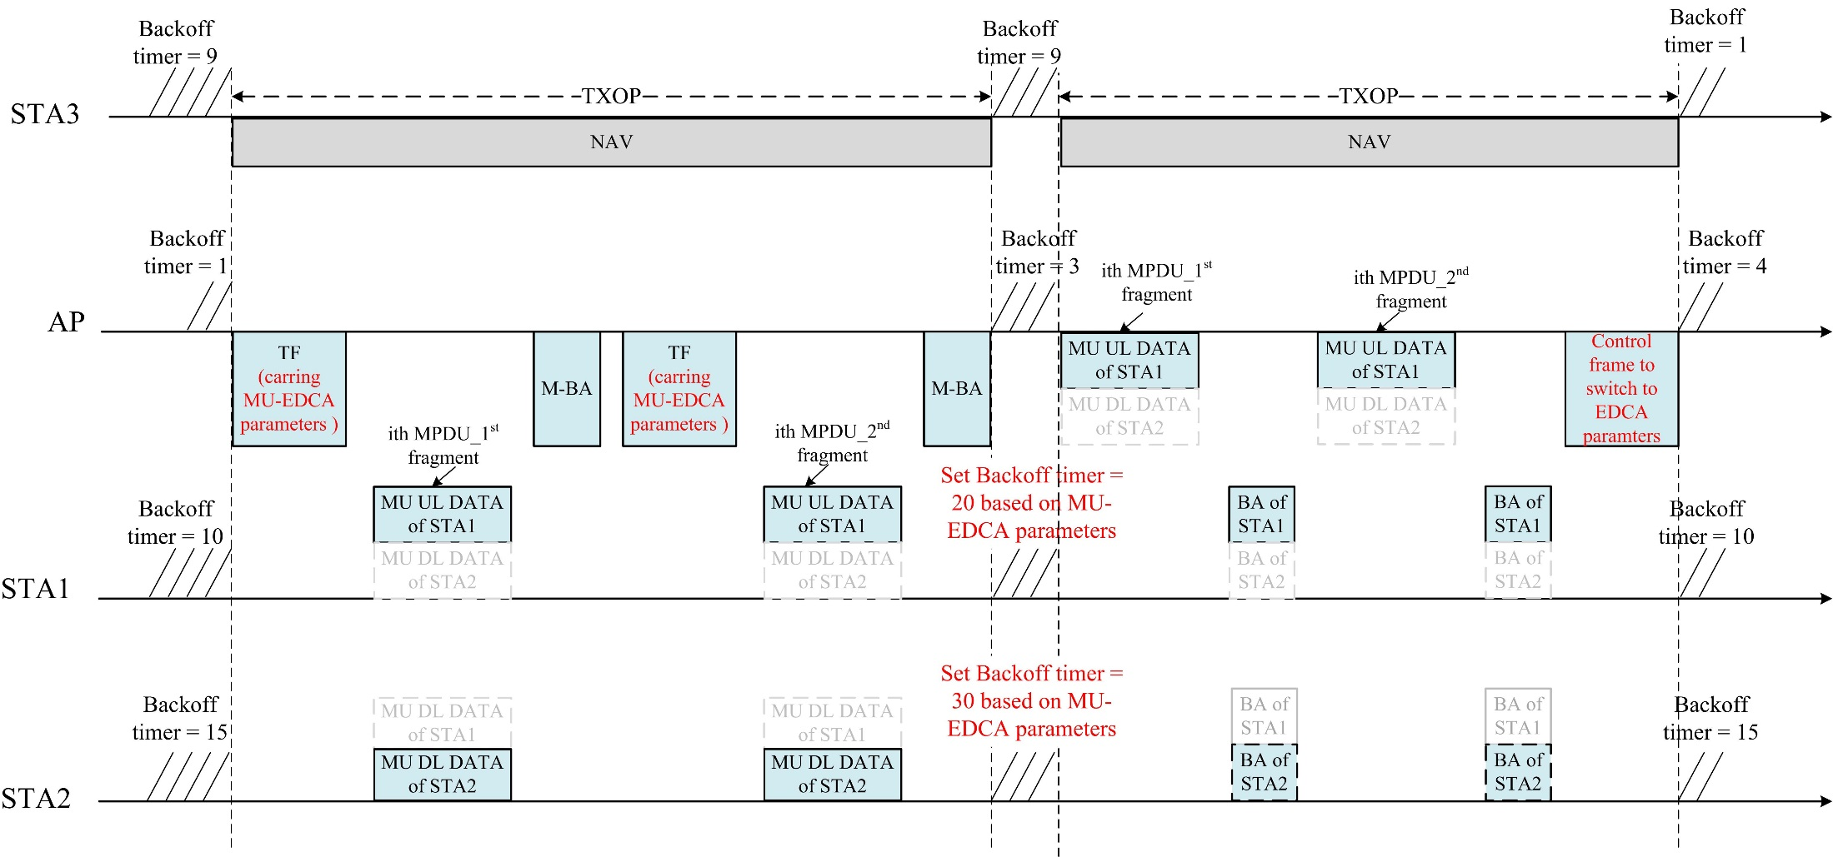
Proposal (con’t)
Option2: AP broadcasts bigger EDCA parameters to constrain associated STAs from accessing channel for a certain period.
  Example:

Slide 7
Conclusion
Basically, AP may follow baseline EDCA channel access mechanism which implies AP is allowed to use smaller EDCA parameters than its associated STAs.
How to use different set of EDCA parameters
  Option 1: AP is allowed to choose smaller EDCA parameters to raise its priority to access channel.
    Probs: flexibility, almost no overhead
    Cons: the schedulability is limited.
  Option 2: AP broadcasts bigger EDCA parameters to constrain associated STAs from accessing channel for a certain period.
    Probs: schedulability
    Cons: overhead

Slide 8
SP
Which option do you prefer to decide how to use different set of EDCA parameters
  Option 1: AP is allowed to choose smaller EDCA parameters to raise its priority to access channel.
  Option 2: AP broadcasts bigger EDCA parameters to constrain associated STAs from accessing channel for a certain period.

Slide 9
References
11-15-0132-17-00ax-spec-framework, May 2016
11-16-0762-00-00ax-edca-rules-for-sending-trigger-frames, June 2016
11-16-0768-00-00ax-tgax-teleconference-minutes-from-june-to-july-2016
Draft P802.11REVmc_D6.0

