Slide 1
Consideration on Multi-STA BlockAck Optimization
Date: 2016-07-00
Authors:

Slide 2
Introduction
In the spec draft, Block Acknowledgement procedures for UL MU and some Ack optimization methods are agreed:
  When receiving multiple frames from more than one STA that are part of an UL MU transmission (Clause 9.42.2) and that require an immediate acknowledgement, an AP may send multiple BlockAck frames (or ACK frames) in an OFDMA HE MU PPDU or a Multi-STA BlockAck (M-BA) frame.
  If the Ack Type field is 0, then the Block Ack Starting Sequence Control and Block Ack Bitmap subfields are not present and the Per STA Info subfield indicates the acknowledgment of successful reception of either a single MPDU or of all the MPDUs carried in the eliciting (A-)MPDU.
  MPDUs with multiple TIDs that ask for Ack and/or BA acknowledgement and a management frame that asks for Ack acknowledgement may be aggregated in one A-MPDU of MU transmission.
However, more effort for Ack optimization is needed
In this presentation, we discuss further optimization method for BlockAck is proposed as in CID 2389

Slide 3
Problem: BA length exceeds EIFS
The duration for BA procedures lasts up to milliseconds
Hidden STAs may send Data frames after EIFS duration, which makes collision

Slide 4
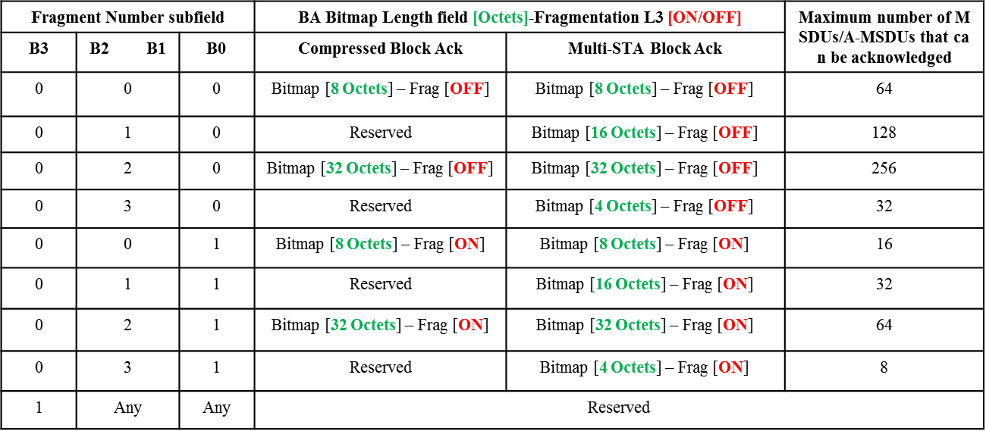
Recap: Multi-STA BA length selection
In [2] the length of M-BA with fragmentation is decided
  Depending on Fragment Number subfield value, the length of BlockAck bitmap varies from 4 octets to 32 octets

Slide 5
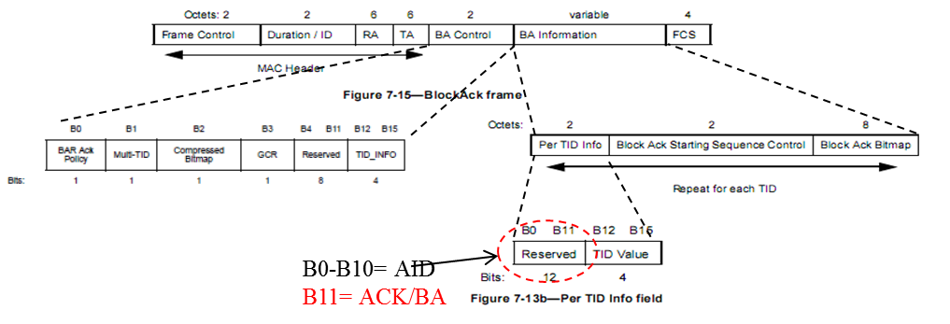
Recap: Ack/BA mode for Multi-STA BA
In Draft,
  If the Ack Type field is 0, then the Block Ack Starting Sequence Control and Block Ack Bitmap subfields are not present and the Per STA Info subfield indicates the acknowledgment of successful reception of either a single MPDU or of all the MPDUs carried in the eliciting (A-)MPDU.
Notes:
15/626

Slide 6
Recap: Multi-TID BA
In 11ax, Multi-TID A-MPDU format is allowed[4]
  Multiple TIDs in a single PSDU between AP and a STA for DL/UL OFDMA/MU-MIMO
  BlockAck setup is done per TID.
In [5],
  Multi-STA BA supports BA acknowledgement and Ack acknowledgement for multiple TIDs of a STA
  The spec shall allow UL MU transmission of Multi-STA Block ACK frame in response to multi-TID A-MPDU of DL MU transmission.
Notes:
For multiple TID A-MPDU
불명확하다

Slide 7
Multi-TID Ack (cont.)
All TID Ack
  The Ack mode for multiple TID can be done with specific TID value (group TID), when all of A-MPDU for an AID is received successfully
  More discussion about TID setting in Multi-TID Ack is discussed in 16/916r0

Slide 8
The Ack duration problem
The Ack duration extends up to more than 3ms, even though it assumes 4 octet length in BlockAck bitmap
Also, using Ack Type field is not enough, because in many cases, it exceeds EIFS even though all of M-BA has 0 in Ack Type field
EIFS excess problem may cause the retransmission of UL STAs due to corrupted BlockAck.
  Ack protection or further Ack optimization is needed

Slide 9
Additional Ack Optimization method
All STA All Ack
  In case of A-MPDUs from all AIDs are received successfully, AP may use a specific AID in Multi-STA BlockAck frame to indicate the all frames from all triggered STAs are successfully received

Slide 10
Conclusion
In this presentation, we continued to discuss the Ack optimization method and some clarification
  There are some methods to reduce the duration of Ack procedure, including adjusting length of Ack Bitamap, Ack/BA mode, and Multi-TID Ack
However, though all of triggered frame is sent successful, Ack duration exceeds EIFS even though all of M-BA has 0 in Ack Type field for many user case
We present the further optimization method, in case all of triggered STAs’ transmission is successful
  All AID Ack mode with group AID

Slide 11
Straw Poll 2
Do you agree to add to the spec draft?
  9.3.1.9.7 Multi-STA BlockAck variant
  …
  If the Ack Type field is 0, then the Block Ack Starting Sequence Control and Block Ack Bitmap subfields are not present and the Per STA Info subfield indicates the acknowledgment of successful reception of either a single MPDU or of all the MPDUs carried in the eliciting (A-)MPDU.
  If the ACK Type field is 0, the AID value of the Per AID TID Info subfield is set to TBD value (e.g., 2047), and the TID value of the Per AID TID Info subfield is set to 14, then the Block Ack Starting Sequence Control and Block Ack Bitmap are not present and the single Per STA Info field indicates the acknowledgement of successful reception of all the A-MPDUs of all the STAs elicited by the trigger frame.

Slide 12
Reference
[1] IEEE P802.11ax D0.2
[2] IEEE 802.11-16/616r2 “BlockAck generation and selection rules”
[3] IEEE 802.11-15/626r1 “Further consideration for Multi-STA BlockAck frame”
[4] IEEE 802.11-15/1065r1 “UL multi-TIDs aggregation”
[5] IEEE 802.11-16/0069 “Multi-TID A-MPDU in MU Transmission”

