Slide 1
UL OFDMA for Unassociated STAs
Date: 2016-07-25
Authors:

Slide 2
Summary
In this contribution, we propose to increase the efficiency of multi-frame exchanges involving unassociated STAs using UL OFDMA.

Slide 3
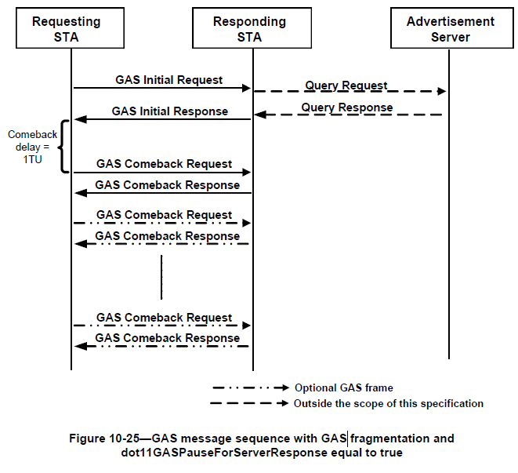
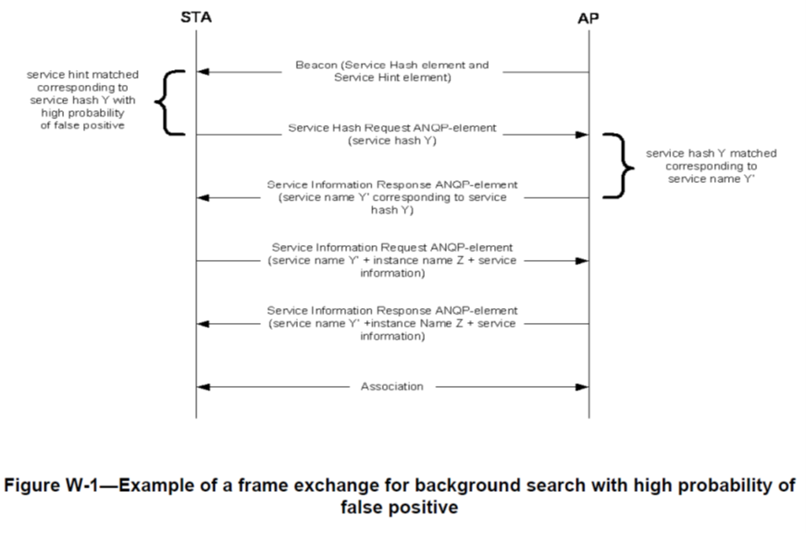
Multi-frame Exchanges Involving Unassociated STAs
Authentication/Association
802.11u GAS frame exchange
802.11aq Pre-association discovery

Slide 4
UL MU Transmission of Unassociated STAs
-Multi-frame exchanges can benefit a lot using UL MU Transmission
-However, right now only Random access OFDMA is allowed in the standard which has low efficiency.
-Hence we propose that the AP be able to allocate RUs to unassociated STAs.

Slide 5
UL MU Transmission of Unassociated STAs
-Temporary AIDs are assumed to identify Unassociated STAs in multi-STA BA
-These AIDs can be used to identify the same STAs in subsequent frame transmissions
Trigger Frame
Random Access (AIDs 1,2,3,0,0)
AID 1 (STA 1)
Trigger Frame
(AID1,2,3,tAID1,2)
AID 1 (STA 1)
AID 0 (STA 4)
Authentication
Request
tAID 1(STA4)
Association
Request
Multi-STA ACK (AID1,2,3,tAID1,2)
AID 2
(STA2)
Multi-STA ACK (AID1,2,3,tAID1,2)
AID 2
(STA2)
AID 0 (STA 5)
GAS Initial
Request
…
tAID 0 (STA 5)
GAS Comeback
Request
AID 3 (STA 3)
AID 3 (STA 3)

Slide 6
Conclusion
In this presentation, we proposed that temporary AIDs for unassociated STAs be used for subsequent UL OFDMA frame exchanges involving unassociated STAs.

