Slide 1
Non-Uniform HOM Constellations for 11ay Single Carrier
Date: 2016-07-25
Authors:

Slide 2
Introduction
The squared (uniform) 64QAM modulation has been accepted in IEEE802.11 REVmc Draft 5.4 [1] for 11ad single carrier.
It has been well-known that the squared 64QAM modulation can yield reasonable error rate performance with simple implementation. However, due to its geometric representation of constellations, the impairments of phase noise and PA non-linearity may significantly degrade the performance of the squared 64QAM.
Other non-uniform constellation modulation schemes have been extensively investigated. Some of non-uniform constellations have been accepted in the standards such as the APSK modulation in DVB-S2X [2].
Some 64-point non-uniform constellations (NUCs) have been proposed for 11ay SC [3]-[6].
This presentation evaluates several 64-point non-uniform constellations for 11ay SC, which are optimized with consideration of AWGN and AWGN+phase noise impairments.
Simulation results demonstrate that all the 64-point non-uniform constellations proposed in this presentation can yield significant performance gains compared to the squared 64QAM and 64-APSK in DVB-S2X.

Slide 3
Design Criteria of NUCs
To improve robustness of constellations against phase noise.
To maintain the increase in complexity within a moderate level.

Slide 4
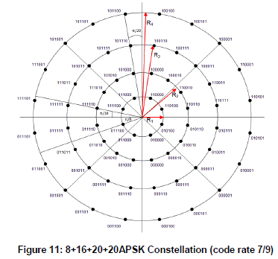
Example of NUC: 64-APSK in DVB-S2X [2]
Code rate | Modulation/coding spectral efficiency | R1 | R2 | R3
7/9 | 4.65 | 2.2 | 3.6 | 5.2

Slide 5
Design of New NUCs
Mutual Information and Pragmatic Mutual Information
  The ultimate performance of a given modulation set (constellation) over a channel under ideal detection and decoding can be computed using the Mutual Information (MI) or the Pragmatic Mutual Information (PMI)
  It is an upper bound on the maximum spectral efficiency r=mr_{c}
B=(B₁,…,B_{m})
X=x(B)
X
U
binary
Encoder
Mapping
Channel
Y
r_{c}
m

Slide 6
Transmitter and Receiver of Pragmatic Approach
binary
decoder

Slide 7
Consideration of Phase Noise and PA Nonlinearity Constraints
AWGN：
White Phase noise：
Ideal non linearity ：
To limit the peak power

Slide 8
Optimized Constellations (AWGN with Phase Noise) (1)
Rate 5/8
Rate 3/4

Slide 9
Optimized Constellations (AWGN with Phase Noise) (2)
Rate 13/16
Rate 7/8

Slide 10
Optimized Constellations (AWGN with Phase Noise and PA Nonlinearity) (1)
Rate 5/8
Rate 3/4

Slide 11
Optimized Constellations (AWGN with Phase Noise and PA Nonlinearity) (2)
Rate 13/16
Rate 7/8

Slide 12
Simulation Assumptions
64-point constellations with 11ad LDPC code of rates 5/8, 3/4 and 13/16
SC modulation
Packet length: 4096 bytes
LDPC iterations: 6
AWGN channel
11ad phase noise model

Slide 13
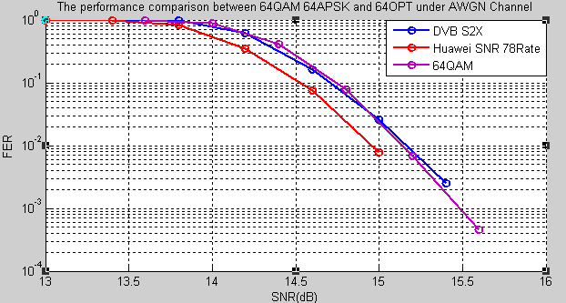
FER Performance (1)
  AWGN:
Rate 5/8
    For the case of code rate 5/8, the 64-OPT-SNR-rate7/8 constellations yield about 0.21dB gain w.r.t. 64 QAM and about 0.2dB gain w.r.t. DVB S2X at 1% FER.

Slide 14
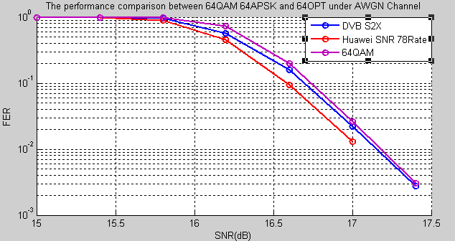
FER Performance (2)
  AWGN : rate 3/4
    For the case of code rate 3/4, the 64-OPT-SNR-rate7/8 constellations yield performance gains of 0.15 dB, and 0.16 dB at 1% FER compared to DVB S2X and 64 QAM, respectively.

Slide 15
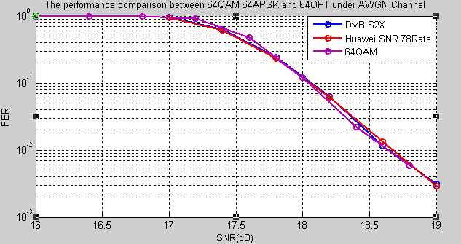
FER Performance (3)
  AWGN : rate 13/16
    For the case of code rate 13/16, All the constellations nearly have the same performances.

Slide 16
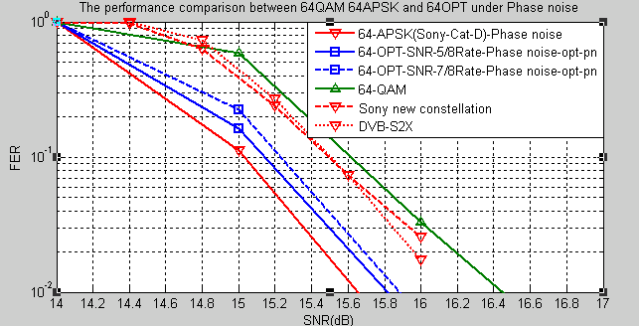
FER Performance (4)
Rate 5/8
  AWGN with Phase Noise:
    For the case of code rate 5/8, the 64-OPT-SNR-rate5/8 constellations yield about 0.61dB gain w.r.t. 64 QAM, about 0.5dB gain w.r.t. DVB S2X, about 0.51dB gain w.r.t. SONY New and result in 0.18 dB performance loss compared to SONY Cat. D rate 5/8 at 1% FER . Alternatively, the 64-OPT-SNR-rate7/8 constellations yield about 0.58 dB gain w.r.t. 64 QAM, about 0.49dB gain (est.) w.r.t. DVB S2X, about 0.5dB gain (est.) w.r.t. SONY New, and result in 0.21 dB performance loss compared to SONY Cat. D rate 5/8.

Slide 17
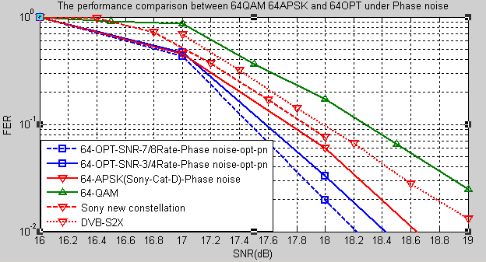
FER Performance (5)
  AWGN with Phase Noise: rate 3/4
    For the case of code rate 3/4, the 64-OPT-SNR-rate7/8 constellations yield performance gains of 0.2 dB, 0.4 dB , 0.9 dB, 0.41dB (est.) and 0.82dB (est.) at 1% FER compared to 64-OPT-SNR-rate3/4, SONY Cat. D rate ¾ and 64 QAM, SONY New, DVB S2X respectively.

Slide 18
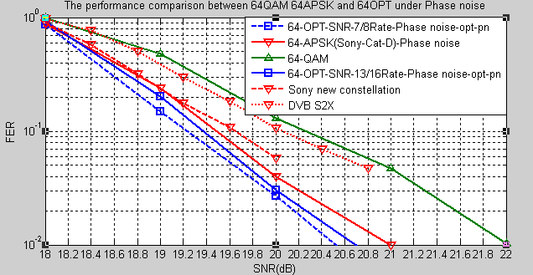
FER Performance (6)
  AWGN with Phase Noise: rate 13/16
    For the case of code rate 13/16, the 64-OPT-SNR-rate7/8 constellations yield performance gains of 0.17 dB, 0.5dB, 0.8dB (est.), 1.5dB (est.), and 1.6dB at 1% FER compared to 64-OPT-SNR-rate13/16, SONY Cat. D rate 13/16, SONY New, DVB S2X and 64QAM, respectively.

Slide 19
Summary
Simulation shows that the non-uniform constellations (NUCs) proposed in this presentation and the NUCs proposed in [3]-[6] can significantly improve the error rate performance of the uniform (squared) QAM constellations (up to 1.6 dB) and DVB S2X constellations (up to 1.5 dB).
The performance of the NUCs proposed in this presentation are also compared with the NUCs in [3]-[6]. In most cases (different code rates and impairment setups), the NUCs proposed in this presentation result in better performance than the NUCs [3]-[6].
NUCs should be considered to be used in 11ay especially for relatively higher order modulation, such as 64-point modulation, which may be significantly impacted by phase noise.

Slide 20
References
[1] IEEE P802.11-REVmcTM/D5.4, May 2016.
[2] ETSI DVB-S2 Extensions (DVB-S2X), October 2014.
[3] 11-15-0096-01-ng60 Non-uniform Constellations for higher Order QAMs.
[4] 11-15-0601-00-00ay Non-uniform Constellations for 64QAM.
[5] 11-15-0835-00-00ay-potential-of-non-uniform-constellations-with-peak-power-constraint.
[6] 11-16-0072-00-00ay-performance-of-non-uniform-constellations-in-presence-of-phase-noise.

Slide 21
Straw Poll/Motion
Do you agree to insert “A 64-point non-uniform constellation shall be included in the 11ay specification” in 11ay SFD?
Yes:
No:
Abstain:

