Slide 1
Multi-TID Aggregation for 11ay
Date: 2016-07-24
Authors:

Slide 2
Introduction
Future 60GHz PHY rate may hit ~100Gbps
Multiple studies have shown that existing BlockAck scheme limits the efficiency of future 60GHz data pipe
Overhead (preamble plus IFSs) is eminent when data payload is comparably short
One enhancement of BlockAck scheme has been adopted in the Spec Framework [1]
Increase BA window size from 64 to 1024

Slide 3
Proposal for More Enhancement
Multi-TID Aggregation
There could be multiple flows among a pair of STAs, which have different QoS requirement
Enable Aggregation of unicast Management Frame and single Data MPDU soliciting ACK
It is not efficient in terms of link utilization to insert {single frame + ACK} exchanges in between high rate data frame exchange
Management frame that asks for ACK is not allowed in AMPDU
Single data MPDU from other TIDs

Slide 4
Design Principle for Multi-TID BA Support
Existent structure of multi-TID BA defined in 11mc (9.3.1.9.4 Multi-TID BlockAck variant) contains multiple instances of the BA Information field with full size BA Bitmap, which increases the PPDU size almost in proportion to the number of delivered TIDs
Byte count of the multi-TID BA is equal to (22+N*12), there N is number of TIDs sent in the same A-MPDU.
If this approach is used for the extended BA Bitmap size of 1024 bits, the byte count becomes 22+N*(4+128)
This substantially exceeds the optimal PPDU size (BA) compared to a single BA Bitmap of 1024 bits.
N | BA Length (us)
1 | 3.96
2 | 4.84
4 | 6.58
8 | 10.36

Slide 5
EDMG Multi-TID BA Variant Indication
In latest 11ax/11ak draft spec, BlockAck Frame encoding is shown as the following
BA Type |  |  | BlockAck frame variant
0 | 0 | 00 | Basic BlockAck
 |  | 01 | Reserved
 |  | 10 | Reserved
 |  | 11 | Reserved
0 | 1 | 00 | Compressed BlockAck
 |  | 01 | GLK-GCR BlockAck
 |  | 10 | GCR BlockAck
 |  | 11 | Reserved
1 | 0 | 00 | Extended Compressed BlockAck
 |  | 01 | Reserved
 |  | 10 | Reserved
 |  | 11 | Reserved
1 | 1 | 00 | Multi-TID BlockAck
 |  | 01 | Multi-STA BlockAck
 |  | 10 | Extended Multi-TID BlockAck
 |  | 11 | Reserved

Slide 6
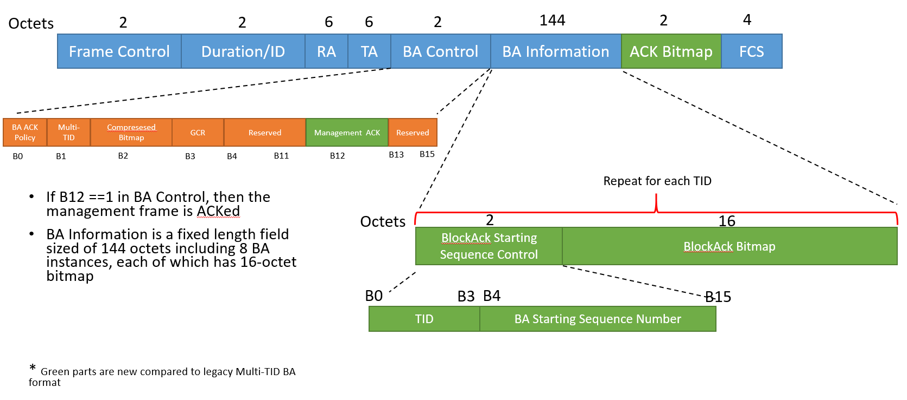
EDMG Multi-TID BA Format for Enabling Aggregation

Slide 7
Reference
[1] 11-15-1358-04-00ay-specification-framework-for-tgay

Slide 8
Straw Poll/Motion 1
Do you agree to add to 11ay Specification: the extended Multi-TID BA variant for EDMG STAs is signaled by setting B1B2B3B4 == 1110 of the BA Control subfield?
Y
N
A

Slide 9
Straw Poll/Motion 2
Do you agree to add to 11ay Specification: the extended Multi-TID BA variant for EDMG STAs has the format as shown below.
Y
N
A

