Slide 1
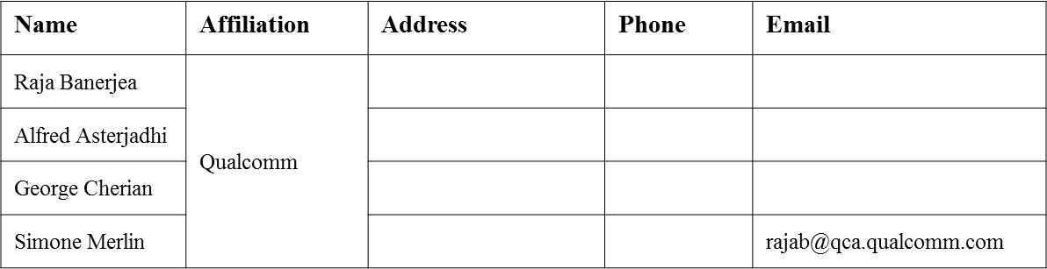
Mandatory ways to solicit UL MU ACK
Date: 2016-07-22
Authors:

Slide 2
Authors (continued)
Name | Affiliation | Address | Phone | Email
Albert Van Zelst | Qualcomm | Straatweg 66-S Breukelen, 3621 BR Netherlands |  | allert@qti.qualcomm.com
Alice Chen |  | 5775 Morehouse Dr. San Diego, CA, USA |  | alicel@qti.qualcomm.com
Alfred Asterjadhi |  | 5775 Morehouse Dr. San Diego, CA, USA |  | aasterja@qti.qualcomm.com
Carlos Aldana |  | 1700 Technology Drive San Jose, CA 95110, USA |  | caldana@qca.qualcomm.com
George Cherian |  | 5775 Morehouse Dr. San Diego, CA, USA |  | gcherian@qti.qualcomm.com
Gwendolyn Barriac |  | 5775 Morehouse Dr. San Diego, CA, USA |  | gbarriac@qti.qualcomm.com
Hemanth Sampath |  | 5775 Morehouse Dr. San Diego, CA, USA |  | hsampath@qti.qualcomm.com
Lin Yang |  | 5775 Morehouse Dr. San Diego, CA, USA |  | linyang@qti.qualcomm.com
Menzo Wentink |  | Straatweg 66-S Breukelen, 3621 BR Netherlands |  | mwentink@qti.qualcomm.com
Naveen Kakani |  | 2100 Lakeside Boulevard Suite 475, Richardson TX 75082, USA |  | nkakani@qti.qualcomm.com
Raja Banerjea |  | 1060 Rincon Circle San Jose CA 95131, USA |  | rajab@qit.qualcomm.com
Richard Van Nee |  | Straatweg 66-S Breukelen, 3621 BR Netherlands |  | rvannee@qti.qualcomm.com
Rolf De Vegt |  | 1700 Technology Drive San Jose, CA 95110, USA |  | rolfv@qca.qualcomm.com
Simone Merlin |  | 5775 Morehouse Dr. San Diego, CA, USA |  | smerlin@qti.qualcomm.com
Tevfik Yucek |  | 1700 Technology Drive San Jose, CA 95110, USA |  | tyucek@qca.qualcomm.com
VK Jones |  | 1700 Technology Drive San Jose, CA 95110, USA |  | vkjones@qca.qualcomm.com

Slide 3
Authors (continued)
Name | Affiliation | Address | Phone | Email
Ron Porat | Broadcom |  |  | rporat@broadcom.com
Sriram Venkateswaran
Matthew Fischer |  |  |  | mfischer@broadcom.com
Zhou Lan
Leo Montreuil
Andrew Blanksby
Vinko Erceg
Thomas Derham
Mingyue Ji

Slide 4
Authors (continued)
Robert Stacey | Intel | 2111 NE 25th Ave, Hillsboro OR 97124, USA | +1-503-724-893 | robert.stacey@intel.com
Shahrnaz Azizi |  |  |  | shahrnaz.azizi@intel.com
Po-Kai Huang |  |  |  | po-kai.huang@intel.com
Qinghua Li |  |  |  | quinghua.li@intel.com
Xiaogang Chen |  |  |  | xiaogang.c.chen@intel.com
Chitto Ghosh |  |  |  | chittabrata.ghosh@intel.com
Laurent Cariou |  |  |  | laurent.cariou@intel.com
Yaron Alpert |  |  |  | yaron.alpert@intel.com
Assaf Gurevitz |  |  |  | assaf.gurevitz@intel.com
Ilan Sutskover |  |  |  | ilan.sutskover@intel.com

Slide 5
Authors (continued)
Name | Affiliation | Address | Phone | Email
Hongyuan Zhang | Marvell | 5488 Marvell Lane, Santa Clara, CA, 95054 | 408-222-2500 | hongyuan@marvell.com
Lei Wang |  |  |  | Leileiw@marvell.com
Liwen Chu |  |  |  | liwenchu@marvell.com
Jinjing Jiang |  |  |  | jinjing@marvell.com
Yan Zhang |  |  |  | yzhang@marvell.com
Rui Cao |  |  |  | ruicao@marvell.com
Sudhir Srinivasa |  |  |  | sudhirs@marvell.com
Bo Yu |  |  |  | boyu@marvell.com
Saga Tamhane |  |  |  | sagar@marvell.com
Mao Yu |  |  |  | my@marvel..com
Xiayu Zheng |  |  |  | xzheng@marvell.com
Christian Berger |  |  |  | crberger@marvell.com
Niranjan Grandhe |  |  |  | ngrandhe@marvell.com
Hui-Ling Lou |  |  |  | hlou@marvell.com

Slide 6
Authors (continued)
Name | Affiliation | Address | Phone | Email
Jianhan Liu | Mediatek USA | 2860 Junction Ave, San Jose, CA 95134, USA | +1-408-526-1899 | jianhan.Liu@mediatek.com
Thomas Pare |  |  |  | thomas.pare@mediatek.com
ChaoChun Wang |  |  |  | chaochun.wang@mediatek.com
James Wang |  |  |  | james.wang@mediatek.com
Tianyu Wu |  |  |  | tianyu.wu@mediatek.com
Russell Huang |  |  |  | russell.huang@mediatek.com
James Yee | Mediatek | No. 1 Dusing 1st Road, Hsinchu, Taiwan | +886-3-567-0766 | james.yee@mediatek.com
Frank Hsu |  |  |  | frank.hsu@mediatek.com
Joonsuk Kim | Apple |  |  | joonsuk@apple.com
Aon Mujtaba |  |  |  | mujtaba@apple.com
Guoqing Li |  |  |  | guoqing_li@apple.com
Eric Wong |  |  |  | ericwong@apple.com
Chris Hartman |  |  |  | chartman@apple.com
Jarkko Kneckt |  |  |  | jkneckt@apple.com

Slide 7
Authors (continued)
Name | Affiliation | Address | Phone | Email
David X. Yang | Huawei | F1-17, Huawei Base, Bantian, Shenzhen |  | david.yangxun@huawei.com
Jiayin Zhang |  | 5B-N8, No.2222 Xinjinqiao Road, Pudong, Shanghai | +86-18601656691 | zhangjiayin@huawei.com
Jun Luo |  | 5B-N8, No.2222 Xinjinqiao Road, Pudong, Shanghai |  | jun.l@huawei.com
Yi Luo |  | F1-17, Huawei Base, Bantian, Shenzhen | +86-18665891036 | Roy.luoyi@huawei.com
Yingpei Lin |  | 5B-N8, No.2222 Xinjinqiao Road, Pudong, Shanghai |  | linyingpei@huawei.com
Jiyong Pang |  | 5B-N8, No.2222 Xinjinqiao Road, Pudong, Shanghai |  | pangjiyong@huawei.com
Zhigang Rong |  | 10180 Telesis Court, Suite 365, San Diego, CA 92121 NA |  | zhigang.rong@huawei.com
Jian Yu |  | F1-17, Huawei Base, Bantian, Shenzhen |  | ross.yujian@huawei.com
Ming Gan |  | F1-17, Huawei Base, Bantian, Shenzhen |  | ming.gan@huawei.com
Yuchen Guo |  | F1-17, Huawei Base, Bantian, Shenzhen |  | guoyuchen@huawei.com
Yunsong Yang |  | 10180 Telesis Court, Suite 365, San Diego, CA 92121 NA |  | yangyunsong@huawei.com
Junghoon Suh |  | 303 Terry Fox, Suite 400 Kanata, Ottawa, Canada |  | Junghoon.Suh@huawei.com
Peter Loc |  |  |  | peterloc@iwirelesstech.com
Edward Au |  | 303 Terry Fox, Suite 400 Kanata, Ottawa, Canada |  | edward.ks.au@huawei.com
Teyan Chen |  | F1-17, Huawei Base, Bantian, Shenzhen |  | chenteyan@huawei.com
Yunbo Li |  | F1-17, Huawei Base, Bantian, Shenzhen |  | liyunbo@huawei.com

Slide 8
Authors (continued)
Name | Affiliation | Address | Phone | Email
Jinmin Kim | LG Electronics | 19, Yangjae-daero 11gil, Seocho-gu, Seoul 137-130, Korea |  | Jinmin1230.kim@lge.com
Kiseon Ryu |  |  |  | kiseon.ryu@lge.com
Jinyoung Chun |  |  |  | jiny.chun@lge.com
Jinsoo Choi |  |  |  | js.choi@lge.com
Jeongki Kim |  |  |  | jeongki.kim@lge.com
Dongguk Lim |  |  |  | dongguk.lim@lge.com
Suhwook Kim |  |  |  | suhwook.kim@lge.com
Eunsung Park |  |  |  | esung.park@lge.com
JayH Park |  |  |  | Hyunh.park@lge.com
HanGyu Cho |  |  |  | hg.cho@lge.com
Bo Sun | ZTE | #9 Wuxingduan, Xifeng Rd., Xi'an, China |  | sun.bo1@zte.com.cn
Kaiying Lv |  |  |  | lv.kaiying@zte.com.cn
Yonggang Fang |  |  |  | yfang@ztetx.com
Ke Yao |  |  |  | yao.ke5@zte.com.cn
Weimin Xing |  |  |  | xing.weimin@zte.com.cn
Brian Hart | Cisco Systems | 170 W Tasman Dr, San Jose, CA 95134 |  | brianh@cisco.com
Pooya Monajemi |  |  |  | pmonajem@cisco.com

Slide 9
Authors (continued)
Name | Affiliation | Address | Phone | Email
Fei Tong | Samsung | Innovation Park, Cambridge CB4 0DS (U.K.) | +44 1223 434633 | f.tong@samsung.com
Hyunjeong Kang |  | Maetan 3-dong; Yongtong-Gu Suwon; South Korea | +82-31-279-9028 | hyunjeong.kang@samsung.com
Kaushik Josiam |  | 1301, E. Lookout Dr, Richardson TX 75070 | (972) 761 7437 | k.josiam@samsung.com
Mark Rison |  | Innovation Park, Cambridge CB4 0DS (U.K.) | +44 1223 434600 | m.rison@samsung.com
Rakesh Taori |  | 1301, E. Lookout Dr, Richardson TX 75070 | (972) 761 7470 | rakesh.taori@samsung.com
Sanghyun Chang |  | Maetan 3-dong; Yongtong-Gu Suwon; South Korea | +82-10-8864-1751 | s29.chang@samsung.com
Yasushi Takatori | NTT | 1-1 Hikari-no-oka, Yokosuka, Kanagawa 239-0847 Japan | +81 46 859 3135 | takatori.yasushi@lab.ntt.co.jp
Yasuhiko Inoue |  |  | +81 46 859 5097 | inoue.yasuhiko@lab.ntt.co.jp
Shoko Shinohara |  |  | +81 46 859 5107 | Shinohara.shoko@lab.ntt.co.jp
Yusuke Asai |  |  | +81 46 859 3494 | asai.yusuke@lab.ntt.co.jp
Koichi Ishihara |  |  | +81 46 859 4233 | ishihara.koichi@lab.ntt.co.jp
Junichi Iwatani |  |  | +81 46 859 4222 | Iwatani.junichi@lab.ntt.co.jp
Akira Yamada | NTT DOCOMO | 3-6, Hikarinooka, Yokosuka-shi, Kanagawa, 239-8536, Japan | +81 46 840 3759 | yamadaakira@nttdocomo.com

Slide 10
Authors (continued)
Name | Affiliation | Address | Phone | Email
Masahito Mori | Sony Corp. |  |  | Masahito.Mori@jp.sony.com
Yusuke Tanaka |  |  |  | YusukeC.Tanaka@jp.sony.com
Yuichi Morioka |  |  |  | Yuichi.Morioka@jp.sony.com
Kazuyuki Sakoda |  |  |  | Kazuyuki.Sakoda@am.sony.com
William Carney |  |  |  | William.Carney@am.sony.com
Sigurd Schelstraete | Quantenna |  |  | Sigurd@quantenna.com
Huizhao Wang |  |  |  | hwang@quantenna.com
Minho Cheong | Newracom | 9008 Research Dr. Irvine, CA 92618 |  | minho.cheong@newracom.com
Reza Hedayat |  |  |  | reza.hedayat@newracom.com
Young Hoon Kwon |  |  |  | younghoon.kwon@newracom.com
Yongho Seok |  |  |  | yongho.seok@newracom.com
Daewon Lee |  |  |  | daewon.lee@newracom.com
Yujin Noh |  |  |  | yujin.noh@newracom.com

Slide 12
Authors (continued)
Name | Affiliation | Address | Phone | Email
Ron Porat | Broadcom |  |  | rporat@broadcom.com
Matthew Fischer |  |  |  | mfischer@broadcom.com
Sriram Venkateswaran
Zhou Lan
Leo Montreuil
Andrew Blanksby
Vinko Erceg
Robert Stacey | Intel | 2111 NE 25th Ave, Hillsboro OR 97124, USA | +1-503-724-893 | robert.stacey@intel.com
Eldad Perahia |  |  |  | eldad.perahia@intel.com
Shahrnaz Azizi |  |  |  | shahrnaz.azizi@intel.com
Po-Kai Huang |  |  |  | po-kai.huang@intel.com
Qinghua Li |  |  |  | quinghua.li@intel.com
Xiaogang Chen |  |  |  | xiaogang.c.chen@intel.com
Chitto Ghosh |  |  |  | chittabrata.ghosh@intel.com
Rongzhen Yang |  |  |  | rongzhen.yang@intel.com
Laurent cariou |  |  |  | laurent.cariou@intel.com

Slide 13
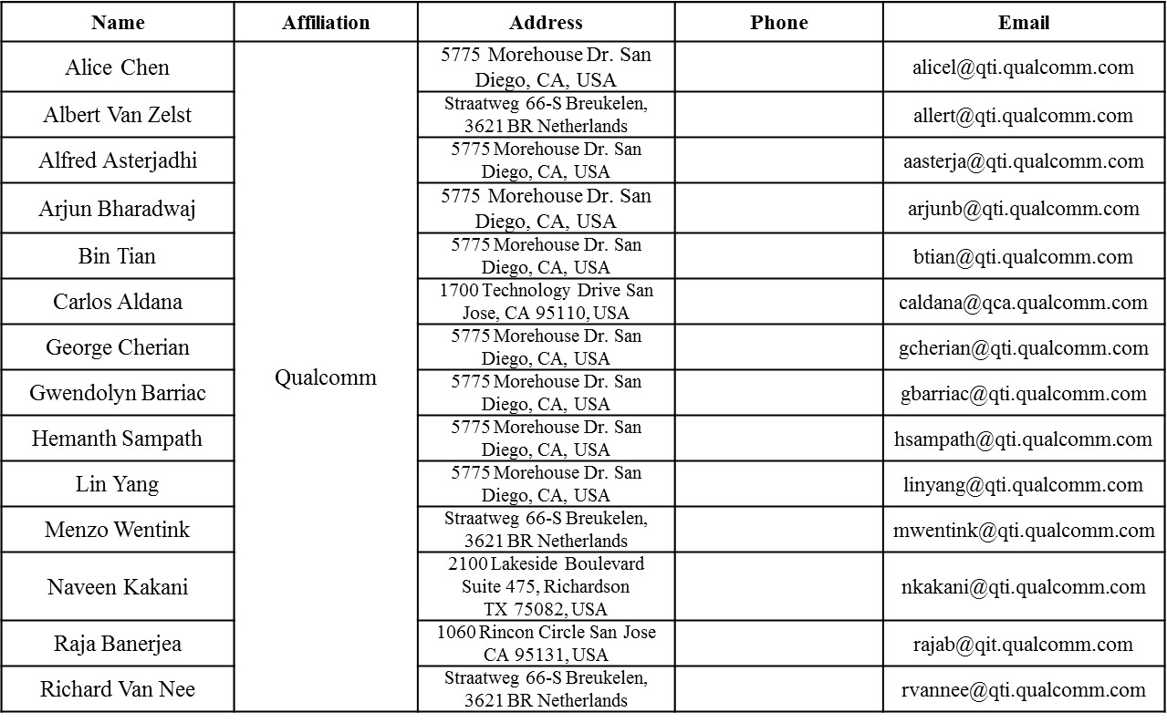
Authors (continued)

Slide 14
Authors (continued)
Name | Affiliation | Address | Phone | Email
James Yee | Mediatek | No. 1 Dusing 1st Road, Hsinchu, Taiwan | +886-3-567-0766 | james.yee@mediatek.com
Alan Jauh |  |  |  | alan.jauh@mediatek.com
Frank Hsu |  |  |  | frank.hsu@mediatek.com
Thomas Pare | Mediatek USA | 2860 Junction Ave, San Jose, CA 95134, USA | +1-408-526-1899 | thomas.pare@mediatek.com
ChaoChun Wang |  |  |  | chaochun.wang@mediatek.com
James Wang |  |  |  | james.wang@mediatek.com
Jianhan Liu |  |  |  | Jianhan.Liu@mediatek.com
Tianyu Wu |  |  |  | tianyu.wu@mediatek.com
Russell Huang |  |  |  | russell.huang@mediatek.com
Brian Hart | Cisco Systems | 170 W Tasman Dr, San Jose, CA 95134 |  | brianh@cisco.com
Pooya Monajemi |  |  |  | pmonajem@cisco.com
Joonsuk Kim | Apple |  |  | joonsuk@apple.com
Aon Mujtaba |  |  |  | mujtaba@apple.com
Guoqing Li |  |  |  | guoqing_li@apple.com
Eric Wong |  |  |  | ericwong@apple.com
Chris Hartman |  |  |  | chartman@apple.com

Slide 15
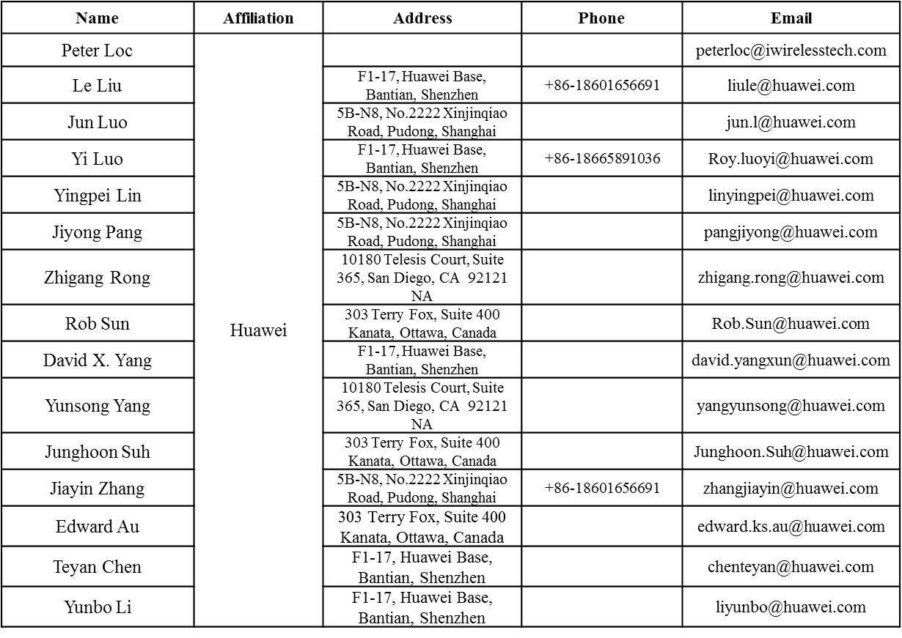
Authors (continued)

Slide 16
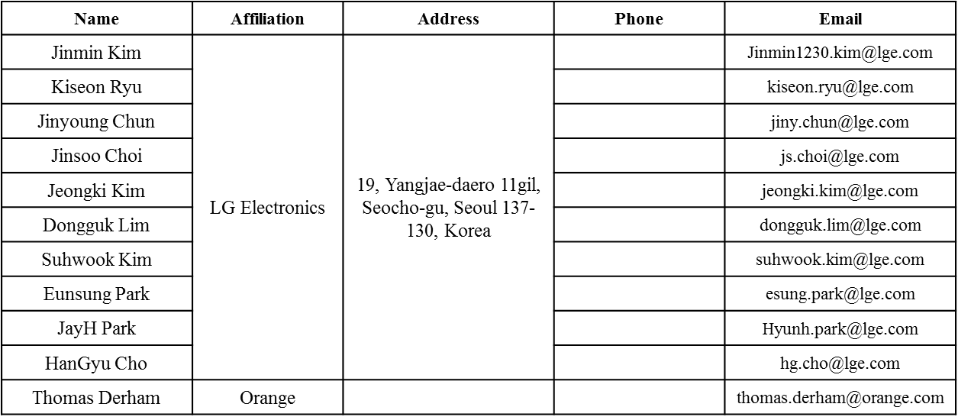
Authors (continued)
Bo SunBo Sun | ZTE | #9 Wuxing duan, Xifeng Rd, Xi’an, China |  | SubSub.bo1@zte.com.cn
Kaiying Lv |  |  |  | lv.kaiying@zte.com.cn
Yonggang Fang |  |  |  | yfang@ztetx.com
Ke Yao |  |  |  | Yao.ke5@zte.com.cn
Weimin Xing |  |  |  | Xing.weimin@zte.com.cn

Slide 17
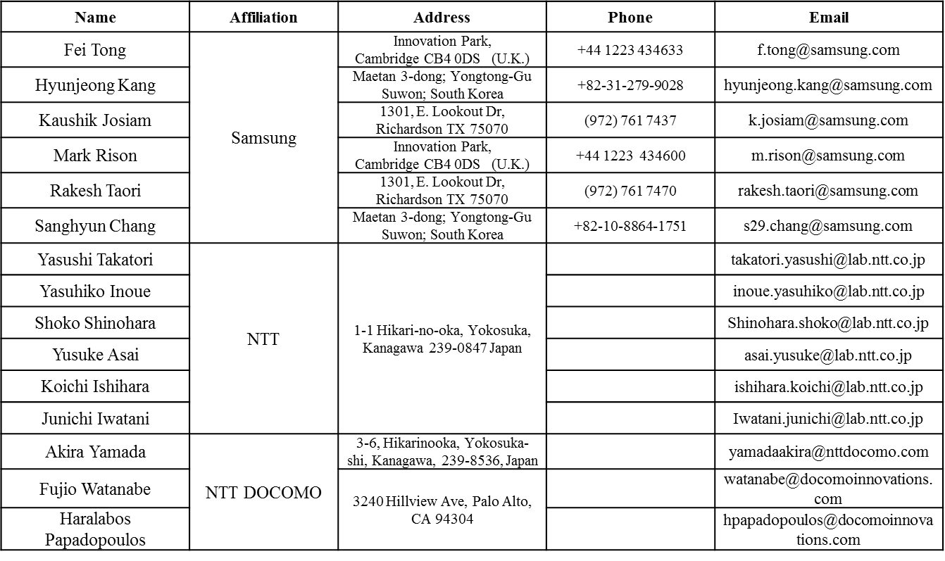
Authors (continued)

Slide 18
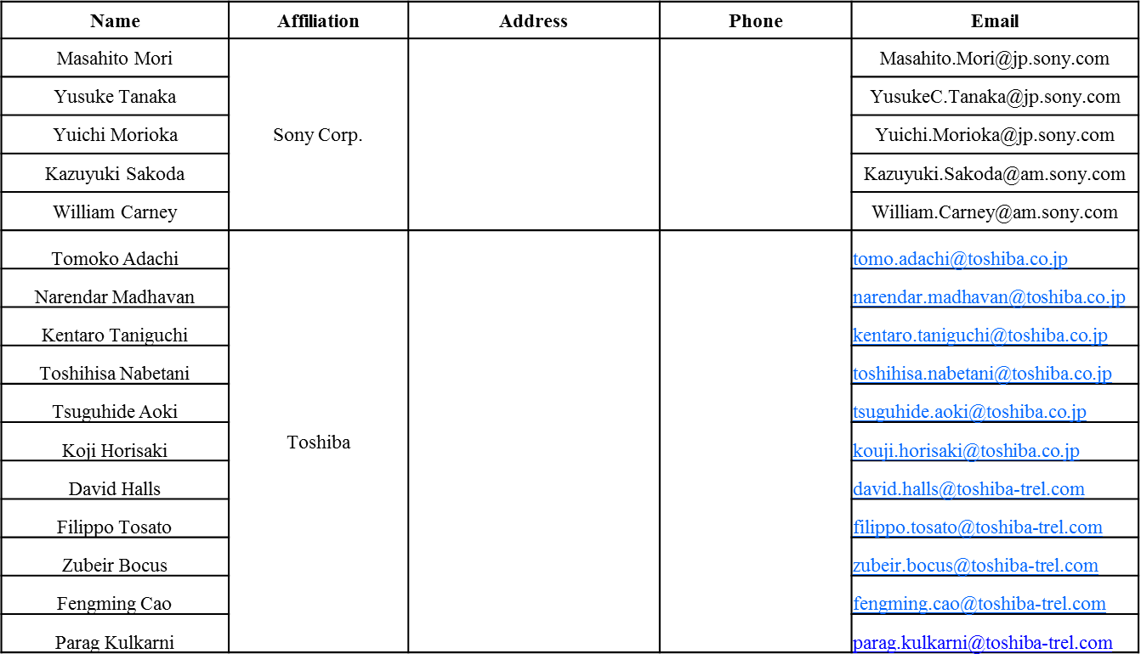
Authors (continued)

Slide 19
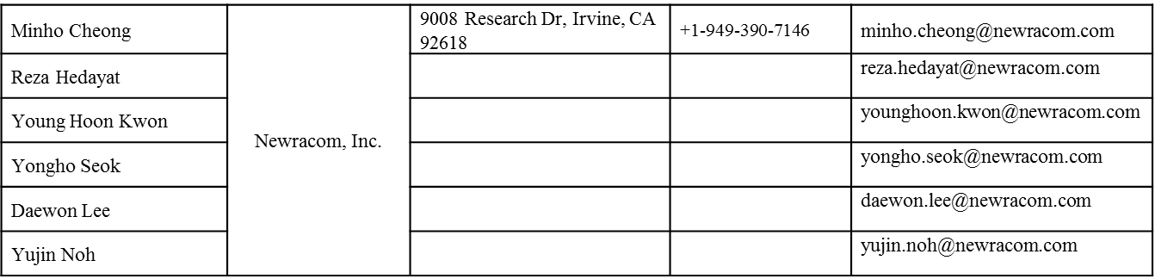
Authors (continued)

Slide 20
Overview
There are multiple ways to solicit a UL MU ACK/BA for DL MU transmission.
Goal: To facilitate discussion on which options should be mandatory for IEEE 802.11.ax
Raja Banerjea, Qualcomm, et. al.

Slide 21
DL MU Sequences with UL MU ACK
DL MU PPDU with Basic Trigger followed by ACK/BA
DL MU PPDU with UL MU Response A-Control followed by ACK/BA
DL MU PPDU followed by (MU) BAR followed by ACK/BA
DL MU PPDU followed by DL MU PPDU with Trigger and BAR followed by ACK/BA
DL MU PPDU with Basic Trigger & BAR followed by ACK/BA
Details on each of the sequence in the following slides
Raja Banerjea, Qualcomm, et. al.

Slide 22
DL MU PPDU with Trigger
STA 1 (Basic Trigger + AMPDU)
ACK/BA/M-BA (STA1)
STA 2 ( Basic Trigger + AMPDU)
ACK/BA/M-BA (STA4)
STA 3 (Basic Trigger + AMPDU)
ACK/BA/M-BA (STA2)
STA 4 (Basic Trigger + AMPDU)
ACK/BA/M-BA (STA3)
DL
UL
01 (Trigger based UL MU ACK)
SIFS
Requirement in SFD/Baseline Spec:
  A unicast Trigger frame for a single user may be included in an A-MPDU for that user in the DL MU PPDU that precedes the UL MU transmission by TBD IFS. [MAC Motion 20, July 16, 2015, see [89]]
  Ack Policy field in a frame soliciting an immediate response is set to 00 (Normal Ack or Implicit Block Ack Request ) if the immediate response is carried in SU PPDU, or it is set to 01 (Trigger based UL MU Ack) if the immediate response is carried in MU PPDU.
Advantage: Simplified design, low overhead
Disadvantage: Requires repetition of Basic Trigger to improve robustness (single point of failure), Does not allow for EIFS reset at legacy STA
Raja Banerjea, Qualcomm, et. al.

Slide 23
DL MU PPDU with UL MU Response A-Control
STA 1 (ULMURSP(A-Control) + AMPDU)
ACK/BA/M-BA (STA1)
STA 2 (ULMURSP(A-Control) + AMPDU)
ACK/BA/M-BA (STA4)
STA3 (ULMURSP(A-Control) + AMPDU)
ACK/BA/M-BA (STA2)
STA4 (ULMURSP(A-Control) + AMPDU)
ACK/BA/M-BA (STA3)
DL
UL
01 (Trigger based UL MU ACK)
SIFS
Requirement in SFD/Baseline Spec:
  HE A-Control field for UL acknowledgement is optional in RX.
  Ack Policy field in a frame soliciting an immediate response is set to 00 (Normal Ack or Implicit Block Ack Request ) if the immediate response is carried in SU PPDU, or it is set to 01 (Trigger based UL MU Ack) if the immediate response is carried in MU PPDU.
Advantage: lower overhead, robust (no single point of failure)
Disadvantage: Optional in SFD, different trigger frame, Does not allow for EIFS reset at legacy STA
Raja Banerjea, Qualcomm, et. al.

Slide 24
DL MU PPDU followed by MU-BAR
STA 1 (AMPDU)
MU - BAR
(STA1,STA2, STA3, STA4)
(legacy duplicate/ HE )
ACK/BA/M-BA (STA1)
STA 2 ( AMPDU)
ACK/BA/M-BA (STA4)
STA 3 ( AMPDU)
ACK/BA/M-BA (STA2)
STA 4 ( AMPDU)
ACK/BA/M-BA (STA3)
DL
SIFS
DL
SIFS
UL
Block ACK or No Ack
Requirement in SFD/Baseline Spec:
  The spec shall define a MU-BAR frame to solicit BA/ACKs from multiple STAs in UL MU transmissions. [MU Motion 13, September 17, 2015, see [171]]
  The recipient of a MU-BAR frame can transmit other data or management frame in addition to BA/ACK frame if it does not exceed the indicated UL MU duration. [MAC Motion 58, January 2016, see [113]]
Advantage: Simplified design, Robust, Allows for EIFS reset, Sequence required if BA is lost in the UL
Disadvantage: Not the lowest overhead
Raja Banerjea, Qualcomm, et. al.

Slide 25
DL MU PPDU followed by DL MU PPDU with Trigger and BAR
STA 1 (AMPDU)
Basic Trigger + BAR (STA1)
ACK/BA/M-BA (STA1)
STA 2 (AMPDU)
Basic Trigger + BAR (STA4)
ACK/BA/M-BA (STA4)
STA 3 (AMPDU)
Basic Trigger + BAR (STA2)
ACK/BA/M-BA (STA2)
STA 4 (AMPDU)
Basic Trigger + BAR (STA3)
ACK/BA/M-BA (STA3)
DL
SIFS
DL
SIFS
UL
Block ACK
Requirement in SFD/Baseline Spec:
  None
Advantage: Sequence required if BA is lost in the UL, does not need a new MU-BAR
Disadvantage: highest overhead, Does not allow for EIFS reset at legacy STA, need to clarify to differentiate between UL MU/SU ACK, do we need to sent multiple BAR for multiple TIDs?
Raja Banerjea, Qualcomm, et. al.

Slide 26
DL MU PPDU with embedded Basic Trigger and BAR followed by ACK/BA
STA 1 (Basic Trigger + AMPDU + BAR)
ACK/BA/M-BA (STA1)
STA 2 ( Basic Trigger + AMPDU + BAR)
ACK/BA/M-BA (STA4)
STA 3 (Basic Trigger + AMPDU + BAR)
ACK/BA/M-BA (STA2)
STA 4 (Basic Trigger + AMPDU + BAR)
ACK/BA/M-BA (STA3)
DL
UL
Block ACK/01
SIFS
Not currently allowed in the baseline
Raja Banerjea, Qualcomm, et. al.

Slide 27
Comparison
Sequence | Pro | Con
DL MU PPDU with Trigger | Simplified design, low overhead | (single point of failure), Does not allow for EIFS reset at legacy STA
DL MU PPDU with UL MU Response A-Control | lower overhead, robust | Optional in SFD, different trigger frame, Does not allow for EIFS reset at legacy STA
DL MU PPDU followed by MU-BAR | Simplified design, Robust, Allows for EIFS reset, Sequence required if BA is lost in the UL | Not the lowest overhead
DL MU PPDU followed by DL MU PPDU with Trigger and BAR | Sequence required if BA is lost in the UL | highest overhead, Does not allow for EIFS reset at legacy STA
DL MU PPDU with embedded Basic Trigger and BAR followed by ACK/BA |  | NOT Allowed in Baseline spec
Raja Banerjea, Qualcomm, et. al.

Slide 28
SP#1
Do you support the following:
Add to section 25.5.1.1 of the IEEE 802.11ax :
It is mandatory at the non AP HE STA to support reception of Trigger in the DL MU PPDU aggregated with Data and respond with an ACK/BA/M-BA if the QoS ACK Policy in the DL A-MPDU is set to 01 (MU ACK) and the STA has not set the UL MU Disable to 1.
STA 1 (Basic Trigger + AMPDU)
ACK/BA/M-BA (STA1)
STA 2 ( Basic Trigger + AMPDU)
ACK/BA/M-BA (STA4)
STA 3 (Basic Trigger + AMPDU)
ACK/BA/M-BA (STA2)
STA 4 (Basic Trigger + AMPDU)
ACK/BA/M-BA (STA3)
DL
UL
01 (Trigger based UL MU ACK)
SIFS
Raja Banerjea, Qualcomm, et. al.

Slide 29
SP#2
Do you support the following: Add to section 25.5.1.1 :
It is mandatory at the non AP HE STA to support reception of DL MU PPDU with QoS ACK Policy set to Block Ack or No ACK followed by a MU-BAR within SIFS followed by transmission of the ACK/BA/M-BA appropriately if the STA has not set the UL MU Disable to 1.
STA 1 (AMPDU)
MU - BAR
(STA1,STA2, STA3, STA4)
(legacy duplicate/ HE )
ACK/BA/M-BA (STA1)
STA 2 ( AMPDU)
ACK/BA/M-BA (STA4)
STA 3 ( AMPDU)
ACK/BA/M-BA (STA2)
STA 4 ( AMPDU)
ACK/BA/M-BA (STA3)
DL
SIFS
DL
SIFS
UL
Block ACK or No Ack
Raja Banerjea, Qualcomm, et. al.

