Slide 1
Discussions on Partial BSS Color
Date: 2016-07-25
Authors:

Slide 2
Introduction
AID assignment rule has been defined in 11ax [1].
AID assigned by the rule is reflected in Partial AID (PAID) field in VHT PPDU, especially for SU DL case.
The part of the PAID becomes the partial BSS color.
By using PAID field, a STA can determine whether the VHT PPDU is intra-BSS.
Spatial reuse transmission is possible.
For certain BSSIDs, one BSS may have two partial BSS color values following the rule.

Slide 3
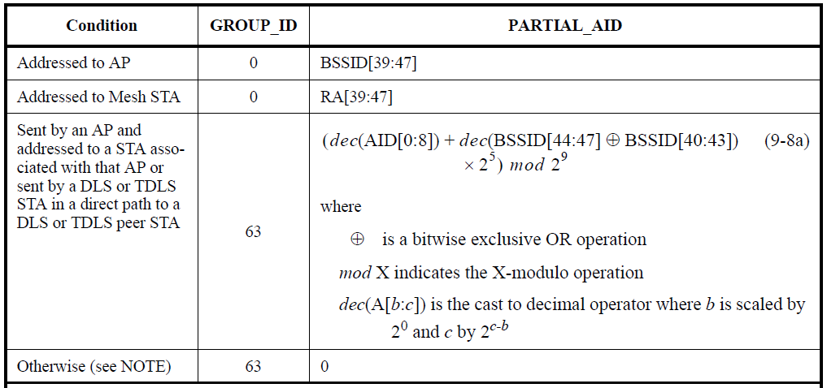
Recap: AID Assignment Rule (1) [2]
AP assigns AIDs to associated STAs according to
Settings for PAID field in VHT PPDU
N = 1, 2, 3 or 4
BCB: (Partial) BSS Color Bits
A TBD IE contains N and BCB.
← Uplink
← Downlink

Slide 4
Recap: AID Assignment Rule (2) [2]
Then the PAID(8−N+1:8) automatically becomes the partial BSS color.
Spatial reuse transmission is possible on the VHT PPDU by using PAID field.
* PAID for DL
PAID = (dec(AID[0:8]) + dec(BSSID[44:47] XOR BSSID[40:43]) * 2⁵) mod 2⁹
* AID assignment rule
AID[8−N+1:8] = bin[(dec(BCB[0:N−1])
+ dec(BSSID[47−N+1:47] XOR BSSID[43−N+1:43])) mod 2^{N}, N]

Slide 5
Ambiguity in PAID Field
One BSS may have two PAID[8−N+1:8] values.
When the addition is performed,
For N < 4, 1 can be rounded up from the bit position (8−N+1−1)
For example, N = 3, if B5 of y is 1,
B5 of AID is 0 or 1 ➔ 0: No rounding / 1: Rounding ➔ Two PAID[6:8] values
For N = 4, there is no rounding from B4 since y[0:4] is always b00000.
No ambiguity
N-bit assigned by the rule
x
B8 | B7 | B6 | B5 | B4 | B3 | B2 | B1 | B0
+
y
B8 | B7 | B6 | B5 | B4 | B3 | B2 | B1 | B0
mod 2⁹
(Cutting off B9)
z
00000 due to * 2⁵
PAID
B8 | B7 | B6 | B5 | B4 | B3 | B2 | B1 | B0
x
y
Partial BSS color (N-bit)
* PAID for DL
Higher N bits of x only depend on the BSS.
y only depends on the BSS.
PAID = (dec(AID[0:8]) + dec(BSSID[44:47] XOR BSSID[40:43]) * 2⁵) mod 2⁹
* AID assignment rule
z
AID[8−N+1:8] = bin[(dec(BCB[0:N−1])
+ dec(BSSID[47−N+1:47] XOR BSSID[43−N+1:43])) mod 2^{N}, N]

Slide 6
Ambiguity Example (Details in Appendix)
HE AP
BSSID
xx:xx:xx:xx:xx:5B
Frame carrying TBD IE
VHT PPDU
Including PAID
AP cannot receive a PPDU.
PAID
1 | 0 | 1 | 0 | 0 | 0 | 0 | 0 | 0
VHT STA
AID[0:8]
b001100000
TBD IE
carrying N and BCB
N = 3
BCB[0:N−1] = b110
Interference
HE STA
AID[0:8]
b001000011
Spatial Reuse Transmission
HE STA calculates BSS’s PAID[8−N+1:8]
PAID
1 | 0 | 0 | 1 | 0 | 0 | 0 | 1 | 1
Different PAID[8−N+1:8]
: If the HE STA compares PAID[8−N+1:8] values, an intra-BSS frame is identified as inter-BSS.
* PAID for DL
PAID = (dec(AID[0:8]) + dec(BSSID[44:47] XOR BSSID[40:43]) * 2⁵) mod 2⁹
* AID assignment rule
AID[6:8] = b001
AID[8−N+1:8] = bin[(dec(BCB[0:N−1])
+ dec(BSSID[47−N+1:47] XOR BSSID[43−N+1:43])) mod 2^{N}, N]

Slide 7
Discussions
Due to the ambiguity using PAID for partial BSS color, an HE STA may identify an intra-BSS VHT PPDU as inter-BSS.
Then, the HE STA may transmit a packet using OBSS PD level which interferes the intra-BSS PPDU.
The spec should further consider the BSS color ambiguity of PAID in VHT PPDU when Partial BSS Color Length N is less than 4.

Slide 8
References
[1] 11-15/0132r17 Specification Framework for TGax
[2] 11-16/0364r3 AID Assign Rule Based on BSS Color and HE Operation Element

Slide 9
Appendix: Detailed Example
HE AP
BSSID
xx:xx:xx:xx:xx:5B
Frame carrying TBD IE
VHT PPDU
B47 | B46 | B45 | B44 | B43 | B42 | B41 | B40
1 | 0 | 1 | 0 | 1 | 1 | 0 | 1
Including PAID
AP cannot receive a PPDU.
x
0 | 0 | 1 | 1 | 0 | 0 | 0 | 0 | 0
y
+
0 | 1 | 1 | 1 | 0 | 0 | 0 | 0 | 0
VHT STA
AID[0:8]
b001100000
mod 2⁹
z
1 | 0 | 1 | 0 | 0 | 0 | 0 | 0 | 0
PAID
1 | 0 | 1 | 0 | 0 | 0 | 0 | 0 | 0
TBD IE
carrying N and BCB
N = 3
BCB[0:N−1] = b110
Interference
HE STA
AID[0:8]
b001000011
Spatial Reuse Transmission
HE STA calculates BSS’s PAID[8−N+1:8]
x
0 | 0 | 1 | 0 | 0 | 0 | 0 | 1 | 1
y
+
0 | 1 | 1 | 1 | 0 | 0 | 0 | 0 | 0
Different PAID[8−N+1:8]
: If the HE STA compares PAID[8−N+1:8] values, an intra-BSS frame is identified as inter-BSS.
mod 2⁹
z
1 | 0 | 0 | 1 | 0 | 0 | 0 | 1 | 1
PAID
1 | 0 | 0 | 1 | 0 | 0 | 0 | 1 | 1
x
y
* PAID for DL
PAID = (dec(AID[0:8]) + dec(BSSID[44:47] XOR BSSID[40:43]) * 2⁵) mod 2⁹
* AID assignment rule
z
AID[6:8] = bin[(6 + dec(b101 XOR 110)) mod 2³, 3]
= bin[(6 + dec(b011)) mod 2³, 3]
= bin[9 mod 2³, 3] = bin[1, 3] = b001
AID[8−N+1:8] = bin[(dec(BCB[0:N−1])
+ dec(BSSID[47−N+1:47] XOR BSSID[43−N+1:43])) mod 2^{N}, N]

