Slide 1
Link Level Performance Comparisons of Open Loop, Closed Loop and Antenna Selection for SU-MIMO
Date: 2016-07-25
Authors:

Slide 2
Introduction
TGay has agreed that 11ay will support SU-MIMO [1]
In [2], we have shown 11ay system throughput benefits from CL SU-MIMO, using theoretical achievable sum rate.
Still further studies are required to see whether benefits exist for SU-MIMO with equal MCS among spatial streams with single CRC.
In this contribution, we performed SU-MIMO link level simulations based on 11ay channel model for analog beamforming, and baseband open loop, closed loop, antenna selections precoding as a follow-up study.

Slide 3
Baseband Precoding Methods
Open loop:
Use the first N_{ss} columns of an orthogonal matrix as precoding matrix cross all antennas*
No channel knowledge needed at transmitter
Closed loop:
Use SVD based on the time domain channel matrix of the strongest path
Full Channel State Information (CSI) knowledge at transmitter
Antenna selection:
Select the best N_{ss} Tx antennas which gives the best total Rx power
Partial CSI knowledge at transmitter
* One PAA with dual polarization is considered as two antennas

Slide 4
Simulation Assumptions
Based on 11ad SC PHY
Spatial stream parser:
MCS index is the same for all streams per PPDU, single CRC per PPDU
MMSE receiver
Conference room (CR) scenario in 11ay/ad channel model
STAs are randomly placed on a 1×2.5 m table in the center of the CR, 1m above the floor
AP is positioned at x=1.5, y=0.5, z=0.1m below the ceiling
Ideal channel estimation at receiver
Detailed assumptions can be found in the appendix
Stream 1
Encoder Output Bits
b1
b3
b5
b1
b2
b3
b4
b5
b6
Stream 2
b2
b4
b6

Slide 5
Simulated SU-MIMO Configurations
Beamforming implemented in all configurations
Analog beamforming: Using phase shifter at each antenna to align Tx and Rx beams
Digital beamforming: Spatial streams are precoded (as described in slide “Baseband Precoding Methods”) and distributed to all antennas
We simulated the following SU-MIMO PAA configurations [3]
Configuration #2
2x2 channel, 1 PAA with dual polarization, on each side
Configuration #4
4x4 channel, 2 PAAs with dual polarization on each side
Configuration #4 @Tx, Configuration #2 @Rx
4x2 channel, 2 PAAs with dual polarization on Tx side, 1 PAA with dual polarization on Rx side

Slide 6
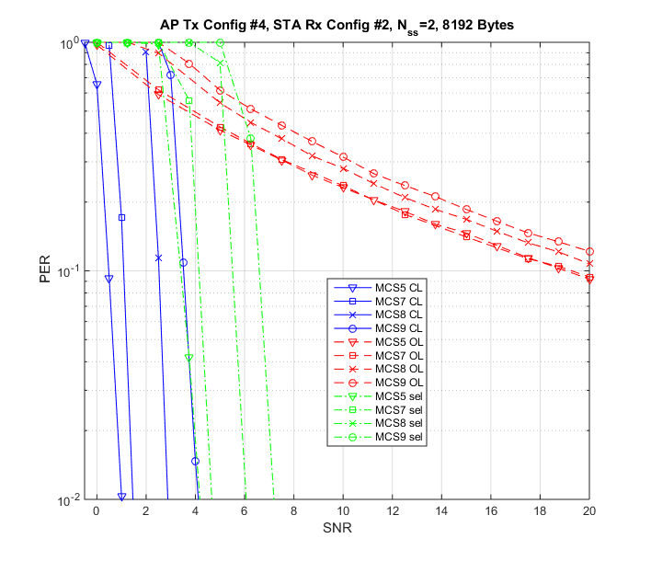
TX Conf #4/RX Conf #2, Nss=2, AP-STA
PER performance for CL is significantly better than OL
In OL, the signals of the same polarization from different Tx PAAs cause interference at RX, while in CL, these signals are combined coherently at RX.
Tx
Rx

Slide 7
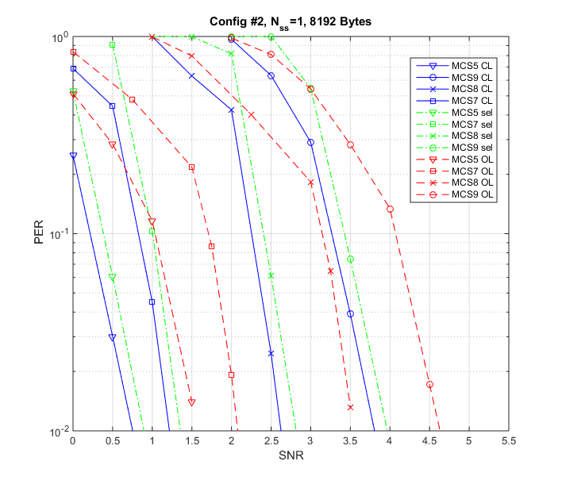
Conf #2, Nss=1, STA-STA
PER performance for CL and antenna selection are better than OL
Virtual channel after analog beamforming provides enough spatial/polarization separation
CL is slightly better than antenna selection however it requires much more channel knowledge
In this case the number of stream is less than the rank of the channel. There is extra degree of freedom for CL to explore
Tx
Rx

Slide 8
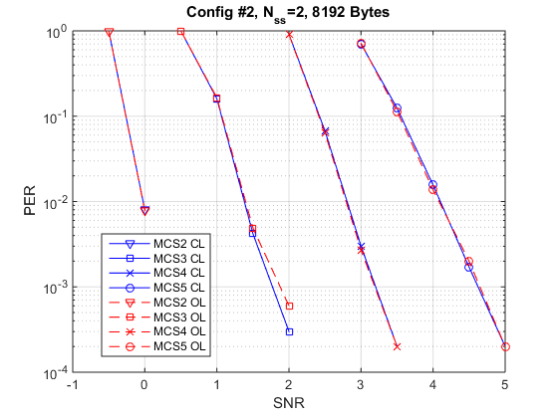
Conf #2, Nss=2, STA-STA
CL and OL have similar PER performances
The channels between different polarizations are close to orthogonal. The OL/CL have similar performance when Nss is equal to the rank of the channel
In this case the number of stream is the same as the rank of the channel. There is no extra degree of freedom for CL to explore.
Tx
Rx
Slide 8

Slide 9
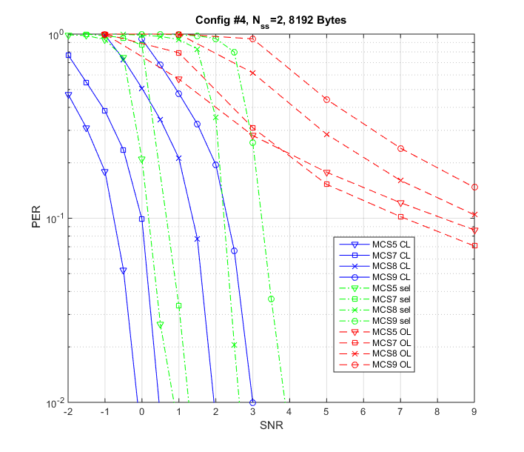
Conf #4, Nss=2, STA-STA
CL and antenna selection are significantly better than OL
Virtual channel after analog beamforming provides some spatial/polarization separation
CL is slightly better than antenna selection however it requires much more channel knowledge
In this case the number of stream is less than the rank of the channel. There is extra degree of freedom for CL to explore
Tx
Rx

Slide 10
Conclusion
We demonstrated that CL SU-MIMO achieves up to 20 dB performance gain compared to OL SU-MIMO, particularly for the case Ntx > Nss
Antenna selection provides better performance for SU-MIMO than OL while requiring significantly less feedback than CL

Slide 11
References
Carlos Cordeiro, “Specification Framework for TGay”, IEEE 802.11-15/01358r4
Rui Yang, et al, “Open Loop vs Closed Loop SU-MIMO for 11ay”, IEEE doc. 11-15/0642r1
A. Maltsev, et al, “Channel models for ieee 802 11ay”, IEEE doc. 11-15/1150r4
R. Maslennikov, et al, “Implementation of 60 GHz WLAN Channel Model,” IEEE doc. 11-10/0854r3.

Slide 12
Appendix

Slide 13
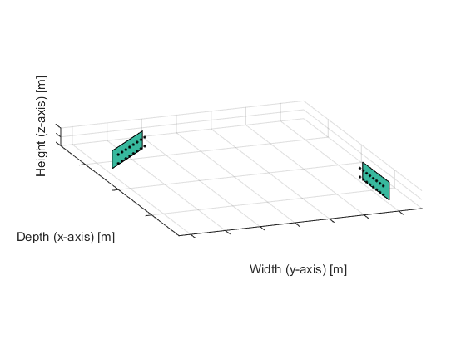
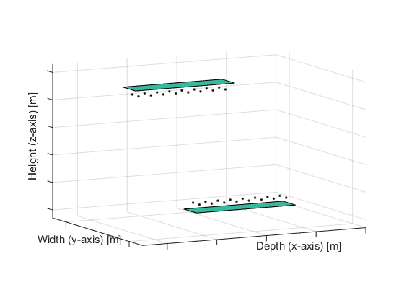
AP/STA Orientation
For STA-STA scenarios, STA are placed randomly at the same height on the conference room table. Each STA is randomly rotated around z-axis with LOS path not blocked
For AP-STA scenario, STA is placed at a plane 1.9m below AP on the conference room table. Random rotation around z-axis between STA/AP.

Slide 14
Channel parameters
Ray generation between each TX/RX PAA pair is based on the parameters in Table 2 of [4], with exception of LOS probability set to 1
For SU-MIMO configuration #2,
TX/RX analog beamforming for both polarizations are based on the LOS direction
Each PAA has 2x8 elements
For SU-MIMO configuration #4,
TX/RX analog beamforming for both polarizations of PAA#i are based on the LOS direction between TX PAA#i ↔ RX PAA#i
Each PAA has 2x8 elements
For SU-MIMO TX configuration #4 and RX configuration #2
TX analog beamforming for both polarizations of PAA#i are based on the LOS direction between TX PAA#i ↔ RX PAA#1
RX analog beamforming for both polarizations of PAA#1 are based on the direction between RX PAA#1 ↔ middle point of TX PAAs
TX PAA has 2x8 elements
RX PAA has 2x2 elements
Channel bandwidth 1.76 GHz, center frequency 60GHz
Distance between antenna elements 0.0025m
Distance between center of PAAs 10cm

